Slide 1

OFFICIALS
EDUCATION
RULE 6: TECHNICAL FOULS
MENS OFFICIALS DEVELOPMENT | 2025 SEASON
Notes:
Approx 60 min

Slide 2
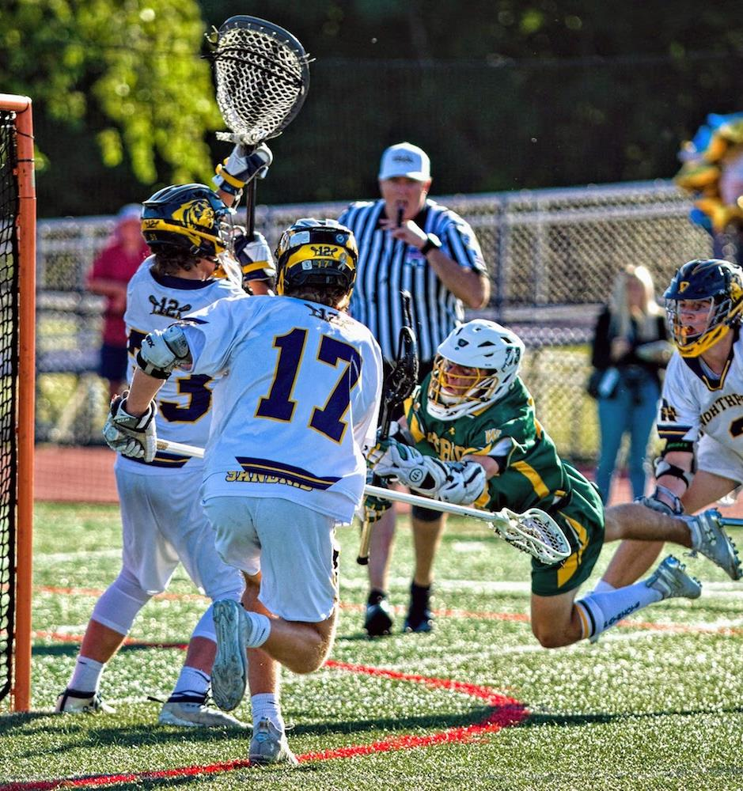
RULE 6 – TECHNICAL FOULS
T.P.O.A.D.
THE
PRINCIPLE
OF
ADVANTAGE
DISADVANTAGE
In most situations, your judgement, the level of play and game situation will determine how you call technical fouls. Some fouls, you MUST call. These are “line calls” such as offside and crease violations.
2
Notes:
RULE 6 – TECHNICAL FOULS - TPOAD
Generally, about advantage with a few exceptions
Advantage differs based on level
A college player can play through a “soft push” more than a 14U player
Sometimes, the defense can DISadvantage themselves by fouling
Don’t bail them out with a call when the offense can benefit

Slide 3
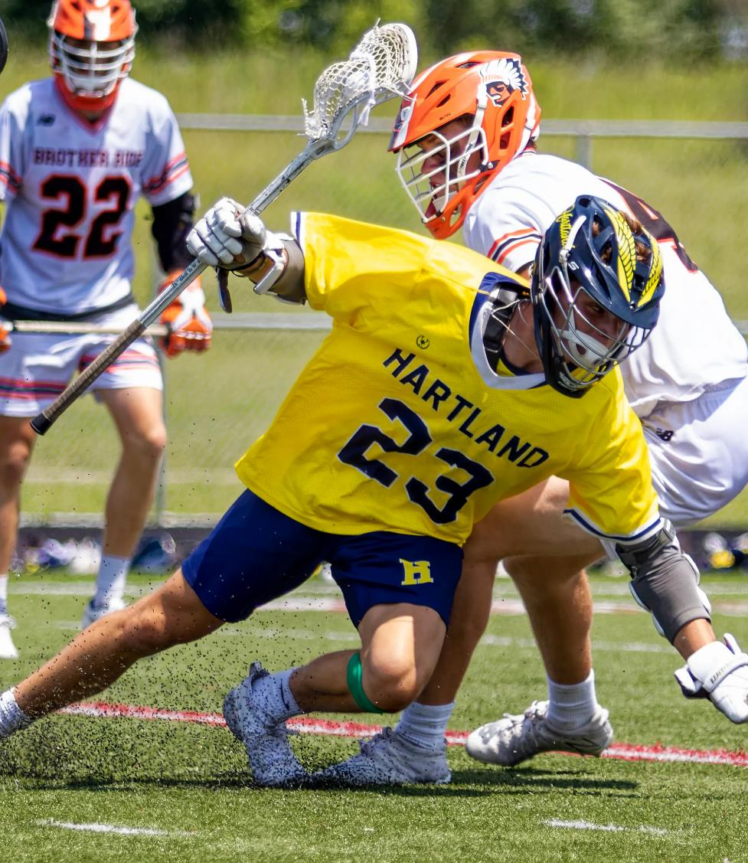
RULE 6 – TECHNICAL FOULS
MOTION vs. CONTACT vs. GAME MANAGEMENT
Motion
Offsides
Crease Violations
Illegal Procedures
Illegal Screens/Warding Off
Illegal Contact
Holding
Interference
Pushing
Game Management
Conduct Fouls
Stalling
3
Notes:
RULE 6 – TECHNICAL FOULS - TPOAD
Motion Fouls
Generally, MUST be called regardless of perceived advantage
Use play-on when possible (loose-ball crease violations)
Moving picks/screens are a “hot button” call in today’s game
Warding-off is another “hot button” due to the 2-hand change
Illegal Contact
Lots of judgement for these
Experience and skill level of players determine what should be called.
Game Management
These are minor calls that are technical fouls only because of their lower level of adjudication
Use these to control the game speed as well as behavior

Slide 4
MOTION FOULS
Notes:
MOTION FOULS
Title Page

Slide 5
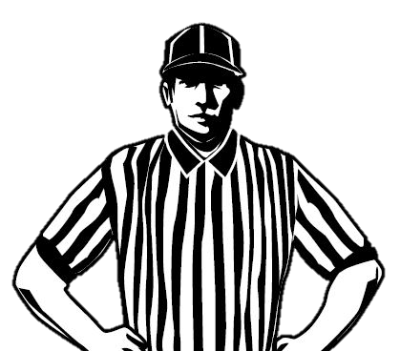
OFFSIDE
LINE CALL
Offside
Not always an advantage
MUST be called due to a line violation
Must be 7 in the offensive half
How to Count Offside
2-man Mechanics
Trail has responsibility
Look for “toe-touch” in transition and then count forward to 7
Settled – count BOTH teams after crossing midfield
5
Notes:
OFFSIDE
Arguably, the one we miss the most that EVERYONE sees but us. The camera doesn’t lie!
This take practice to get it right on a consistent basis.
How to Count Offside (2-man trail, 3-man single and/or trail)
Basic coaching rule of clearing is that the far-side player has to stay back, so offisides happens most when that player forgets his responsibility.
You know the near side player is over, so start counting with him as #1.
Next, start counting the field and work from MIDFIELD down and see if you get to 7
Tough to do quickly if it’s a contested clear, so make sure you have an idea of where everyone is prior to restart
Count Attack and D at the side of field where the play is heading
Do you have 3A and 3D/G deep and can “forget” about them for a minute?
Rides are transactional – keep a running tally of how many are in the offensive end
Use video to practice on your own. Watch games and replay offside calls!
Word Choice Matters!
“<Far-side> or <The other middie> was the seventh, Coach”
“We count forward”

Slide 6
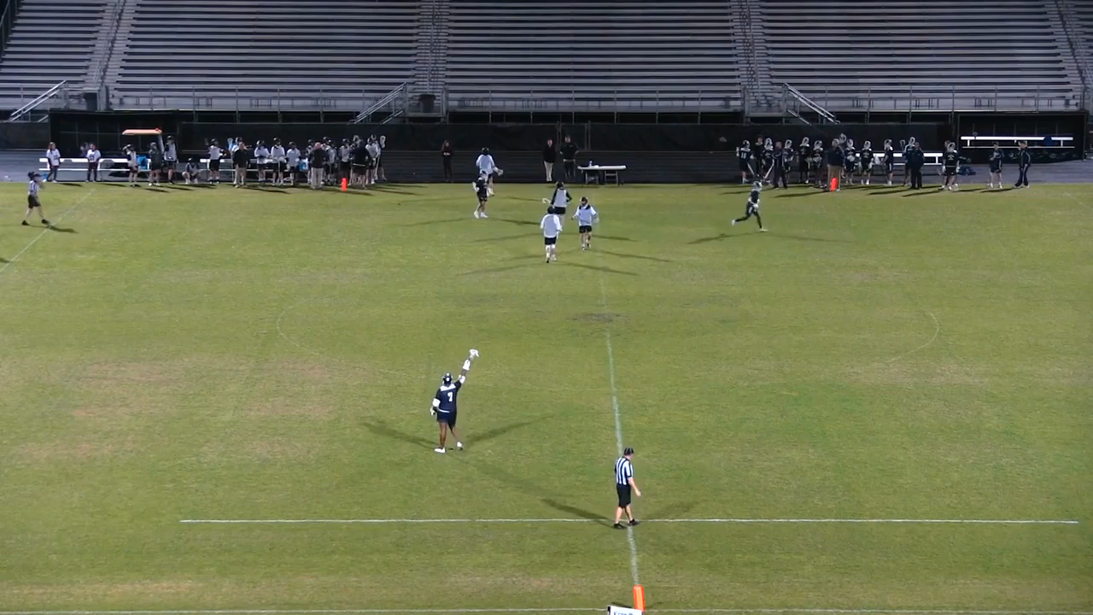
OFFSIDE
VIDEO EXAMPLE - OFFENSE
1
6
2
5
3
7
4
6
Notes:
OFFSIDE – Video Example
Whose call is this?
Settled offense most likely will fall on the Trail
The single should be watching the goal and scrimmage area at this point

Slide 7
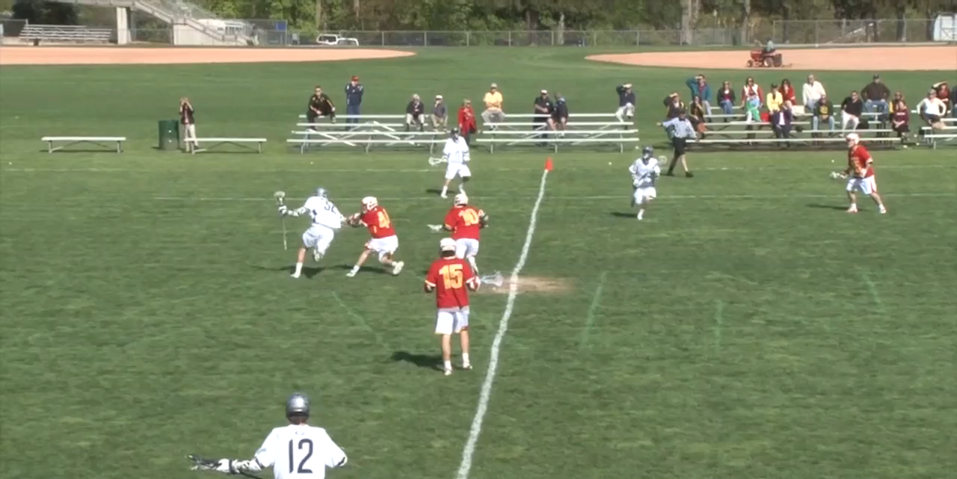
OFFSIDE
VIDEO EXAMPLE - DEFENSE
Class Discussion Questions
7
Notes:
OFFSIDE – Video Example
Whose call is this?
Transition most likely will fall on the Single (3-man) or Trail (2-man)
The Lead has all of the scrimmage area at this point
The Trail should be watching for this as well and can call if missed by Single
CLASS DISCUSSION
What is the call if #10 goes over and participates in the play after the flag?
He is already offside and can only be offside once
What is the call if #44 goes over and participates in the play and #10 stays back onside?
Second flag for offside in #44

Slide 8
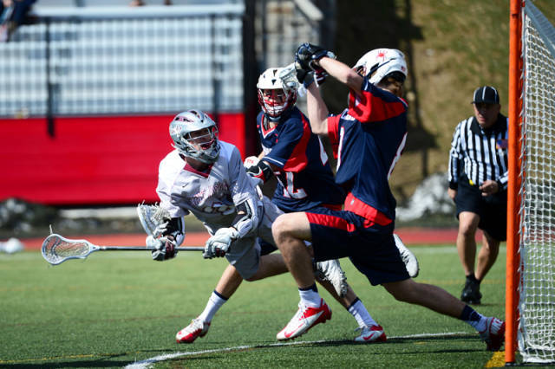
CREASE VIOLATIONS
LINE CALL
Crease Violations
Not always an advantage
MUST be called due to a line violation
Can use Play-On if no goal is scored
Class Discussion Questions
8
Notes:
CREASE VIOLATIONS
Two Different Occurrences
Shots/Dodges by Offense
Should be called IMMIDIETELY
Solves problems and ends potentially dangerous follow-up fouls
This call be must be BIG and animated!!
Loose balls
Give the goalie a reasonable chance to get the ball and play the advantage
Talk the offender through it
“Goalie’s got it, get out”
Say “play-on, play-on, play-on” so EVERYONE knows you see it

Slide 9
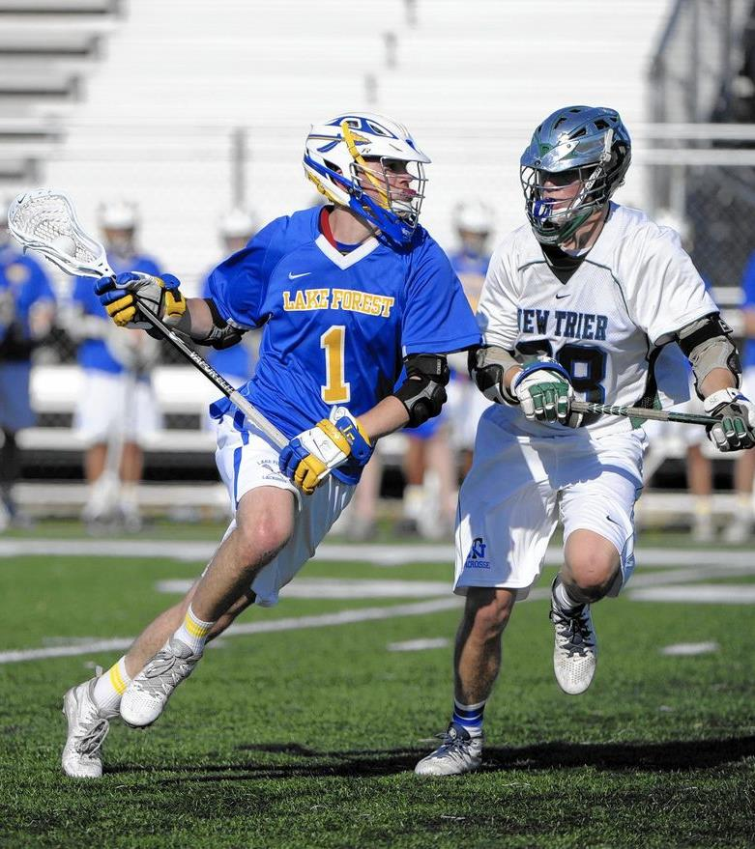
ILLEGAL PROCEDURE
THE CATCH-ALL CALL
It’s a Category, Not a Call!
Always explain what actually happened
Get play started and offer additional explanation if needed
Delay of Game
  You will be tested for tolerance level
  Keep the game going
  Call it early if you have issues to set tone
Mouthpiece
  Discuss as a crew and be consistent
  Game Management
9
Notes:
ILLEGAL PROCEDURE
Equipment
Mouthpiece – Warn>Take Ball Away>Flag
Lines
Improperly Marked Field – Midline, Endline
Restraining – leaving early before possession on a faceoff
Substitution – leaving early before a penalty is finished
Boundary – playing the ball, which is inbounds, while your feet are out-of-bounds
Numbers
Long Poles – more than 4
Too Many Men
Delay of Game
Subs during faceoff setup (can’t call violation, must be DoG)
Failure to give 5yds to offense on a restart before engaging
Not immediately dropping ball on quick turnover
Word Choice Matters!
“Coach, your player took away their advantage”
“Quick AND clean restart, Coach”

Slide 10
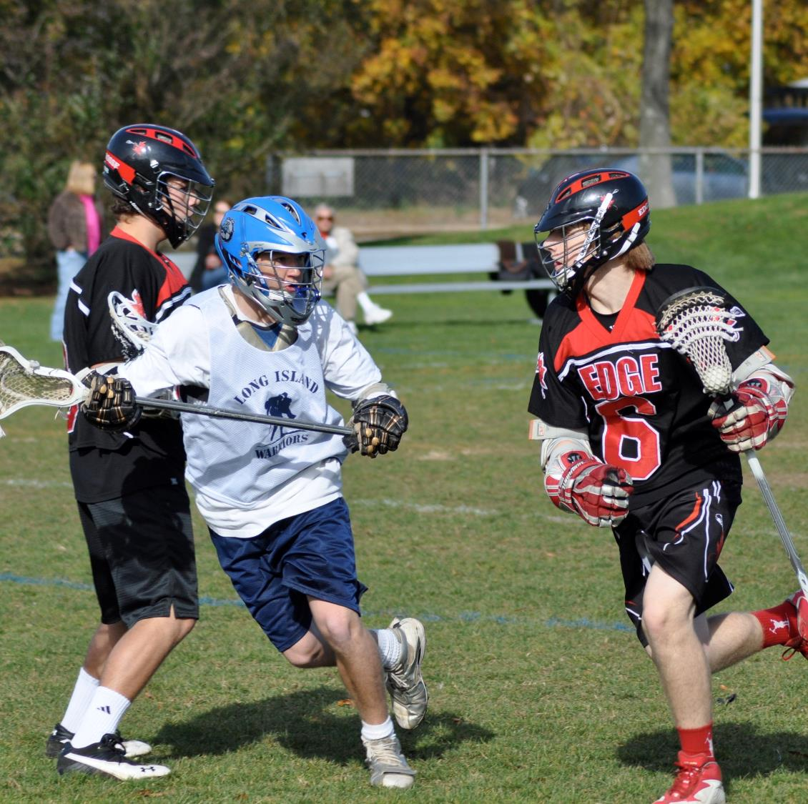
ILLEGAL SCREENS
MOVING OR NOT?
Usually called “moving pick”
No more than shoulder-width
Hands/arms/stick inside body frame
Common Issues
  Leaning
  Not being set BEFORE contact
  Wide stance
Class Discussion Questions
10
Notes:
ILLEGAL SCREENS
Very common now due to the influence of the 2-man game and box
This is an ABSOLUTE call. It cannot be “waived-off” due to lack of advantage
Can happen ON or OFF ball
Use “interference” if you can’t sell an off-ball pick
CLASS DISCUSSION
Does a player have to face the person he is screening?
NO…he can face any direction (back-screen is legal although rare in field lacrosse)

Slide 11
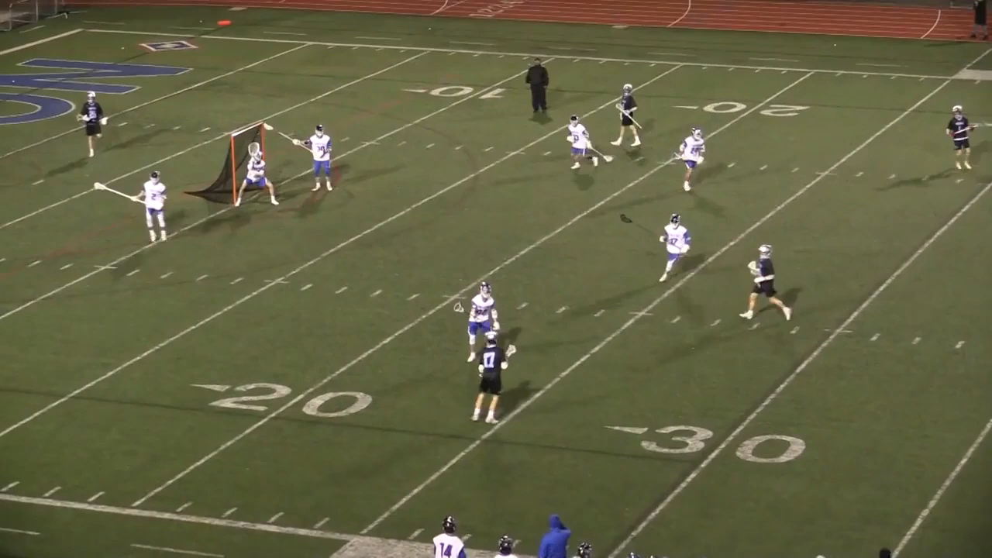
ILLEGAL SCREEN
VIDEO EXAMPLE
Class Discussion Questions
11
Notes:
OFFSIDE – Video Example
What is the problem with this pick?
Last-second lean
CLASS DISCUSSION
Would you have called a Delay on the restart had the white player not been able to pick up the ball immediately?

Slide 12
ILLEGAL CONTACT

Slide 13
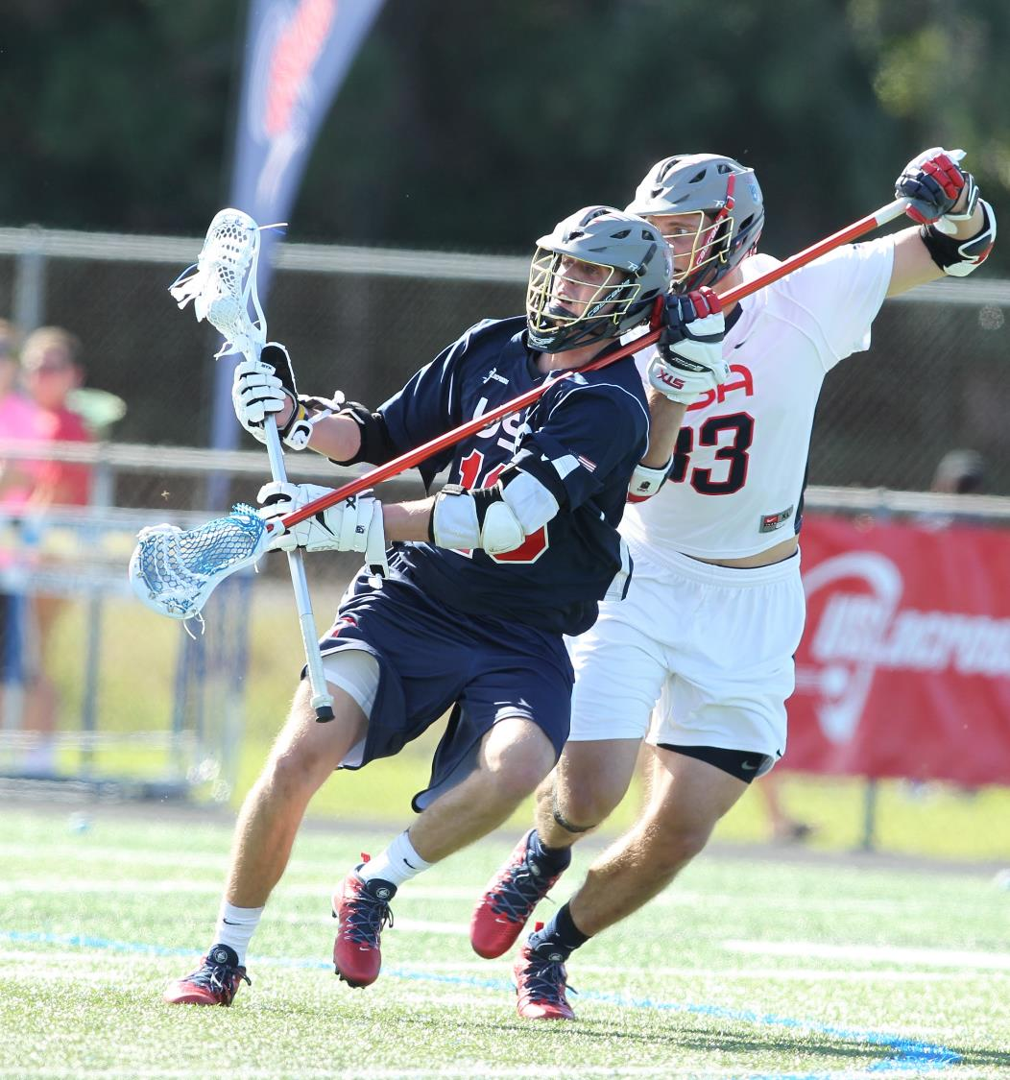
HOLDING
POSSESSION vs. NO POSSESSION
Possession
  Simple advantage/disadvantage
  Sometimes a “no-call” is OK to keep the FLOW going
Loose Ball
  Get the ball off the ground
  Control Call
Level of Play Matters
  Can the player being held play through with no advantage lost
Context Matters
  A1’s body/stick contacting B1’s body/stick
  Contact and Pressure
13
Notes:
HOLDING
Context Matters
A1’s body/stick contacting B1’s body/stick? – stick on stick contact is LEGAL.
Officials should look for:
A1 using his stick to “hold BACK” B1 (failed OTH check that results in dragging a player down, hooking a player impeding his progress to a loose ball, etc)
A1 using his arm to “chicken wing” B1’s crosse
Contact & Pressure – A1 applying equal pressure to B1 is LEGAL
Officials should look for:
UNEQUAL PRESSURE – A1’s stick dragging down B1’s arm, A1’s stick holding down B1’s shoulder

Slide 14
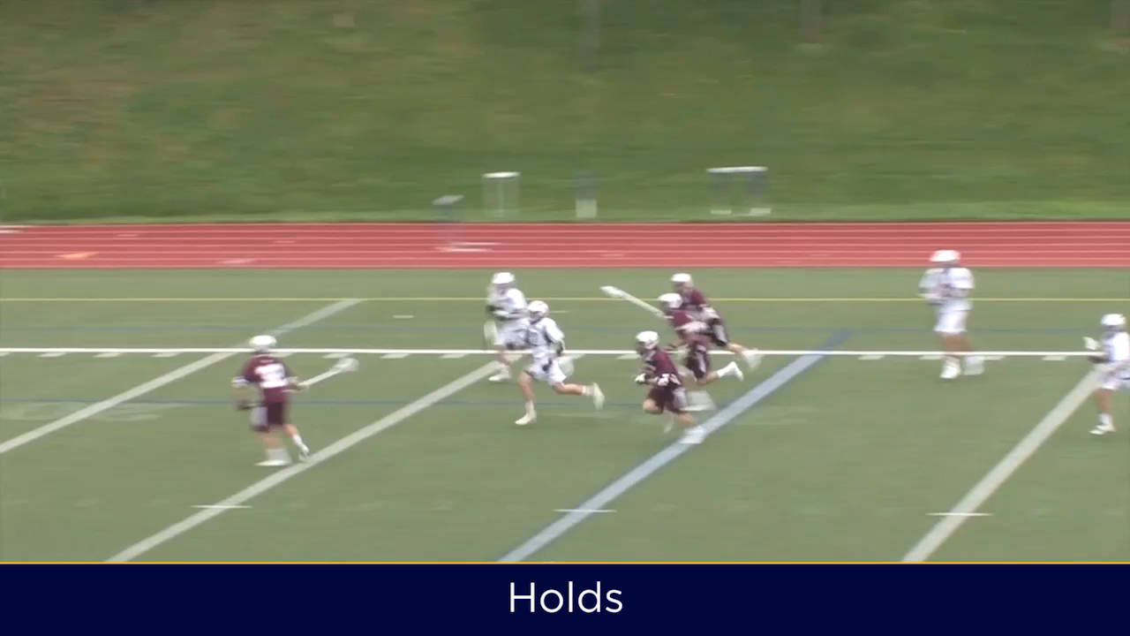
HOLDING
VIDEO EXAMPLE
14
Notes:
HOLDING
Several of the more obvious examples that MUST be called

Slide 15
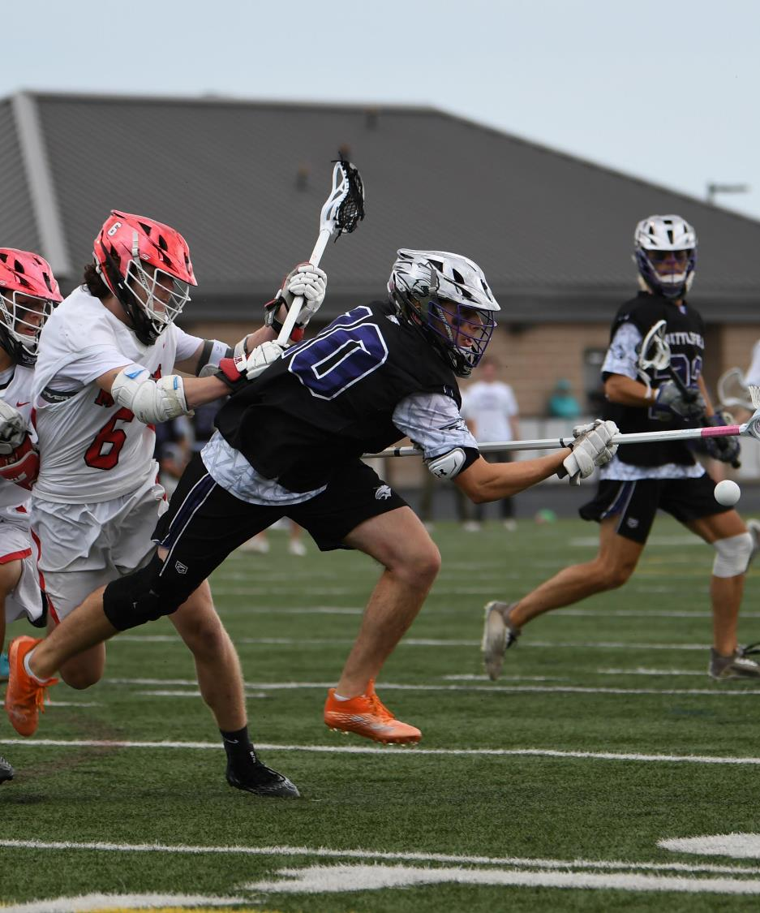
PUSHING
POSSESSION vs. NO POSSESSION
Possession
  Simple advantage/disadvantage
  Sometimes a “no-call” is OK to keep the FLOW going
Loose Ball
  Get the ball off the ground
  Control Call
Level of Play Matters
  Can the player being held play through with no advantage lost
Context Matters
  Front or side is LEGAL
  Within 5y on a loose ball is LEGAL
15
Notes:
Context Matters
Contact from the front or side is LEGAL
Officials should look for:
UNEQUAL PRESSURE from behind
Extension of arms from defender into the back of A1
B1 trails A1 and feet get tangled up causing A1 to fall – PUSH
Was it Violent Contact? – If so, then it shouldn’t be a push. It should be Cross-check or Unnecessary Roughness
Word Choice Matters! – only use “push” to describe ILLEGAL contact. Use “contacted from the front/side” to describe LEGAL contact. Avoid “hit” to describe a LEGAL play.

Slide 16
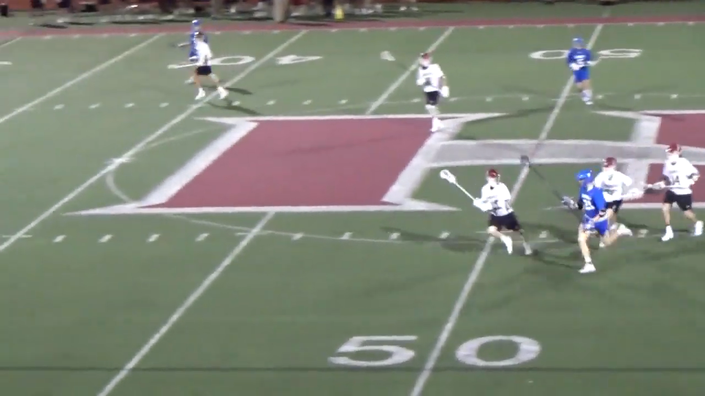
PUSHING
VIDEO EXAMPLE
16
Notes:
PUSHING
Great example of a push near the sideline
What call would you make?
Was ball loose?
Does this deserve a flag?
Did push occur before ball going out of bounds?

Slide 17
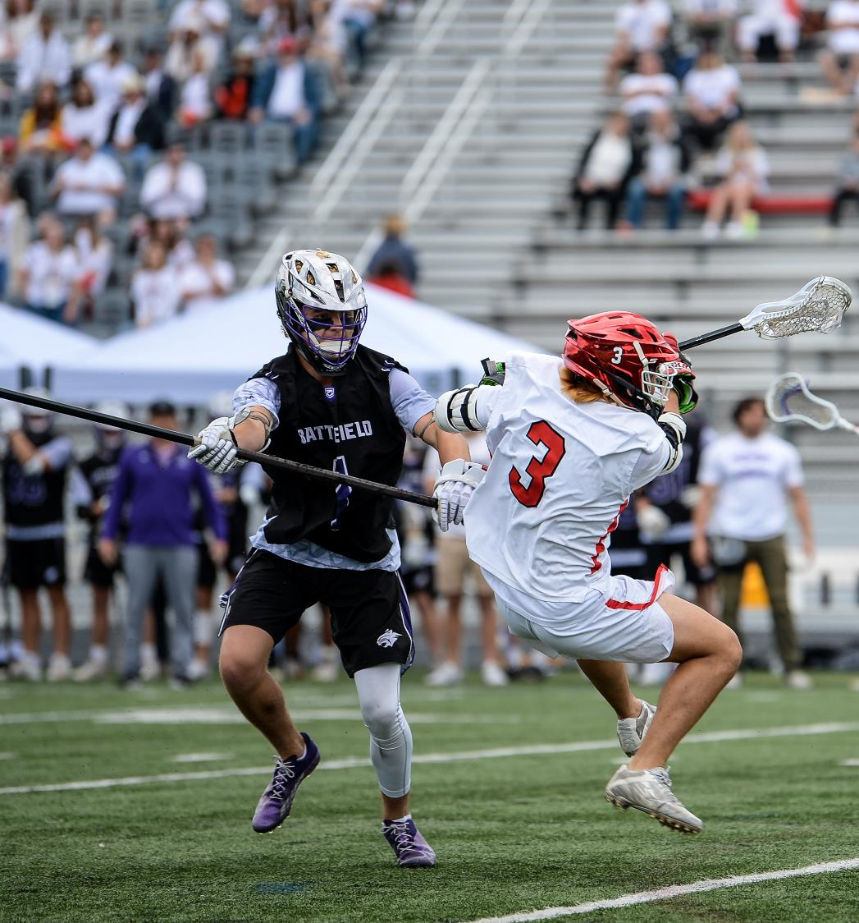
INTERFERENCE
NON-GOALKEEPER
Catch-all Rule
  Can’t Interfere w/Free Movement
  Usually Occurs Off-Ball
  Off-Ball = More than 5-yards
Loose Ball = Possession
  More than 5y away bodycheck/push
Offense = Turnover
  Off-Ball Screens
Defense = Flag Down
  Off-Ball Pushes
  Off-Ball Stick-Checks
  Off-Ball Pushes into Crease
17
Notes:
INTERFERENCE
Can’t interfere more than 5y from ball
Off-ball stick checks usually mean stick must be dislodged
Defense illegally pushes offense into crease

Slide 18
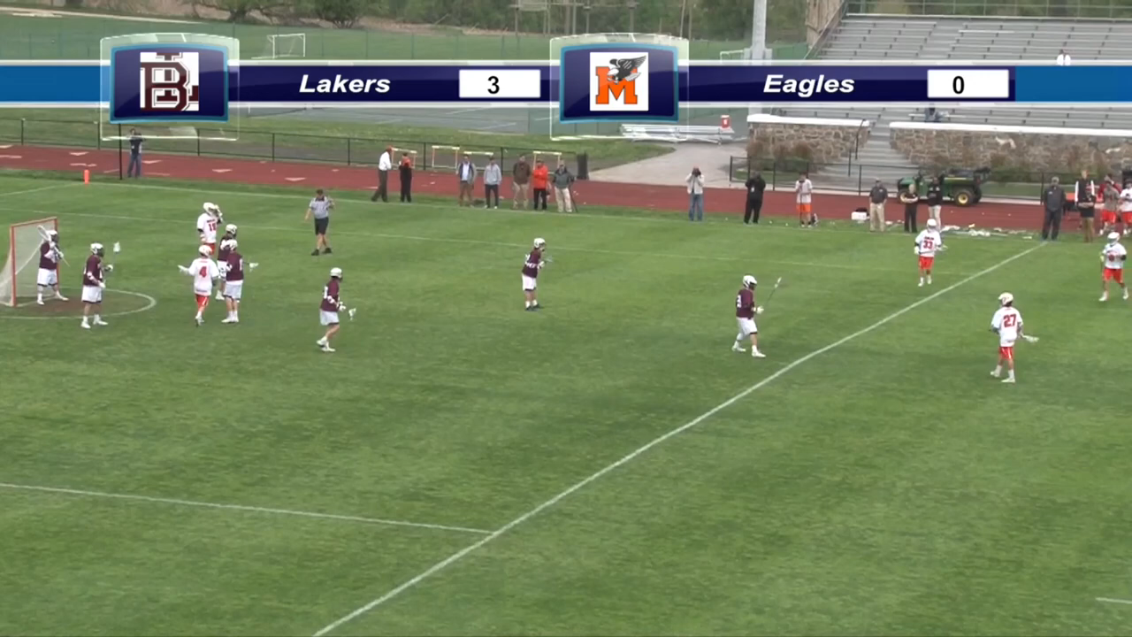
INTERFERENCE
VIDEO EXAMPLE
18
Notes:
INTERFERENCE
Great example of a stick checked out of the hands of a player off-ball
Must be called!!

Slide 19
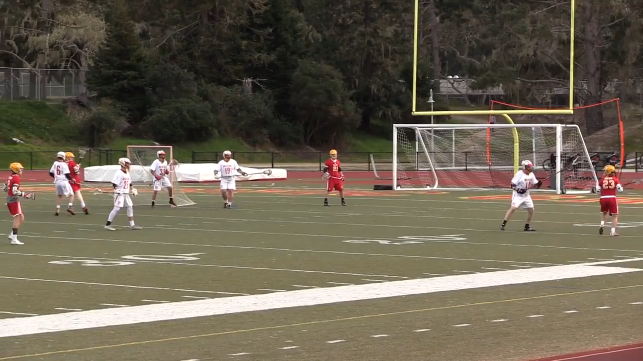
INTERFERENCE
VIDEO EXAMPLE
19
Notes:
INTERFERENCE
Off-ball Push into Crease
Go over procedure
NOT a play-on due to crease violation
Immediate Whistle
Adjudicate Foul

Slide 20
GAME MANAGEMENT FOULS

Slide 21
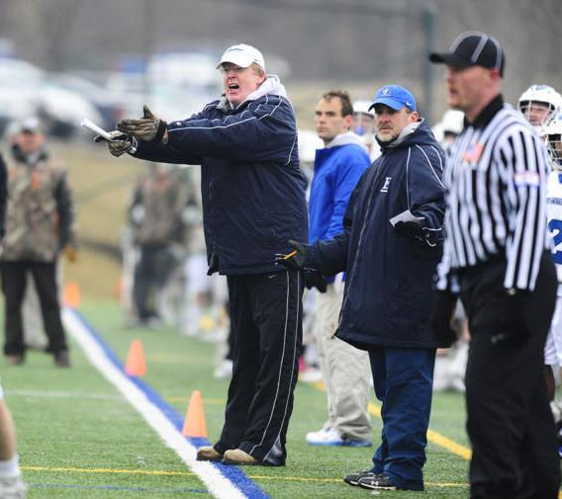
CONDUCT FOUL
CONTROL CALL
Use to get coaches and players under control
Can be called on coach, player or any non-playing personnel
CANNOT be called on fans!
Generally used as a first-level before going to Unsportsmanlike Conduct
Be consistent with both teams
21
Notes:
CONDUCT FOUL
Use it to keep from losing control
Make the call and restart play
Give an explanation when you can

Slide 22
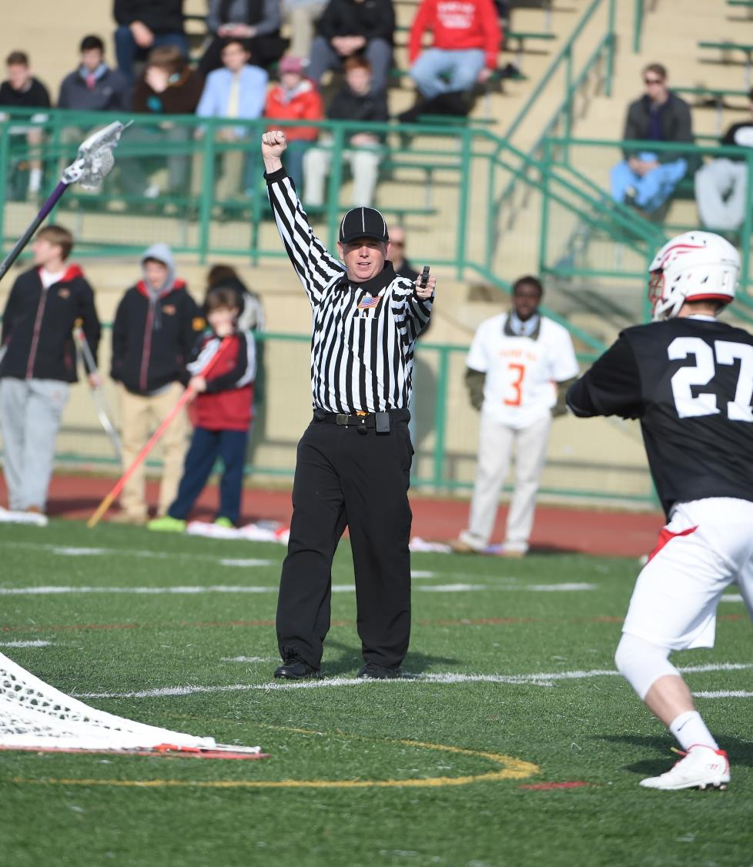
STALLING
DISCUSS IN PREGAME
Required to Call
  NFHS – Last 2m of Game
  4 goals or less
Subjective Call
  When team in possession is NOT attacking goal
  Consider the following:
    Score differential
    Zone vs. Man-to-Man
22
Notes:
STALLING
This is why the shot-clock exists in college
Most likely will NOT happen in NFHS lacrosse until adopted by basketball
Cost prohibitive
Discuss in pregame
Crew Chief must provide direction
Consider 60, 90, 120 seconds after possession
Be consistent with both teams

Slide 23
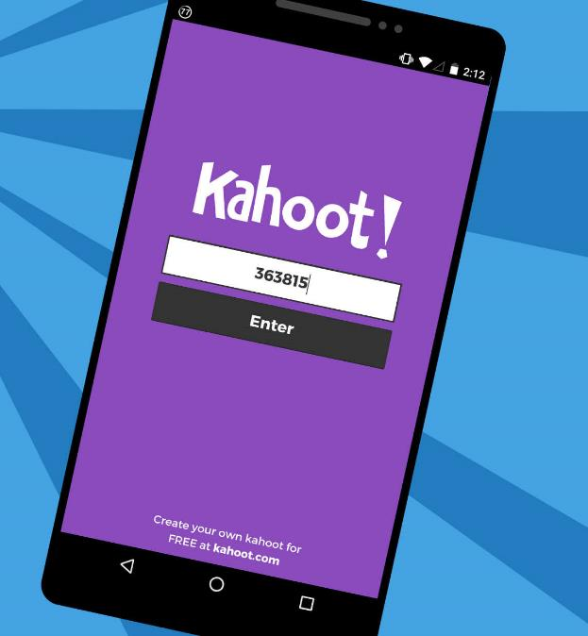
KAHOOT!
GAME-STYLE LEARNING
Kahoot! is a digital learning platform that uses quiz-style games to help students learn by making the information engaging in a fun way.
As one of the biggest names in quiz-based learning, it's impressive that Kahoot! still offers a free-to-use platform, which makes it highly accessible for teachers and students alike. It's also a helpful tool for a hybrid class that uses both digital and classroom-based learning.
The cloud-based service will work on most devices via a web browser. That means this is accessible for students in class or at home using laptops, tablets and smartphones.
23
Notes:
KAHOOT (You need to be connected to the internet to Play Kahoot!)
Practice this before the class starts
Open the link and have it sitting in a browser window waiting
No app or login is required

Slide 24

KAHOOT INSTRUCTIONS
PLAYERS
On your smartphone, tablet or laptop, go to www.kahoot.it
Wait for the instructor to give you the Game Pin
Enter your first name and last initial ONLY
INSTRUCTORS
A Kahoot account can keep track of results, otherwise, you can play without an account
https://create.kahoot.it/auth/login
Create a free BASIC account (up to 50 users) or paid PRO account (up to 100 users)
Click on the link below
Game will open in an internet browser window
USA Lacrosse Officials Development Program - TECHNICAL FOULS : RULE 6
24
Notes:
You need to be connected to the internet to Play Kahoot!

Slide 25
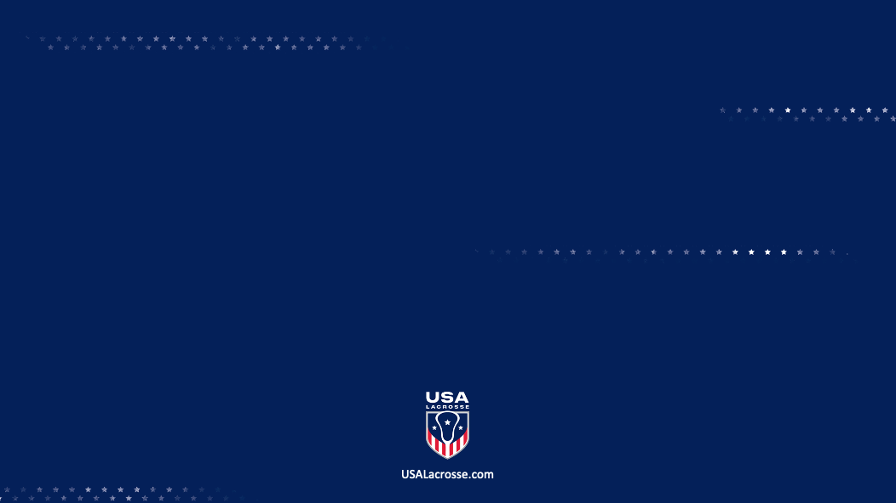
THANK YOU TO THE MEMBERS OF THE
2024 MENS OFFICIAL’S EDUCATION DEVELOPMENT TEAM

