Slide 1

MENS OFFICIALS TRAINING GUIDE
MENS OFFICIALS DEVELOPMENT | 2025 SEASON

Slide 2
OVERVIEW
HOW TO USE THIS PROGRAM & MATERIALS
The USA Lacrosse Men’s Officials Education Development Team has developed this program and associated materials to help you train, retain and grow your local officials. The materials are designed for two distinct groups of officials; New & Returning.
NEW OFFICIALS
The materials for your new officials, both adults and juniors, are detailed and inclusive. You should have everything you need to train this group.
RETURNING OFFICIALS
The materials for returning officials are a suggested program. Training has changed for returning officials. Many associations are using a hybrid approach with officials needing to complete a certain amount of self-study prior to in-person or virtual sessions.
We hope these materials will give you a good baseline to conduct your training. Please feel free to contact Mark Burnett, Manager, Men’s Officials Development with any questions or comments on the materials.

Slide 3
QUESTIONS TO ANSWER
SETUP THE PLAN THAT WORKS BEST FOR YOUR LOA
WHEN do we start training?
WHERE can we get the information?
HOW do we keep the officials engaged during training?
WHO should be leading the training?
WHAT format do we use?
RETURNING MENS OFFICIALS TRAINING PROGRAM GUIDE
3

Slide 4
LIVE FORMAT OPTIONS
POST-PANDEMIC LIFE HAS CREATED NEW LEARNING PROTOCOLS
IN-PERSON
Although we have changed how we work, this is a people business. Consider some in-person sessions
VIRTUAL
Much of the pre-work can be done virtually either as a group, or individually
HYBRID
The best process for today’s new world is a combination of in-person and virtual
Learning has been redefined in the modern world. No longer do we need to be in-person for all activities. Officiating is a "people-business" as parts of our curriculum are better delivered in-person.​​
RETURNING MENS OFFICIALS TRAINING PROGRAM GUIDE
4

Slide 5
CLASS DELIVERY OPTIONS
LEARNER LED
Allows for flexibility in topics and scheduling
INSTRUCTOR LED
Scheduled and organized
COMBINATION
Learners are different and unique
Self Learning
Individuals
Small Groups
Self-Guided
Consistency in what is learned
More rigid and can feel monotonous
Takes the best of both Learner Led & Instructor Led
Good level of engagement can be achieved
Better class participation
Can be challenging to stay on topic due to "off-topic" conversations
Best for training which combines rules knowledge & mechanics
Self-Study creates prerequisites which can be tracked
RETURNING MENS OFFICIALS TRAINING PROGRAM GUIDE
5

Slide 6
WHEN TO START TRAINING
DEPENDS ON YOUR LOCAL SPRING SEASON START DATE
Training typically starts 8-12 weeks prior to your first scrimmages
Most training occurs in December, January, February
Training should continue throughout the season
SAMPLE SCHEDULE
NOVEMBER
Assign Prerequisites
DECEMBER
Begin Virtual Training
JANUARY
Continue Virtual Training
FEBRUARY
MARCH
Begin In-Person Training
On-Field Training
USA Lacrosse
Re-Certification
Rules Tests
Two Sesions ONLY
Soft Skills – Communication
Rules Changes & Points of Emphasis
Game Management
Mechanics & Expectations
Allow for Social Time
Scrimmage Evaluations
Final Kick-Off Meeting & Social
RETURNING MENS OFFICIALS TRAINING PROGRAM GUIDE
6

Slide 7
HOW TO CREATE YOUR LOA CURRICULUM
CONSIDER ALL STAKEHOLDERS
What issues came up last season that need to be addressed?
Survey coaches, officials, assignors for feedback
Look at points of emphasis for the upcoming year
Use data from observations, tests and other resources
What goals does your organization want to achieve this year?
RETURNING MENS OFFICIALS TRAINING PROGRAM GUIDE
7

Slide 8

PLAN YOUR PLAN
Use the US Lacrosse Planning Checklist Provided ​
    Use the USA Lacrosse Training Plan Checklist
    Plan Early, Specifically, and Name Owners​
    Communicate and Confirm ​
    Establish Pre-Requisites for Returning Officials
      USA Lacrosse Recertification (test, webinar, etc.)
Planning​
    Prepare with USA Lacrosse Resource Tools​
    Ask Questions With Ample Time to Get a Response​
    Time will be your friend, or your enemy – your choice​
    If You “Wing It”, Your Audience Will Know!
RETURNING MENS OFFICIALS TRAINING PROGRAM GUIDE
8

Slide 9

ESTABLISH CLEAR OBJECTIVES
Clear objectives keep trainers on task
    What are the Learning Objectives for this class?
    How will you know if the class has learned?
    How will you remediate what has NOT been learned?
Clear objectives create clarity for participants
    Communicate at the beginning of each classroom session
    Confirm at the end of each classroom session
    Summary sheets can be helpful
RETURNING MENS OFFICIALS TRAINING PROGRAM GUIDE
9

Slide 10
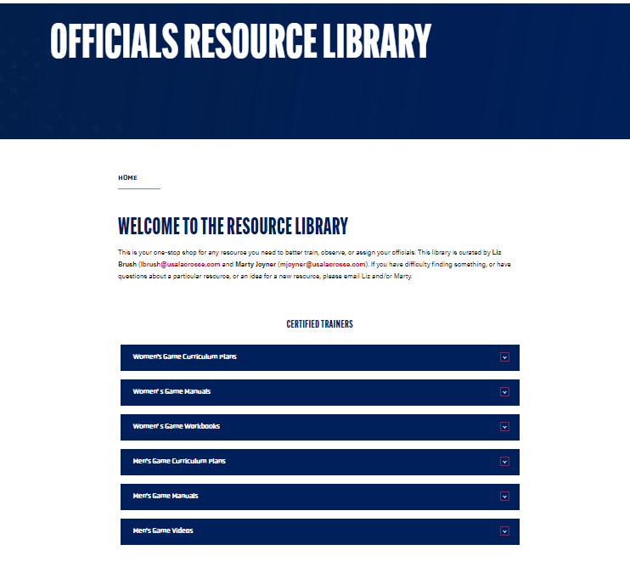
TRAINING RESOURCES
USA LACROSSE CERTIFIED MATERIALS
Visit My Transcripts
Certified Trainer (Boys Game)
2024 (or 2025) Certified Officials Trainer & Observer
Resource Library Link & Password
Bookmark or Save Link for future reference
RETURNING MENS OFFICIALS TRAINING PROGRAM GUIDE
10

Slide 11
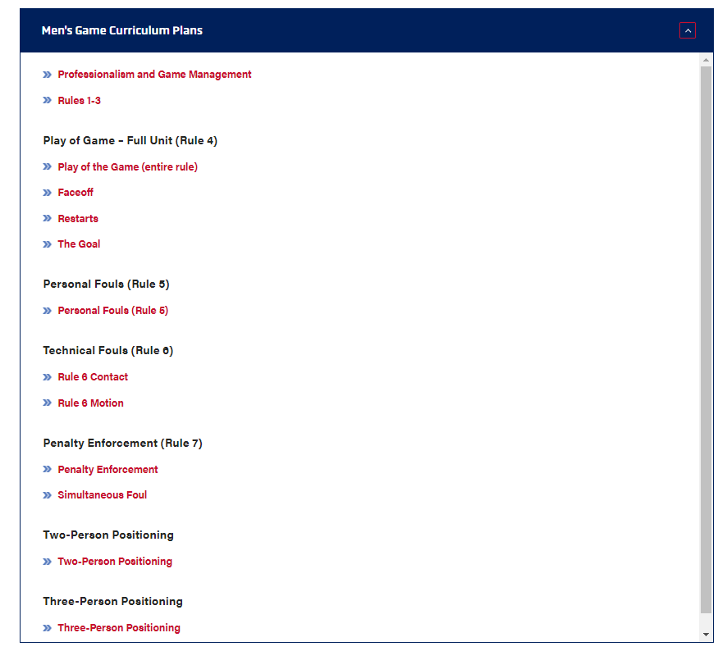
TRAINING RESOURCES
CURRICULUM PLANS
New Officials
  Adult
  Junior
Returning Officials
RETURNING MENS OFFICIALS TRAINING PROGRAM GUIDE
11

Slide 12
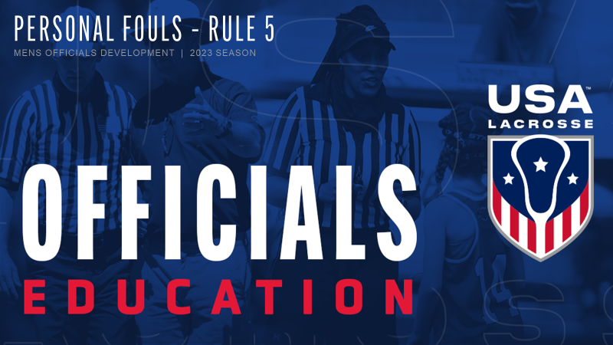
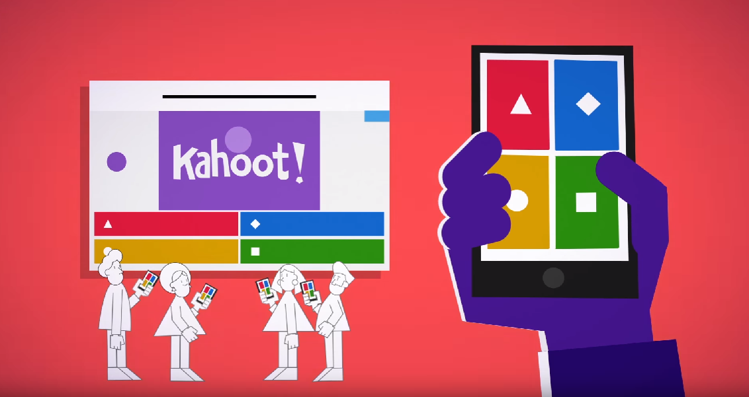
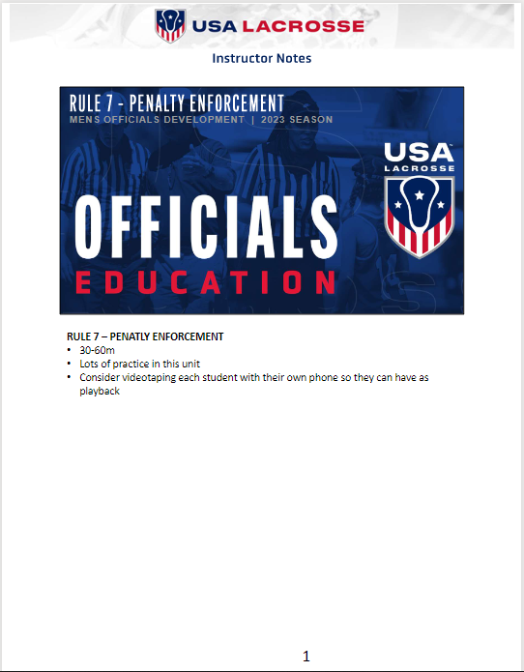
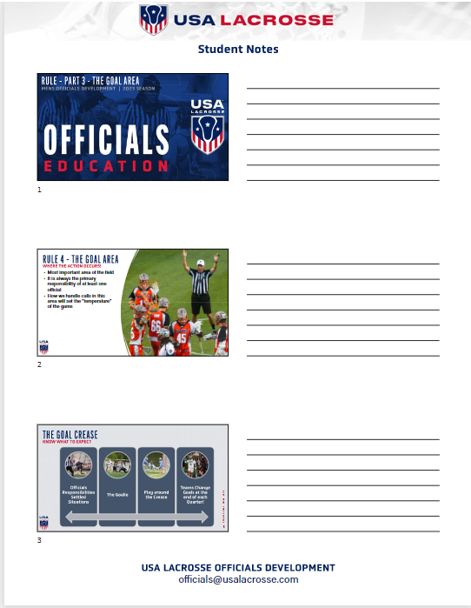
RESOURCE DESIGN
EVERYTHING YOU NEED
Each unit contains the following resources
PowerPoint Presentation
  Animated sections
  Video examples
  Kahoot at end of most lessons
Trainer Notes
Student Notes for Printing
RETURNING MENS OFFICIALS TRAINING PROGRAM GUIDE
12

Slide 13
WHO SHOULD LEAD THE TRAINING?
USA LACROSSE CERTIFICATION
Certified Trainers
  One trainer per 20 officials
  Establish a LEAD TRAINER too coordinate group
  Divide virtual classes amongst certified trainers
  All trainers attend in-person classes and lead separate portions
Certified Observers
  Observers can lead on-field training
  Provide anecdotal feedback
  Formal evaluations if officials are new or looking to move up
Certified Assignors
  Should be on-hand to show continuity
  Could also be trainers and observers
  Should observe on-field training
  Should observe scrimmages
Guest Speakers
  Do you have any superstar officials (NILOA, PLL, NLL)?
  Guests from other associations – great for virtual
RETURNING MENS OFFICIALS TRAINING PROGRAM GUIDE
13

Slide 14
UNDERSTANDING ADULT LEARNERS
FOUR LEARNING STYLES
STEP LEARNER
Follows steps to learn
Desires goals & practicality
"Tell me what I need to do & I'll get it done!"
TALK LEARNER
Rephrases to learn
Desires verbal exchange
"Can you repeat that?"
RESEARCH LEARNER
CREATIVE LEARNER
Sythesizes to learn
"Let me ask about this situation..."
Desiree to generate something
Reads & studies to learn
Desires debate & wants BIG picture
"Let me draw this situation up"
RETURNING MENS OFFICIALS TRAINING PROGRAM GUIDE
14

Slide 15
HOW TO CREATE AN ENGAGING CLASS
WHAT NOT TO DO
READ
Simply reading presentations can be boring
Most learners will have already read the material before you do
Story Time
Give brief examples, not long stories
You are not there to "one-up" the class
Go Off on Tangents
We all have passion subjects, know what yours is and avoid too much time
Don't "underteach" one subject to make time for another
Lecture
Don't talk down to your audience
Engage them in the process
RETURNING MENS OFFICIALS TRAINING PROGRAM GUIDE
15

Slide 16
HOW TO CREATE AN ENGAGING CLASS
WHAT TO DO
USA Lacrosse Resources
Each Lesson Plan Kit will contain:
Written Lesson Plan
PowerPoint Presentation
Lesson notes on each slide
Video and Pictures where appropriate
Assessment Tool (Kahoot)
Use Guest Speakers
Internal "Stars" from NILOA, PLL, NLL
External = Other high-level sports officials
Movement Breaks
Bathroom breaks every 60m at a minimum
Movement activities every 30m
Penalty Signal Practice for everyone
Breakout Sessions
Discuss Scenarios
Ask for Group Consesus
Present Finding to Class
RETURNING MENS OFFICIALS TRAINING PROGRAM GUIDE
16

Slide 17
FINAL THOUGHTS
PLAN YOUR WORK – WORK YOUR PLAN
An effective LOA training program for Returning Officials takes planning, execution and reflection. These officials have "heard it all" and finding an annual, repeatable system that works for your association and your officials is the key to success. Supervising and executing a training program is hard work!
One of the biggest challenges for any association will be finding the "worker bees" and engaging them through financial compensation, peer recognition and other forms of extrinsic and intrinsic motivation. These members are the "lifeblood" of your association and should be held in high regard. Better or extra assignments should not be used as incentives.
USA Lacrosse & the Men's Officials Education Development Team believe our goal is to provide you with the "tools" necessary to conduct your training, your way. Each association has different needs, and our resources will help you meet those needs. You can do this and do it well!
We wish you the best and as always, please contact us of you need any assistance.
mburnett@usalacrosse.com
RETURNING MENS OFFICIALS TRAINING PROGRAM GUIDE
17

Slide 18
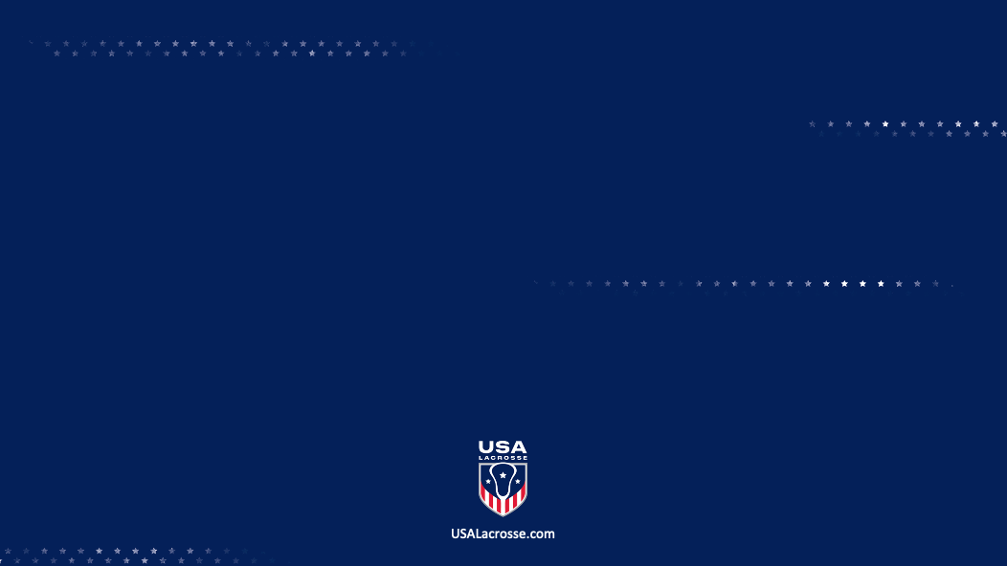
THANK YOU TO THE MEMBERS OF THE
2025 MENS OFFICIAL’S EDUCATION DEVELOPMENT TEAM

