Slide 1


OFFICIALS EDUCATION
PROFESSIONALISM & GAME MANAGEMENT
MENS OFFICIALS DEVELOPMENT | 2026 SEASON

Slide 2
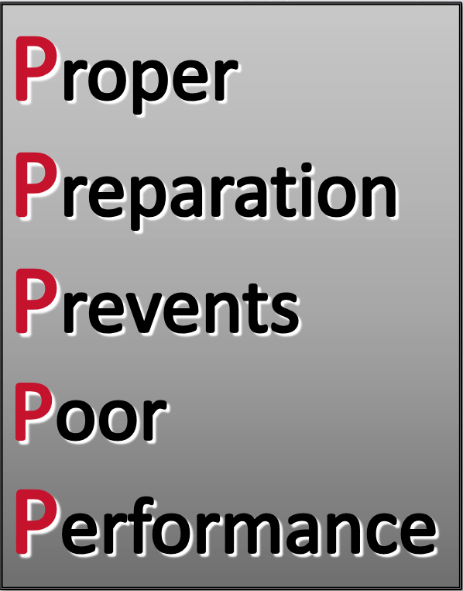
PROFESSIONALISM
OUR APPROACH TO THE GAME
What is a Professional?
-”a calling requiring specialized knowledge and often long and intensive academic preparation”
Lacrosse is “controlled chaos”
We are the calming factor
We are unbiased
We are entrusted to be keepers of the game
We must respect our role
WE MUST HONOR THE GAME
Notes:
PROFESSIONALISM
What does it mean to be a professional?
Are you a professional?
If not, can you get there?
Can you treat this avocation with the seriousness and respect it deserves?

Slide 3
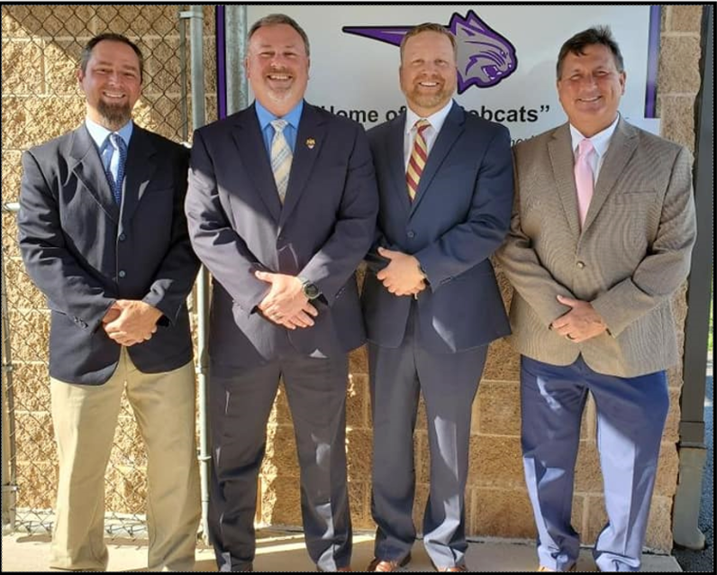
APPEARANCE
IT STARTS BEFORE YOU GET TO THE FIELD
First impressions speaks volumes
Conveys a level of respect for the game, coaches and players
Is your ref bag ready to go?
Have you taken inventory?
Are you in shape?
Can you “ref with a smile”?
Notes:
APPEARANCE
More than just what you are wearing
How you carry yourself
How you “appear” to others

Slide 4
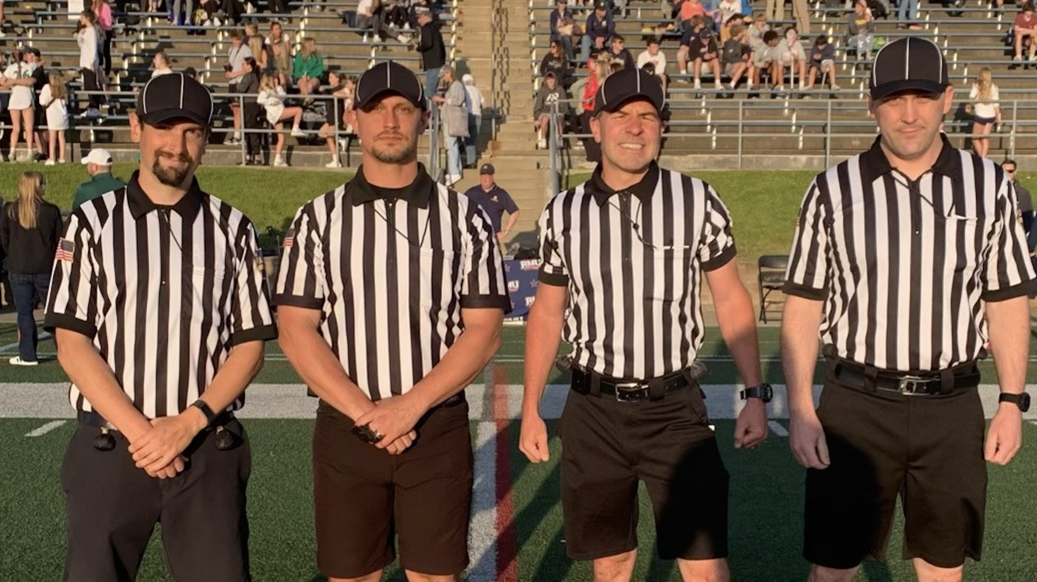
UNIFORM
DRESS THE PART
Complete uniform
Match your partner(s)
Shirt
Shorts or pants w/ Black Belt
Socks that cover the ankle bone
All Black Shoes
Striped Hat
Whistle (Fox40 preferred)
2 Flags
20-Second Timer
Tape Measure
Notes:
UNIFORM
A mis-matched crew looks bad
Intolerable if you want to get to the next level
Crew Chief MUST make it clear
ALWAYS bring everything
Use Velcro or magnets for various patches

Slide 5
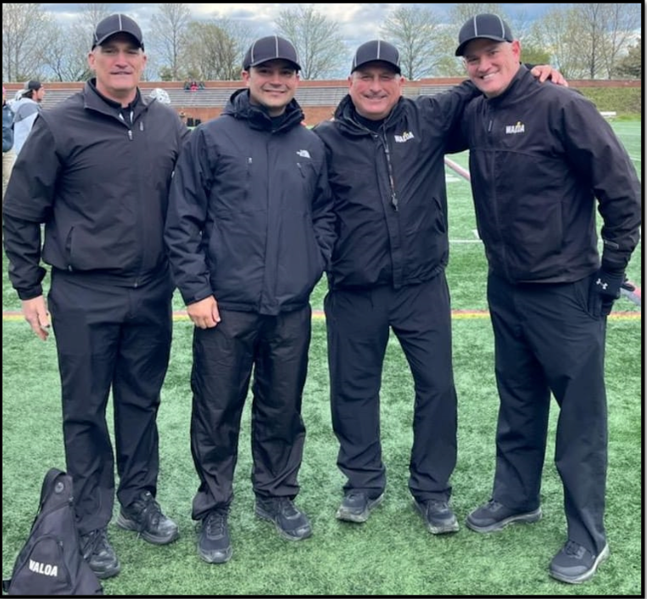
UNIFORM
OPTIONAL ITEMS
All Must Match
All Black Coats
- OK for extreme weather
Black Gloves
-Football receiver gloves are great
-Wear lates/rubber gloves under to keep hands warm
Neck Covering
-A headband worn around the neck can be a great way to block to the cold
All Black Winter Hats
-Only in extreme and all must wear
Notes:
UNIFORM – Optional Items
Coats should be all black, no striped coats
Gloves should be worn together
Limit amount of gear brought to the field
Have a small bag for your phone, keys, etc

Slide 6
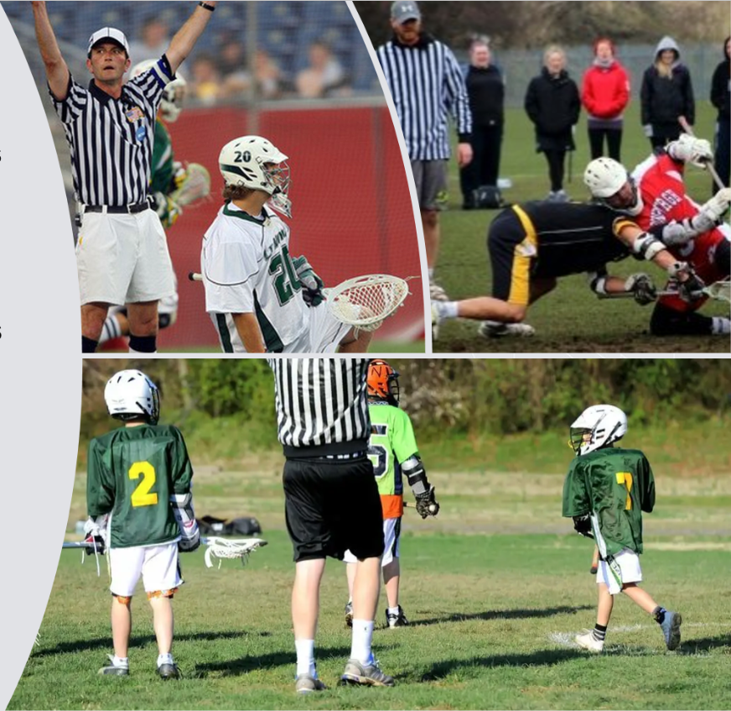
DOES IT MATTER?
ABSOLUTELY
A properly coordinated crew sends several unspoken messages
We take our job seriously
We are prepared
We respect the work the coaches and players have done to prepare
We respect our partners
We respect ourselves
WE HONOR THE GAME
Notes:
DOES IT MATTER?
A neat professional looking uniform instills TRUST and CONFIDENCE in you with the coaches, players and fans
Remember: “You have to look good to be good”

Slide 7
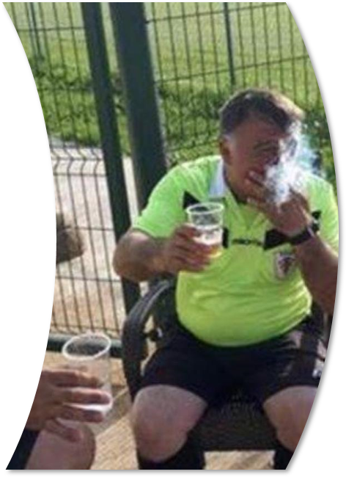
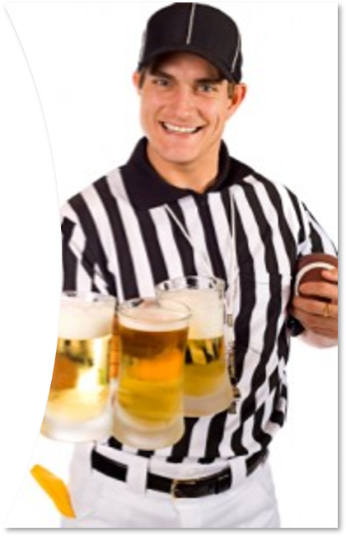
RESPECT THE UNIFORM
WE ARE JUDGED WHILE IN THE STRIPES
We all became officials to make friends and have some fun, but there are limitations.
Always leave the immediate playing area to have a post-game beverage.
Do not socially engage with anyone from the teams that you just officiated.
Have a change of clothes to wear if you do decide to spend some time with your crew
Notes:
RESPECT THE UNIFORM
You will be judged while in uniform
Get away from stakeholders before social activity
Be careful of what you “say” around others

Slide 8
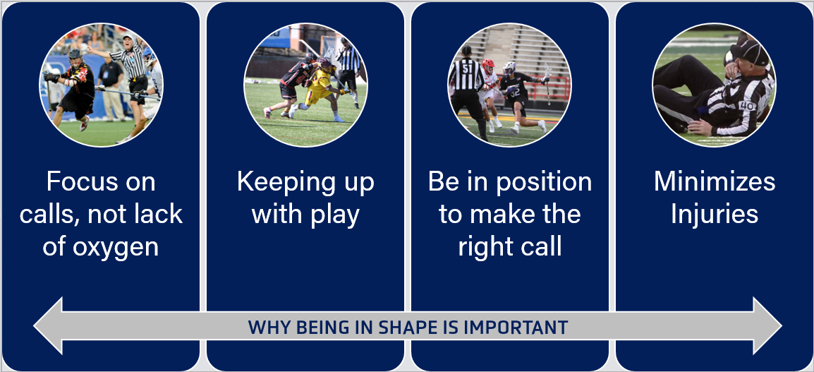
CONDITIONING
THE GAME IS FAST
Notes:
CONDIITIONING
Its easier to make calls when you aren’t out of breath
Helps maintain being in position during the game
Provides confidence in the coaches and players that you will be in position to make the right call
Focus on cardiovascular conditioning more than speed
Start slow and work your way up
Spring conditioning is different than off-season

Slide 9
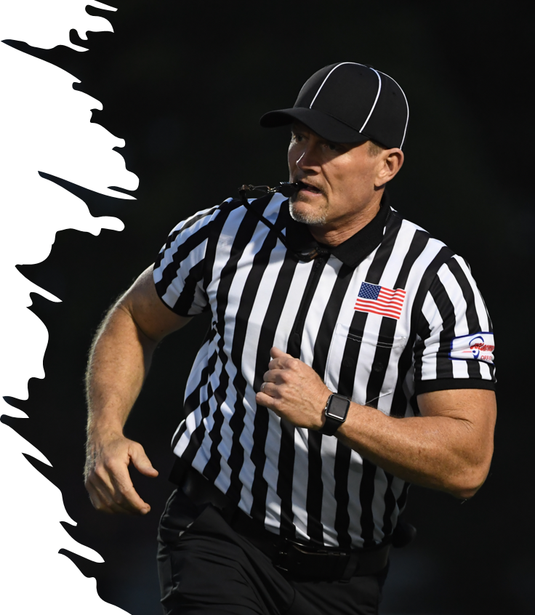
BEING IN “GAME SHAPE”
THE PLAYERS ARE FASTER THAN WE ARE!
What does “Game Shape” mean?
Endurance
-Youth Games (2-3 miles)
-High School Games (3-4 miles)
-College Games (5-7 miles)
Speed
-Can you keep up with the players?
How do you “cheat” if you can’t?
Agility
-Can you move side-to-side to get out of the way?
-Can you “yo-yo” as lead or single at GLE?
Notes:
BEING IN “GAME SHAPE”
“Lacrosse Shape” is different than getting on a treadmill and jogging for 30 minutes
Anerobic conditioning with sprinting and minimal rest
HINT (High Intensity Interval Training)
-Raising and lowering heart rate
”Run and Gun” is the new normal
Get on a field and practice realistic movements as in game situations

Slide 10
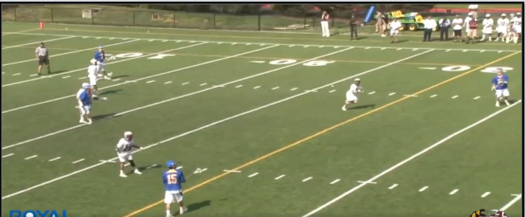
GAME SHAPE
THIS IS WHY IT MATTERS
Notes:
GAME SHAPE
Simple Question
-Could YOU keep up with this play?

Slide 11

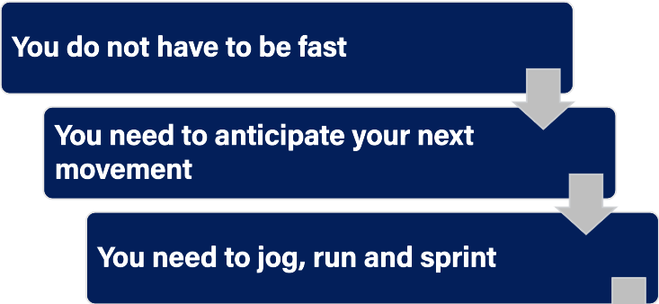
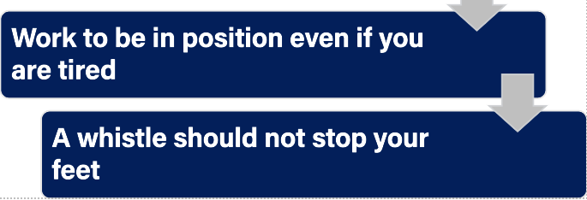
HUSTLE
EVERYONE CAN DO IT
Notes:
HUSTLE
Not everyone is FAST
We can all hustle
Do you notice other officials that don’t?
They WILL notice you

Slide 12
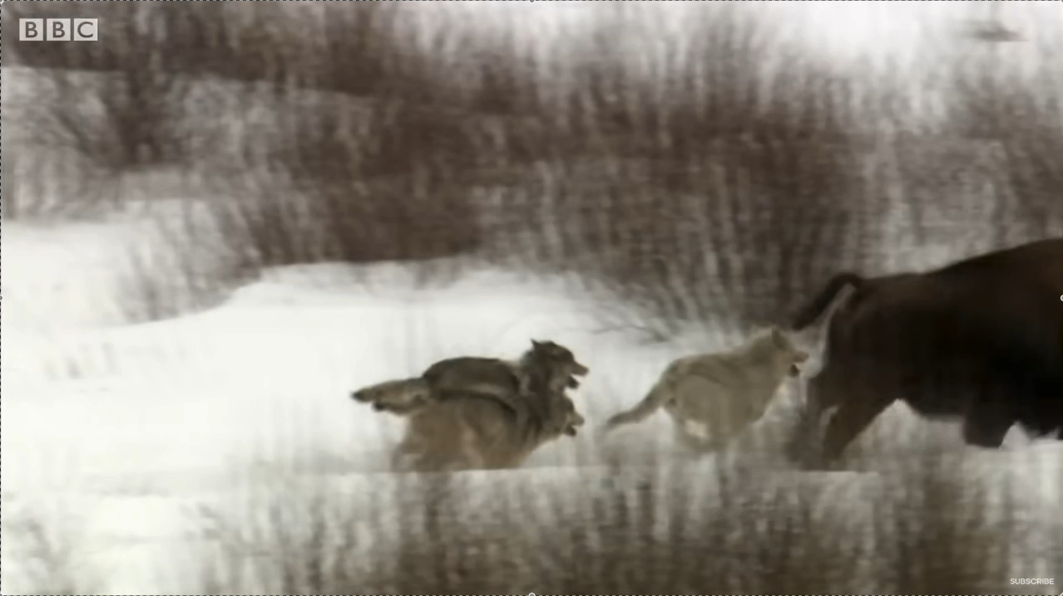
HUSTLE INTEGRITY
WHAT YOU DO WHEN NO ONE IS WATCHING
Do you give 100% all the time?
Do you hustle even when not being observed?
Do you work hard in JV games?
Notes:
HUSTLE INTEGRITY
We have to officiate consistently
We have to work hard for the game and players

Slide 13
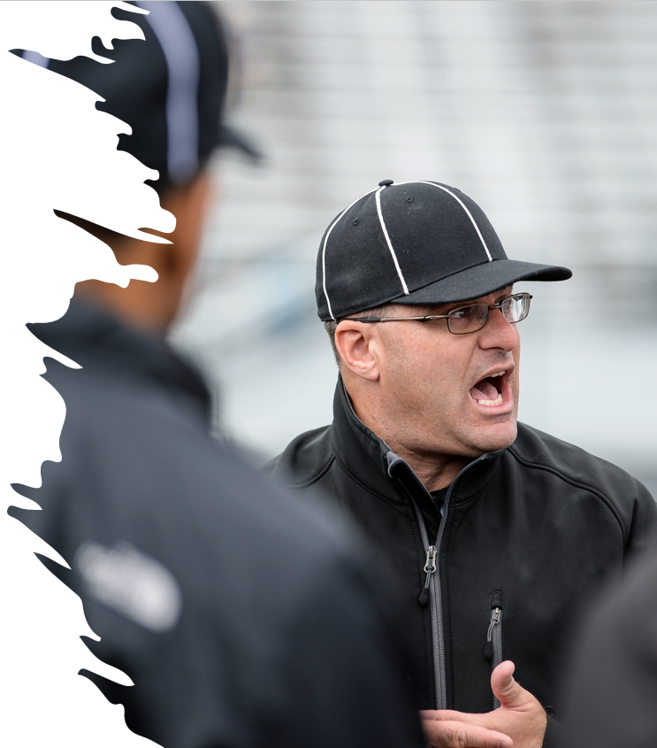
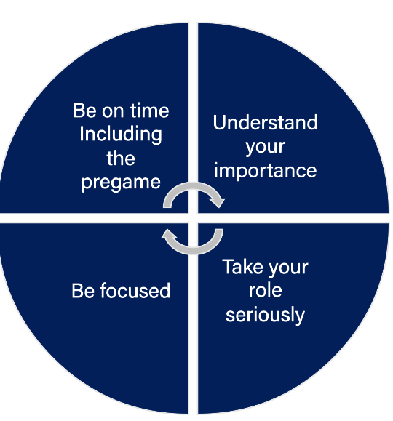
THE LITTLE THINGS MATTER
ESTABLISH GOOD HABITS
Notes:
LITTLE THINGS MATTER
Habits can be good and bad
Establish good habits and routines
Do you job consistently

Slide 14

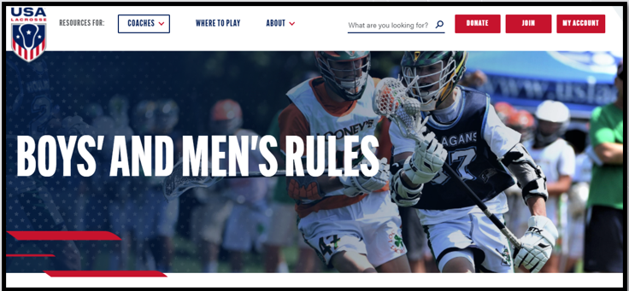
RULES KNOWLEDGE AND APPLICATION
RULES & MECHANICS
Notes:
RULES KNOWLEDGE & APPLICATION
Rules & Mechanics are our primary responsibility
We have to consistently study and want to improve

Slide 15

RULES
STUDY THE BOOK
Have multiple copies
Consider getting the app for NFHS
Highlight areas of interest or concern
Review your most common mistakes every game
Be a student of the game
Notes:
RULES
Study the rule book
-Have a copy at work
-Have a digital copy
-Have a copy on the nightstand
-Have a copy in your game bag
Underline
Highlight
Paperclip
Have topics you review every game
-Crease privilages/prohibitions
-Simultaneous fouls
-Quick restarts
Be a student of the game

Slide 16
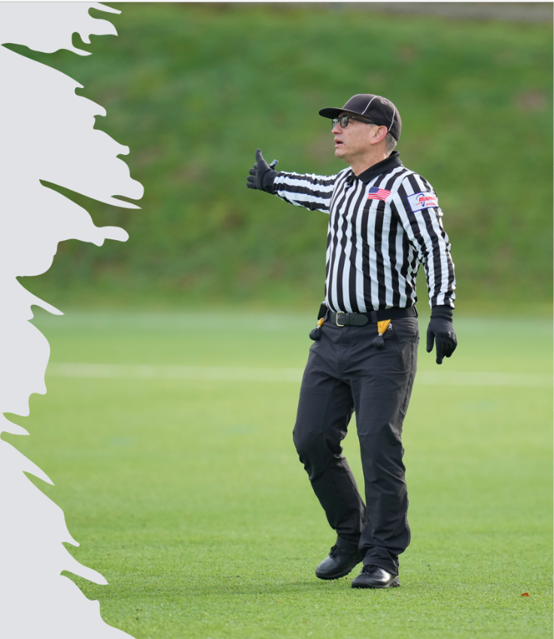
MECHANICS
HOW WE DO OUR JOB
Correct mechanics allow you to be in the best position to see the play
Make adjustments as the play changes
Being out of position opens the door for problems on the field and from the sideline
Keep moving – Don’t Kill Grass
Be on the lines (goal, endline, sideline) when the ball is there
Notes:
MECHANICS
95% of the time if you use the mechanics, you will be able to see what you need to see
5% of the time you will have to move to see a play
Easiest way to have a coach call you out is be not being in the right place on the field
Be on the lines (goal, endline, sideline) when the ball is there

Slide 17
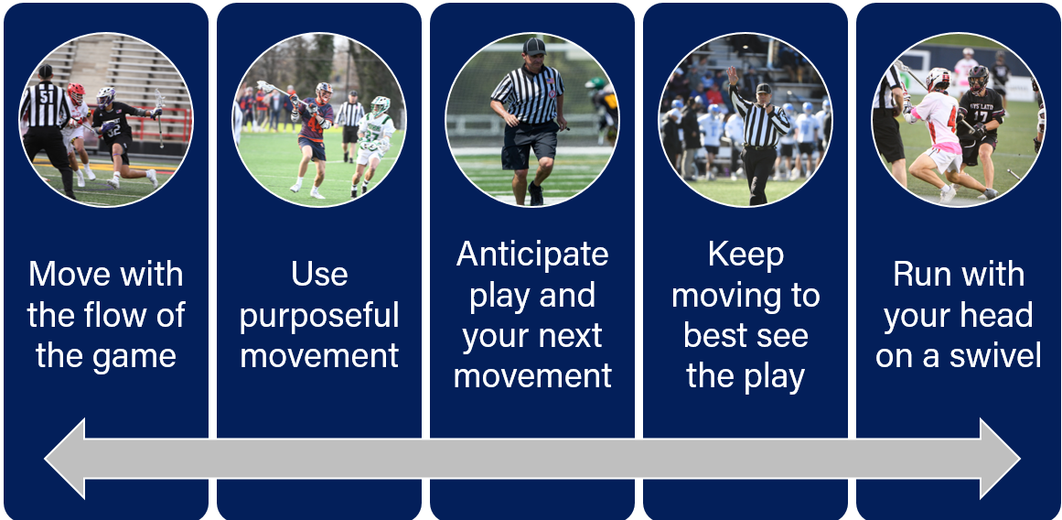
Mechanics
KEY POINTS
Notes:
MECHANICS
Do not be robotic, move with the flow of the game
Do not bounce around
Always ask yourself if the ball changes possession where do I need to be next
Think one play ahead
Once the ball hits the ground start moving while watching the play
Run with your head of a swivel!

Slide 18
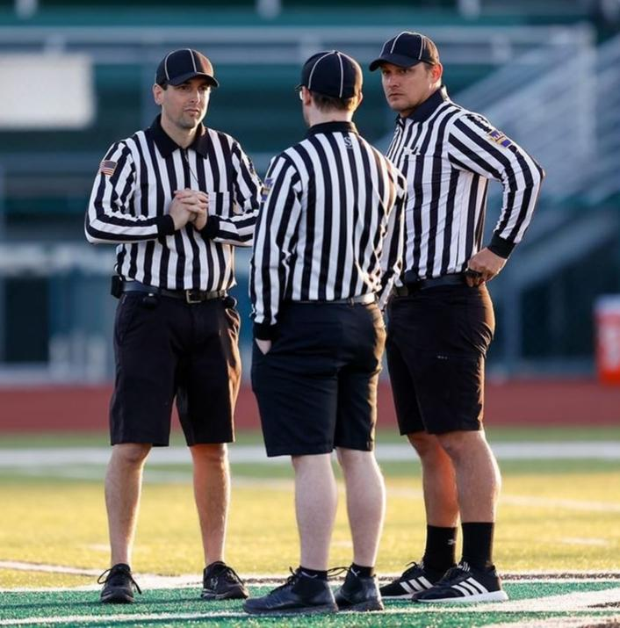
PREGAME
TIME TO GO TO WORK
Socialize before the pregame or after the game
Ask relevant questions
Have your rule book available
Discuss the teams playing
What does this game mean?
Is this a rivalry game?
What are the strengths and weaknesses of each team
Notes:
PREGAME
The pregame sets the tone for the game
A solid pregame gets you focused and allows you to cover any topics that will make this game the best you have ever worked
Interject previous game situations
Talk about player or team tendencies
Use film if it is available
Only bring up penalty situations if they are pertinent
Don’t go down the rabbit hole
Please do not tell me how many coaches/players you have ejected!!
Hydrate and use the restroom

Slide 19
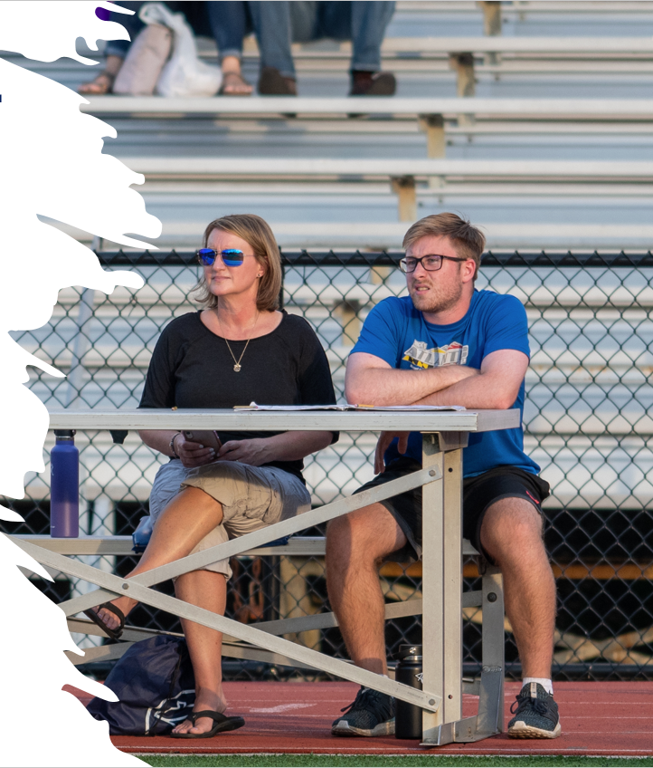
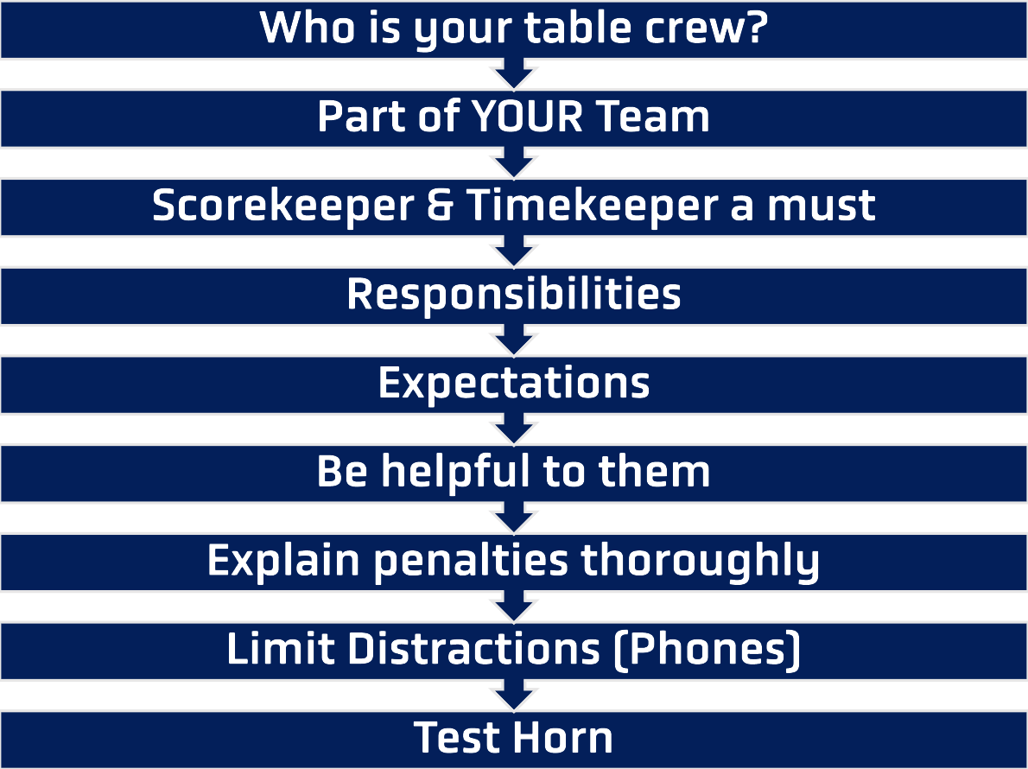
TABLE AND GAME PERSONNEL
PART OF YOUR CREW
Notes:
TABLE AND GAME PERSONNEL
The table is part of the official's crew
Go over responsibilities
Go over expectations
Remember they are volunteers
Help take care of them
Take time to explain penalties

Slide 20
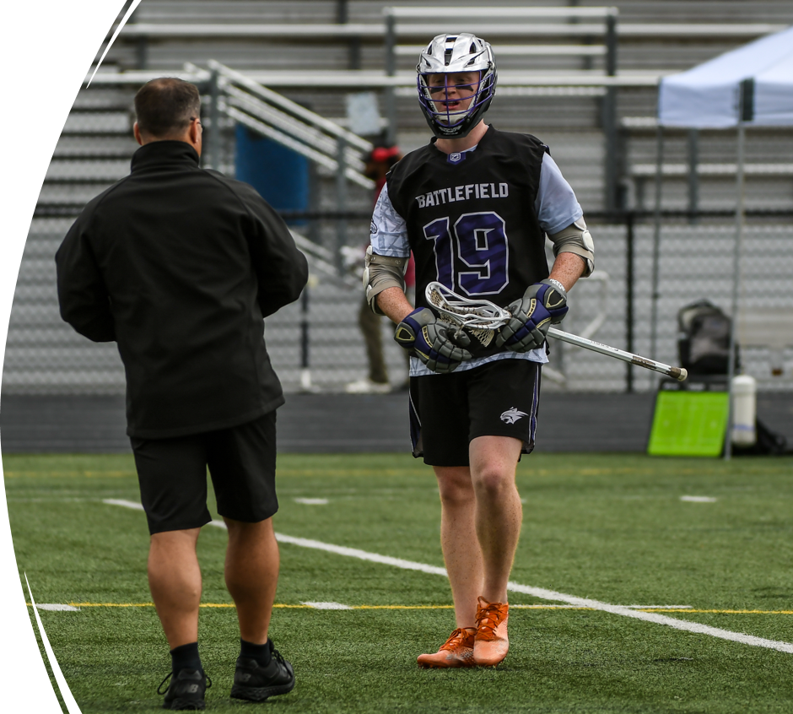
THE SOFT SKILLS
COMMUNICATION IS KEY
It takes practice
The comments and questions are generally the same
Develop your responses and practice
Answer questions, not statements
Don’t be afraid to say “It’s time to move on”
Notes:
THE SOFT SKILLS
You cannot do this correctly without practice
If they escalate, you de-escalate
Use your inside voice
Verbal Judo – Have responses for common comments

Slide 21
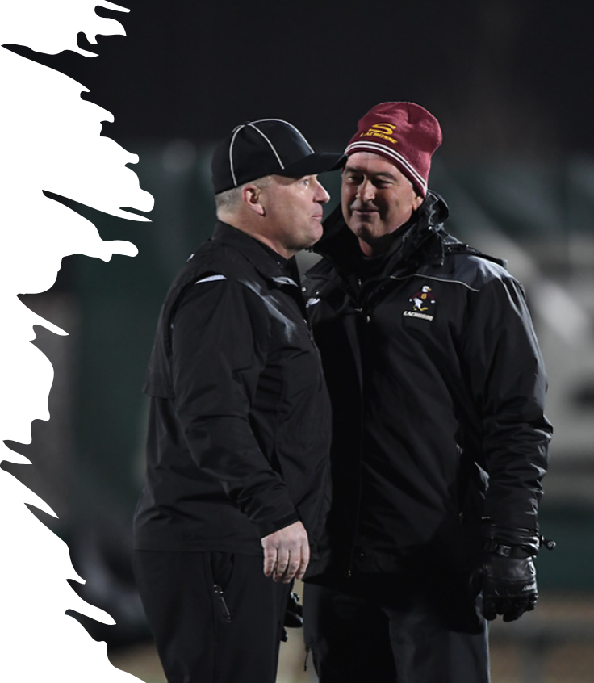
THE SOFT SKILLS
HEAD COACH COMMUNICATION ACTIVITY
Situation
You have a head coach that has a reputation as a “hot-head” and likes to yell at everything. He has no social filter and typically gets one conduct penalty per game and sometimes a USC. As you are running by the bench as trail and call a loose ball push the coach screams, “What are you doing? Have you ever seen lacrosse? This must be your first game!”
How do you handle this?
Notes:
THE SOFT SKILLS
In this situation, we have not yet reached the level of a foul unless this is repeated behavior
Get within conversation distance (when possible) and as the coach “Did I miss something coach?”
Let him respond and simply say “I may have missed that one coach”
Also tell the coach “You can call me over and Im happy to explain a call, but I can’t have the comments”
Use the “Ramp” and penalize if necessary to regain control

Slide 22
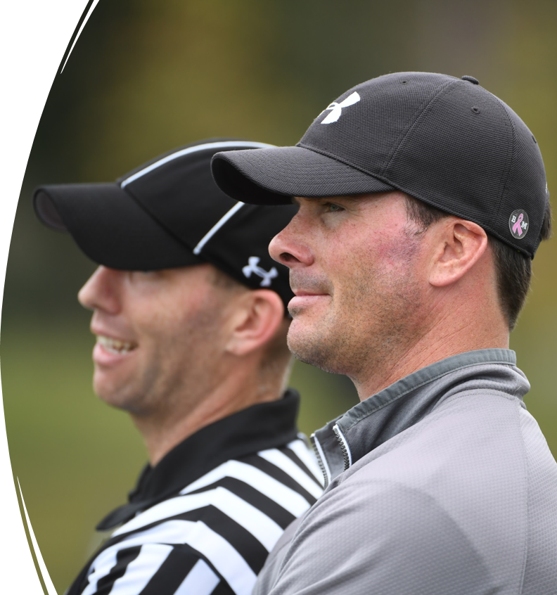
ASSISTANT COACHES
CAN BE GREAT ASSETS
You guide the conversation
Have them be a buffer to the coach
Remember their first responsibility is to coach the kids and not talk to you
The Sub Box coach can help with the bench and player issues
Questions are OK
Comments are NOT
If they become a problem, you can take away their right to speak
Notes:
ASSISTANT COACHES
Assistant coaches can be great tools for managing the play of the game
This is especially true when they run the sub box
Try to connect with one early if you see a head coach getting heated
If the assistant IS the problem, talk to the Head Coach

Slide 23
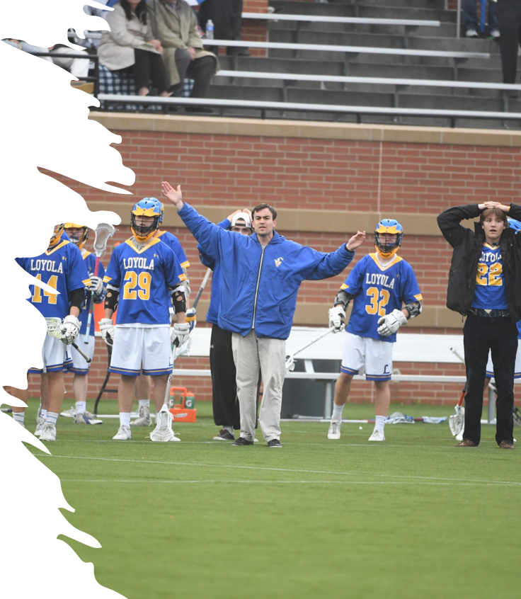
THE SOFT SKILLS
ASSISTANT COACH COMMUNICATION ACTIVITY
Situation
You are in a conference game with teams that are similarly skilled. One of them is having a bad game but fighting to hang in there. An assistant coach for the loosing team who has been quiet for the entire game is standing at the end of the coaching box when you throw a flag. He says “Come on ref, you have to call it both ways.”
What do you do?
Notes:
THE SOFT SKILLS – ASSISTANT COACH COMMUNICATION ACTIVITY
Not a comment that would raise to a flag for the first comment
Get to the Head Coach immediately, let him know what was said and warn that the next comment will be a flag
Typically, this is the end of it
If not, use the “Ramp” and penalize if necessary

Slide 24
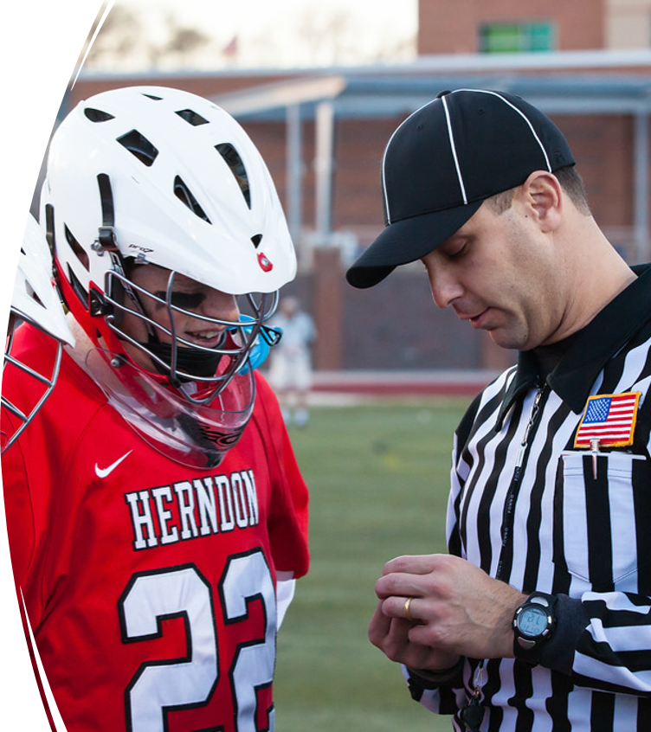
PLAYERS
YOUR BIGGEST ASSET
Connect with the players and they will work with you
Establish a working relationship with the captains
Faceoff men should be your best friends
Players are generally embarrassed by poor behavior by parents and coaches
Use them as first line of intervention when needed
Notes:
PLAYERS
Does not have to be captains
Pick the ones that can be your allies
Stop talking to them if they become combative
This is a great time during dead balls and stick checks
Address them by name or at least number
Always talk to the goalie

Slide 25
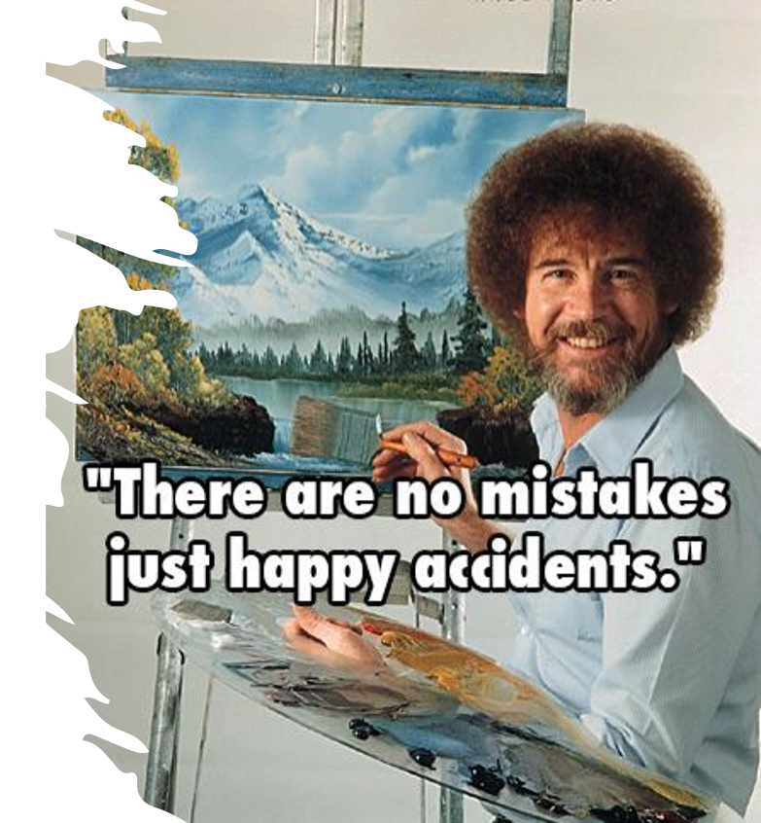
MISTAKES
WE ALL MAKE THEM
How you handle a mistake will determine your credibility with all stakeholders
Own them, don’t try to cover up or ignore
Admit to a coach when you made a mistake
Apologize to the coach and players
Reset the field so no advantage is gained from your mistake
No make up calls
Learn from it
Notes:
MISTAKES
”Experience is simply the name we give our mistakes”
They are not fun but are part of the process
Many of the harder concepts (play on, simultaneous fouls, etc) do not get locked in your mind until you make a mistake in a game
Learn from it and make them part of your pregame
Be self-deprecating and share with others
Learn to laugh!

Slide 26
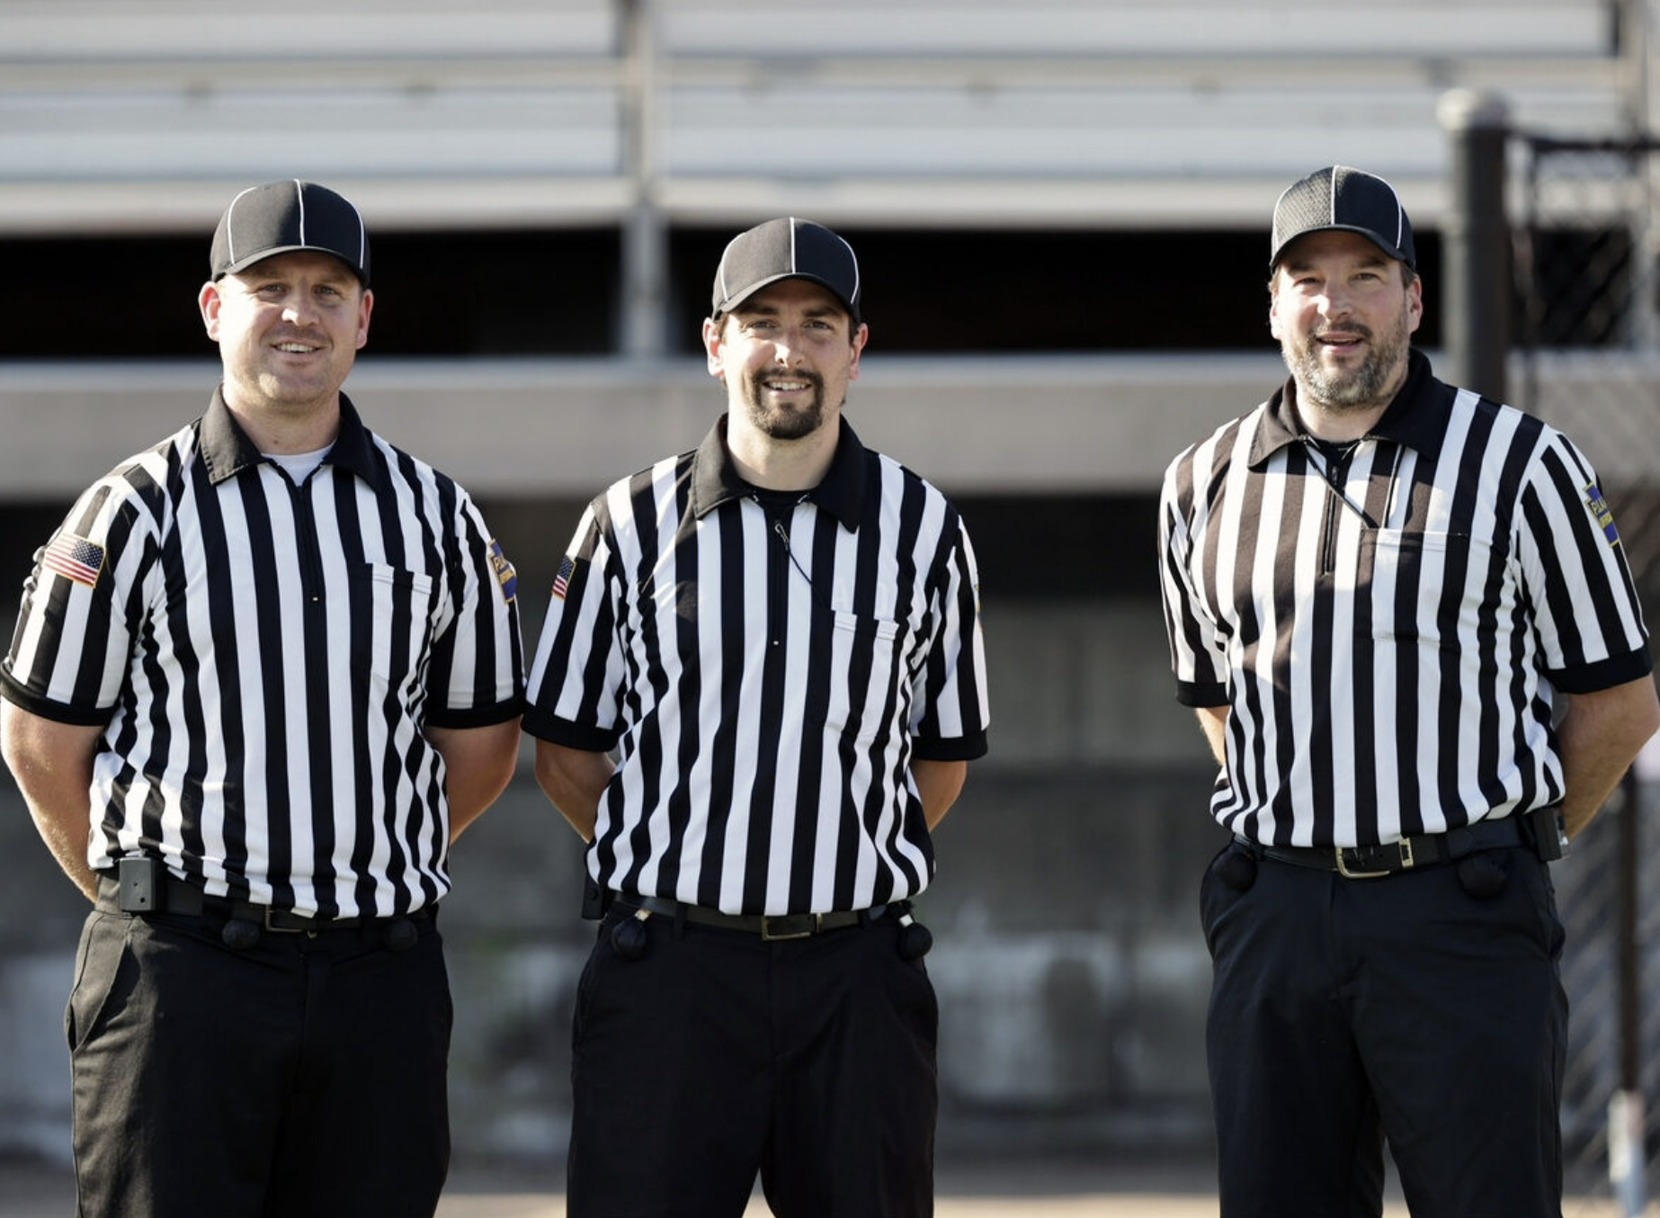
YOUR CREW
LOYALTY IS PARAMOUNT
Your crew is YOUR team
Live as a team or die as an individual
Your partners will make mistakes
Don’t throw them “under the bus”
Senior officials need to be good mentors
Let your Crew Chief do their job
The goal is always to make the SAFE & FAIR call
Notes:
YOUR CREW
What are you doing to help each other out
We are always a unit
Never sell out a partner to a coach, player, or fan
The answer should always be “(coach/Assistant/Player) I will talk to my partner about that the next chance I get.”
“He had a different view than you and I”
Always make the calls that involve player safety regardless of who is in the driver seat

Slide 27
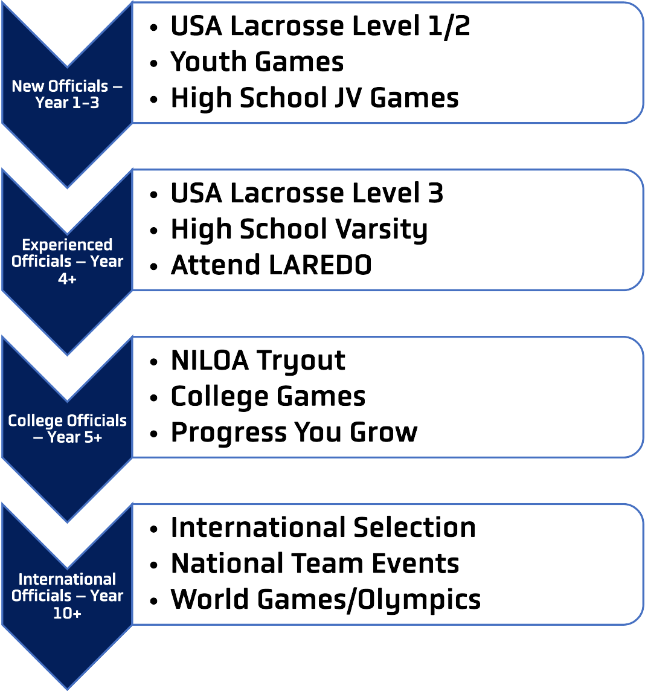
GROWTH AS AN OFFICIAL
HOW TO GET TO THE NEXT LEVEL
What level are you now?
What level do you want to get to?
Who can help you get there?
Be willing to travel
Be willing to accept all assignments
Communicate your goals
Ask for HONEST feedback
Be willing to ACCEPT it and grow
Attend a USAL LAREDO Clinic
Notes:
GROWTH AS AN OFFICIAL
What level are you now?
Be open with your assignor
Should you take that next assignment
What level do you want to get to?
High school
College
Pro/International
Who can help you get there?
Experienced officials/Mentors
Trainers
Observers
Be willing to travel
Be honest about your abilities

Slide 28
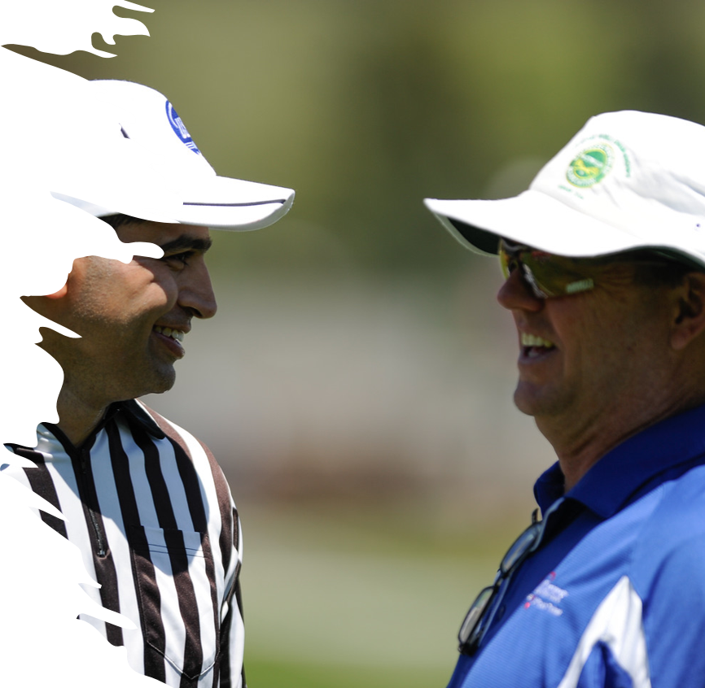
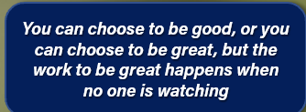
PATHWAYS TO SUCCESS
YOUR GROWTH IS YOUR JOB
Officiating growth is a personal responsibility
You are competing with your fellow officials for the “Big Game”
Find a mentor
Watch high level officials
Watch other sports officials
Learn and get better every game
Accept challenges and setbacks
Don’t blame others
Notes:
PATHWAYS TO SUCCESS
Create your own path
Depending on age, you have to return to “learner” mode
Don’t be the smartest in the room, find someone smarter
Accept where you are and enjoy the time

Slide 29
THANK YOU TO THE MEMBERS OF THE
MENS OFFICIAL’S EDUCATION DEVELOPMENT TEAM
TAKE CARE OF YOUR CREW
Notes:
Please let us know if you have any questions or comments on this presentation.
Thank you for taking your time to develop the next crop of officials!
officials@usalacrosse.com

