Slide 1


OFFICIALS EDUCATION
RULES 1-3:GAME, FIELD & EQUIPMENT, PERSONAL & TIMING FACTORS
MENS OFFICIALS DEVELOPMENT | 2026 SEASON

Slide 2
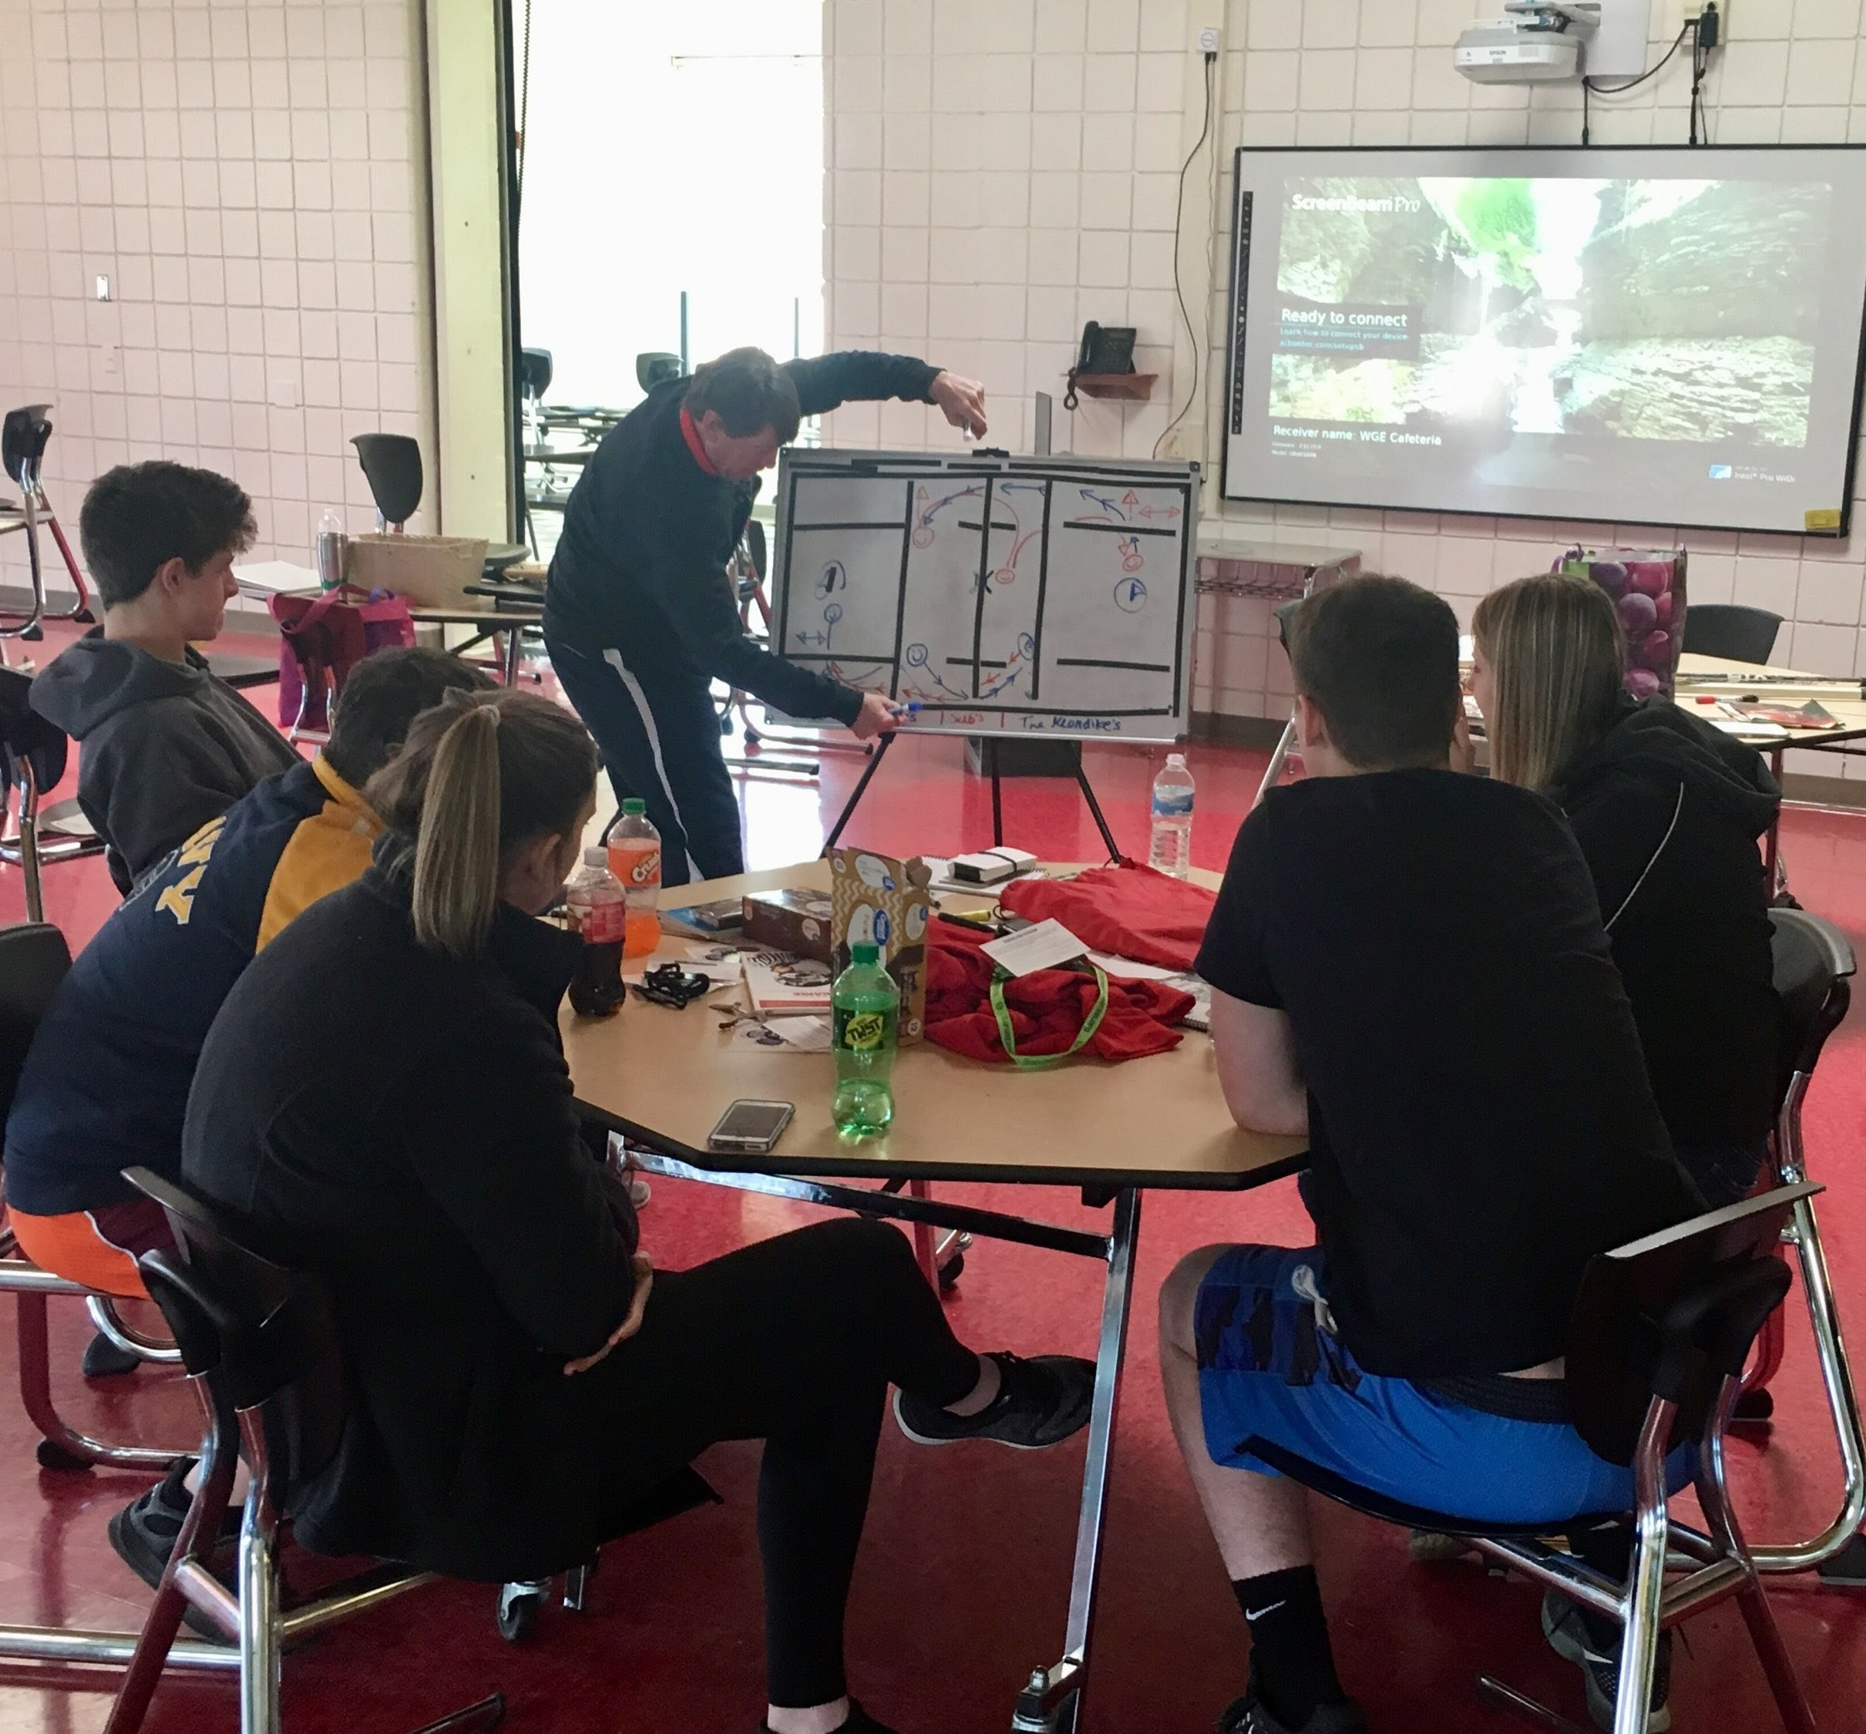

WELCOME
Congratulations on taking the first step to becoming a men’s lacrosse official
Instructor Introductions
Let’s get to know you and your classmates
PAIR/SHARE
Present to Class
Notes:
WELCOME
Start w/ and Icebreaker since this is probably your first class
Share/Pair
Put in groups of 2 or 3
Take notes on another partner in the group and give their background in lacrosse or officiating
One unique detail about each person
Present to class

Slide 3
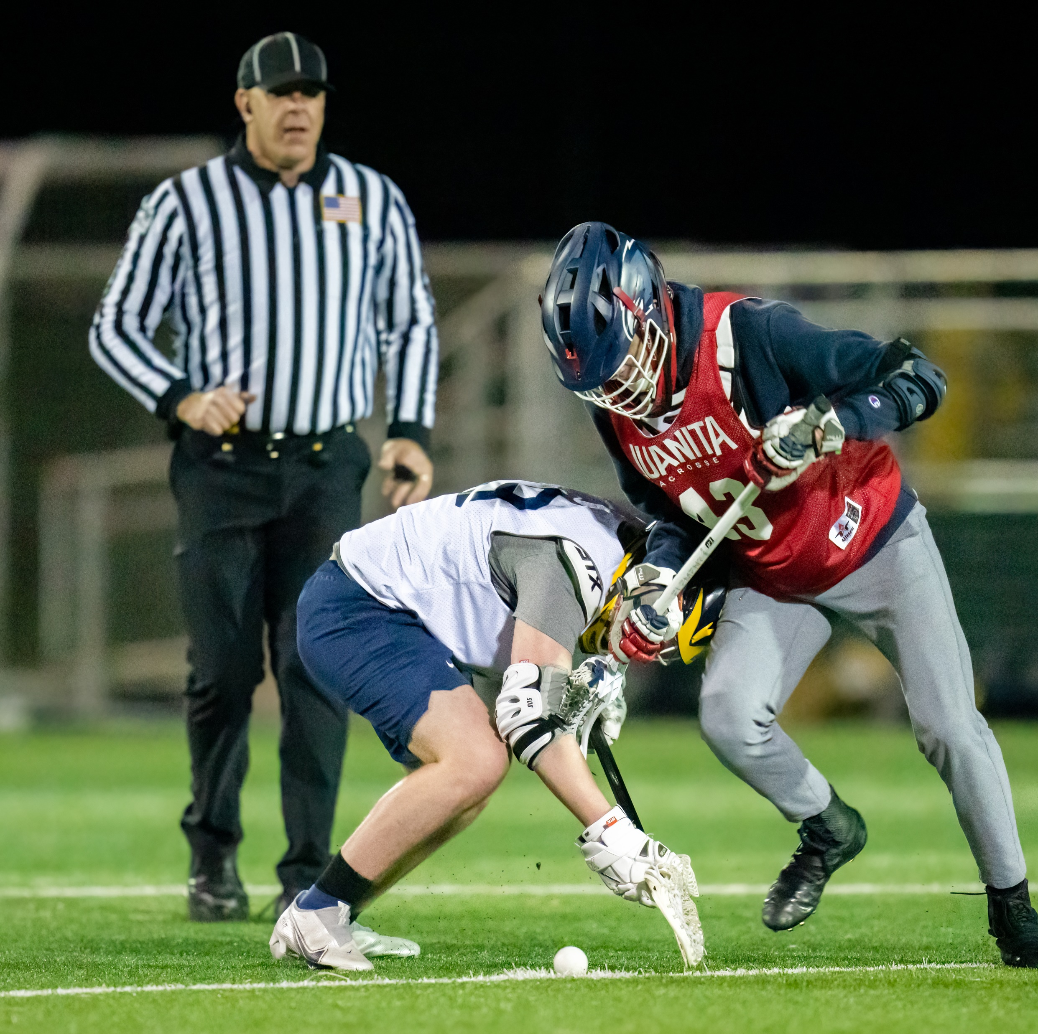
LEARNER OBJECTIVES
Gain an understanding of the “basics” of a lacrosse game.
Knowing the minimum requirements for teams/players to participate in the game safely.
Learn your responsibilities as an official for facilitating a game.
Notes:
LEARNER OBJECTIVES
What are we trying to accomplish?
Basics of lacrosse
Minimum requirements
Learn your responsibilities as an official

Slide 4

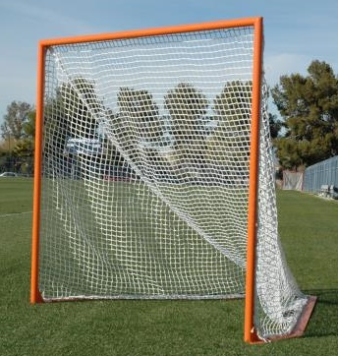
RULE 1- THE GAME, FIELD AND EQUIPMENT
A
A
A
M
M
M
D
D
D
G
2 teams of 10
Legally equipped GK
A
A
A
M
M
M
D
D
D
G
6’
6’
Class Discussion Questions
Notes:
RULE 1 – THE GAME, FIELD & EQUIPMENT
Teams
2 teams of 10
Must have legally equipped goalie
Goals
6x6’
Ball
White – Orange, Green, Yellow if Coaches Agree
“Meets NOCSAE standard” stamped on ball
Class Questions
Does the ball have to be stamped “NFHS” to be legal for play?
No, just “Meets NOCSAE Standard.”

Slide 5
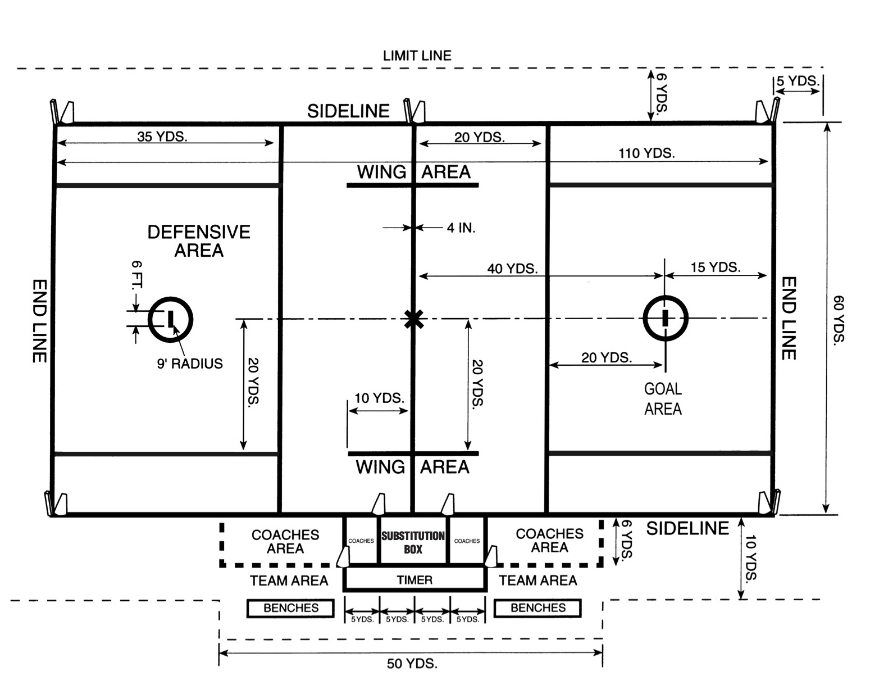
STANDARD FIELD
Class Discussion Questions
Notes:
STANDARD FIELD
110 yards long X 53 1/3 – 60 yards long
Shorter than a football field, less wide than a soccer field
If on a football field the end lines go through the middle of the endzones and must be visible or penalty
Midline – only line that is 4” long
A line must go through the midfield logo
Home team responsible
If no midfield line the home team loses the first faceoff
End lines – 15 yards behind GLE
Goal crease – 9’ radius
Goal line – 2” wide (same width as the goal pipes)
Table and bench areas – 6 yards behind sideline
Restraining Line
Wing Line
Substitution Box – 5 yards each side of midfield
Alley
Faceoff line, square or "X"
Class Discussion Question:
What is the call for endlines or midline that you can’t see?
How do enforce this?
Will you have support from your assignor?

Slide 6
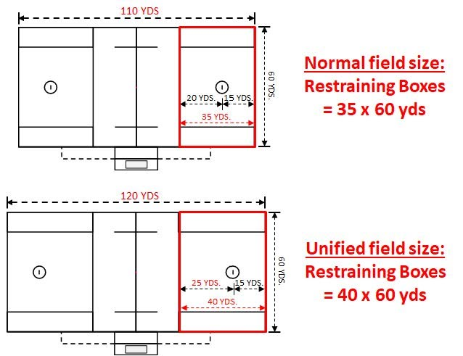
UNIFIED FIELD
Created to minimize the need for additional lines
120y field is used for international
Class Discussion Questions
Notes:
UNIFIED FIELD
Rare but becoming more common
Athletic Director friendly to minimize lines through football end zone
Basic Difference is that distance from restraining line to goal is 5+ yards
CLASS DISCUSSION
Has anyone seen or played on a unified field?

Slide 7
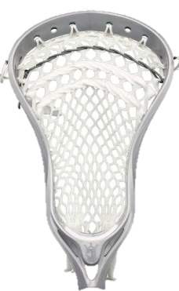
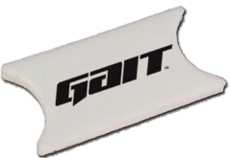
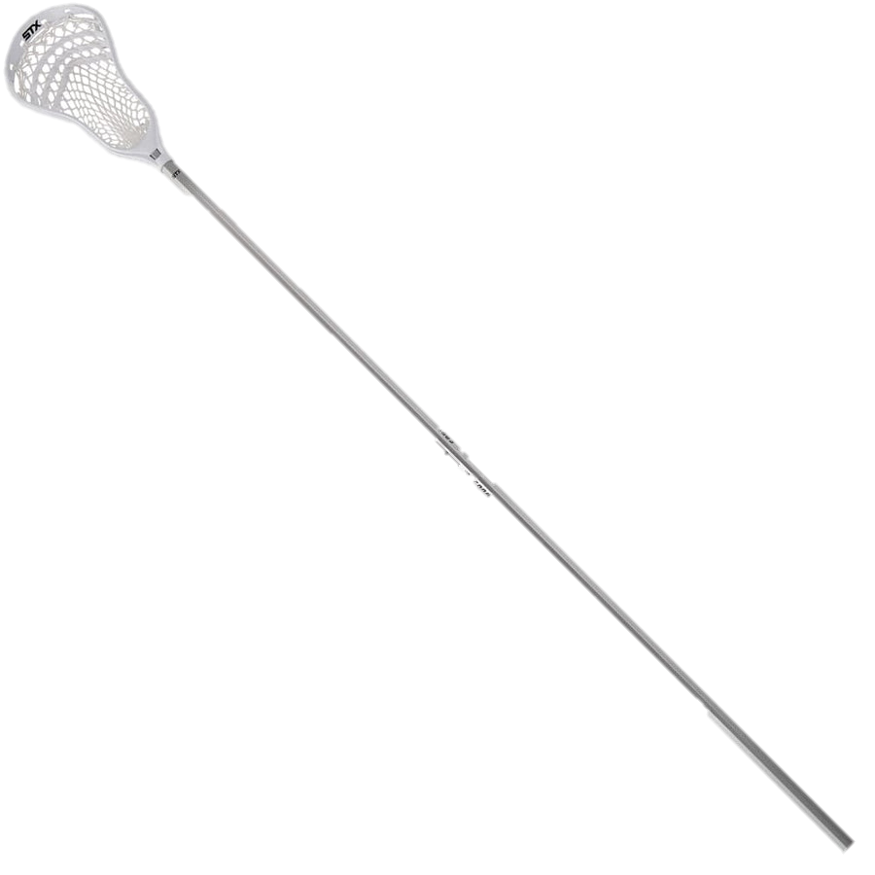
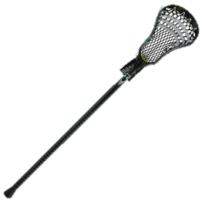
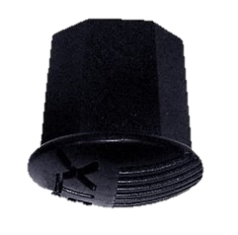
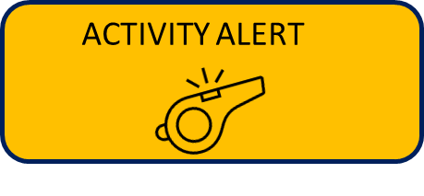
THE STICK (CROSSE)
4”
Notes:
THE STICK
Short crosse: 40-42”
Long crosse: 52-72” (max of 4 per team not including goalkeeper)
6” is minimum width of field player head (widest point)
End caps - Must be manufactured for a lacrosse stick
Ball stops - Not required but may not have more than one if used
Deep pocket & strings (best demonstrated by showing a legal and illegal crosse to the class)
Pocket is illegal if the top of the ball can be seen below the lowest point of the sidewall
Strings and leathers are limited to 2” hanging length – No penalty the first time, tell player to fix it.
No strings permitted past 4” from top of head
A broken crosse is considered no crosse
2 minute Non-releaseable penalty on all infractions
DEMONSTRATION: Stick Check
Go through the proper procedure of a stick check in front of the class. Discuss the different dimensions you check while completing it for both a long and short crosse. Be sure to include hints such as marking tape measure with important dimensions, use of score card, etc. Mention penalty time associated with an illegal crosse and process.
PRACTICE: Stick Check
Break participants into groups and have each participant complete a full stick check with crosse. Feel free to have an illegal one or two to help with recognition of an illegal crosse. Bring group back together for break down discussion afterwards.
Class Question:
Can a player use an NCAA head in a game under NFHS rules?
Yes, The rules are now consistent.

Slide 8
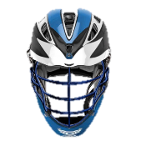

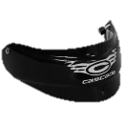


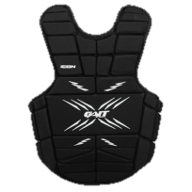
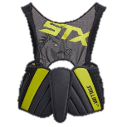


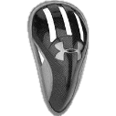

REQUIRED PLAYER EQUIPMENT
Class Discussion Questions
Notes:
REQUIRED PLAYER EQUIPMENT
Helmet – NOCSAE approved
Mouth guard (any color including clear and white. Nothing hanging off it)
Gloves
Shoulder pads NOCSAE ND 200
Arm Pads
All players required to wear a protective cup/pelvic protector (covered during coach's certification)
Goalkeeper Required Equipment:
Throat protector
Chest protector NOCSAE ND-200
NFHS – may choose to not wear shoulder or arm pads
Class Questions:
Is there a width requirement for shoulder pads?
No. The rules only state that a shoulder pad is required, but does not specify a minimum width.

Slide 9
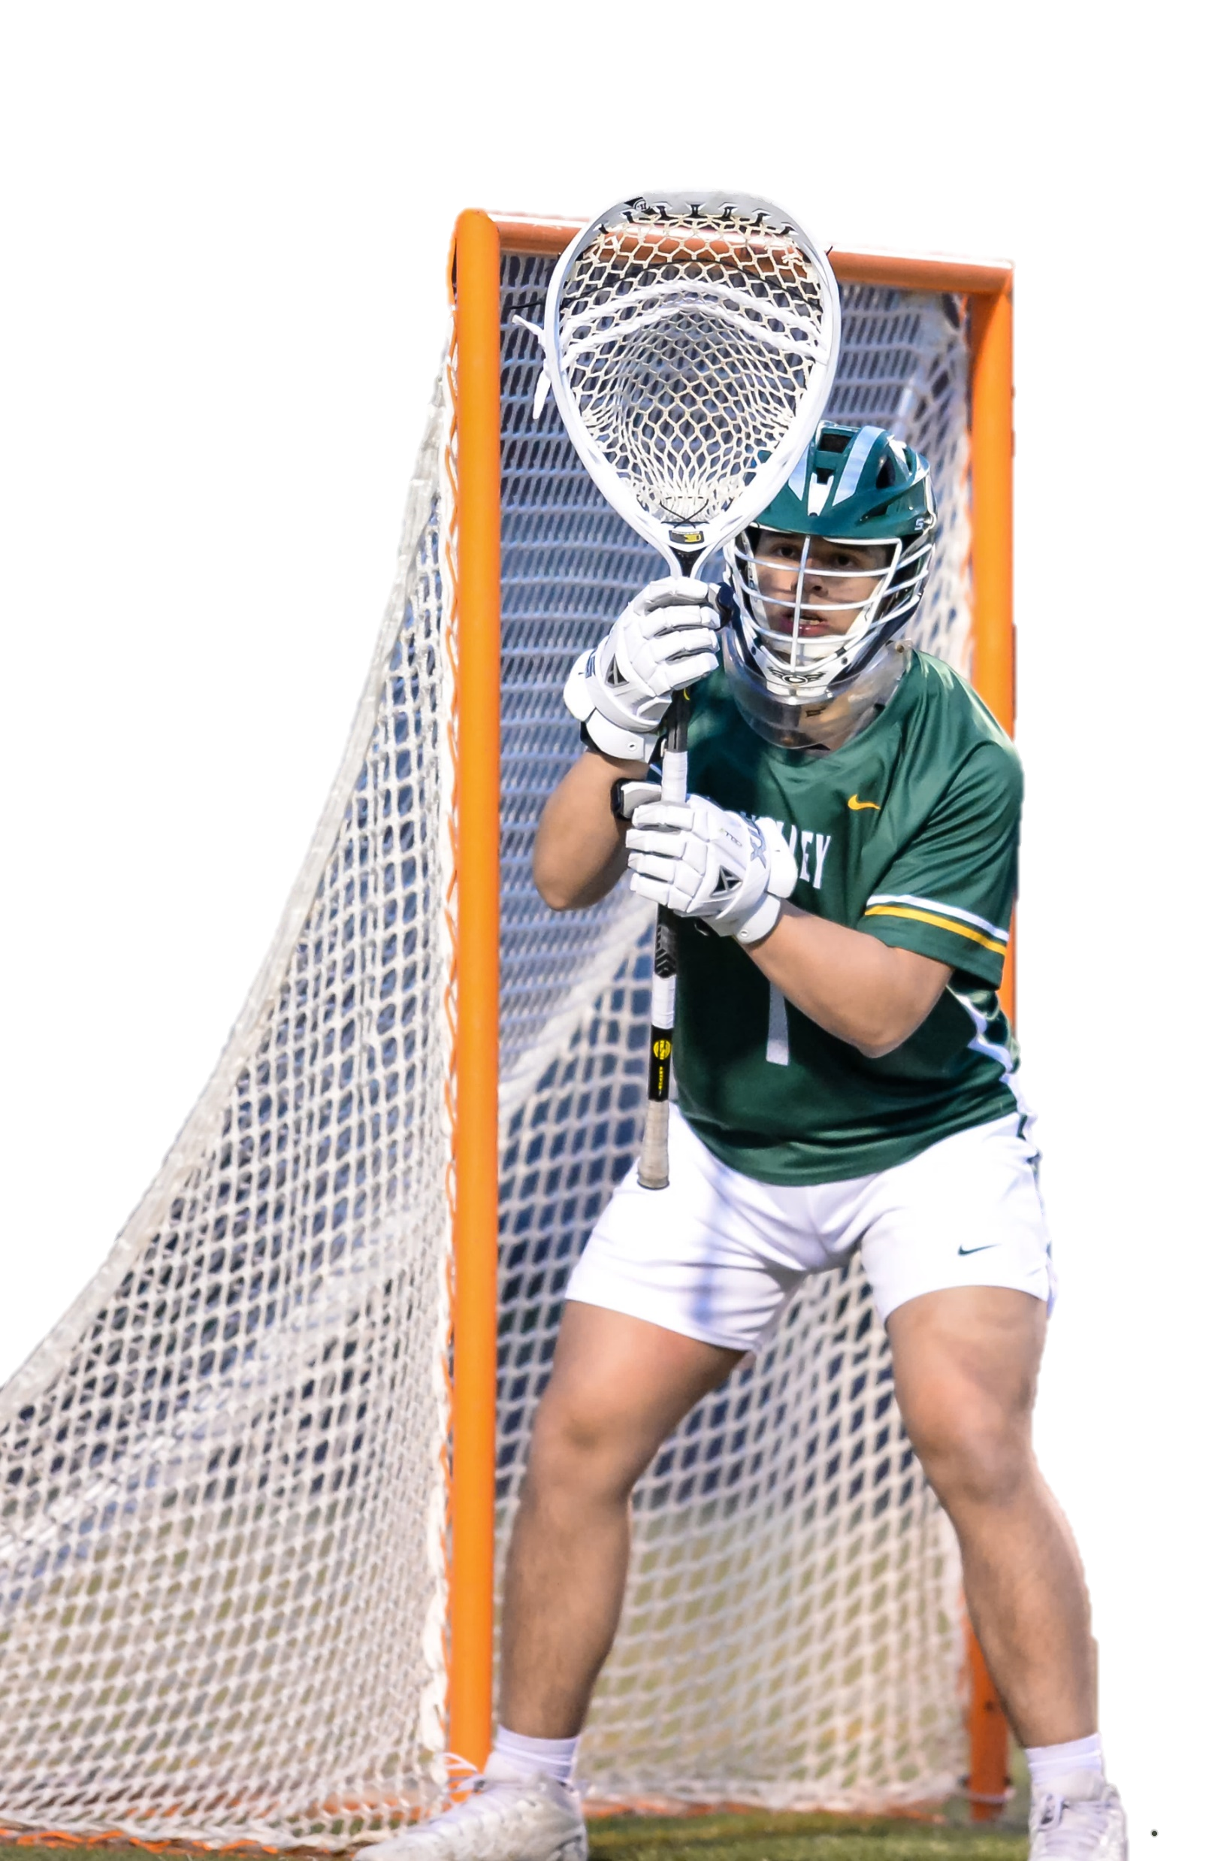
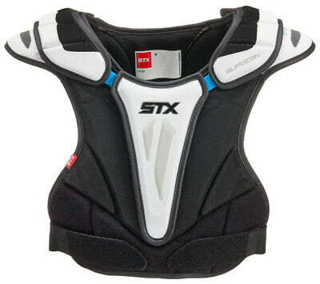
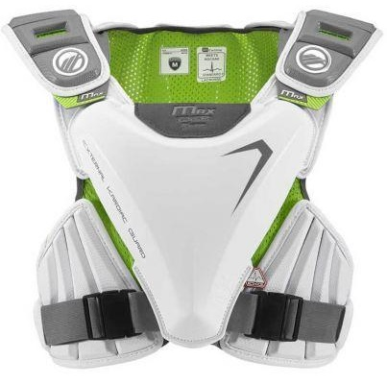
REQUIRED EQUIPMENT– RECENT CHANGES
Added requirement for protective cup or pelvic protector
Added Chest Protector Requirement that adds protection for comio-cordis
Notes:
RECENT CHANGES TO EQUIPMENT
DEMONSTRATION: Random Equipment Check Practice
Groups of 3
Player, Ref and Observer
Teach students to check from head-to-toe
Helmet (NOCSAE logo)
Mouthpiece (make sure it’s a FULL mouthpiece)
Shoulder Pads
Armpads
Gloves
Shoes
DO NOT Check or Ask for Cup (covered during coach’s certification)

Slide 10
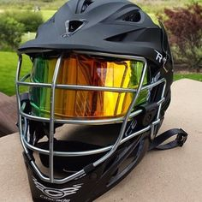
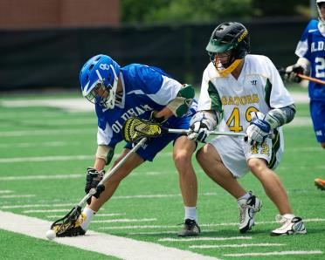
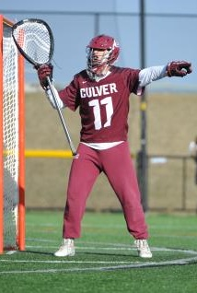
UNIFORMS
X
Jersey
covers the shoulder pads
NO Tinted Visors
Sweatpants
one solid color
Class Discussion Questions
Notes:
UNIFORMS
Jerseys – single solid color w/trim
Must cover the shoulder pads
Home team MUST wear white jerseys
Away team MUST wear non-white
Options items:
Under jerseys – same solid color; number restrictions (0-99 only)
Compression shorts
Sweatpants – solid team color
Eye shield – clear/molded/non-rigid, must be 100% clear (no shading or mirroring permitted)
Doctor’s note does not permit a player to wear an eye shield that is not 100% clear
Class Question:
Why are shaded visors not allowed?
Lacrosse facemasks are not designed for quick removal like football helmets. In the event of a head/neck injury medical personnel must be able to clearly see the player’s eyes.

Slide 11
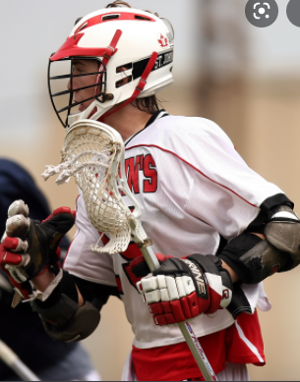
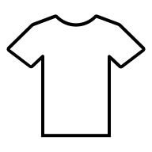
UNIFORMS– RECENT CHANGES
Jersey Color
Home wears WHITE
Number Restrictions
0-99 ONLY
0
99
00
Notes:
UNIFORMS– RECENT CHANGES
Home team wear white
0-99

Slide 12



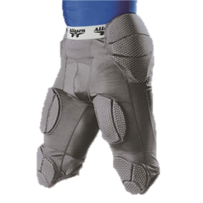
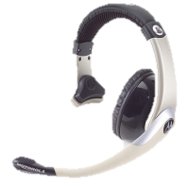
EQUIPMENT– PROHIBITED & ALLOWED
Prohibited
Allowed
Class Discussion Questions
Notes:
PROHIBITED EQUIPMENT
Non-lacrosse helmets (hockey, box, football)
Football leg pads
Electronic equipment
Jewelry
Allowed
Medical alerts – may be visible but taped down
Religious medals – taped down and not visible
Equipment Certification
Head coach must affirm with a “Yes” that all of his players are legally equipped, have been informed what constitutes legal equipment, and know what to do if they become unequipped during play
Game Administration
Home Team provides a scorebook, table, working horn, timing equipment
Class Question:
Are GoPro cameras allowed on a player’s helmet or chest if securely mounted?
No, this is electronic equipment which is not permitted on the field.

Slide 13
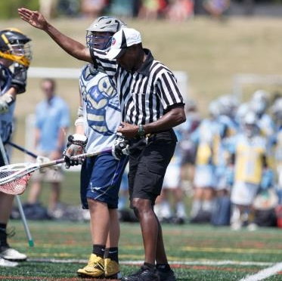
RULE 2 – GAME PERSONNEL
Officials
Timekeeper
Scorekeeper
Players
Captains
In-Home
Coaches
Sideline Manager
Notes:
RULE 2 - GAME PERSONNEL
Intro Slide

Slide 14
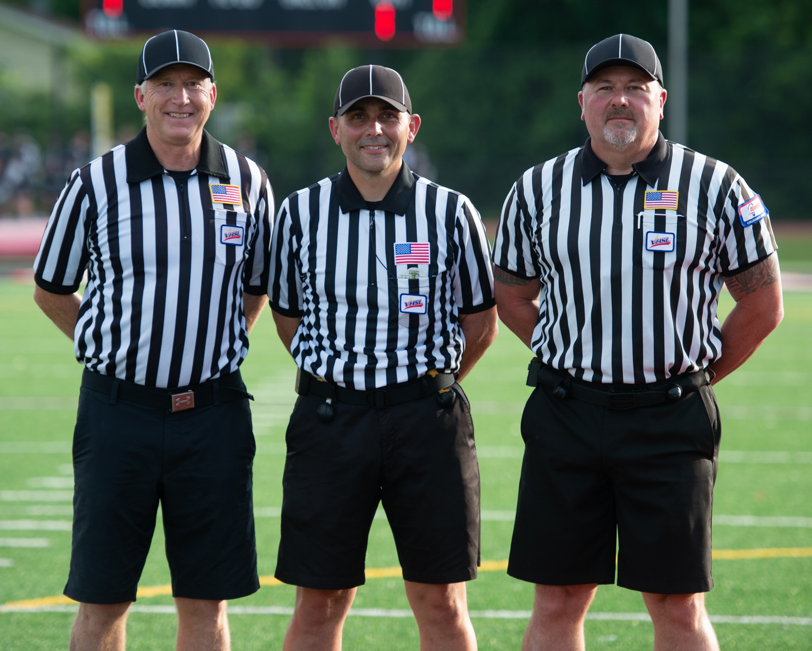

GAME OFFICIALS
Minimum 2
  Referee
  Umpire
Recommended 3
  Referee
  Umpire
  Field Judge
EQUAL
Referee
final say on all disputes
Class Discussion Questions
Notes:
GAME OFFICIALS
Referee (R), Umpire (U), Field Judge (FJ).
May suspend play for any reason.
Authority begins when they arrive, ends when they leave immediate playing area
Class Question
What kind of situation could come up in a game where the Referee would have to decide a dispute?
When the scorekeeper and the officials cannot agree on how many timeouts each team has or what the official score is. The Referee has final say.

Slide 15
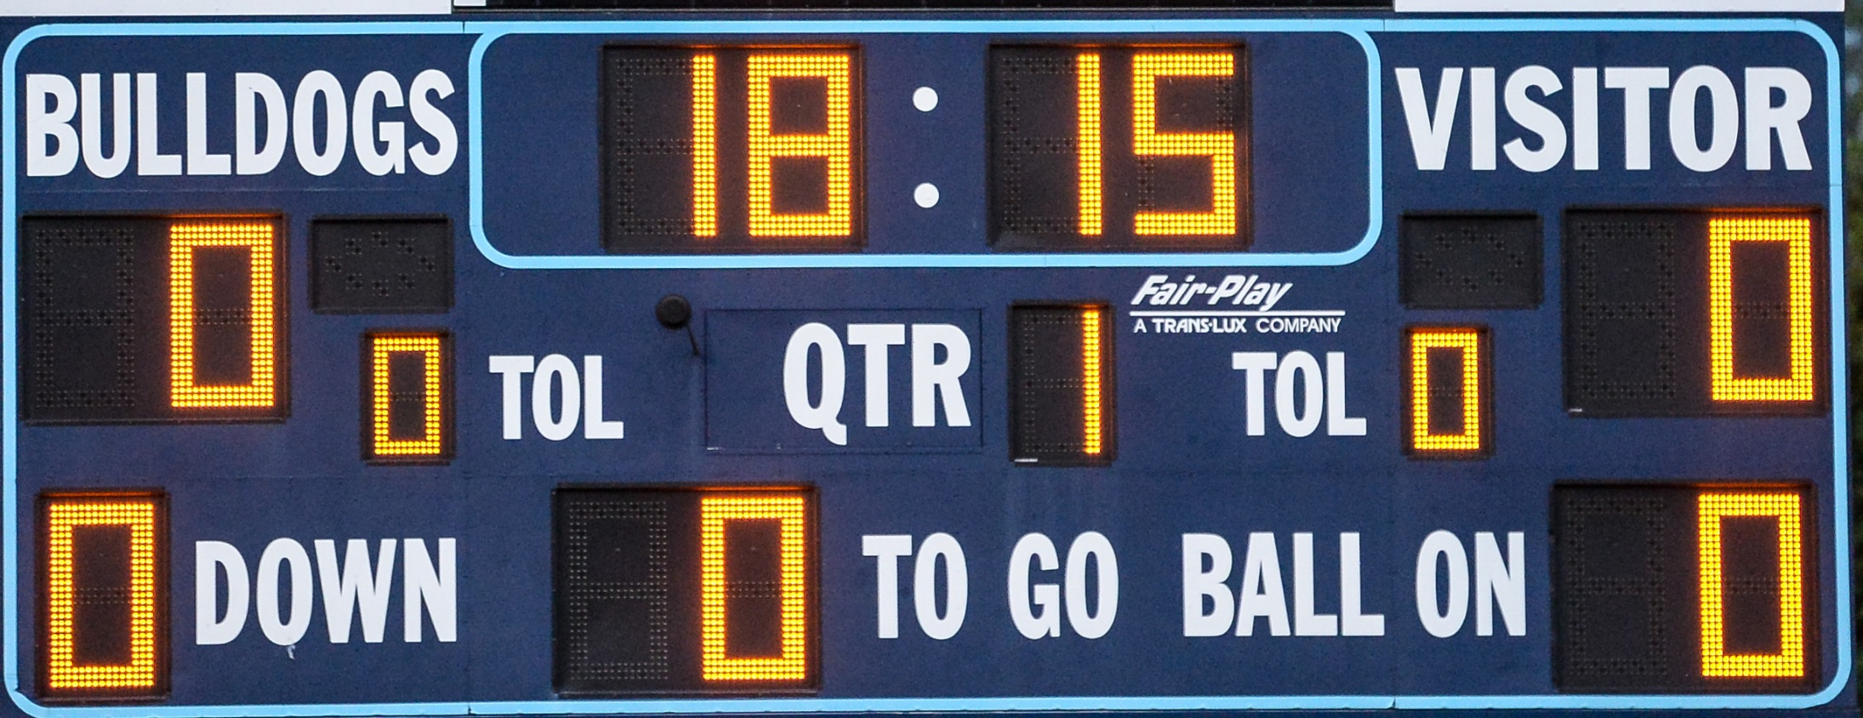
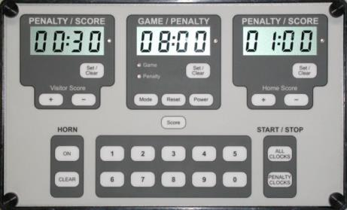
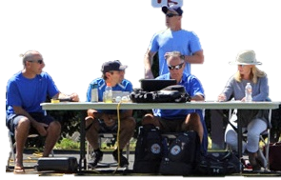
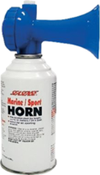
TIMEKEEPER
Class Discussion Questions
Notes:
TIMEKEEPER
Home Team Provides
Introduce yourself BEFORE the game
Check clock and horn for operation
Keep accurate time and penalty time.
If no automatic horn, sound horn at end of quarter.
Start/stop clock on whistle unless running time.
Sound double horn at dead ball requested coaches long pole count and when A player enters the field of play from the penalty area before being permitted by the rules.

Slide 16
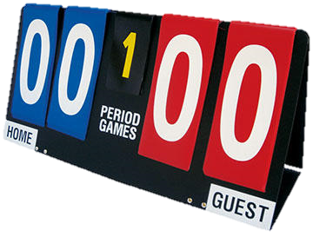
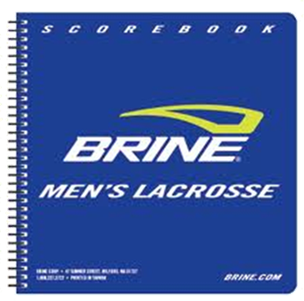
SCOREKEEPER
Notes:
SCOREKEEPER
Home team scorer provides official scorer
CANNOT be the same person as timekeeper
Get Roster of Opponent
Keeps records of goals, assists, T.O.s, name, number, violation and time of penalties.
Notify nearest official when team exceeds T.O.s or when a player accumulates 5 minutes of personal fouls.
Class Question:
Since the scorekeeper is keeping the timeouts and the score, do you really have to keep track of that on your scorecard?
Yes! Do not assume that the scorekeeper is paying attention or that they have the correct number of remaining timeouts or an accurate score. It is the responsibility of all officials to keep track of this information.
Class Discussion:
Discuss who is a qualified scorekeeper; what guidelines you give them
Timer/scorer sheet activity

Slide 17
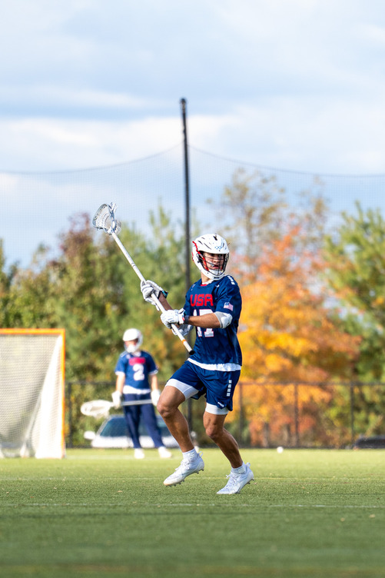
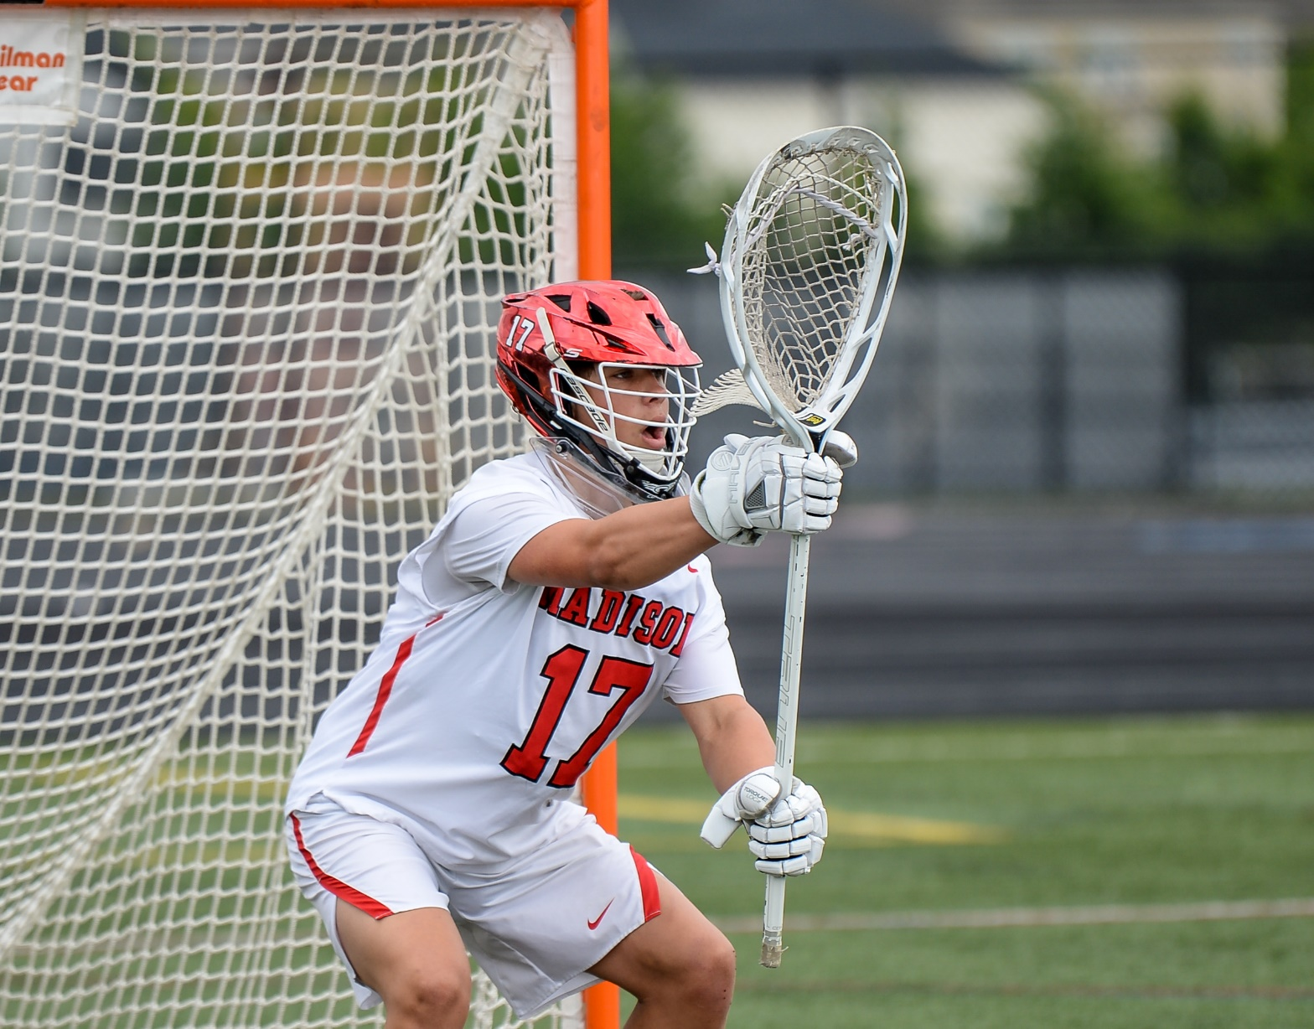
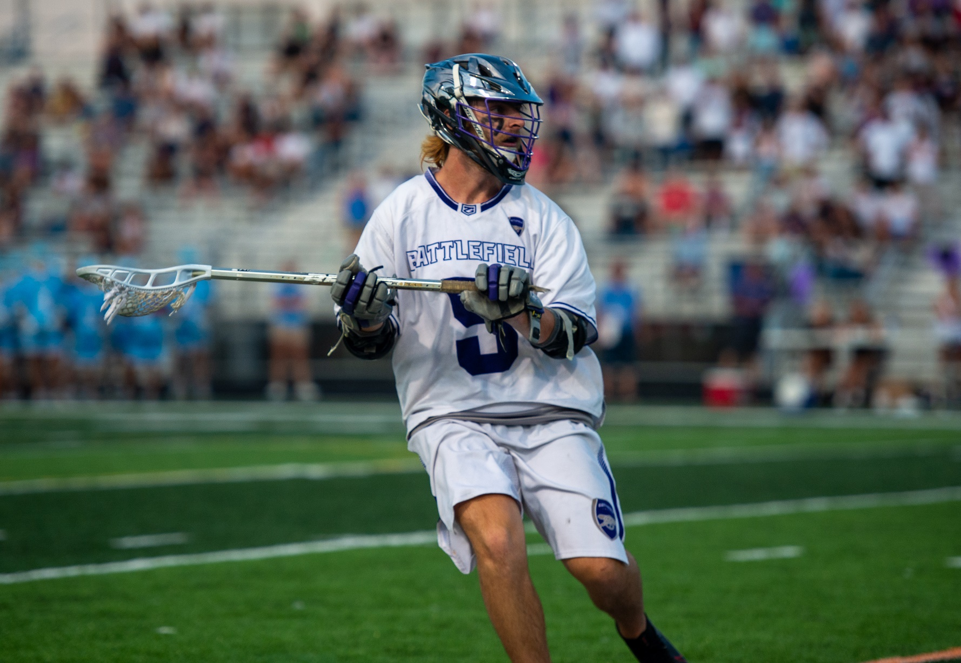
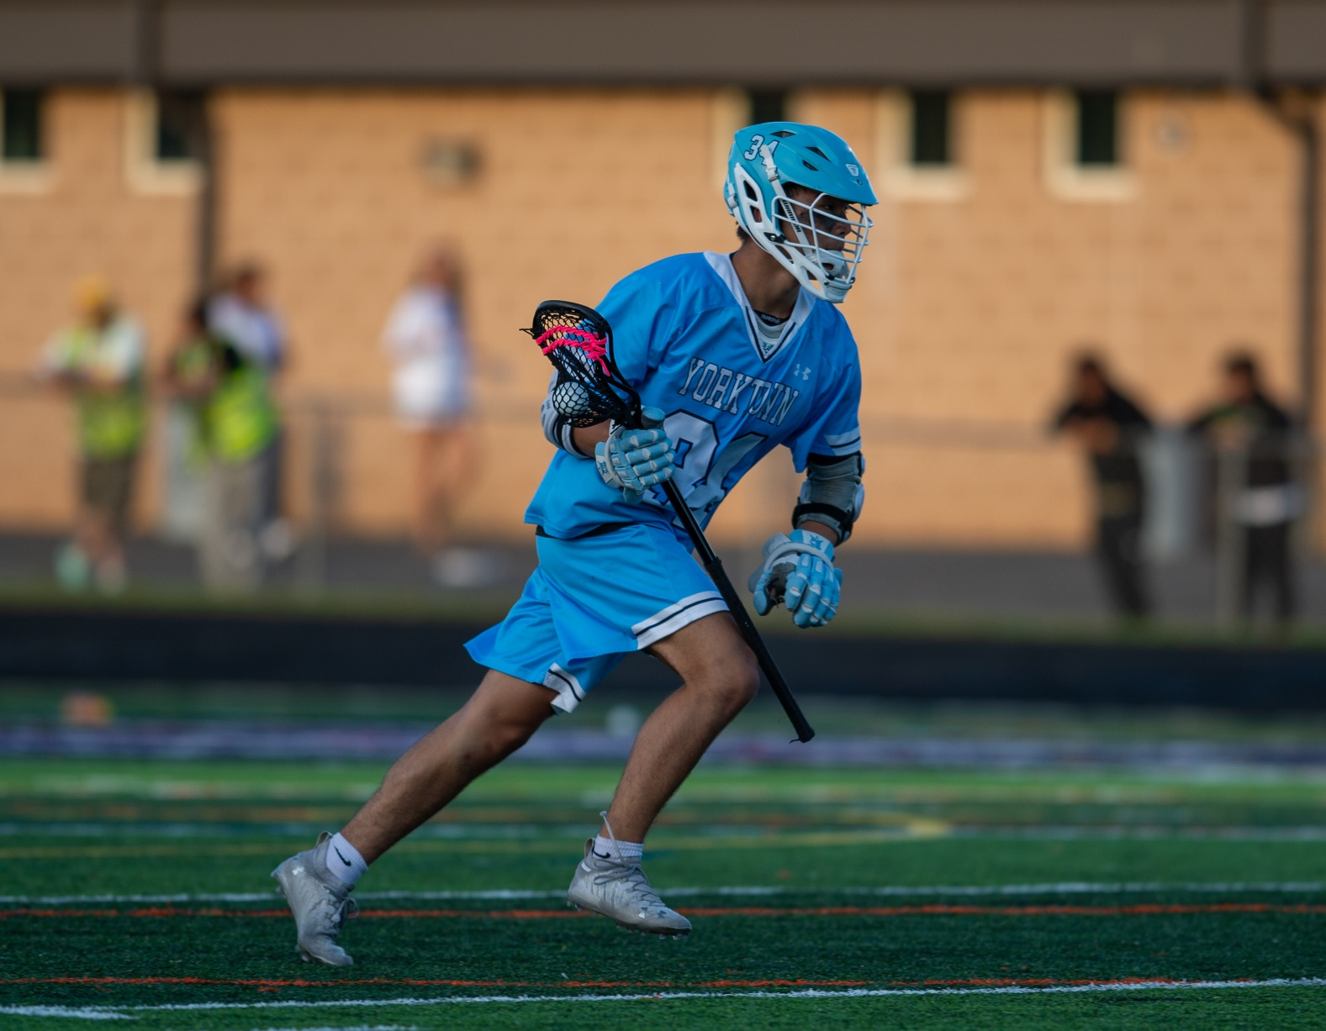
PLAYERS
STANDARD
1 Goalie
3 Defensemen
3 Midfielders
3 Attackmen
SPECIALISTS
Faceoff (FOGO)
LSM (Long Stick Midfielder)
DEFENSE
GOALIE
ATTACK
MIDFIELD
Notes:
PLAYERS
Begin game with 10 players one of whom MUST be legally equipped goalkeeper. Attack, Midfielders, Defensemen, Goalie.
10 starters listed in this order, top to bottom in book with name position and number; first player listed is the in-home.
Maximum of 4 long crosses on field (except goalie). Game continues if fewer than 10 (stalling and on sides rules remain in effect).
Class Question
Can a game begin with fewer than 10 players?
No, the game must start with 10 players otherwise the game does not start and the team without enough players forfeits.

Slide 18
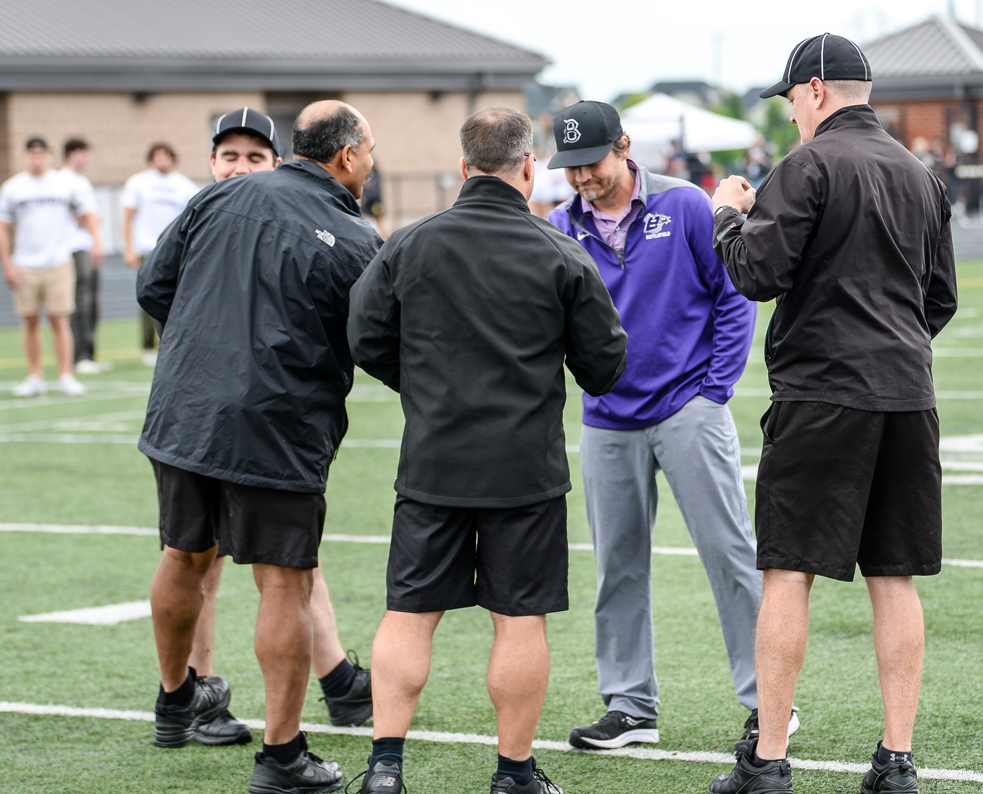
COACHES
Head Coach
  Certifies
  Responsible for everyone
  Acts in courteous manner
Other coaches
  Answer questions if asked respectfully
Notes:
COACHES
Head coach makes all decisions and is the only coach allowed to communicate with officials.
Home Coach: Field should be ready for play , properly lined, with goals, cones, balls. Timer and score keeper provided with proper equipment.
BREAKOUT GROUP ACTIVITY: Coaches Meeting Practice
Divide class into groups of 3
Role play the coaches meeting. Each individual should rotate into the referee, coach and captain role at least once to experience different perspectives.
Class Question
If the assistant coach gets a penalty, is that charged to the head coach?
No, whomever is penalized will be the individual that the penalty is assessed to.

Slide 19
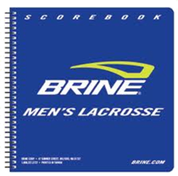
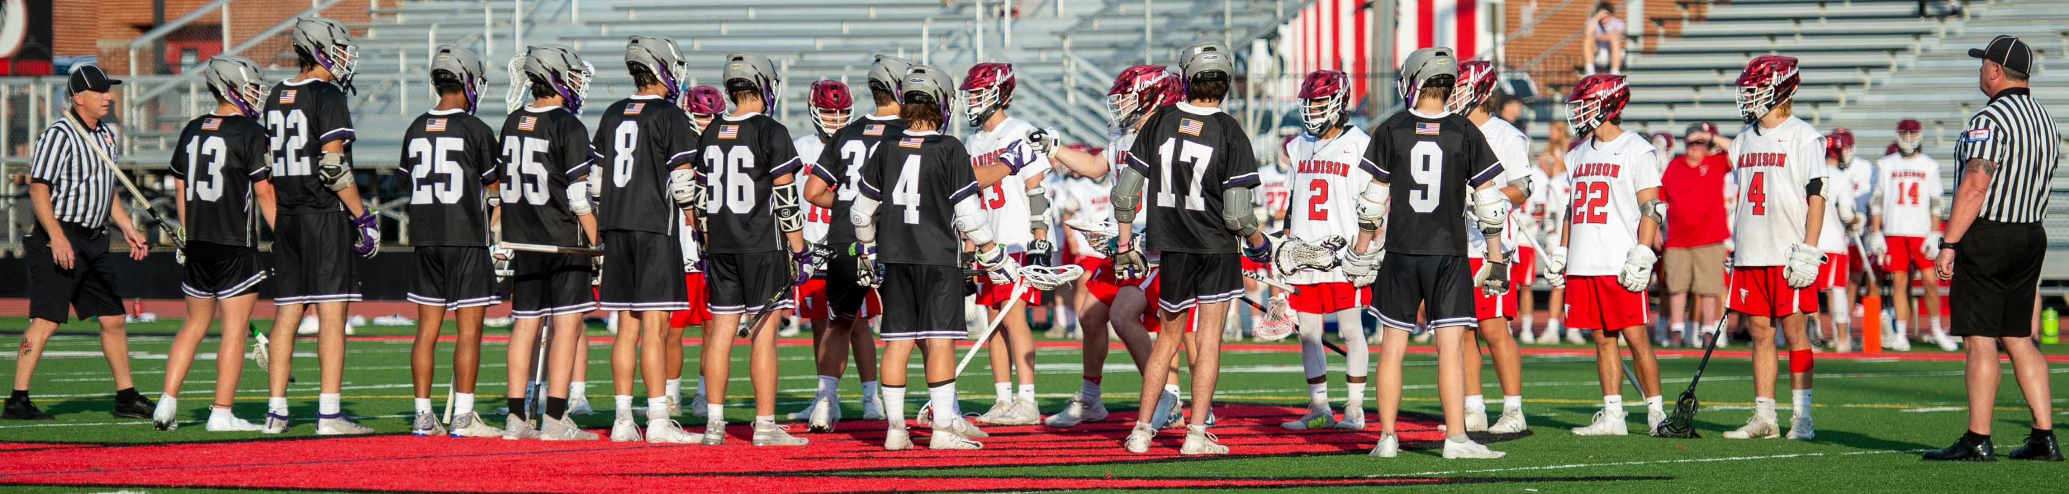
IN-HOME
Starting Attackman
In pre-game lineup
Class Discussion Questions
Notes:
IN-HOME
Serves any penalty on a non-player or when the official cannot determine the number of the player who committed the foul.
Class Question:
What happens if the in-home is not in the pre-game lineup at midfield prior to faceoff?
Send one of the players off the field and have him replaced by the in-home or have the coach choose an attack player in the lineup.
The in-home may be subbed out after the first whistle.

Slide 20
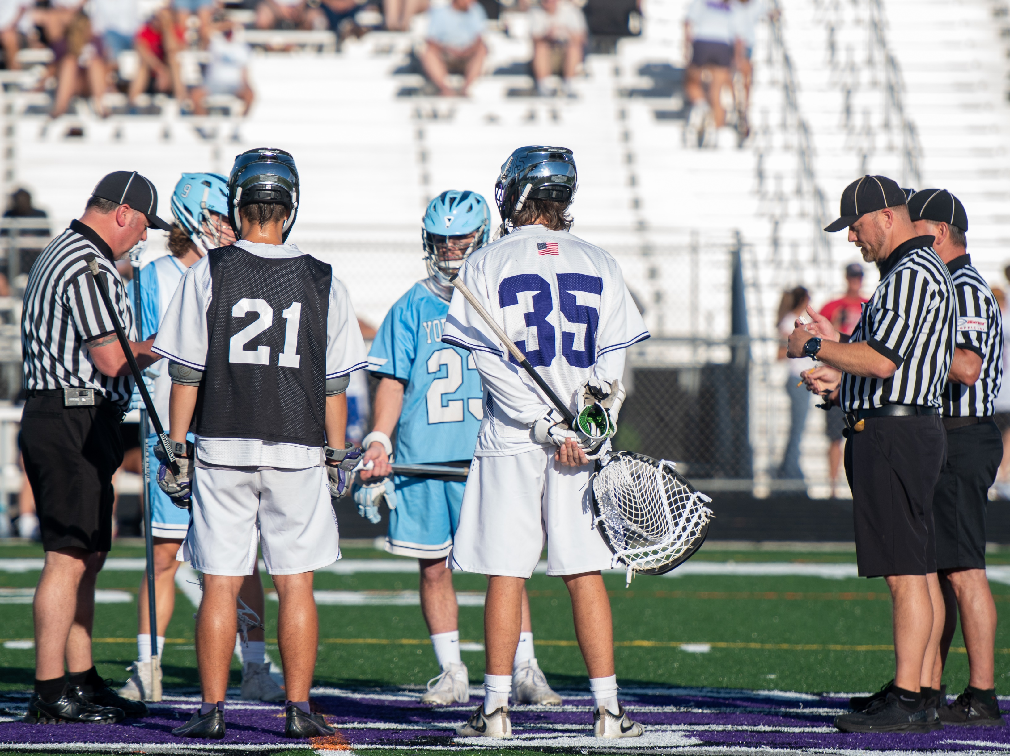
CAPTAINS
At least one per Team
If more than one, designated speaking captain
Closest to Referee
Visitor calls the coin toss before the toss
Class Discussion Questions
Notes:
TEAM CAPTAINS
Each team designates a captain who serves as team representative on field.
Only one is speaking if co-captains.
May be replaced during the game.
No right to argue with or criticize an official.
Official may designate an acting captain, if no captain available.
Class Question:
Is there a limit to how many captains a team may have?
No.
BREAKOUT GROUP ACTIVITY: Captains Meeting Practice
Divide class into groups of 5 (2 players per team and R)
Role play the captains meeting.
Each individual should rotate into the referee to practice
Include Coin Toss!

Slide 21
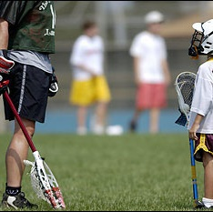

BALL RETRIEVERS
Must wear:
  Helmet
  Contrasting uniform
Not Permitted Behind Goal!
Class Discussion Questions
Notes:
BALL RETRIEVERS (Ball Boys)
Home team must train, protect and provide for safety of ball retrievers.
Class Question:
Is the home team or sponsoring authority required to provide ball retrievers?
No, only the placement of the minimum number of required balls along the end lines and sidelines is required, HOWEVER, the balls should be replenished at the beginning of each quarter
Who is responsible for balls at a NEUTRAL site game?
Sponsoring authority (usually the home team) must provide balls and all game required equipment.
Common during playoff games

Slide 22
GAME LENGTH
FOUR, 12-minute, stop-time Quarters for NFHS high school Varsity games
JV games can vary from location to location
Youth Games vary by league
2-minute breaks
10-minute half
12
Min
2
Min
12
Min
10
Min
12
Min
2
Min
12
Min
Class Discussion Questions
Last 2 min. – Stall rules for leading team if 4 or fewer goals
Notes:
GAME LENGTH
Change of Goals: Teams switch goals after periods, except the first overtime period which is determined by coin toss.
Final Two Minutes of Play: Stalling rules in effect for team ahead even if team ahead is man-down.
Class Question:
Who keeps track of how much time is left between the quarters and the halftime?
The officials should keep track of the 2-minute intermissions.
Usually, the 10-minute halftime is displayed on the scoreboard. If it is not, then the officials should track the time.

Slide 23
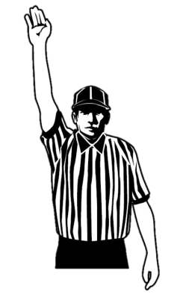
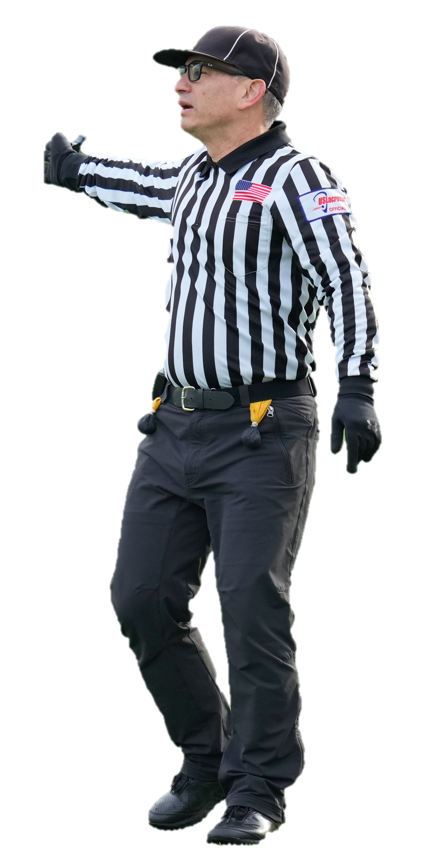
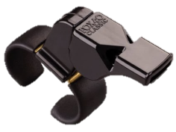
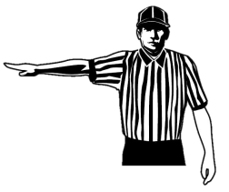
STOPPING THE CLOCK
Out of Bounds
  1 long whistle blast
  Hand in the air for dead ball
  Point direction of play
  Hand back in the air
In-bounds or Unusual Play
  Several short blasts
  “ta-tweet, ta-tweet, ta-tweet”
  “Cicada” Whistle
  Hand in the air for dead ball
  Explain the call
  Point direction
  Hand back in the air
Dead Ball
Point Direction
Class Discussion Questions
Dead Ball
Notes:
STOPPING THE CLOCK – WHEN?
Ball or player in possession goes OB.
To end a play on.
Foul by the offense.
Flag Down Slow Whistle (FDSW) ends.
Horn sounds to end period.
Goal is scored.
Injury in scrimmage area.
Goalie loses required equipment.
Exception: The dead ball signal is not given when stopping the clock on a goal. DO NOT raise a single arm prior to your goal signal.
Class Question:
Does play stop if the goalkeeper is OUT OF THE CREASE and loses his stick?
No, the goalkeeper is treated as a field player when he is OUTSIDE of the crease.

Slide 24
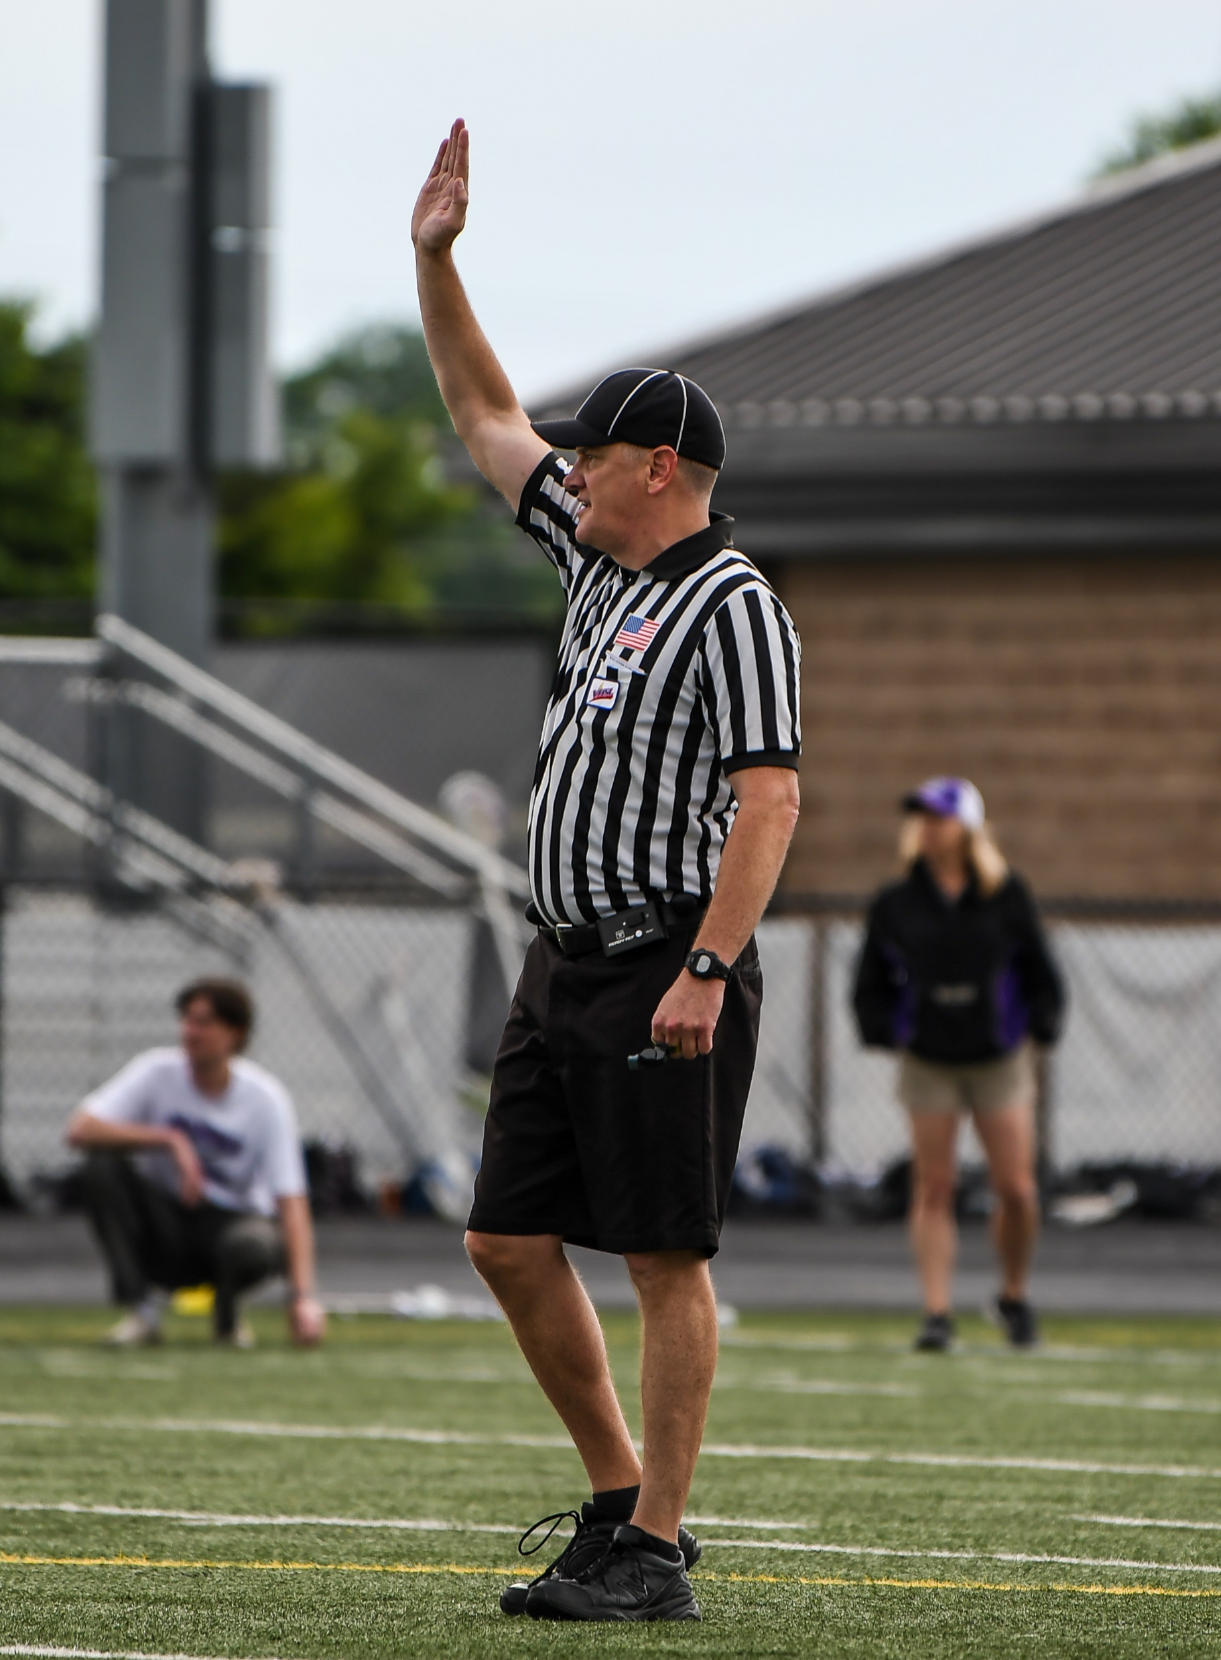
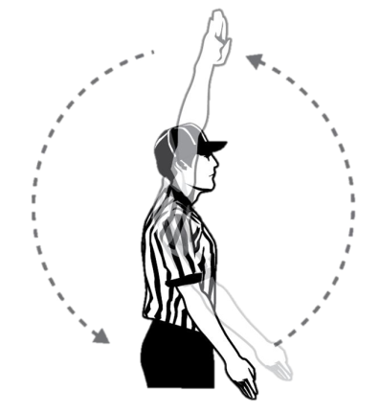
STARTING THE CLOCK
Hand in the air
Solid whistle blast for 2-count
1.5 winds backwards (no half winds)
Hand finishes at side
Class Discussion Questions
Notes:
STARTING THE CLOCK
Clock starts and stops with a whistle.
Long blast to start that is at least a 2-count
Class Question:
Is it okay to pump the arm or do the “front stroke” when winding the clock?
No. The correct mechanic is to wind the arm backwards 1.5 times with the hand starting at the top and finishing at the bottom, while whistling the play to begin.

Slide 25

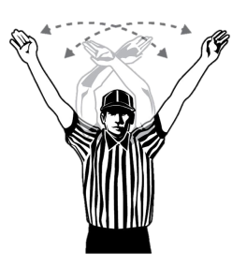


SIGNALING A TIMEOUT
Dead Ball: on-field player or head coach
Live Ball: on-field player or head coach with possession
  Several short blasts
  “ta-tweet, ta-tweet, ta-tweet”
  “Cicada” Whistle
Class Discussion Questions
Timeout Bluet!
1:40
Notes:
SIGNALING A TIMEOUT
Determine whether the time-out can be legally granted.
Blow the whistle
Wave both arms overhead
Point to the bench of the team calling the time-out, and announce the time-out (e.g., “Time-out, Blue!).
Class Question:
Do you have to look behind you to see if the head coach is the coach calling the timeout?
It is not recommended that any official turn away from live ball play to confirm who on the bench asked for a timeout.

Slide 26



TEAM TIMEOUTS
Class Discussion Questions
Two per half for each team
1:40 + 20 seconds
+
Notes:
TEAM TIMEOUTS
Two minutes including the 20 second warning.
If the team that called TO is ready early, opponents are given 20 second warning.
Coaches must remain in the coach's area.
Explain timeout and how to administer it properly
Class Questions:
What do you say to inform the teams that they must take the field?
“Timer’s on!”
If the team that called the timeout is ready to go before 1:40 has elapsed should the officials say, “Timer’s on” and make the opposing team get back on the field?
Yes, the team that called the timeout does not have to use the entire allotted time.
What is the call for failing to be ready on the field before the timer runs out?
This is a delay of game penalty. A flag if it is on the team not entitled to possession, a turnover if committed by the team entitled to possession. This should ONLY be used if there is an egregious violation

Slide 27





OFFICIALS TIMEOUTS
Class Discussion Questions
Time Out!
My Time!
Dog on the field
Notes:
OFFICIALS TIMEOUTS
Officials may suspend play at their discretion:
harsh weather conditions
during dead ball
loss of player equipment (especially goalie)
injured player (immediately if in scrimmage area)
excessive blood, open wound or blood on uniform.
Demonstration: Starting and Stopping Clock
Using the proper mechanics demonstrate the correct procedure for stopping and starting the clock, calling a team or officials time out during a live or dead ball.
Activity: Starting and Stopping Clock
Participants demonstrate how to stop/restart clock. If space allows, go outside for this activity to understand how loud the whistle needs to be blown for others on the field to hear.
Class Question:
Who gets the ball if the officials stop play while the ball is loose?
The officials will award the ball via AP. In these situations, if time permits, it is recommended that the officials wait until a team gains possession of the ball. That is not always acceptable as in the case of an injured player in the scrimmage area.

Slide 28


INJURIES
Stop play
Call trainer
Report unconscious players/major injuries*
DO NOT rush an injured player off the field
Notes:
INJURIES
If possible, delay whistle if no team in possession until gained.
If ball is loose, use Alternate Possession unless loose in crease; award to Defense.
Teams may go to sideline; substitutions may be made.
Officials should restart play as soon as the injured player has been removed from the field.
The injured player shall be replaced before the restart but can substitute back into the game after the next dead ball following the resumption of play.
Class Question:
Should the official attend to the injured player?
Absolutely not! The officials should make sure the appropriate medical personnel attend to the injured player.

Slide 29

MERCY RULE
2nd half only
12-goal difference
Running Clock
Continues through end of game
Starts on next whistle
Clock does NOT stop if differential becomes less than 12 goals
Penalty time is NOT
time-and-a-half!
1 minute = 1 minute
2 minutes = 2 minutes
3 minutes = 3 minutes
Notes:
MERCY RULE
Score difference of 12 goals in second half.
Remains running clock even if goal differential becomes less than 12
Running clock stops for TO and injury only.
Penalties begin with whistle resuming play and are running time.
Call out release time upon restart if using visible clock

Slide 30



OVERTIME
Class Discussion Questions
4-minute periods
Call one captain from each team.
Visitor calls coin toss for choice of goal only
1st goal wins (sudden-victory, golden goal)
One Timeout per overtime period per team
Flip coin for goal
Alternate Possession stays the same
1 Timeout Each
Notes:
OVERTIME
2-minute intermissions.
4-minute period until a goal.
Change goals after each 4-minute overtime period.
Repeat until winner.
Class Question:
Can the losing team coach call for an equipment check after the winning goal in an overtime period?
No, the game is over and no equipment check is permitted.

Slide 31


INTERUPTION OF PLAY
Notes:
INTERUPTION OF PLAY
Appendix E of Rulebook for Lightning or Thunder
30m after last flash
Unless conference, association or state rules supersede.
Periods can be reduced due to unusual circumstances if both coaches and Referee agree.
Discuss “what-ifs” during the first suspension with Athletic Trainer, Game Manager and Coaches
Class Question:
What if the coaches do not agree to reducing the game time due to unusual circumstances?
The game time remains the same, but the officials may suspend play again at their discretion if they judge the game must stop due to safety concerns.

Slide 32
THANK YOU TO THE MEMBERS OF THE
MENS OFFICIAL’S EDUCATION DEVELOPMENT TEAM
TAKE CARE OF YOUR CREW
Notes:
Please let us know if you have any questions or comments on this presentation.
Thank you for taking your time to develop the next crop of officials!
officials@usalacrosse.com

