Slide 1
OFFICIALS
EDUCATION
THE RAMP
Actions Have Consequences
MENS OFFICIALS DEVELOPMENT
Notes:
RETURNING OFFICIALS
The purpose of this curriculum is to give the trainer “talking points” for virtual and/or in-person meetings
Returning officials generally benefit more from discussion rather than rule-by-rule lessons
Use the material as you see fit and use your “style” to make it work for your officials

Slide 2
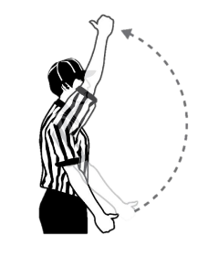




THE RAMP – NFHS
Ejection
USC
1-minute
NR
Conduct foul with opponent possession
30-seconds
Conduct foul with possession
Verbal Warning
Notes:
Answer polite questions from coaches
Use the conduct foul “ladder” to manage the benches
Opportunities
Coach leaves coach's area to confront you
Head coach is impolite / unprofessional
Assistant coach tries to influence you
Maligning comment from bench area

Slide 3
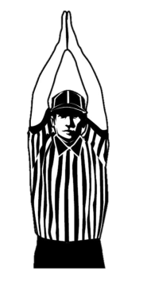

MAGIC WORDS
Attacks against integrity
F-Bombs
Ejection
USC
1-minute
NR

Slide 4
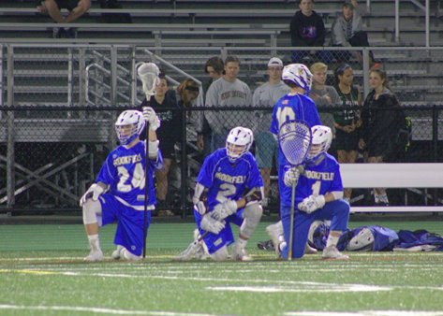
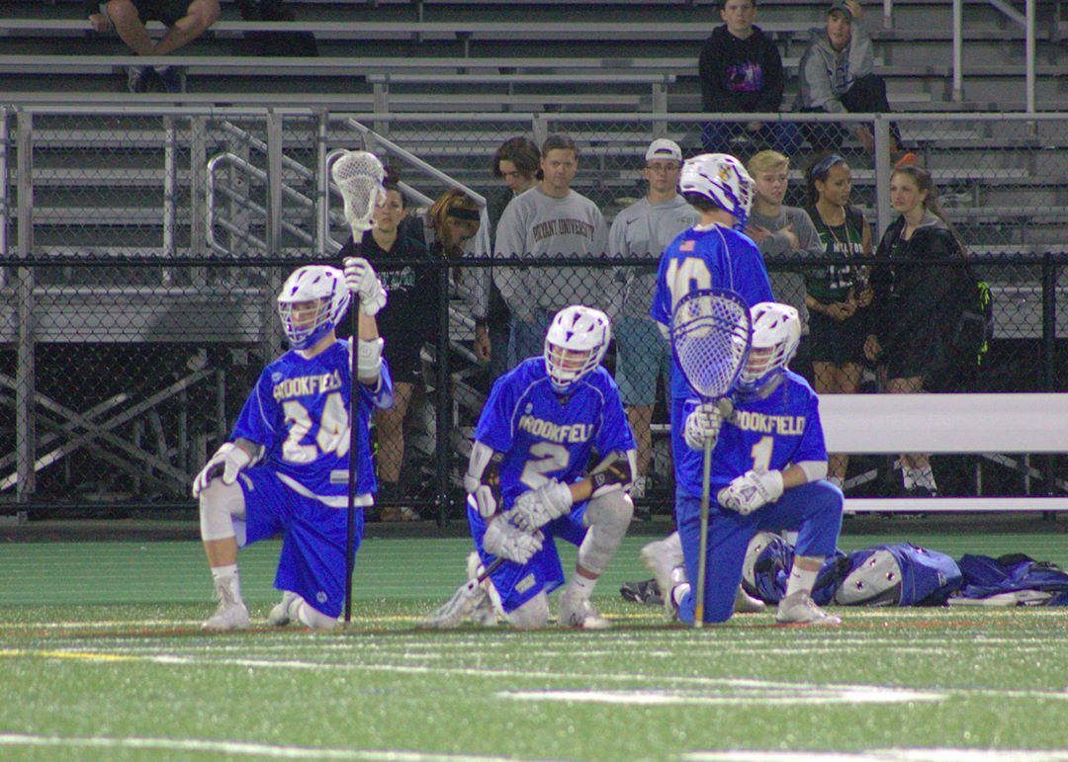
PLAYER EJECTION PROCEDURE
May leave if supervised by a parent/guardian
Confined to the end of the bench without equipment if no supervision is available
Mandatory 3-minute nonreleasable unsportsmanlike conduct (USC)

Slide 5
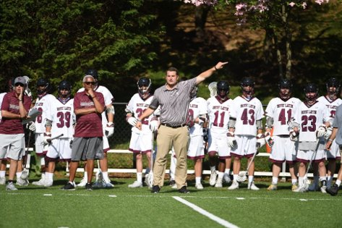
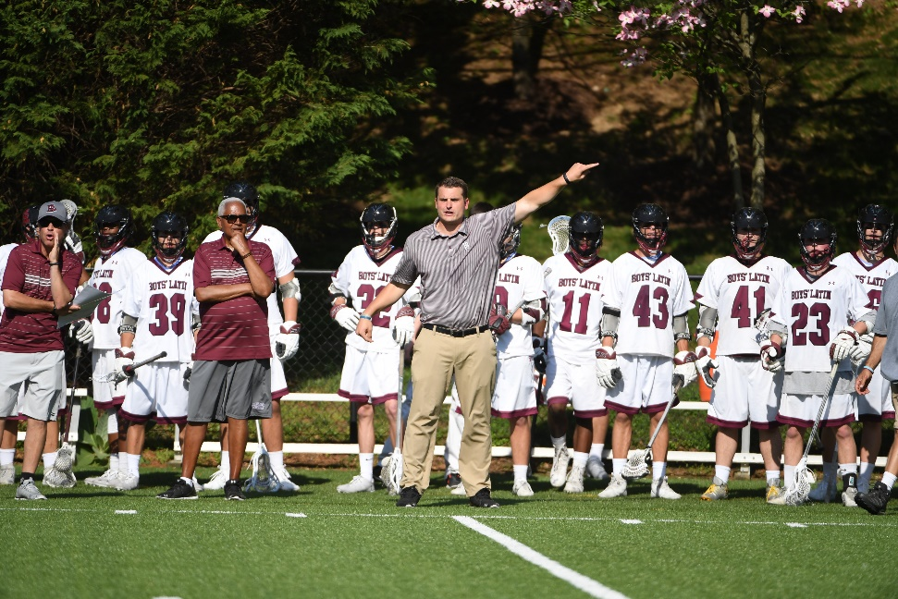
COACH EJECTION PROCEDURES
Coach must leave the premises
In-home serves 1-minute nonreleasable USC based on official’s judgment

Slide 6
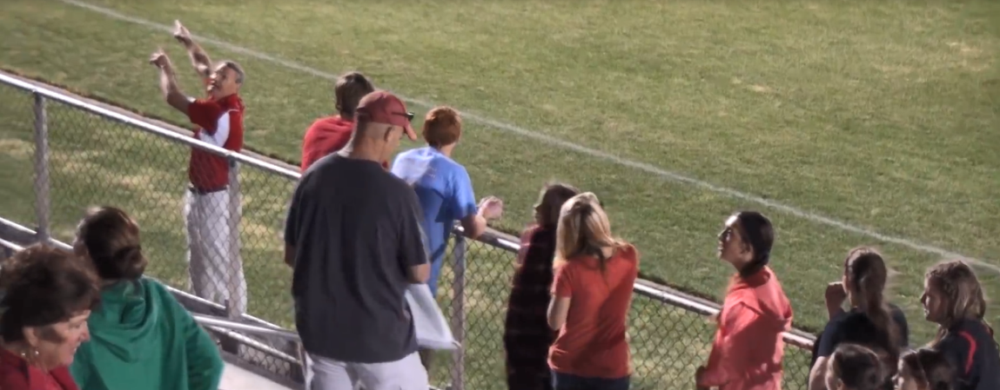
CROWD EJECTIONS
The referee informed me that the game will not continue until everyone has left.
Notes:
CROWD EJECTIONS
Officials have no authority to penalize either team
Officials may stop the game and refuse to continue until the problem is solved
Identify the Game Manager on duty prior to the start of the game

Slide 7
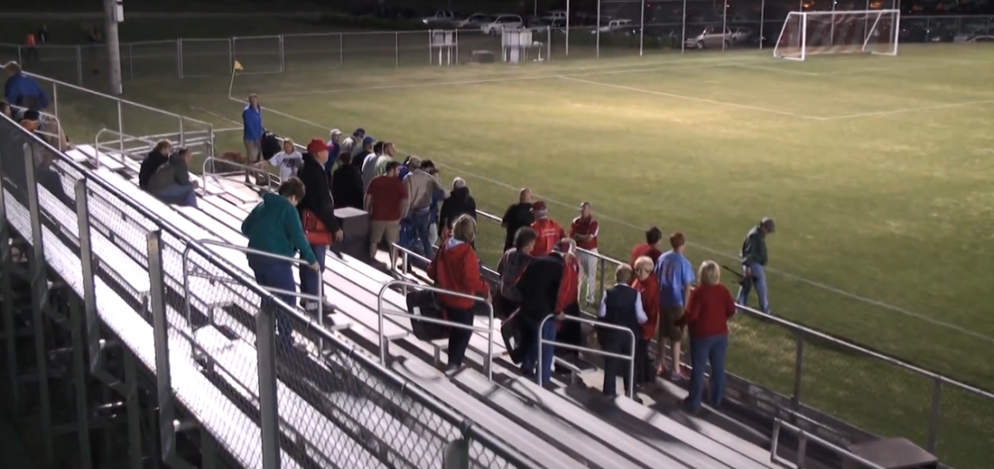

Crowd Removal
Notes:
This is the nuclear option, and we want to avoid this if possible.
Use the head coach of the teams and the site administrator to address fans if they become a problem.
Eject the individuals most responsible for the abusive comments or actions
When all else fails, have the site administrator send everyone out of the venue.

Slide 8


TAKE CARE OF YOUR CREW

Slide 9
DIVIDER PAGE TITLE

