Slide 1
OFFICIALS
EDUCATION
ZEN OFFICIATING
MENS OFFICIALS DEVELOPMENT
Notes:
RETURNING OFFICIALS
The purpose of this curriculum is to give the trainer “talking points” for virtual and/or in-person meetings
Returning officials generally benefit more from discussion rather than rule-by-rule lessons
Use the material as you see fit and use your “style” to make it work for your officials

Slide 2
WHAT YOU WILL LEARN
What the structures of the brain are.
Why the stress response works.
How to remain calm
2

Slide 3
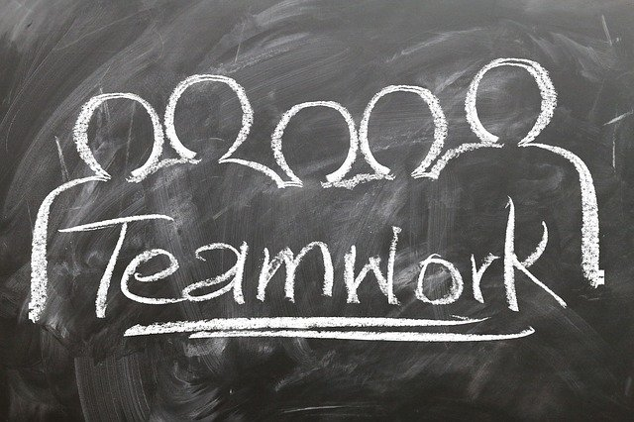
WHAT MAKES UP THE BRAIN

Slide 4
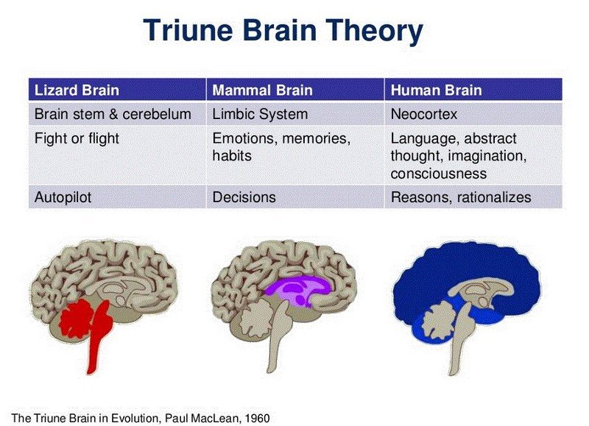
WHAT MAKES UP THE BRAIN
The Triune Brain

Slide 5
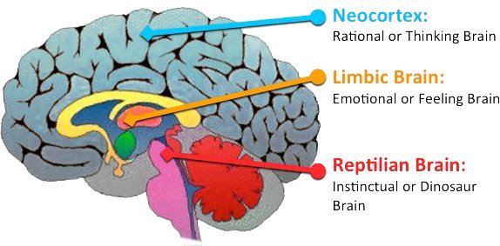
WHAT MAKES UP THE BRAIN
A Combination of Smart and Stupid
Neocortex and Pre-Frontal Corex -Very smart -Very expensive to run
Lizard Brain -Very stupid -Keeps you alive

Slide 6
WHY THE STRESS RESPONSE WORKS

Slide 7
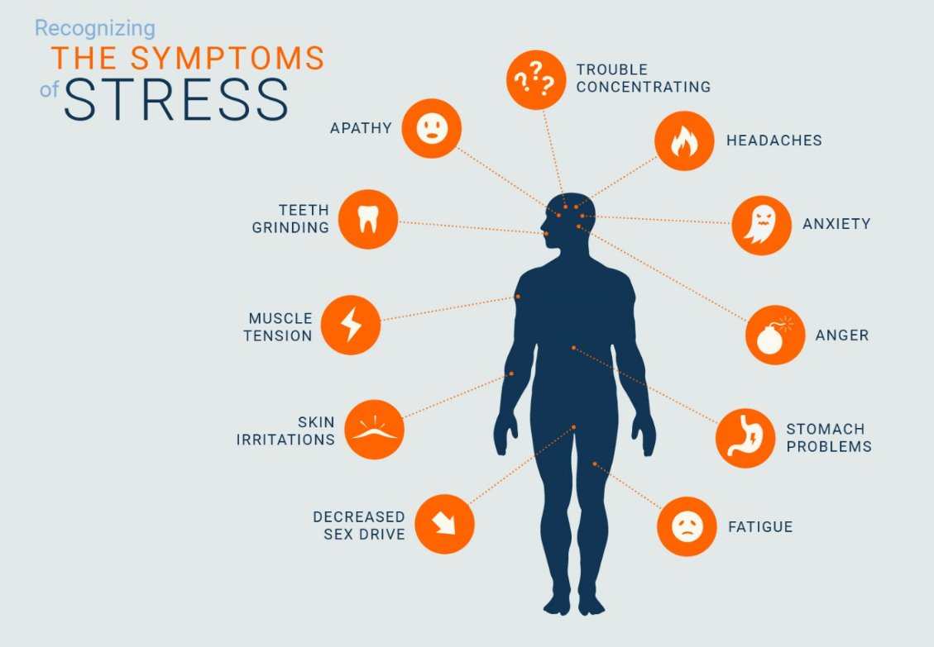
STRESS RESPONSE
Know the Signs
The stress response evolved in primates over millenniums
It’s sole purpose, is to keep you alive.
Notes:
The stress response evolved in primates over millenniums.
It’s sole purpose, is to keep you alive.

Slide 8
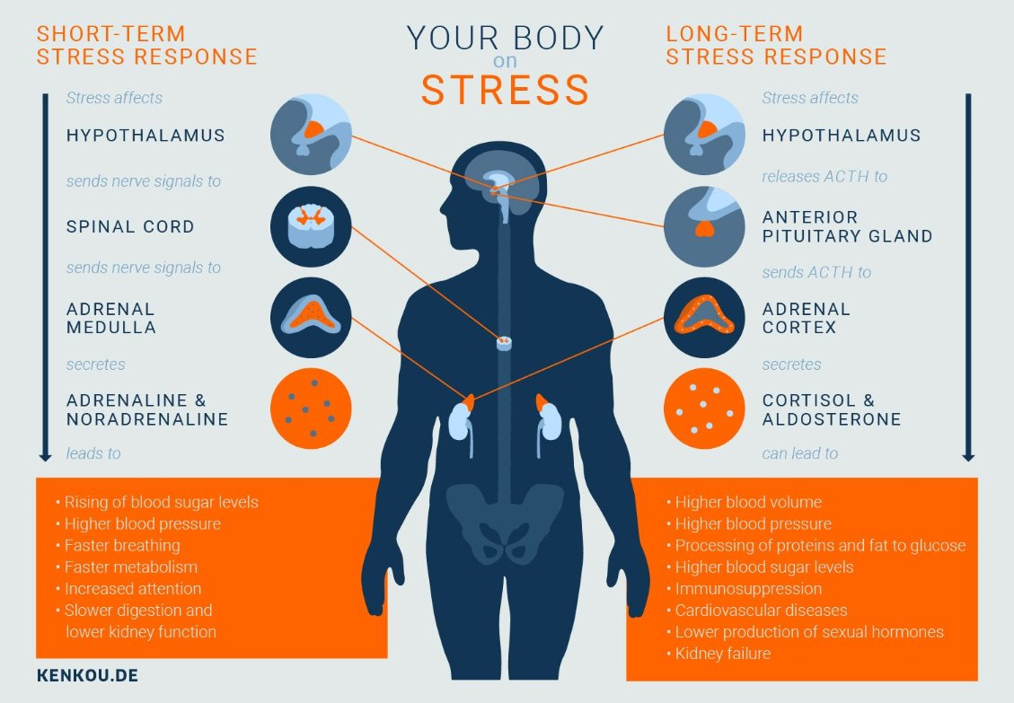
STRESS RESPONSE
What are the Long-Term Costs?

Slide 9
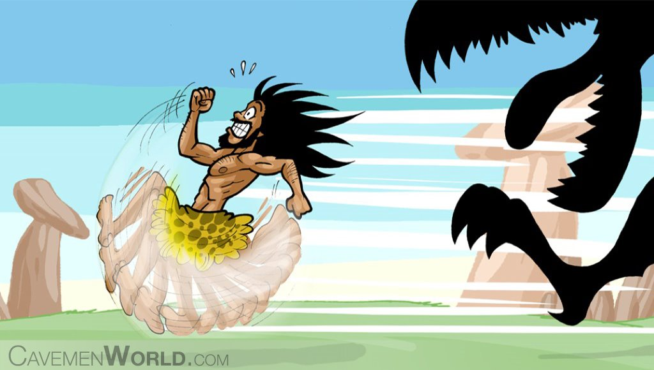
STRESS RESPONSE
Why Do We Have This Response?
Natural Selection
Our ancestors lived
Selected responses that: -Engaged muscles -Focused attention -Sped up heart rate

Slide 10
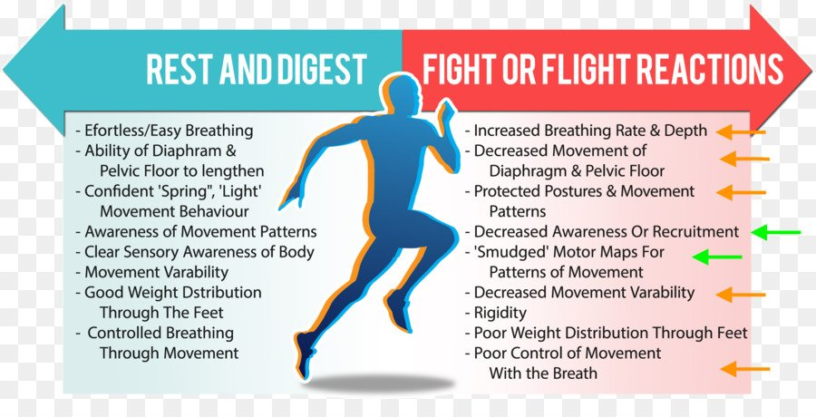
STRESS RESPONSE
Two Sides – Parasympathetic / Sympathetic, or. . .

Slide 11
CALMING TECHNIQUES

Slide 12
CALMING TECHNIQUES
One or Two Wil Do You Good
Relaxation -Breathwork
Power Posing -Superhero posture
Visualization -Reduce stress and gain confidence
Set a Threshold -Model for discovering your line
Ghosting -How to stick to your line

Slide 13

RELAXATION
Inhale into the Low Belly
Sync your breathing with this

Slide 14
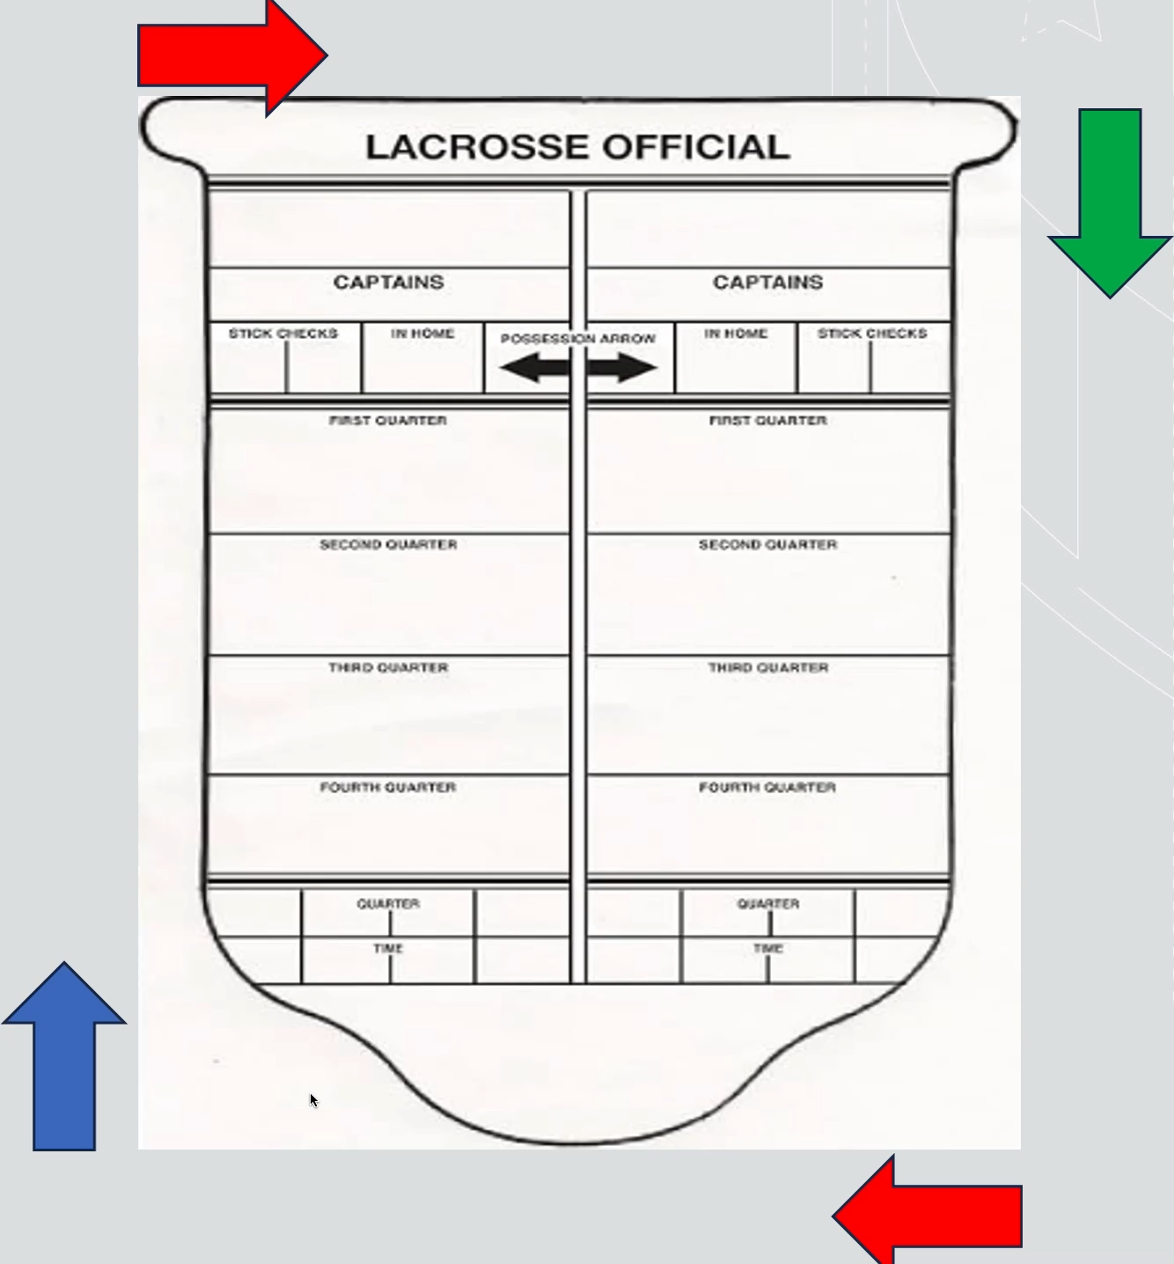
RELAXATION
Inhale into the Low Belly
Green= Breath in
Red= Hold your breath
Blue = Exhale

Slide 15
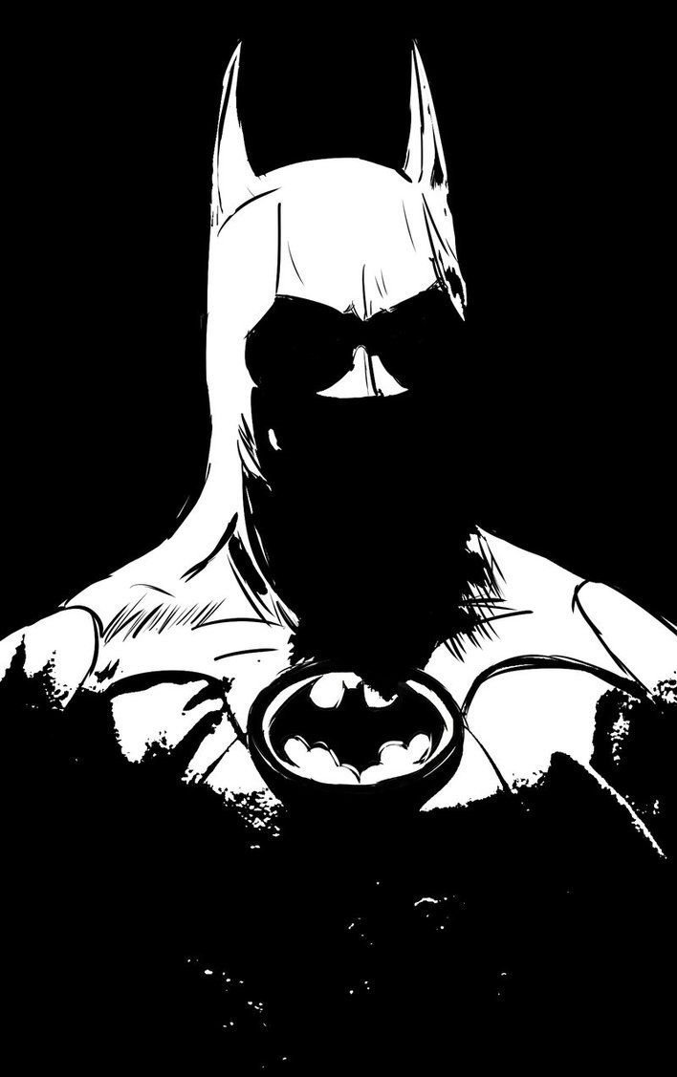
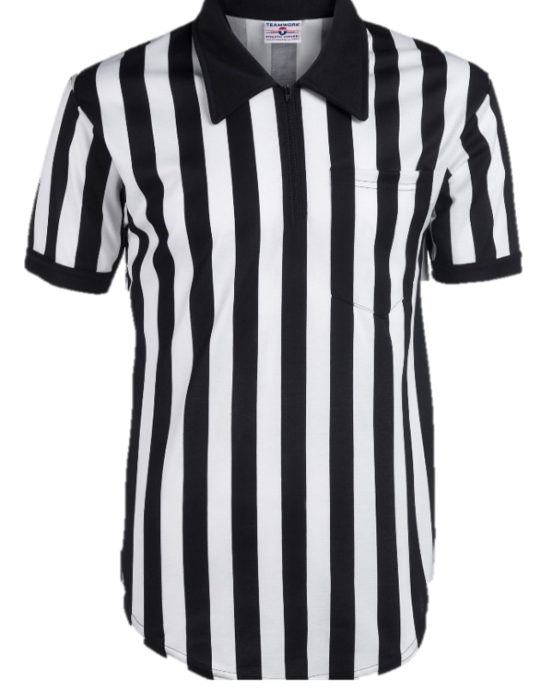
POWER POSING
Your Stripes Are Powerful!

Slide 16
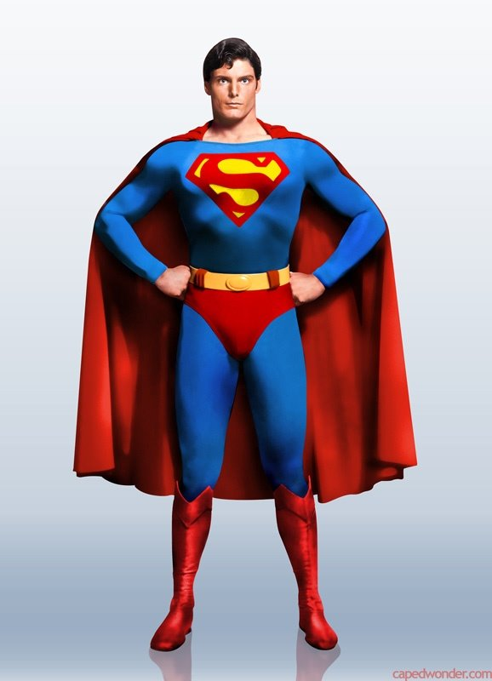
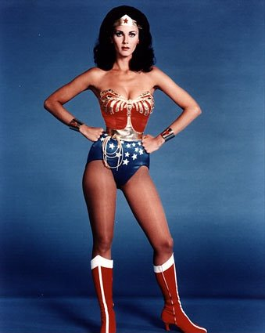
POWER POSING
Notes:
https://www.ted.com/talks/amy_cuddy_your_body_language_shapes_who_you_are

Slide 17
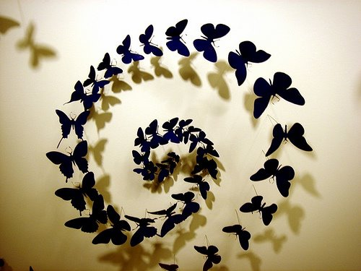
VISUALIZATION
Nervous? Think of your Butterflies Flying in a Pattern
Notes:
https://www.ted.com/talks/kelly_mcgonigal_how_to_make_stress_your_friend?language=en

Slide 18
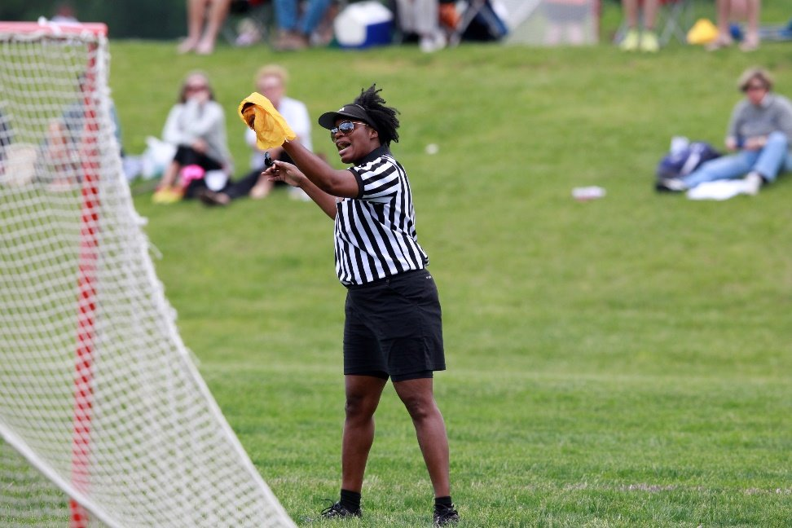
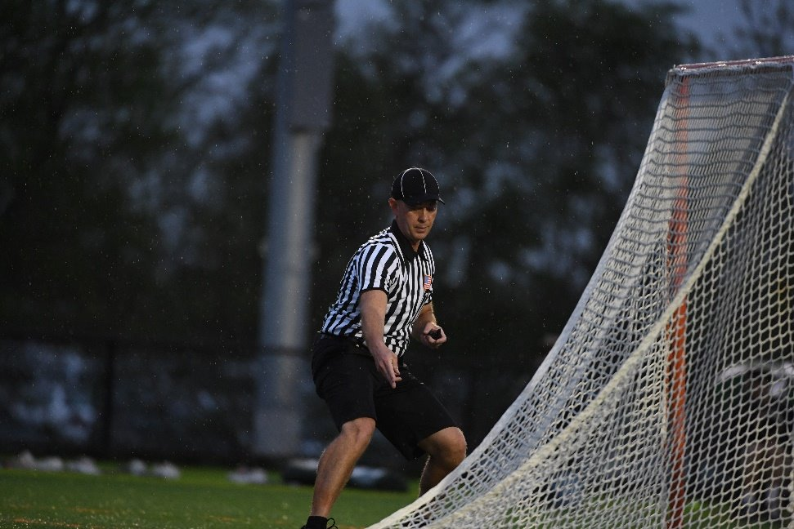
VISUALIZATION
Visualize Getting the Call Right!
Notes:
https://www.ted.com/talks/daniel_levitin_how_to_stay_calm_when_you_know_you_ll_be_stressed?language=en​
​
Before you find yourself making a call​
Imagine yourself in a tie game,​
Cross-town rivalry,​
Packed stadium,​
Under the lights!​
You get the call right!​
​
​

Slide 19
SET A THRESHOLD
Write it Down!
Permissible
Awful call
Terrible, just terrible
Oh, c’mon
Has Consequences
You’re awful!
How much did they pay you before the game?
Your partner is clueless

Slide 20
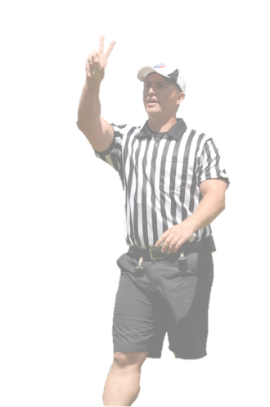
GHOSTING
Review the statements you wrote down earlier
Circle worst one. -The one that you WILL NOT allow to be said without consequence
Allow the other comments to pass through you
You are terrible!
Aweful, just aweful!
Horrible call!
Notes:
Imagine the words passing through you.​
​
Only the ones that merit a response and the ones you respond to.​

Slide 21
TIPS
What to say and what NOT to say

Slide 22
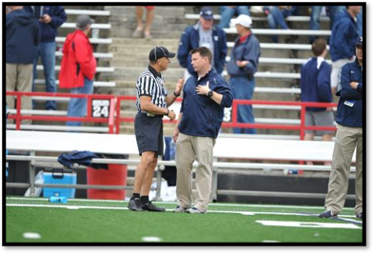
TIPS
Phrases for Your Back Pocket
I hear you coach
From my angle, I did not see that
I’ll find out and get back to you
Remind me at the next timeout
Coach, I need your help
Notes:
Yelling at my partner is not going to make him better today – yell at me not at him

Slide 23
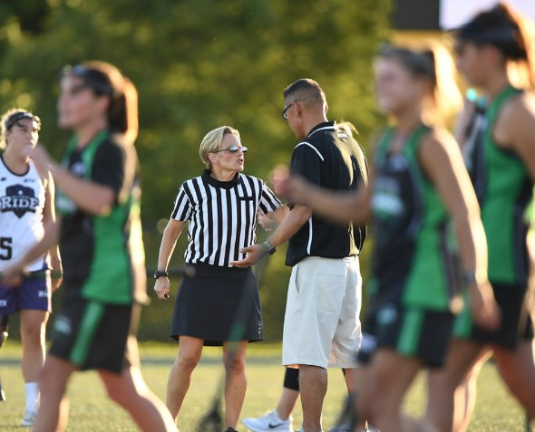
TIPS
Phrases to Avoid
Coach, it’s only club ball
Do you want to ref?
Next time I’m flagging you
Shut up!
Calm down
Notes:
There are ample studies that show pointing fingers raises antagonistic and angry feelings at the person you are pointing at.
If you want greater success persuading someone of your point, use an open palm instead

Slide 24
THANK YOU TO THE MEMBERS OF THE
MENS OFFICIAL’S EDUCATION DEVELOPMENT TEAM
Notes:
THANK YOU TO THE MEMBERS OF THE MENS OFFICIAL’S EDUCATION DEVELOPMENT TEAM

