Slide 1
Advanced Training:
Complex Penalty Administration And Restraining Line

Slide 2
Advanced Penalty Administration
  Multiple fouls in the same ‘time frame’
  Offsetting/Subsequent fouls
  Additional fouls on a Held Whistle
  Major fouls involving the Goalie
  Multiple carded fouls

Slide 3
Multiple Fouls
Q. Offside on Red (attack); Dangerous Check, #9 Blue
A. Alternate Possession
Q. Offside on Blue (defense); Charge, #8 Red
A. Is Red on a scoring play?
If YES, pull flag until Charge foul was committed, then signal Alternate Possession.
If NO, Alternate Possession.

Slide 4
Multiple Fouls
Q. Blue has 13 players on the field and scores a goal
A. No goal, remove illegal player, Red possession at center.
Q. Red has 12 players on the field and is offside
A. Did the player come in early from a card?
If YES, return player to the penalty area. Player finishes serving penalty and serves an extra penalty (2 min. Yellow; 4 min. Red). Correct offside. FP to Blue at the spot of the ball. Closest player goes 4m behind.
If NO, administer the free position for the offside foul.

Slide 5
Offsetting vs Subsequent Fouls
Q. Blue #2 Illegal Draw, Early Entry Blue #4
A. Subsequent foul. Free position to any Red player at spot of ball
Q. Illegal Substitution Red, Illegal Draw Blue
A. Offsetting Fouls. Alternate Possession at center
Q. Early Entry Red, Illegal Draw Blue
A. Offsetting Fouls. Alternate Possession at center

Slide 6
Early Entry on the Draw
O
O
X
X
X
O
X
O
O
X
OGK
O
X
XGK
O
O
O
X
X
X
X
X
O
O
Once the official’s hands are on the sticks, all “gates” are closed!
Notes:
New for 2023!
Players may not step on or over the restraining lines after the official’s hand is in contact with the sticks at the draw until the restraining line is released regardless of number of players between the restraining lines.
These “gates” are closed over the restraining lines and the substitution area

Slide 7
Early Entry on the Draw
O
O
X
X
X
O
X
O
O
X
OGK
O
X
XGK
O
X
O
O
X
X
X
X
O
O
Free position awarded at the spot of the BALL. Self-start
Notes:
Free position for Early Entry is at the spot of the ball at the time of the foul. Offending player moves 4m away from the free position. Self start allowed.

Slide 8
Offsetting vs Subsequent Fouls
Blue #2 Shooting Space
Red #6 Charge in the 8m arc
R6
B3
B2
Answer: Alternate Possession at the nearest dot
Notes:
Offsetting fouls – AP at the dot

Slide 9
Offsetting vs Subsequent Fouls
Red #3
Illegal Pick
Red #5
Dangerous Shot
R3
R5
B3
R4
B1
R7
B2
Answer: Penalize Dangerous Shot
Notes:
Red #3 set an illegal pick for Red #5. As Red#5 moves past the pick, they shoot on goal.
Subsequent fouls. Penalize the most recent foul (Dangerous Shot). Free position to the goalie. Self start permitted.

Slide 10
Major Fouls and the Goalie
Q. Blue Goalie commits Slash while in the Goal Circle
Is there a Second Dressed Goalie?
If YES…

Slide 11
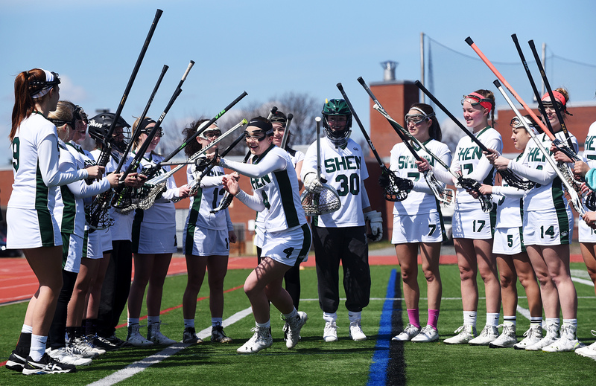
Handling Goalkeeper Penalties
When there IS a second dressed goalie…
The 2nd dressed goalie must enter the game
Carded goalie serves two minutes (yellow) or four minutes (red) in penalty area
Coach selects a field player who a serves with the goalie in the penalty area.
Team plays short ONE player during the penalty.
Substitute Goalie goes behind free position. Open net.
Notes:
Note that the player serving with the goalie does not receive a card for this foul -- only the goalie gets a card.

Slide 12
Major Fouls and the Goalie
Q. Blue Goalie commits Slash while in the Goal Circle
Is there a Second Dressed Goalie?
If NO…

Slide 13
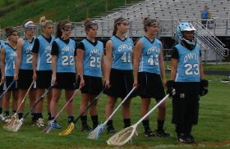
Handling Goalkeeper Penalties
When there is only ONE dressed goalkeeper…
Goalie may stay in the game for the first yellow card infringement.
Coach selects a field player who serves the goalie’s penalty in the penalty area
Team plays short for two minutes (yellow) or four minutes (red)
A field player may become the substitute goalie
Goalie goes behind free position. Open net.
Notes:
In both cases, when the coach takes a player off the field, make sure there is not resulting in an offside. If it is created, then you must place another player behind the RL before you start play.
If the goalie receives a red card: If there is no field player willing to put on the goalie gear and play goalkeeper, the team may play without a goalkeeper. However, NO PLAYER MAY ENTER THE GOAL CIRCLE UNTIL THE BALL HAS COME TO REST WITHIN THE GOAL CIRCLE.

Slide 14
Major Fouls and the Goalie
Q. Blue Goalie commits Crosscheck while in the goal circle
A. Free position at 8m hash closest to the spot of the foul. Goalie goes 4m behind.
Q. Blue Goalie throws ball 70 yards and scores on Red!
A. No goal. Illegal Procedure. Free position to Red Goalie in goal circle.

Slide 15
Major Fouls and the Goalie
Q. Blue Goalie Lines up between the restraining lines for the Draw.
A. Illegal. Major foul. Free position to Red at center.
Q. Blue Goalie crosses restraining line after the draw but before possession.
A. Early Entry foul. Free position to Red at spot of the ball.

Slide 16
Major Fouls and the Goalie
Q. Blue Goalie has possession and Blue Coach calls timeout. After timeout, as Blue Goalie self-starts in goal circle, Red #10 commits crosscheck on Blue Goalie.
A. Alternate Possession at closest dot.

Slide 17
Held Whistle
In effect when an attack player in the Critical Scoring Area is on a scoring play, and is fouled by a defense player committing a Major foul but retains possession of the ball
OR
When an attack player in the Critical Scoring Area is on a scoring play and a Major foul is committed against attack’s teammate (without the ball).
In both instances, the official will raise a YELLOW FLAG to indicate the held whistle.
Notes:
Rule 11

Slide 18
Held Whistle Criteria
Ball Is In the Critical Scoring Area
Attack Is On a Scoring Play
Major Foul by Defense
If Criteria Met:
Pull Yellow Flag
Hold until Scoring Play ends
Notes:
Click to start animation
Discuss all the major parts of the definition.
Relate the ‘held whistle’ to the advantage arm on a midfield ‘held’. Is it the same
Discussion on the “scoring Play” . What is it?
And emphasize, that the Major foul need not be on the attacker with the ball but any major foul on any attacking player on this scoring play.
Could the flag be raised by the Trail official? In what scenarios could the Trail raise the flag (to demonstrate a held whistle on a foul the trail sees off-ball?)

Slide 19
Held Whistle
Q. Red #12 going to goal. Blue #3, Check to Head, FLAG. Blue #2, off-ball Hold; Blue #7, Crosscheck on Red #12. Ball down.
Issue Yellow card to Blue #3 for Check to the Head. Free position at closest 8m hash to spot of the ball.

Slide 20
Held Whistle
Q. Blue #12 Push, FLAG. Blue #2 Slash, Red #10 scores?
A. Goal counts. Yellow card to Red #10 for Slash. Free Position to Blue at center.
Reminder: You can flag a cardable foul!
Q. Red #16 going to goal. Blue #3, Check to Head, FLAG. Blue Goalie, Check to Head of #Red 16. Ball down.
A. Issue Yellow card to Blue #3 and Blue Goalie. Free position at closest 8m hash. New goalie goes behind. Open net.

Slide 21
Multiple Cardable Fouls
Q. Blue #9, Check to the Head of Red #10. Red #10, Verbal dissent directed at official?
A. Issue Yellow card to Blue #9, Yellow or Red card to Red #10. Alternate Possession.
Q. Red #16, Dangerous Contact on Blue #2. Blue #2, Slash.
A. Issue Yellow card to Red #16 and Blue #2. Alternate Possession.

Slide 22
Restraining Line

Slide 23
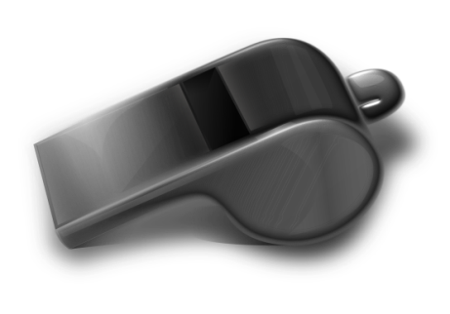
Restraining Line – Attack Offside
1. Whistle immediately
2. Call time-out
3. Correct the offside
4. Administer the penalty
Next step: Where is the ball?
Notes:
Click to start animation
Officials must call a time out for an offside foul.
ALWAYS correct the offside first
Then move to B.O.O:
Ball
Offender
Others
This penalty administration works whether the foul is by the attack, the defense, or even offsetting.

Slide 24
Restraining Line – Attack Offside
Ball inside the CSA and above the GLE
  Free Position for closest defender, 8m from goal circle
  Closest opponent 4m behind
  Whistle start
Ball inside the CSA and below the GLE
  Free Position for defense at closest dot
  Closest opponent 4m behind
  Whistle start
Ball outside the CSA, above or below the GLE
  Free Position for defender at spot of the ball
  Closest opponent 4m behind
  Whistle start
Notes:
Offside Penalty Administration (4 Clicks)
(Click)
Officials must call a time out for an offside foul.
(Click)
ALWAYS correct the offside first
(Click)
then move to B.O.O:
(Click)
Ball
Offender
Others
This penalty administration works whether the foul is by the attack, the defense, or even offsetting.
What if’s…
- What if attack ball carrier causes offside? (Closest defender awarded ball. Correct offside. Penalty administration at spot of foul.)
- What if possession changed and goalie has the ball when attack called offside? (Inadvertent whistle)

Slide 25
Restraining Line – Defense Offside
1. Hold or Whistle?
  The official must evaluate if the attack is on a scoring play/maintaining advantage
2. Call time-out
3. Correct the offside
4. Administer the penalty
Notes:
Click to start animation
Official may allow a defender to go back on sides without penalty IF that defensive player has not impacted play/disadvantaged the attack and IF the defensive player is not offside for a prolonged period of time.
A goal scored while the defense is offside shall count and play is resumed with a draw.

Slide 26
Restraining Line – Defense Offside
Ball inside the CSA and above the GLE
Free Position for closest attack player at the top of the 12m arc
Closest opponent 4m behind
Penalty lane cleared
Whistle start
Ball inside the CSA and below the GLE
Free Position for attack at closest dot
Closest opponent 4m behind
Whistle start
Ball outside the CSA, above or below the GLE
FP for attack at spot of the ball
Closest opponent 4m behind
Whistle start
Notes:
When would an official would allow a defender to move back on sides without penalty? (Attack maintains ball and defender corrected it quickly and had no impact on play) How would the official communicate this decision if players/coach voice dissent?(Offside did not impact play. No advantage to attack to make the call.)
If defense is offside and play ends with another foul by the defense:
If foul is Inside the 8m, penalize the other foul, not the offside.
If foul is outside the 8m but inside the 12m: penalize the other foul, not he offside.

Slide 27
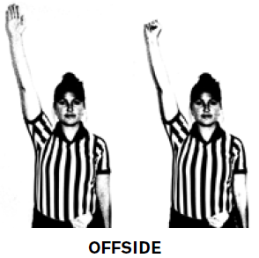
Review: Offside Penalty Administration
Notes:
Review mechanics of penalty administration for RL violation:
Outside the CSA
Inside the CSA, above the GLE
Inside the CSA, below the GLE

