Slide 1


Minor Fouls

Slide 2
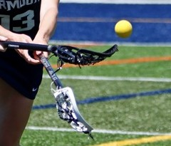

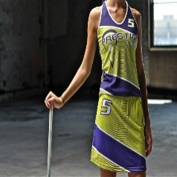
Minor Fouls
Fouls that do not involve body contact or stick to body contact.
May be grouped as fouls that involve:
Misplays
Procedural Errors
Illegal Uniforms/
Equipment
Notes:
Minor fouls fall into 3 catagories, Misplays, Procedural errors and illegal uniforms and equipment. These tend not to compromise the safety of a game, but do need to be addressed for a game to be fair.

Slide 3
Misplays
Body Ball
Using any part of the body to deliberately impede, accelerate, or change the direction of the ball.
  Legal – Kicking the ball (non-shooting attempt)
  Illegal – Using a body to STOP the ball from going out of bounds
  Illegal – catching the ball with the hand
  Illegal – stopping the ball with a chest trap (as in soccer)
Notes:
Note: If the goalkeeper blatantly attempts to stop a shot on goal by playing the ball off their body while outside the goal circle, it is a MAJOR foul.

Slide 4
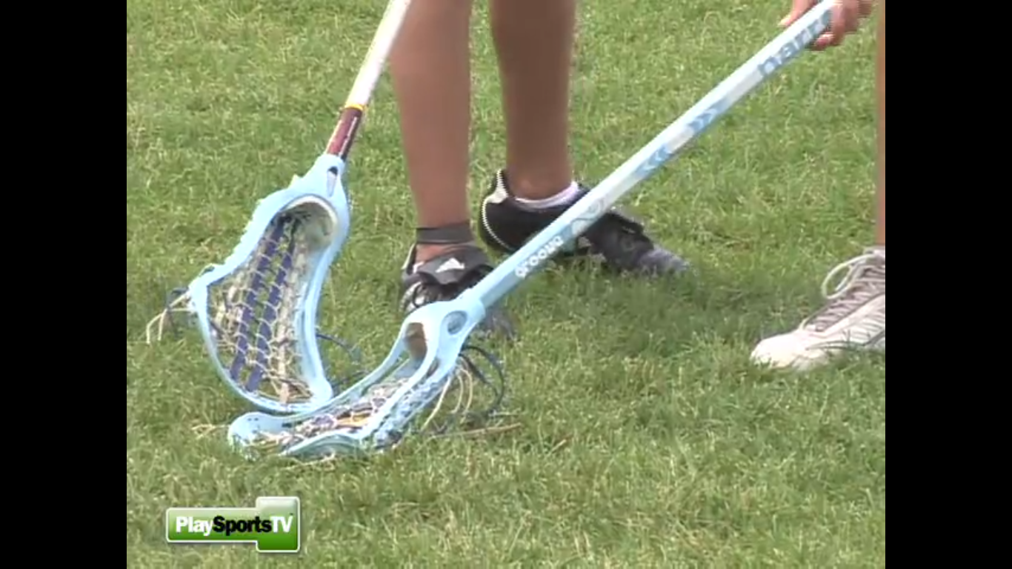
Misplays
Cover
Guarding a ground ball by covering it with the foot, body or crosse, preventing an opponent from playing the ball.
Notes:
Having a set of sticks and a ball are important to be able to demonstrate what a cover looks like.
Remember a cover is only a foul when an opponent is within playing distance, trying to play a ball and is disadvantaged. Lone player or one with only teammates that covers the ball to stop it from going out of bounds or pulling it back to pick it up is legal.

Slide 5
Misplays
Empty Stick Check
Check or impede an opponent’s crosse when the crosse is not in contact with the ball.
Legal – incidental contact (frequently occurring off the draw or ground balls)
Illegal – knock an opponent’s stick away from the ball as they are trying to catch/scoop it
Notes:
Having a set of sticks and a ball are important to be able to demonstrate what an empty stick check looks like.
Incidental contact frequently occurs -- it is important to differentiate between the player that intentionally hits a stick away so that the opponent cannot play the ball and the stick that makes incidental contact while trying to play the ball.

Slide 6
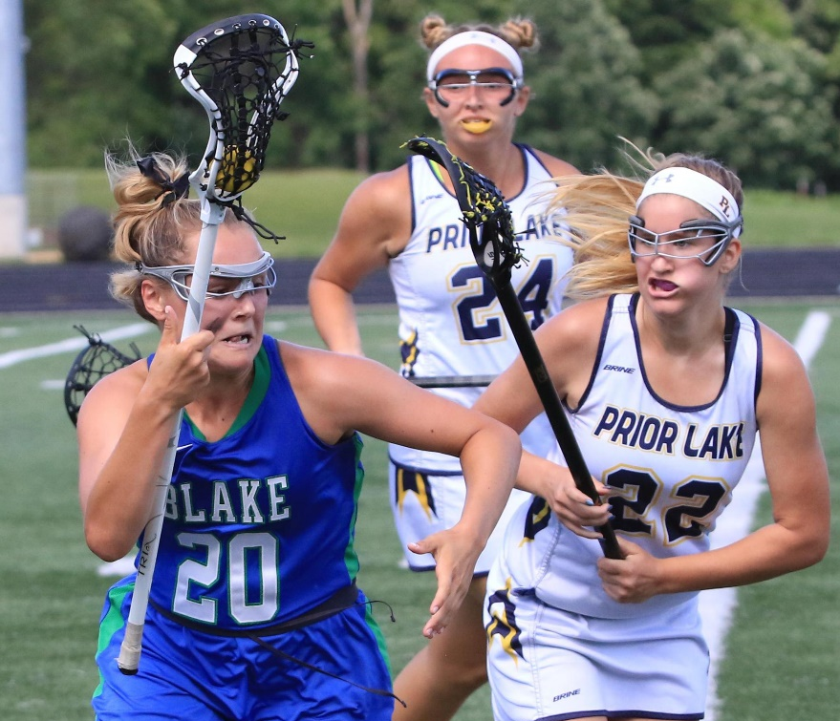
Misplays
Warding
Guard the crosse with an arm.
If one hand is removed from the crosse, it may not be used to ward off an opponent with or without contact. Elbows may not be used to protect the crosse.
Notes:
Discuss the difference between warding and using the free arm to push an opponent away.
Warding is a minor foul. The act of pushing an opponent away is a major foul.
Removing one’s arm from the stick in an effort to change direction or sprint is NOT warding!

Slide 7
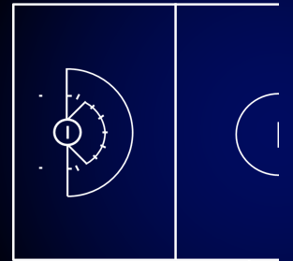
Misplays
A₂
A₁ D₁
Play from Out of Bounds
A player may not take an active part in the game when their feet are out of bounds.
Notes:
A₁ and D₁ are attempting to play a ball that is inbounds. A₂ is out of bounds and attempting to play the ball that is inbounds. Minor Foul on A₂.
Player D₁ is awarded the ball, moves 4m inside the boundary, all other players are 4m away. D₁ may self-start.
This typically happens when a player is trying to stop a ball from going out of bounds and their momentum carries the player out of bounds when the ball stays in. Often that player will try to pick up the ball for check an opponent who is trying to pick up a ball while their feet are still out of bounds.

Slide 8
Misplays
A₂
Restart from Out of Bounds
A player may not commence play with a pass from out of bounds.
A₁
Notes:
If a player restarts play with a pass from out of bounds, it is a minor foul. Possession to any opponent from the other team, 4m inside the boundary. Self-start allowed.

Slide 9
Misplays
Hand Ball
Touch the ball with the hand
  Legal – goalkeeper or deputy within the goal circle
  Illegal – any field player
Squeeze the Head of the Crosse
Use the hand or body to keep the ball in the crosse
Notes:
Goalkeeper and/or deputy in the goal circle may pick up the ball and place it into the crosse with their hand(s).
A field player must use their crosse to scoop the ball. They may not pick up the ball with their hands to put it into the crosse. Also, they may not use their hands to keep the ball in the crosse as they run down the field.

Slide 10
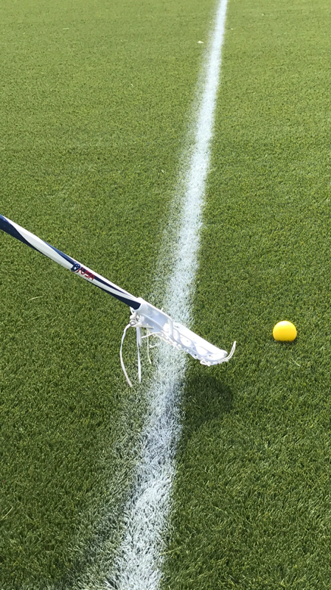
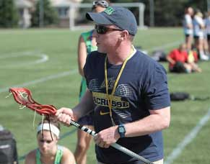
Misplays
Improper Use of the Crosse
Throw the crosse
Take part in the game without a cross
Illegal Exchange of the Crosse
Failure to exchange a field crosse with a crosse on the bench without the crosse entering and exiting the field through the substitution area
Notes:
Players can sometimes mishandle the stick which is dropping the stick, this should not be penalized. Players may throw the stick at a ball heading out of bounds, in exchanging a stick with another player or to intercept a ball. These are all examples of a minor foul. Throwing the crosse to the ground in anger is misconduct and should be carded.
If a player is exchanging a stick for one on the bench, it must take place in the substitution area. The player does not have to enter the substitution area, but the sticks must be exchanged through it. In this situation the coach may enter the substitution area to exchange the stick with the player.

Slide 11
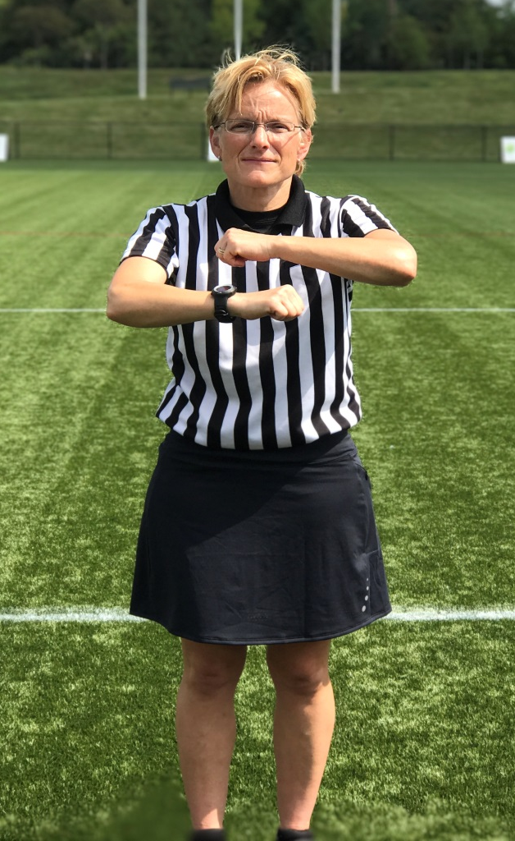
Procedural Errors
Green Card!
Delay of Game
  Failure to move 4m away on a free position
  Repeated self-starts from beyond 4 meters of the spot of the foul
  Repeated self-starts when self-starts are not allowed
  Any type of behavior which in the officials’ opinion amounts to delay
Notes:
Delay of game: to INTENTIONALLY delay the game

Slide 12
Procedural Errors
Delay of Game – Penalty Administration
1st Violation: Green card to the offending team
Change of possession, if applicable
2nd Violation: Green/Yellow card to offending player
Player serves 2-minute penalty
  (doesn’t count in team card count)
All Subsequent: Yellow card to offending player - Misconduct
Violations Player serves 2-minute penalty
  (counts in team card count)
Notes:
Penalty administration depending on how many times the Delay of Game call has been made.

Slide 13
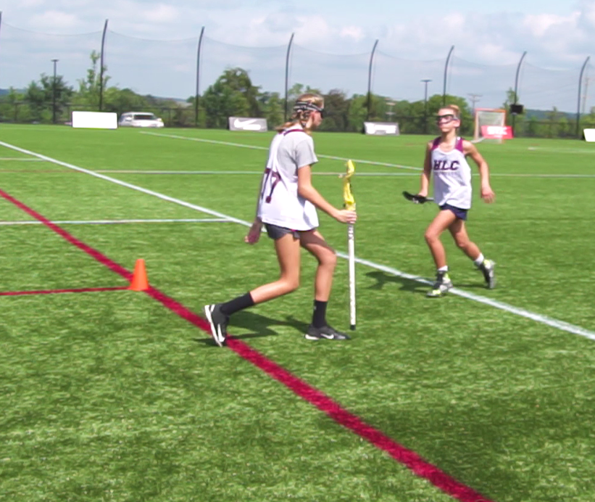
Procedural Errors
Illegal Substitute
Player who enters without going through the sub area
Player who enters prior to her teammate leaving the field
Player not listed or incorrectly listed on the roster or scorebook
An extra player on the field
Player who enters after the official's hand is on the sticks for the draw
Suspended/Ejected player who returns to the game
Notes:
Illegal substitutes are simply players who are not allowed to be on the field!

Slide 14
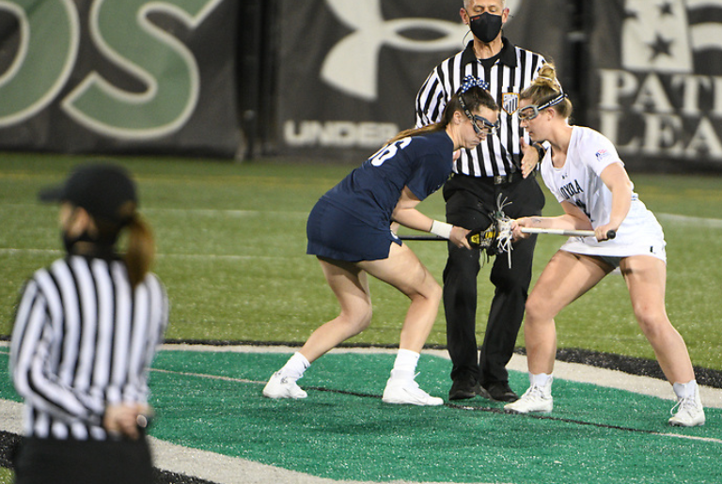
Procedural Errors
Early Entry on the Draw
Step on/into the center circle or illegally crosse the Restraining Line before the whistle
Cross the Restraining Line before possession is established
Players may not step on or over the restraining lines after the official's hand is in contact with the sticks at the draw until the restraining line is released regardless of the number of players between the restraining lines.
Notes:
This foul is also called if a player crosses the restraining line before:
The ball goes out of bounds off a player or her stick;
The ball crosses the restraining line;
A whistle stops play for a foul.

Slide 15
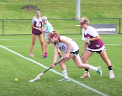
Procedural Errors
Early Entry – Penalty Administration
Possession is awarded to opponent nearest to the spot of the ball
Offending players will move 4m away, toward the goal they are defending
Self-start is allowed unless the game clock is stopped
Note: Early Entry foul is different from Offside foul!
Notes:
In this scenario, Red would get the ball at the spot of the ball (not necessarily where the early entry occurred!) The white player who entered early would stand 4m away, closer to the goal she is defending. Remember: the red player can Self-Start!
An Early Entry foul occurs only on the draw and is a Minor foul. Offside is the result of too many players below/above the restraining line during play. Can occur any time during the game and requires officials to call a time out.

Slide 16
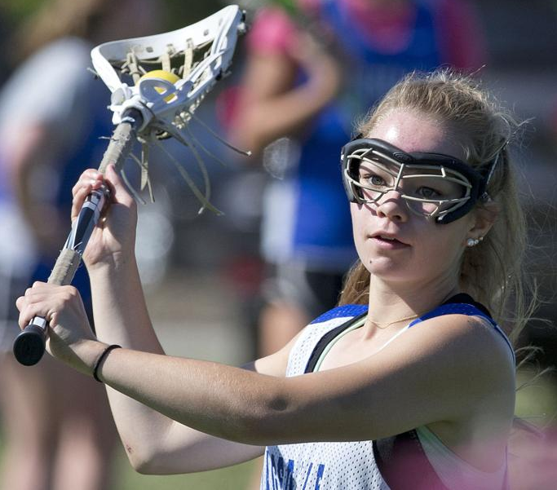
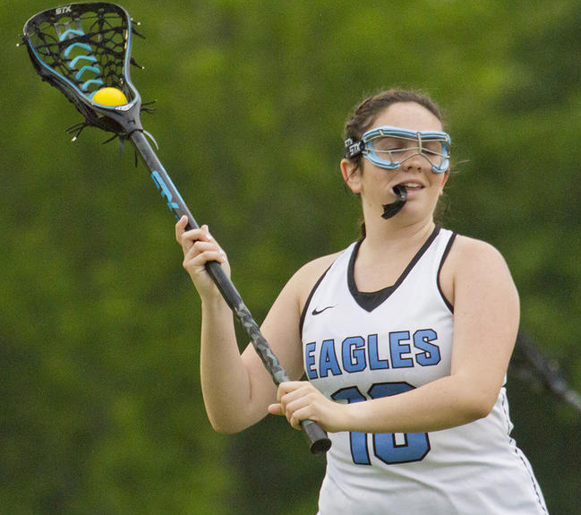
Improper Equipment
Wearing jewelry is illegal. Hair ties on wrists, however, are legal!
Failure to properly wear a mouthpiece
Notes:
Encourage preventative officiating – look for jewelry during the pre-game stick checks so you don’t have to remove a player from the game. Verbally remind players to wear their mouthpieces correctly.
Close-fitting cloth sweatbands, hair ties and other soft, non-rigid materials may be worn on the arm. Barrettes and other hair adornments are legal as long as they do not endanger other players. Head coverings may be worn for religious or medical reasons and must be made of non-abrasive and soft materials and must fit securely.
If it is necessary to remind a player a couple of times to wear her mouthpiece correctly, consider a green card for delay of game.

Slide 17
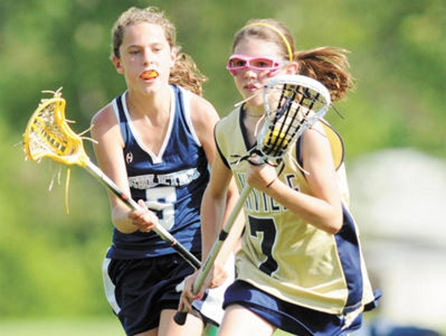
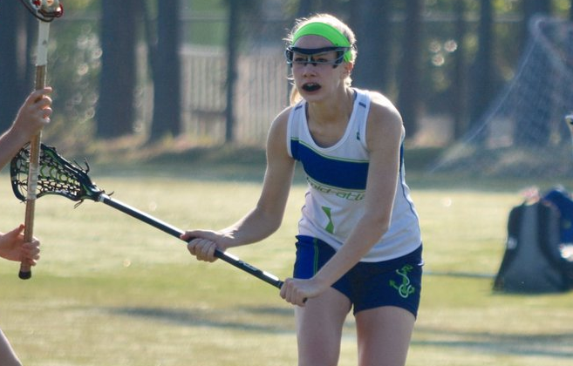
Improper Equipment
Take part in the game if uniform does not meet specifications
Failure to properly wear eye protection (goggles)
Notes:
Illegal uniforms for the entire team is a “one-time” foul (called once for the entire team’s unforms.) The penalty is a free position for the opposing team at the center to start the game.
Many state organizations will give a waiver for uniforms that do not meet specifications. Sub-varsity teams should be allowed to play with uniforms that may not meet the “letter of the rules.” As long as the uniforms aren’t dangerous, allow those teams to play without penalty.

Slide 18
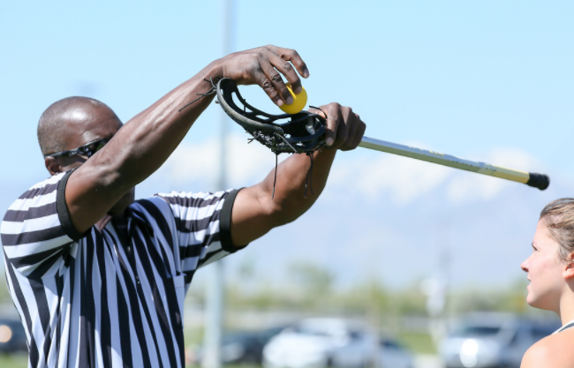
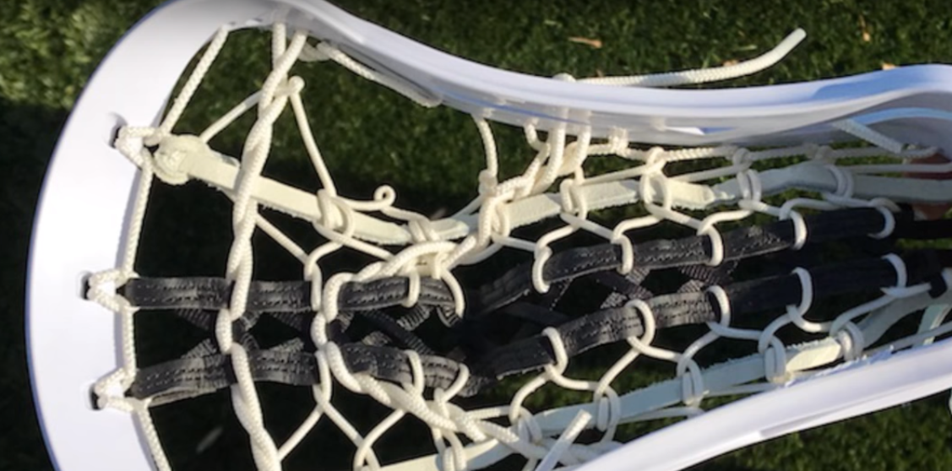
Improper Equipment
Illegal Crosse
  Play with a crosse that does not meet specifications
Pocket too deep
Strung illegally
Notes:
Pre-game stick checks should catch illegal sticks and pockets that are too deep.

Slide 19
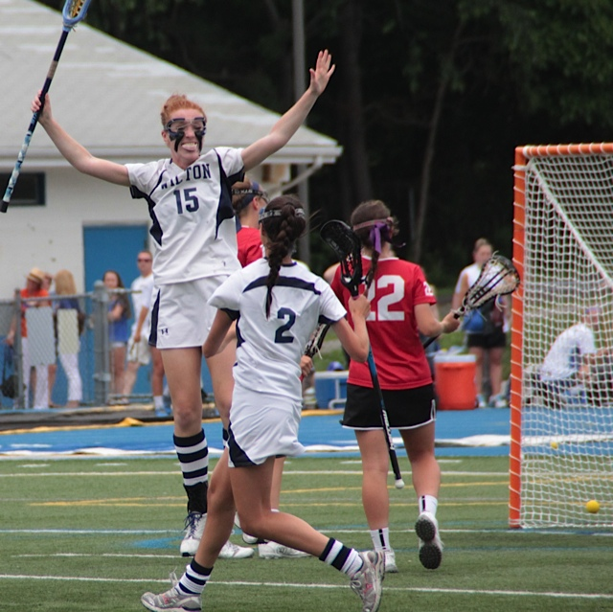
Improper Equipment
A goal will NOT count if:
It is scored with a crosse that does not meet the field crosse specifications.
The player who shot the goal adjusts the strings/thongs of the crosse after an official inspection of crosse has been requested during the game.
NO GOAL!
Notes:
A stick check request by a coach or any player on the field may come after a goal is scored.
The coach/player must give the official the number of the player with the stick that they want to have checked. If the stick is illegal – no goal – and the ball goes to the center draw line free position to the player on the opposing team.

Slide 20
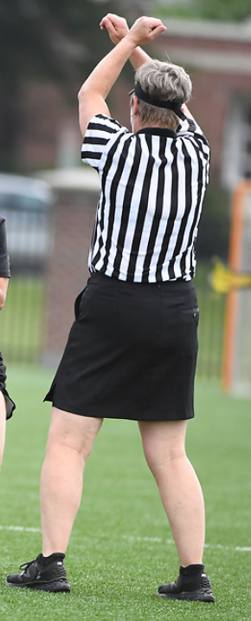
Additional Minor Fouls
Illegal Re-entry
Run out of bounds and re-enter to a
more advantageous position
Illegal Stick Request
Requesting any additional crosse inspections beyond the two permitted per team
Illegal Substitution
Substitute illegally
Illegal Time-Out
A team requesting more than two time-outs

Slide 21
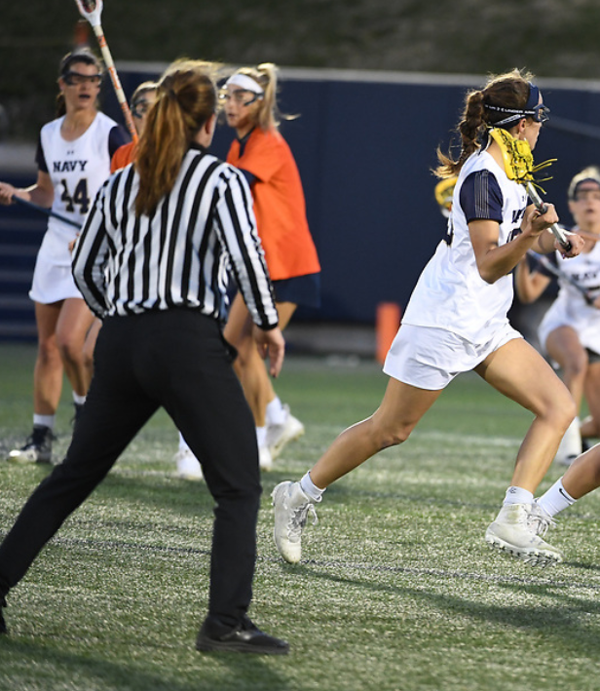
Minor Foul Penalty Administration
Outside the CSA
Ball
Free position at the spot of the foul
Offender
4m away, in the direction from which they approached
Others
4m away
Self-start allowed

Slide 22
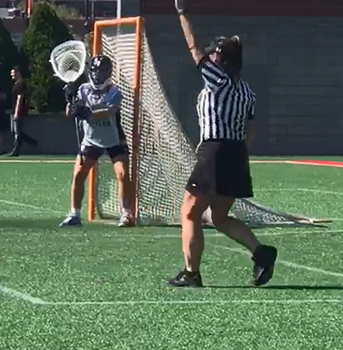
Minor Defense Foul
Inside the CSA – Above GLE
Ball
Free position to the attack player on the
12m fan (nearest to spot of foul)
Offender
4m away, in the direction from which
they approached
Others
4m away
Clear the Penalty Lane
Whistle Start

Slide 23
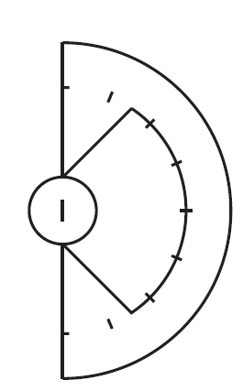
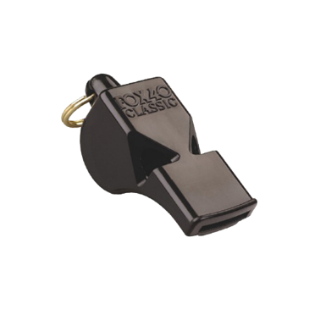
Minor Defense Foul
A gets the ball on the 12m fan. D is 4m away.
A
D
Clear the Penalty Lane
Whistle start
Empty Stick Check
Notes:
Click to start animation
Empty stick check by Defense
Attack is moved to the 12m fan. Defender is placed 4m from the player taking the free position, relative to their position at the time of the foul. (closer to goal? On 8m arc. Behind attack at time of foul? 4m behind)
Clear the Penalty lane. Whistle start.

Slide 24
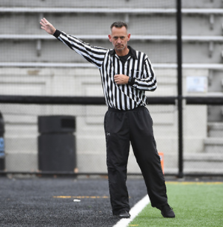
Minor Attack Foul
Inside the CSA
Ball
Free position to the defender at
the spot of the foul
All others
No player may be within 4 meters of the player awarded the free position, including the offender
Self-Start only when the clock is running
Notes:
NOTE: HIGHLIGHTED INFO NEEDS TO BE CONFIRMED BY NFHS 2023 RULES BOOK
Defenders may now self-start for fouls in the CSA – as long as the game clock is running! In the last two minutes of each half, the game clock is stopped so all fouls start on the whistle.
Again, preventative officiating may save a defender from committing a false start when self-starts are not permitted.

Slide 25
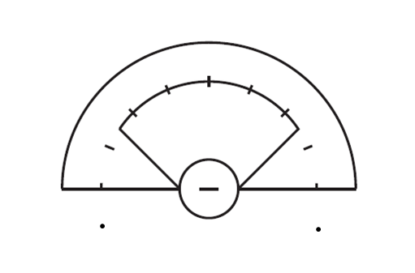

Attack Fouls in 8m Arc
D1
A1
D1
A1
UNDER 1 MINUTE IN EACH QUARTER
CLOCK STOPS
WHISTLE START
ANYTIME THE CLOCK IS RUNNING
SELF-START
Notes:
The defensive player is given the ball and they must start the FP 8 m from the GC. (No Self-Starts in the CSA allowed)

Slide 26
Attack Fouls in CSA Below the GLE
D1
A1
D1
A1
UNDER 1 MINUTES IN EACH QUARTER
CLOCK STOPS
WHISTLE START
ANYTIME THE CLOCK IS RUNNING
SELF-START
Notes:
If this attack foul is in the CSA but below the GLE, they restart on the dot. Again – no self-starts allowed in the CSA.

Slide 27
Minor Attack Foul
Inside the CSA, Above GLE
(stopped clock)
Ball
Free position to the defender at
the spot of the foul (at least 8m
away from the goal circle), whistle start
Offender
4m away, in the direction from
which they approached
Others
4m away
Notes:
NOTE: HIGHLIGHTED INFO NEEDS TO BE CONFIRMED BY NFHS 2023 RULES BOOK
Defenders may now self-start for fouls in the CSA – as long as the game clock is running! In the last minute of each quarter, the game clock is stopped so all fouls start on the whistle.
Again, preventative officiating may save a defender from committing a false start when self-starts are not permitted.

Slide 28
Minor Attack Foul Above GLE
D gets the ball no closer than 8m from the goal circle
A
Cover by Attack
D
Notes:
Click to start animation
Cover by Attack
Defense awarded ball on 8m arc. Attack moves 4m from the player taking the free position, in the direction from which she approached before committing the foul. Whistle start (free position in the CSA)

Slide 29
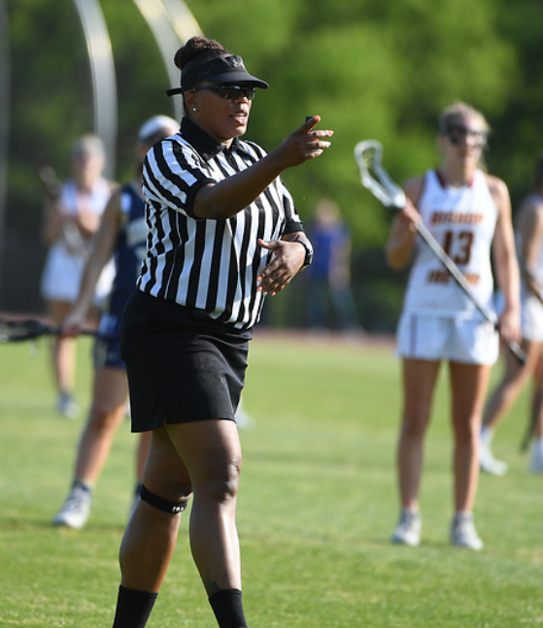
Minor Attack Foul
Inside the CSA, Below GLE
(stopped clock)
Ball
Free position to the defender on the nearest dot, whistle start
Offender
4m away, in the direction from
which they approached
Others
4m away
Notes:
Same set up for either attack or defensive fouls below the GLE

Slide 30

Minor Foul Below the GLE
X gets the ball on the closest dot – if time is out
Cover by Player O
O
X
Notes:
Click to start animation
Player O covers the ball.
X is awarded the ball at the closest dot. O moves 4m away in the direction from which they came. This penalty administration is for a foul by either team – attack or defense.
Whistle start.

