Slide 1
Misconduct and Carding
Notes:
Rule 10 covers the major fouls of women’s lacrosse.
As we go through these major fouls, reference the rules sheet, rule book, and signals in the rule book.
Instructor: after each foul – demonstrate the foul signal for each.( back pages of the rule book)

Slide 2
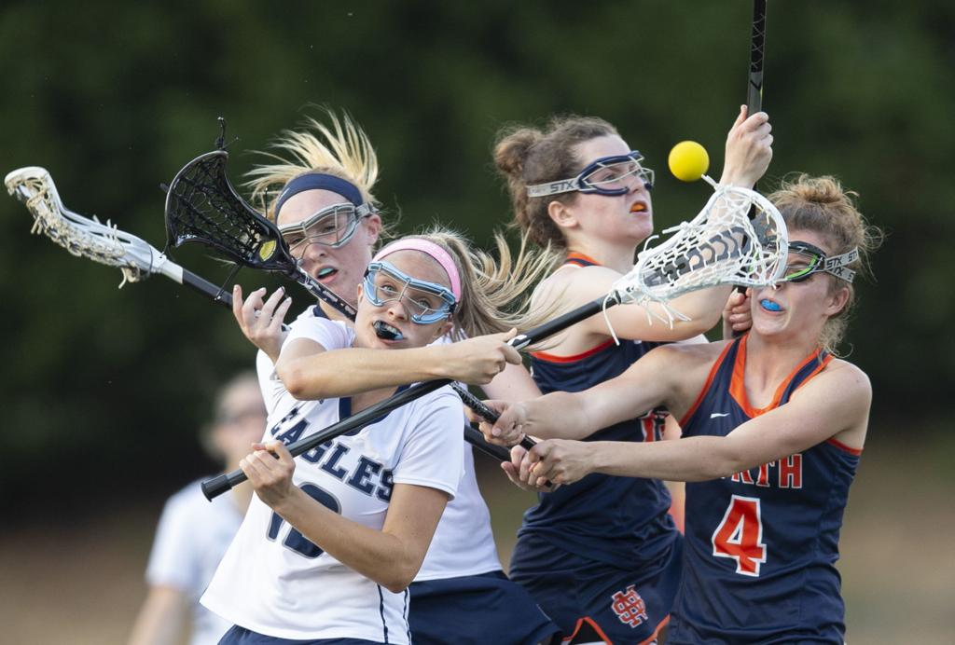
Misconduct
Participants are expected to uphold the spirit of the game and the intent of the girl’s game and in compliance with the USAL/NFHS Girls Lacrosse Rules.
Behavior and play that is not in compliance with the spirit and rules of the game can be defined as Misconduct.

Slide 3
Misconduct/Suspension Fouls
Check to the Head
Slash
Dangerous Propel
Dangerous Follow Through
Dangerous Contact to a Defenseless Player
Unsportsmanlike Conduct - Verbal or Physical
Notes:
The 5 fouls in yellow are mandatory cards.
The lighter one is discretionary but strongly encouraged.
Note what discretionary fouls might warrant a yellow card (give examples of repeated fouls, ex verbal and physical misconduct)
Rseponding to unsafe play early and strong is preventive.

Slide 4
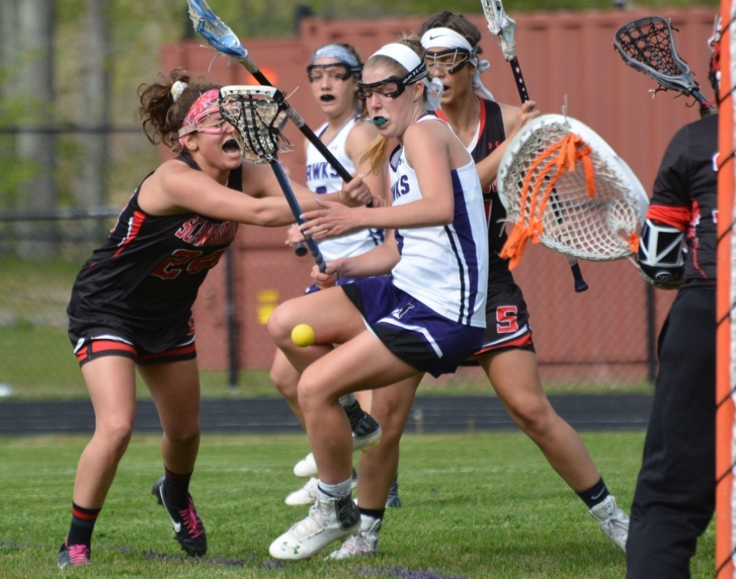
Misconduct
A player must not:
Act in a rough, dangerous, or unsportsmanlike manner.
Deliberately endanger the safety of an opposing player.
Be involved in baiting or taunting that is intended or designed to embarrass, ridicule, or demean others.
Notes:
Sometimes it is difficult to make the decision between yellow or red. It helps to ask yourself if the player was simply over exuberant or if there was true intent to harm. Overzealous – yellow. Think of the terms “flagrant” and/or “deliberate” – definitely red. Repeated fouls can result in a red card also.
Some players are intense and emotional. There is a difference between a personal attack like, “you’re horrible” and frustration with herself and swearing at the official or another player. A personal attack might indicate an immediate red card. Swearing in frustration – not at you or an opponent -- may indicate a yellow card. Firing the stick to the ground in anger or frustration is also a form of excessive dissent and may be deserving of an ejection.

Slide 5
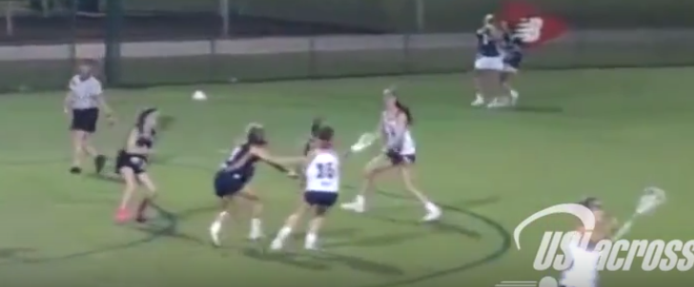
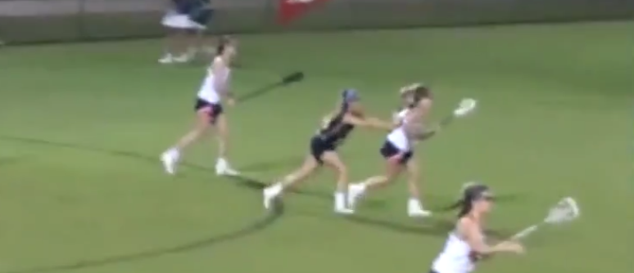
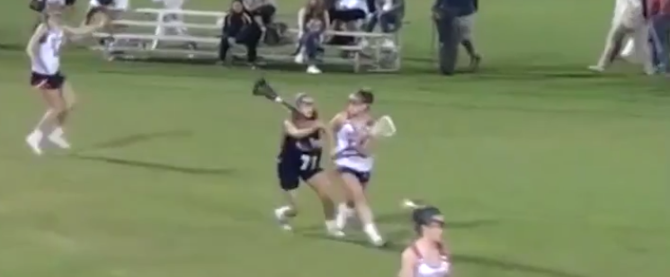
Misconduct
A player must not persistently or flagrantly violate the rules.
Repetitive fouls by the same player or team can be misconduct.
Notes:
Repeated fouls can be the same foul, committed by multiple players, or multiple fouls on the same team in a short period of time.

Slide 6
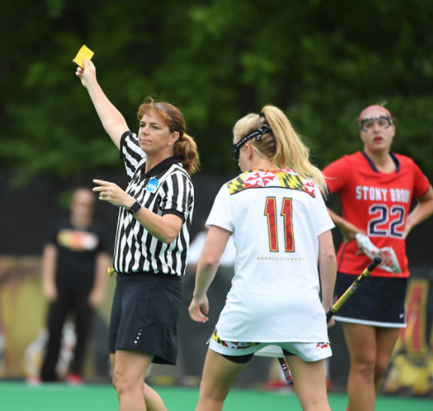
Misconduct
Officials may issue either a yellow (warning) or red (ejection) card for misconduct.
Issuance of a card should be considered a warning to ALL players.
Notes:
What should you do if the yellow has been administered for dissent and then there is a dissent from another player on same team? (Consider two yellow cards for same team) Other team? (Consider cards for both players on opposing teams.)
Use discretion and use the cards for those events that warrant it. Do not threaten a player with a card!

Slide 7
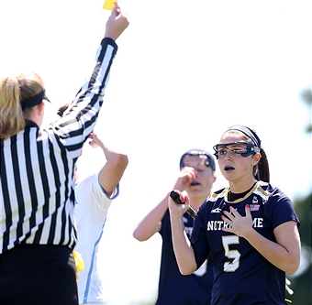
Penalty Time
Yellow Card
  Time = 2 minutes
  Player must sit or kneel in the penalty area
End of Penalty
  Player may return to the field
  Player may be replaced by a substitute
ALL cards are non-releasable
Notes:
All yellow and red cards are non releasable. The player MUST serve the entire time of the penalty

Slide 8
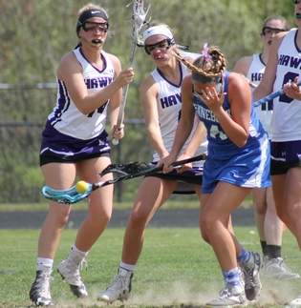
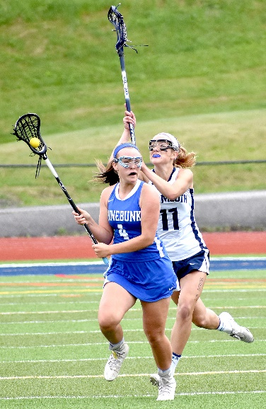
Suspended Player
A suspended player has received a second yellow card in the same game.
She has “fouled out” and may NOT return to the game.
A substitute may take her place at the end of the 2-minute penalty time.
She MAY play in her team’s next game.
1
2
Notes:
A suspended player should go to her team’s bench area after serving her second two-minute penalty.
Second card: “fouled out” of the game -- NOT ejected. Can play in her team’s next game.
May rejoin team on the team bench after 2-minute penalty has expired.

Slide 9
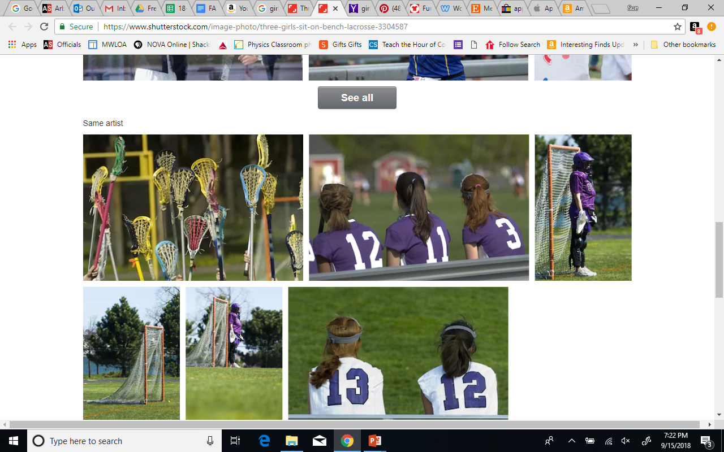
Penalty Time
Ejected Player
Prohibited from playing in next game
Must serve her next game suspension as determined by her state association
All officials should be familiar with their own State associations’ “red card” rules.
Red Card
Time = 4 minutes
Player must sit or kneel in the penalty area
End of Penalty
Player MUST return to team’s bench
Player may NOT return to the game
Player may be replaced by a substitute
Notes:
Ejected players need to stay in their team area after serving their penalty minutes. If the player is unable to stay in her bench, it is essential to have an adult member of the team’s personnel take responsibility.
State associations differ on protocol for red cards.

Slide 10
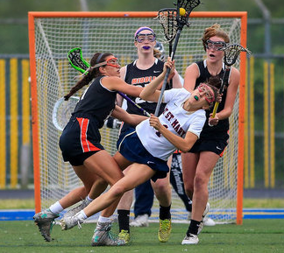
Ejection
An official has the power to eject without any previous warning any player guilty of flagrant or repeated violation of the rules, dissent, misconduct or abusive language.
Ejection will be noted by issuing a red card. Any player receiving a red card is prohibited from further participation in that game.
Notes:
A red card ejection prohibits the carded from playing in her team’s next game.
Unless prohibited by state association, the ejected player may attend her team’s next game in her street clothes and sit on her team’s bench. Most officiating boards require the official to call/contact the assignor or athletic administrator to inform them of the red card to ensure the player is not permitted to play in the next game.

Slide 11
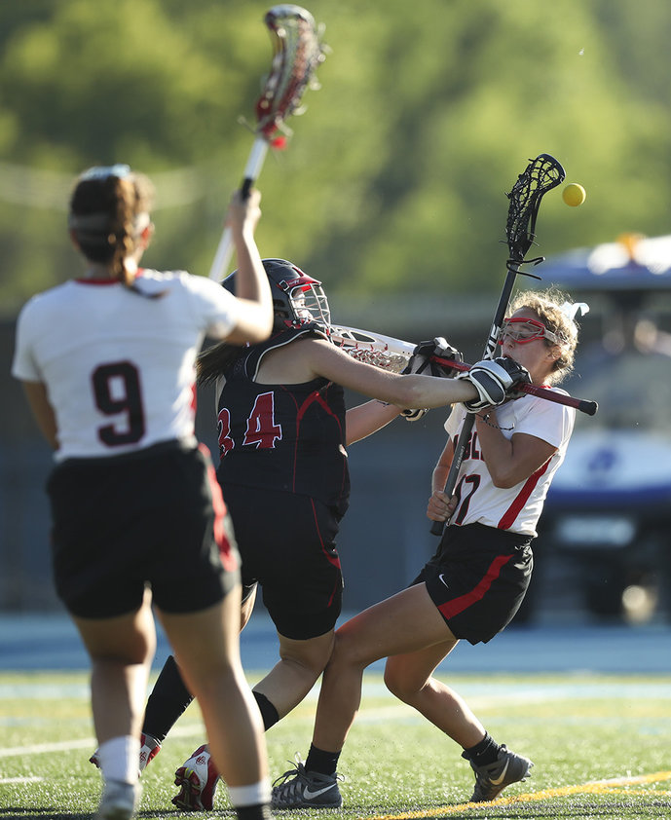
Goalie Misconduct
If a goalie commits a cardable/misconduct foul –
whether in or out of the goal circle –
she must be carded

Slide 12
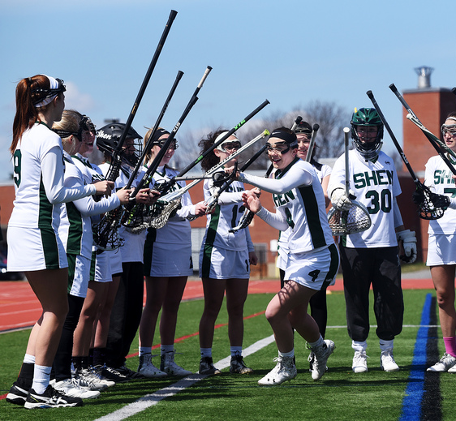
Handling Goalkeeper Penalties
When there is a SECOND dressed goalie:
The 2nd dressed goalie must enter the game
Carded goalie serves two minutes (yellow) or four minutes (red) in penalty area
Coach selects a field player who serves penalty with the goalie
Team plays short ONE player during the penalty
Notes:
Use pre-game stick checks to make note if a team has a second dressed goalkeeper. Share that information with your partner(s) so the officiating team is ready if the goalkeeper receives a yellow card.
Note that the player serving with the goalie does not receive a card for this foul -- only the goalie gets a card.

Slide 13
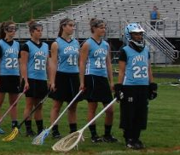
Handling Goalkeeper Penalties
When there is only ONE dressed goalie:
Goalie may stay in the game (for the first yellow card)
Coach selects a field player who serves the goalie’s penalty in the penalty area
Team plays short for two minutes (yellow) or four minutes (red)
Note: A field player may leave the field to become the substitute goalie
Notes:
In both cases, when the coach takes a player off the field, make sure there is not resulting in an offside. If it is created, then you must place another player behind the RL before you start play.
If there is no field player willing to put on the goalie gear and play goalkeeper, the team may play without a goalkeeper. However, NO PLAYER MAY ENTER THE GOAL CIRCLE UNTIL THE BALL HAS COME TO REST WITHIN THE GOAL CIRCLE.

Slide 14
Administering a Card to the Goalkeeper
Play restarts at the spot of the foul or as indicated by foul location
The GOALIE (or substitute goalie) goes behind – goal circle is empty
REMINDER – Playing “Short”
On defense
  6 players and the goalie may be below the restraining line
  4 players must be above the restraining line
On attack
  6 players may be below the restraining line
  4 players plus the goalie must be above the restraining line
Notes:
Because there is a goalie in the game, she goes behind.
Use the “Oh, That Goalie” Activity to review.

Slide 15
Team Cards
Each player, coach, and bench misconduct card shall be recorded and tallied.
12 players on the field after penalty time
1
2
3
If a team receives a fourth card, it will play short for the remainder of the game.
+
4
One player down (per card) after serving the penalty
Notes:
When a team has received 4 cards (yellow or Red--- green do not count) they will play one player down for the remainder the game and For each subsequent card the team will play down an additional player: 5th card = 10 players, 6h card = 9 players, etc.

Slide 16
A Team with Multiple Cards
1
BLUE #10 is carded at 10:25 in Q3. The card is released at 8:25 in Q3
2
RED #12 is carded at 10:03 in Q3. The card is released at 8:03 in Q3
3
BLUE #11 is carded at 9:50 in Q3. The card is released at 7:50 in Q3
Notes:
There may be a time when you have multiple cards being served at the same time. Remember no cards are releasable.
Each time a card is given the near side or closest official should come to the table and confirm with the timer of the release time for each card given. This becomes important when you are in a multiple card situation.
It is recommended that officials keep track of cards given, note both the number of the carded player and the time the card is given.

Slide 17
Cards will carry into the next quarter
1
BLUE #2 is carded at 1:25 in Q2.
The card is released at 11:25 in Q3
Be sure to check that the carded player is in the penalty area and that team is starting the quarter short.
RED #12 is carded at 00:03 in Q3.
The card is released at 10:03 in Q4
2
Notes:
.I a player receives a card with less than 2 minutes in the quarter, she will serve the remainder of her time in the next quarter. If a card is given with less than 2 minutes in the 4th quarter, and the game is going into overtime, the player will serve the remainder of her time in overtime.
Blue #2 receives a yellow card at 1:25 in the second quarter, when is she released…..click. 14:25 in the third Quarter
Red #12 receives a card with 3 seconds left in the third quarter, when is her card released?..... Click….. 13:03 in the fourth quarter
With the card being 2 minutes, the “seconds” of the release time will be the same as the time the card is given.

Slide 18
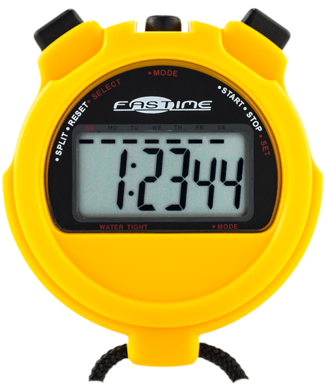
Early Re-Entry
If a carded player – or any replacing player – enters the game before the penalty time has elapsed, the player originally receiving the card will serve an additional penalty.
If the player who received original card:
  1. Serve the remainder of the penalty time
  2. Then serve an additional two or four minutes (depending on the original card)
Notes:
Two different scenarios:
Player entering early is player originally carded. OR Player entering early in NOT player originally carded.
Both are considered an extension of the penalty time – not an additional card.

Slide 19
Early Re-Entry
If a carded player – or any replacing player – enters the game before the penalty time has elapsed, the player originally receiving the card will serve an additional penalty.
If NOT the player who received original card:
  Officials send player closest to the bench off the field
  2. Original carded player serves the remainder of
  the penalty time
  3. Then serve an additional two or four minutes
  (depending on the original card)
Notes:
Pre-game instructions to the person(s) manning the scorer’s table helps ensure that a carded player does not re-enter the game before the penalty time has expired. It also helps to make sure the scorer/timer at the table records the time of the card and the time the card is released.

Slide 20
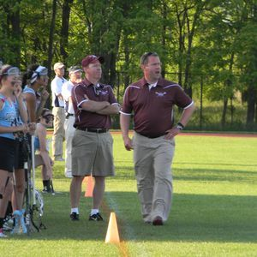

Coach Misconduct
Non-playing team member(s) leaving her team bench area during the game.
Coach leaving her/his coaching area.
Coach(es) coaching from outside the coaching area.
Improper use of electronic equipment.
Any type of behavior which in the official’s opinion amounts to misconduct.
Notes:
Players may wander onto the field in celebration or during the heat of the game. A verbal reminder is usually all that is necessary to have the player return to the team bench area.

Slide 21
Coach Misconduct Penalties
The head coach is responsible for all persons connected with the team, including assistant coaches, and shall receive any card assessed related to bench decorum.
Any card given to a head coach will count towards the team’s cumulative total.
1st Yellow Card
Red Card
Coach selects a field player to serve the 2-minute penalty
Team plays short for two minutes
Coach MUST leave the game and spectator area
An interim coach must be designated and selects a field player to serve the 4-minute penalty
Team plays short for 4 minutes
2nd Yellow Card
Same as red card
Notes:
Remind head coach that they are the only one who can communicate with the officials.
A head coach who receives two yellow cards is considered suspended. They MAY participate in the team’s next game.
A coach receiving a Red card is considered ejected. They MAY NOT participate in the team’s next game.
Ask for help from the athletic administrator, if needed. The game cannot continue until the ejected coach leaves the game/spectator area.
NFHS rules prohibit a team to continue with out a coach or other qualified adult.

Slide 22
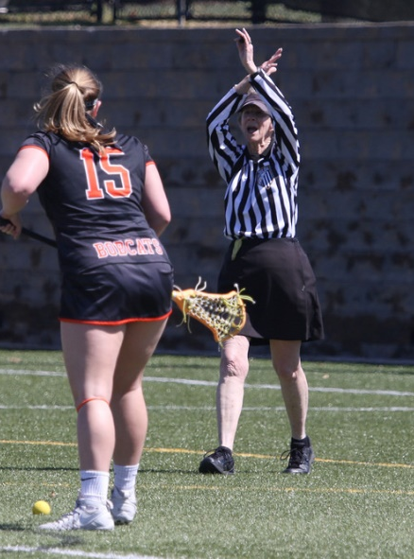
Administering a Card
Call timeout.
Beckon the offender to you.
Face the scorer’s table and display the card.
Signal the cardable foul.
Make sure your partner(s) are aware of the card.
Record the card: Player number, type of card/foul, and time of card.
Official closest to the table reports the card to the official scorer.
Notes:
Official scorer or table official must know when the player will be released. Go to the table to make sure the correct information is reported.
Player serving a penalty may join her team on the bench during a timeout. They will return to the penalty area after the timeout has concluded.
.

Slide 23
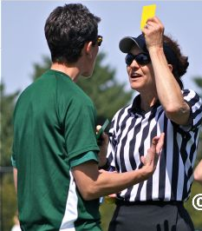
Misconduct
Misconduct rulings are never easy.
The more games you work, the more confident you will be.
Don’t be afraid to ask your partner for help.

Slide 24
Questions?
Notes:
Open Rulebooks and manuals to Rule 8

