Slide 1

Professionalism

Slide 2

We envision a future that offers anyone the lifelong opportunity to enjoy the sport of lacrosse.
As the sport’s national governing body, USA Lacrosse provides national leadership, structure and resources to fuel the sport’s growth and the experience of participants.
“Honor the Past” “Commitment to the Core Values” “Maintain Relevance” “Respect All Participants”
Notes:
Welcome to the fastest game on two feet, lacrosse also happens to be one of the fastest growing games in the country and that is why we are hoping this training gets you hooked and ready to become the best official you can be.
Before getting into the nuts and bolts of the sport and officiating the sport, we want to make you more familiar with US Lacrosse and girls’ lacrosse. And the concept that, as a community, we expect high standards of professionalism and ethics.

Slide 3
Main Focus as Officials
SAFETY
FAIRNESS
FUN
Notes:
As officials our role is to insure that all participants leave each game with a positive experience. Safety is our number one job, and we keep athletes safe through calling fouls and managing the game. Our unbiased influence in the game should insure fairness to all participants, and finally we hope all participants including ourselves has an enjoyable experience.

Slide 4

Pathway to Annual Certification
USL Membership
Annual Rules Exam
Annual Professional Development
Rules Online Course
On-Field Evaluation
Certified Official
ACTIVITY:
USAL Certification Checklist
Notes:
We strive for all officials servicing this game in our country to be US lacrosse certified. Each year you must meet certain requirements in order to gain and maintain this certification.
Being a current Official member of US Lacrosse is the first step.
You will be expected to take and pass the US Lacrosse annual rules test, which is found on US Lacrosse eLearning platform. Only US Lacrosse members have access to this rules exam.
Each year you must complete your Annual Professional Development online, which includes the annual rules interpretation. The rules tend to change a bit each year and keeping up with the most recent changes as well as trends in the game is important in keeping current as an official.
Finally, each year you will have to hold a current US Lacrosse rating, you are expected to have on field, hands on training, during which you will be evaluated on your skills as a women's lacrosse official, at this time you will be given a rating. Ratings will have varying expiration dates, based on your skill set.
Use the "USAL Certification Checklist" and explain the checklist. Tell candidates to keep the check list handy and remember to complete each part.

Slide 5
Competency Levels
Based on Skill Set and Experience
Junior
Beginning Official; capable of controlling youth, middle school, and lower level high school games.
Level 2
Experienced Official; capable of controlling youth, middle school and high school varsity and JV level games. Proficient in the two-person system.
Level 3
Experienced Official; capable of controlling youth, middle school, all levels of high school and low level college games. Competent in three-person system.
Level 1
Youth officials under the age of 18. Capable of controlling youth games (two levels below their current playing level, if applicable.)
Notes:
We need to let the candidates know that each level has a skill set that is required and that obviously Level 2 will have all the Level 1 and Level 2 skills and the Level 3 skills will be all the skills of the Level 1 and Level 2 and then skills of the Level 3. The skills are cumulative.

Slide 6
FIVE CORE CONCEPTS
Professionalism, Responsibility, Ethics
Positioning, Fitness, Field Coverage
Knowledge, Judgement
Game Management, Mechanics, Penalty Administration
Comportment, Communication, Teamwork
On time
Proper uniform
Avoids conflicts of interest
Shows respect for all in game
Composed demeanor
Receptive to feedback
Proper penalty administration/mechanics
Clear, loud whistle
Keeps up with play
Positions relative to ball
Knows areas of responsibility
Calls major and minor fouls quickly
Keeps game safe
DISCUSSION:
LEVEL 1 Rating Form
Notes:
These are the skills areas on which an official’s competency is based. All are necessary for you to become certified and to maintain your certification.

Slide 7
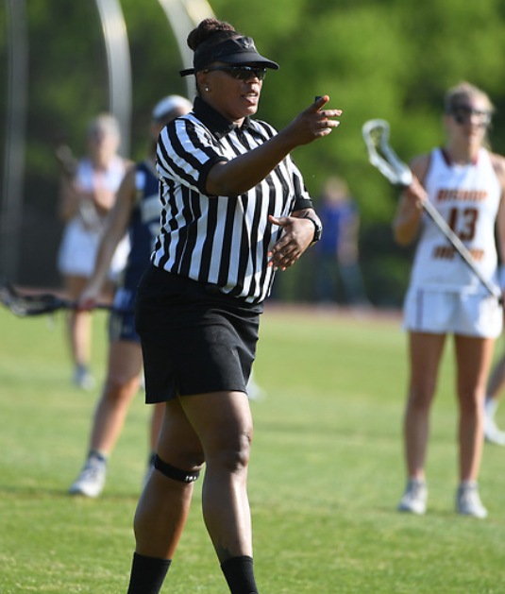
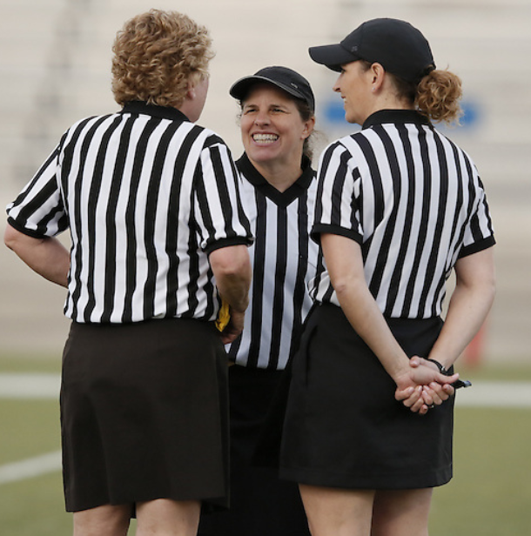
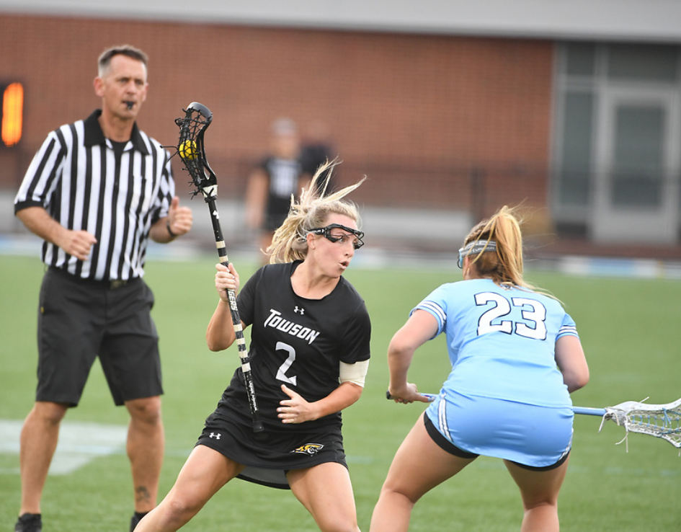
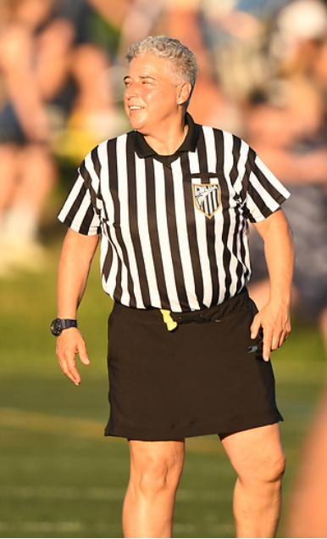
WHAT IS PROFESSIONALISM?
PRESENTATION TITLE HERE
7
Notes:
Professionalism: the skill, good judgement and behavior expected from a person who is trained to do a job well.

Slide 8
KEYS TO BEING A TRUE PROFESSIONAL
Character
Attitude
Excellence
Competency
Conduct
DISCUSSION:
What is Professionalism
Notes:
Use the "What is Professionalism" document to review examples of professionalism.

Slide 9
CODE OF ETHICS
Respect – values the opinions , views, and roles of others
Fairness – makes decisions without favoritism or prejudice
Teamwork – cooperative and coordinated efforts to work towards a common goal
Communication – creates shared understanding
Legality – does not violate the law
Conflict of Interest – avoids any action which leads to a real or perceived conflict of interest

Slide 10


PREPARATION FOR THE SEASON
Mental Preparation
Physical Preparation
Notes:
As you know, athletes that are participating in our game spend many hours preparing for each game. Many have long pre-seasons and devote a great deal of time and hard work in becoming the best they can be. We should expect the same of ourselves. Leading up to our season we need to prepare both mentally and physically.

Slide 11
MENTAL PREPARATION
Read rules book and manual
Review the rules interpretation video
Keep current with rules interpretation memos
Pre season practice games
Notes:
Being an expert on the rules and their interpretations are gained through reading and knowing the current rulebook as well as the US Lacrosse Training Manual.
Each year a rules interpretation video is created to inform you of both new rules as well as any points of emphasis that are being focused on that coming season. Always watch and understand this prior to your season but it is helpful to refer back to this throughout your season.
Throughout the season and year, rules updates and memos may come out through US Lacrosse National Rules Interpreter or your state association, be sure to keep current with these and keep a printed copy with you at your games.
Before your first game, be sure to be in some practice time at either a nearby team’s practice or preseason scrimmage.

Slide 12
PHYSICAL PREPARATION
Stretching
Healthy food plan
Cardiovascular exercise
Pre-season practice games
Notes:
Fitness is an important part of your skill set. Start your fitness plan well before the season.

Slide 13
DRESS FOR SUCCESS
Black and White Stripes
Black Kilt/Pants/Shorts
Black Accessories
Black Outerwear
Equipment
BREAK OUT GROUPS:
Impressions
Notes:
Use the "Impressions" Document to facilitate this discussion.
Have you considered the “view” from a coach’s/parents eyes? What is the coaches/parents’/players impression of the officials as they see them on the field? In small groups or individually create a list of the impressions you have had of the officials for a sport you have watched or participated in.
Note: No tights (unless worn as undergarment) or sweat pants. Shorts should be professional length (golf shorts).

Slide 14
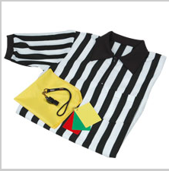

EQUIPMENT CHECK
Whistle
Yellow flag
Cards (red, yellow, green)
Rule book
Measuring tape
Pencil
Coin
Watch
Sportsmanship card (if applicable)
Notes:
Be sure to have these with you at every game. Most officials have a small black bag they take with them on the field that contains these items. Next step – whistle training!

