Slide 1
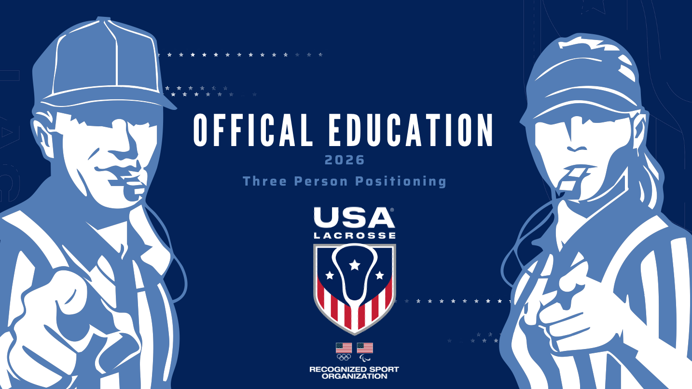

Slide 2
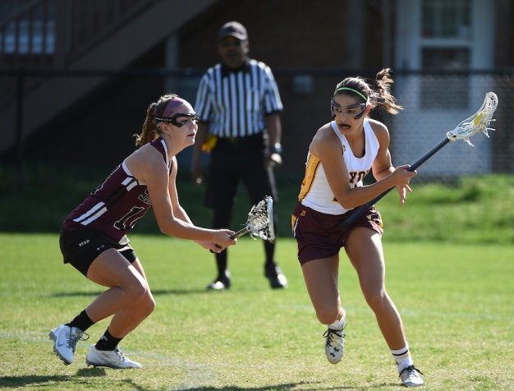
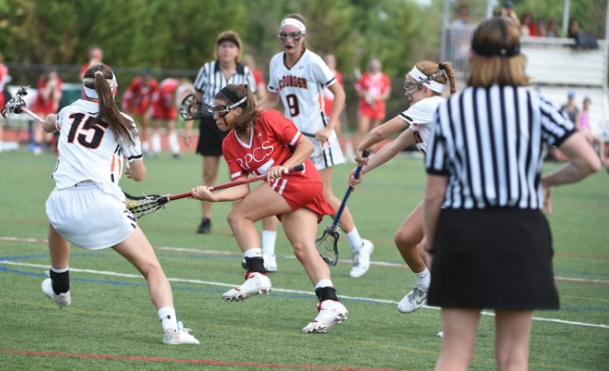
Three Person System
Provides better opportunities for officials to see space between opponents
Provides better opportunities for officials to see space between opponents
Allows officiating team to see the game from multiple changing angles
3 Person System Purpose
2
Notes:
The purpose of using 3-person officiating crews is to add another dimension to the game, allowing officials to be in the best position to make the calls, and to make the game safer.

Slide 3
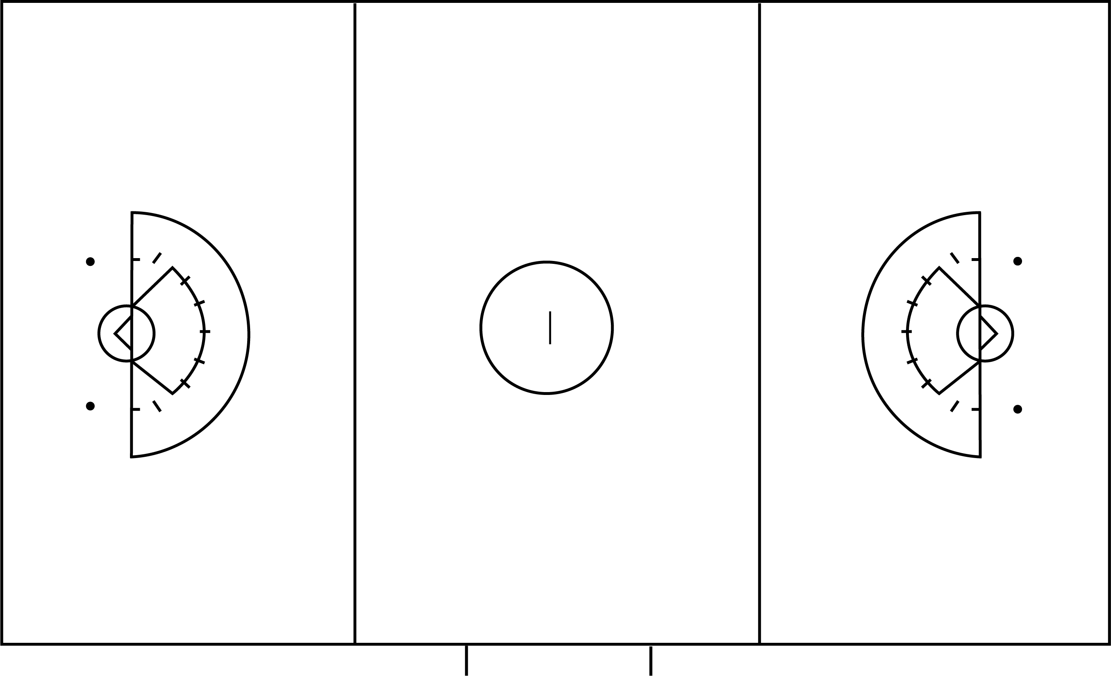
2-Person vs 3-Person
A
Lead
B
C
Trail
3 Person System Purpose
3
Notes:
In the 2-person system, Lead and Trail basically split the field in half (lengthwise) and overlap in the middle third of the field. When play is in the CSA, Lead is responsible for on-ball calls for most of the area and Trail generally covers off-ball fouls.(click)
In the 3-person system, coverage is further defined.
A or B serve as Lead for their end of the field when ball is in the CSA and a deep trail in the opposite end.
In this situation, B is the Lead. C serves as a “second lead” and picks up the ball when it is on her side of the CSA.
C will be off ball (or ‘Second Trail’) when the ball is on Leads side of the Arc .
A is the Deep Trail and responsible for off-ball fouls.
(time to absorb it a bit and then Click to next slide)

Slide 4
Three-Person Positions
A
B
C
Leads to her
RIGHT side
Trails the ball going to her LEFT side
Signals the goal to her RIGHT side
PRESENTATION TITLE HERE
4
Notes:
Note to instructor – Before “filling in the blanks” with this slide, you may wish to ask the class to participate asking “what direction does A move when Lead?, when Trail?, Which end of the field would she signal “goal”?
(Click)
Review A’s basic assignments.

Slide 5
Three-Person System
A
B
C
3 Person System Purpose
5
Notes:
(Click to isolate “A”)
Position A will lead to right as in normal 2-person system.
And will serve as deep trail when ball goes to the B end of the field.
This should be familiar as this is the same assignments in the 2-person system

Slide 6
Three-Person Positions
A
B
C
Leads to her
RIGHT side
Trails the ball going to her LEFT side
Signals the goal to her RIGHT side
Leads to her
LEFT side
Trails the ball going to her RIGHT side
Signals the goal to her LEFT side
PRESENTATION TITLE HERE
6
Notes:
Note to instructor: Option for class participation to “fill in the blanks” with discussion before pulling up slide.
(Click)
B will have the same assignments as A but will do these assignments going to her LEFT.

Slide 7
Three-Person System
A
B
C
3 Person System Purpose
7
Notes:
(Click to isolate “B”)
Position B will lead to LEFT
And will serve as deep trail when ball goes to the A end of the field.

Slide 8
Three-Person Positions
A
B
C
Leads to her
RIGHT side
Trails the ball going to her LEFT side
Signals the goal to her RIGHT side
Leads to her
LEFT side
Trails the ball going to her RIGHT side
Signals the goal to her LEFT side
Is both a second LEAD and a second TRAIL
Escorts in Transition
Administers all Draws
PRESENTATION TITLE HERE
8
Notes:
Note to instructor: Option for class participation to “fill in the blanks” with discussion before pulling up slide.
(Click)
B will have the same assignments as A but will do these assignments going to her LEFT.

Slide 9
Three-Person System
A
B
C
3 Person System Purpose
9
Notes:
(Click to isolate “C”)
C will conduct all the draws and will act as a SECOND LEAD and second Trail in both CSAs at both ends of the field.C will escort the ball down the field while A and B are adjusting to the direction of play.
Each official will work in each position. The team rotates after every two goals (A moves to B, B moves to C, C moves to A)

Slide 10
Good Three-Person Positioning leads to:
Better game management
More thorough foul recognition
Seeing the big picture vs. the small picture
PRESENTATION TITLE HERE
10

Slide 11

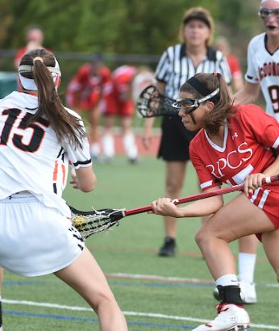
Small Picture vs Big Picture
Stick behind her?
Empty?
Empty? Stick on body?
PRESENTATION TITLE HERE
Small Picture
Big Picture
11
Notes:
Big Picture is your focus as a single official. The Bigger Picture should give you a wider view of the action around the ball.
Notice the difference between the width of vision and game coverage on each picture. On the left, the official is focused on the ball and the two players. (click)
On the right, the officials can see a wider frame and have a better understanding of what the player with the ball is doing but also what the players nearby are doing. (click)
And with an additional set of eyes, we as a crew can add even more visual awareness and help with the play around the ball.
Our bigger picture here demonstrates that while one official is on-ball , the other will be able to see those off ball fouls that might be overlooked/missed in the 2-person system.

Slide 12

Boundaries
A
B
C
3 Person System Purpose
12
Notes:
Who calls boundary balls? The Lead (A or B) will have the end line boundary on their end of the field and share the sideline on her side of the field. (click)
C will have the entire sideline on the far side of the field and will assist each Lead with the area called the ‘coffin corner.’ (click) This is the corner at Lead’s end of the field, but farthest from them (and closer to the C official.)
The Deep Trail (A or B) will be responsible to move to the sideline to assist the Lead with calls headed to their sideline. If the Deep Trail moves to cover this call, the Lead can stay in closer proximity to the goal and be in position to make a call should a quick pass put the ball in the CSA.

Slide 13
The Draw
Circle players wait for the whistle;
RL players wait for possession
Watching for the same!
A
B
X O
X O
X O
X O
X O
C
X O
X O
X O
X O
X O
3 Person System Purpose
X O
13
Notes:
C always administers the draw. (click)
A and B are watching both the players on the circle for early entry or off-ball fouls and the players on the restraining line who cannot cross until the officials’ signal “possession.”
What are the A and B officials looking for prior to releasing C to initiate the draw? (counting the number of players – up to 12 – that are on the field and that no more than three from each team are between the RLs)
How should A and B manage substitutes? (Hold hand in the air to indicate play cannot begin until all substitutes have entered the field. Reminder: no subs once official’s hands are on the sticks.)

Slide 14

The Draw
A
B
X O
C
XG
OG
3 Person System Purpose
14
Notes:
Discuss Draw scenarios:
What if both players draw illegally? Where does the ball go for the restart? (C will call time out and re-draw.)
What if a RL push foul occurs? (click) Where is the restart? (at the spot of the ball – self-start allowed)
What if the Red team draws illegally but the Blue team commits a push foul on the circle at the same time? (click) (Offsetting fouls. Time Out. AP at the spot of the ball. No self-start allowed. All players (other than the ball carrier and the offender) may move freely as long as they are at least 4m away from restart)
In these scenarios, the official managing the restart will depend on which way the ball is headed. Why? (New Lead official may need to get ahead of play, so Deep Trail fficial can manage restart on their side of the field or C can manage if ball is in center of field.)

Slide 15
Monitoring Play – C Official
A
B
X O
X O
OGK
X O
X O
XGK
X O
X O
X O
X O
X O
3 Person System Purpose
C
X O
X O
15
Notes:
C will administer penalties their third of the field (lengthwise). In this situation, C will manage the penalty administration (click). This gives B the opportunity to get ahead of play and have the play transition into their CSA as the ball comes down the field.
B will move forward. A should begin to get a count for players over the Restraining Line to be sure no one from the Attack team goes offside. A should also watch that defenders pressuring the ball at the RL do not go offside as well.

Slide 16
Monitoring Play – A/B Officials
X O
A
B
X O
X O
X O
X O
X O
XGK
OGK
X O
X O
X O
3 Person System Purpose
C
X O
16
Notes:
When fouls occur on the A/B side in transition, the new Trail should come up and release the Lead. This procedure is used on fouls in the midfield as well as sideline boundary calls.
In this situation, B has made the call. A must be engaged in play and immediately move to manage the restart as B moves to get into position to receive play.
The C official in this scenario should have a player count for the offside. If A and B are focused on ball and the ball is transitioning into one end or the other, C should pick up the restraining line responsibilities.

Slide 17
Monitoring Play – Middle of the Field
Which direction?
A
B
X O
X O
X O
Restart? IT DEPENDS!
X O
How have teams been playing?
OGK
X O
XGK
X O
X O
X O
C
X O
3 Person System Purpose
X O
Where are the players?
17
Notes:
Ball is center for a restart. Who manages the restart? (click) IT DEPENDS!
Ask yourself these questions: Where is the ball is going? How are the other players positioned?
How have the teams been playing? If it is very physical game, you may need to stay closer to play to catch body fouls, etc.
Depending on which way the ball is heading, the Trail and C need to be aware of the restraining line count and be prepared to call offsides, if necessary.

Slide 18
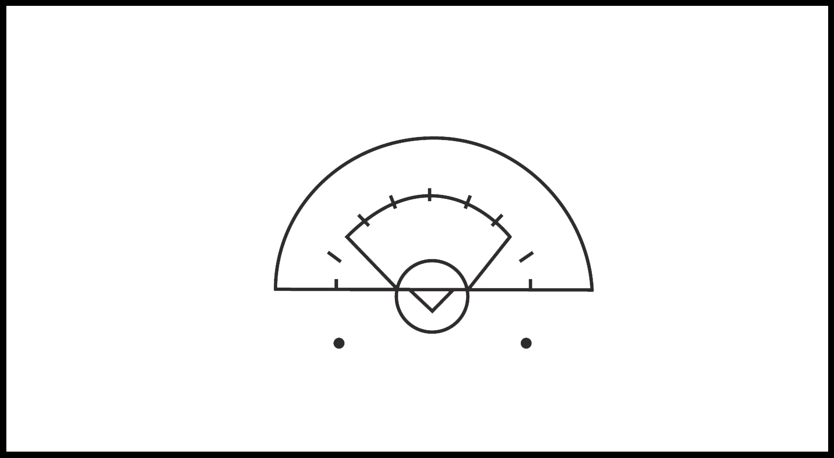
Arcs of Movement
DEEP
TRAIL
C
X O
X
O
X O
X O
X O
LEAD
X O
XGK
3 Person System Purpose
X O
19
Notes:
Now we are looking at play inside the CSA.
Each official will always move in RELATION to the location of the ball – if the ball is moving, the officials are moving.
When the ball is on C’s side, C will cover Shooting Space AND watch for on-ball fouls. The Deep Trail (A) is off-ball while the Lead (B) is on a High Tangent to the ball.
(click)
When the ball transitions to the other side of the CSA, the C official watches for off-ball fouls. The Deep Trail (A) is watching for Shooting Space while the Lead (B) moves to a Low Tangent.
Each official’s responsibilities may change when the ball moves within the CSA.
For example: the Shooting Space call will move from C’s responsibility to Deep Trail’s responsibility as the ball moves across the CSA

Slide 19
Range of Motion - Lead
DEEP
TRAIL
C
LEAD
3 Person System Purpose
20
Notes:
Lead’s movement will be dictated by the ball. (click)
Lead moves on tangent with the ball (creating a 90-degree angle between the ball and the goal circle). In terms of quadrants, Lead is always one quadrant away from the ball.
(Click)
When the ball is below the goal line, the Lead official moves below as well. As the ball moves back up, the Lead moves in the same direction.
When the ball is below the goal line and the attack player is moving around the goal circle (click) towards the Lead, the Lead will drop below the GLE and allow the ball to pass in front of her and then quickly get back on tangent with the ball.

Slide 20
Range of Motion - C
DEEP
TRAIL
C
LEAD
3 Person System Purpose
21
Notes:
(animation starts automatically)
C’s movement is dictated by Lead’s movement and the movement of the ball. If the ball is on C’s side, Lead will move to a high tangent and C will move toward the sideline. As the ball moves back towards center, Lead will drop lower and C will move higher.
C will allow the ball to pass in front of her and then adjust to see the space between the players. C must also be aware of defensive players in the arc in order to accurately call shooting space on C’s side of the field.

Slide 21
Range of Motion – Deep Trail
DEEP
TRAIL
C
LEAD
3 Person System Purpose
22
Notes:
Deep Trail’s movement is much smaller (click), moving from the first to the second inside hash. Deep Trail will move as C moves, but will also move to see “through” the play to see the players down low who may be in Shooting Space or committing a Three-Second violation.

Slide 22
Umpire Triangle
Ball stays in “triangle” between officials.
As ball moves, officials move!
C
XG
B
X O
A
Notes:
This is the general positioning of the officiating team inside this third of the field (at each end).
B will adjust from a HIGH to LOW tangent. While A and C will move to cover FSG and off-ball fouls while making sure there are eyes down the middle of the arc.
In the next slides, note where the ball is and how the triangle changes shape and the area it encloses.

Slide 23
Umpire Triangle
C
The size of the triangle changes as play progresses.
XG
A
X O
B
Notes:
The size of the triangle is dependent on the way the teams are playing. If they are playing tight to the CSA the triangle is smaller. Follow the ball and then look at the triangle.

Slide 24
Umpire Triangle
C
Wider play (ball out towards sidelines or out of CSA) creates a bigger triangle.
XG
A
X O
B
Notes:
If the teams play a very wide attack the triangle will be larger.
Note that A is covering the middle of the arc while C is on-ball. B has moved to a higher tangent

Slide 25
Umpire Triangle
Play dictates how the triangle moves.
Officials should work to keep the ball in the triangle.
C
XG
B
X O
A
Notes:
The triangle will shift based on where the ball is on the field.
Make sure the middle of the arc is covered as demonstrated by the movement of C and A as the ball moves across the arc.
‘A’ here is responsible for FSG.
(move back and forth to the previous slide to demonstrate this coverage)

Slide 26
Umpire Triangle
C
Lead Official (B) adjusts to ball.
C and Deep Trail (A) adjust relative to the ball and each other.
XG
X O
A
B
Notes:
You will note that the Lead is adjusting to the ball, the Deep trail (A) and C are adjusting relative to the ball and each other.
(Use the up and down arrows to run the TRIANGLE slides backward and forward to see the movement again. As you do that, ask the following questions)
Is the middle of the arc covered in each situation?
Is the Lead moving correctly in relation the ball?

Slide 27
Officials’ positioning is based on constantly changing play rather than being in particular places on the field
Move when the ball moves!
Allow the position of the ball and of your partners dictate where you need to be at any particular time
Notes:
We must be clear that there is not one spot that you have to always be, IT DEPENDS.
Positions and responsibilities demonstrated on this presentation may FLEX according to live play. Here we are giving you the general locations and duties.

Slide 28
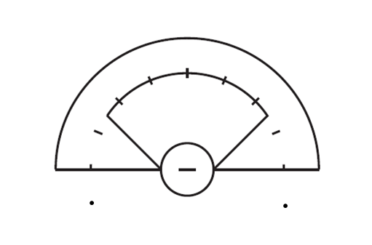
Umpire Triangle
DEEP TRAIL
C
LEAD
Notes:
Lead is covering the red area – on-ball here. C is off-ball. And Trail is off-ball.
We should emphasize that there are no lines on the field that say “this is where you stop looking!” Areas of coverage can and should overlap in the three-person system. IT DEPENDS on where the ball is in the CSA!

Slide 29
Responsibilities
Shooting Space
DFT/DP/Fouls after shot
Hold/Detain
Illegal Picks
Three Seconds
Restraining Line
Hold/Detain
Illegal Picks
Three seconds
DFT/DP/fouls after shot
Restraining Line
DEEP
TRAIL
C
LEAD
On-ball fouls
Goal Circle
Fouls After the shot
Notes:
Each official has specific responsibilities with each changing position of the ball is in the CSA. (Click once for each position) These responsibilities are listed in order of importance. Note who is off-ball and who is on-ball.
As we go though the next slide, pay particular attention to the underlined responsibilities! They change.
Where is the ball? Where are the players? A lot to consider when officiating the CSA!

Slide 30
Responsibilities Shift
DEEP
TRAIL
Hold/Detain
Illegal Picks
3 seconds
DFT/DP/Fouls after shot
Restraining Line
On-ball fouls
Shooting Space
DFT/DP/Fouls after shot
Hold/Detain
Illegal Picks
3 Seconds
Goal Circle
Restraining Line
C
LEAD
Hold/Detain
3 Seconds
Illegal Picks
Goal/Goal Circle
On-ball fouls
Notes:
Again, who is on-ball? (Click once for each position)
While C and Lead are both listed as ON-BALL, note that it is on the top of C’s list and the bottom of Lead’s list (point out the underlined (starred) responsibilities.) Also note that these responsibilities may vary a bit depending on the play. If offense is stacking players on C’s side, for instance, C may be in the best position to see an off-ball pick and make that call.
The responsibilities are not written in stone. We all help each other if one of us is drawn into an unusual situation.
You may want to include a situation where the ball is in the middle of the arc and how to maintain the triangle. (Big Picture) Looking for the possible direction of play and who will cover the middle – C or Trail?

Slide 31
Restarts Inside the RL
DEEP
TRAIL
C
LEAD
  End line and most restarts Below the Goal Line Extended will be the Lead
Notes:
Another coordination between 3 officials is who will restart play in an attacking end of the field?
Managing restarts for end line boundary and fouls below the goal line extended are generally the responsibility of the Lead.

Slide 32
Restarts Inside the RL
The Deep Trail will cover the A/B sideline when play is inside the Restraining Line
DEEP
TRAIL
C
LEAD
Notes:
In settled play inside the Restraining Line, the Deep Trail will cover the side boundary, both making the call and likely managing the restart of play.
In any stoppage of play requiring a whistle start, eye contact is with all officials is necessary to determine readiness.

Slide 33

Restarts Inside the RL
DEEP
TRAIL
C
C will cover this sideline and some restarts
LEAD
Notes:
In general, C will manage restarts in her general third of the field inside the Restraining Line, including her sideline.
Again, always look to Lead as the restart is occurring to see if the Lead is on ball. The Lead will let you know if they want you to restart play.

Slide 34

Restarts Inside the CSA
DEEP
TRAIL
C
LEAD
The Lead will restart play in the CSA.
Notes:
Inside the CSA ,the Lead will restart play – always with a whistle, never a self-start. Occasionally, the Lead may defer the start to the C if the ball is out by the 12-m fan on C’s side and Lead does not have a good angle.
Always look to your partners as you manage restarts anywhere on the field. Make eye contact before you initiate whistle restarts.

Slide 35
Restarts Inside the CSA
No Self-Starts – offense in the CSA!
No Self-Starts- defense in the last minute of each quarter and overtime.
All officials should work to preventively manage defensive false starts heading out of the CSA during the last minute of each quarter.
ACTIVITY:
Position Paddles
Notes:
When there is a defensive foul, players involved in the foul know to move to a hash or go 4m behind and wait for a whistle to restart play.
But what if there is an offensive foul in the CSA? Officials must use proactive officiating techniques to prevent self-starts when they are not allowed, in the last minute of each quarter and all of overtime.
When a foul occurs in the CSA, the official should clearly state: “whistle start”. This may prevent an anxious player from starting when it is not permitted.

Slide 36
Three-Person Pregame Discussion
Shared Areas
In the CSA, 8M, Between C and Trail
Communicating with The Crew
Before starting, after goals, players down
Coach Communication
Pre-game, Halftime/TO, Unruly coach(es)
Handout: Pregame Checklist
Notes:
Based on what you now know about the 3-person system, how do you think the pregame is different than the 2-person game?
Some topics remain the same (communication, coach interaction,) while others are more common in the 3-person system.

Slide 37
Three-Person Pregame Discussion
Shared Areas of Coverage
The Draw
In the CSA
Between C and Trail
Off Ball Responsibilities
  Counting # of players on field, between RL, players on circle; RL early entry, substitutions
Assistance with FPs, false starts, end line coverage
Restraining line coverage, middle of CSA coverage
DISCUSSION:
Three-Person Pre-Game Checklist
In transition, help on managing FP restarts, CSA play
Notes:
Discussion on Shared Areas of Coverage includes:
(click) The Draw – counting proper # of players before draw, players on circle, watching for early entry, illegal/legal substitutions
Officials need to make sure there are not too many players on the field, and that only 3 players from each team are between the RL. Also, be aware of any carded player waiting to enter and the potential for a violation should that player enter after the draw, and before possession is established.
In the CSA – Assistance with FPs, false starts, end line coverage
Between C and Trail – restraining line coverage, middle of the arc coverage
Off Ball – In transition, help on FP set ups, CSA play

Slide 38
Three-Person Pregame Discussion
Communication Between Partners
Managing Midfield Play
Look to Partner
Boundary Coverage
Restraining line
Off-Ball Responsibilities
Double whistles, restarts in shared areas
Managing restarts (eye contact in the CSA), boundary calls, fouls during/after the shot
Deep Trail covers side boundary in attacking end of the field
The “pick up/hand off ” between C and Deep Trail, setting up offside fouls
Transfer of information for 3 seconds, off-ball fouls in the CSA
Notes:
Communication Discussion includes:
(click) Managing Midfield Play – Double whistles, restarts in shared areas
(click) Look to Partner – Managing restarts (eye contact in the CSA), boundary calls, fouls during/after the shot
(click) Boundary Coverage – Deep Trail covers boundary in attacking end of the field
(click) Restraining Line – The “pick up/hand off ” between C and Deep Trail, setting up offsides fouls
(click) Off-Ball – In transition, setting up fouls in CSA, dangerous follow through, false starts

Slide 39
Three-Person Pregame Discussion
Coach Communication
Stick Check Requests
Questions during play
Unruly coaches
Game/Clock awareness
Who performs it?
Working as a team to respond, share information
Warning/carding procedure
Discussing rough play, upgrading cards, injuries (no coaching), OT procedures
Notes:
Discussion on Coach Communication includes:
(click) Stick Check Requests – who performs it?
(click) Questions during play – working as a team to respond, share information
(click) Unruly coaches – warning/carding procedure
(click) Game/Clock awareness – Discussing rough play, upgrading cards, injuries (no coaching), OT procedures

Slide 40
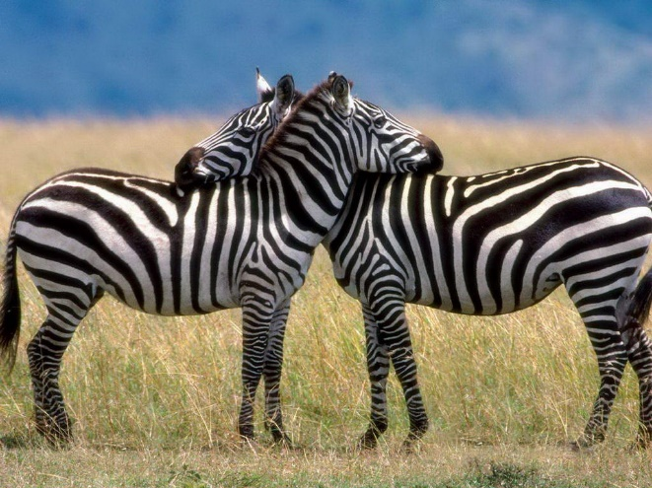
Teamwork
During the Game
Check in with partners throughout the game
Make eye contact, use directional signals
Talk through unusual incidents (when the clock is stopped)
Make sure you are “on the same page!”
Support your partners!
Don’t challenge them in front of others
Trust them to make calls
Be supportive and positive
Notes:
Establishing a good crew means all members feel comfortable and confident.
Whether a veteran official, or someone fairly new to the 3-person game, it’s the job of all officials to lift up and encourage their partners for a great team effort.

Slide 41

Teamwork
Post Game
Post game Discussion:
talk through unusual incidents
what could the team have done better?
what could you personally have done better?
Leave the field together!
Notes:
Note: If during your post-game discussion you would like to review any situation or call that you may have seen differently than your partner, always first ask “What did you see?” You might not have all of the information.
Support your partners on and off the field.

Slide 42
Teamwork divides the tasks and multiplies the success.
-- Author Unknown

