Slide 1
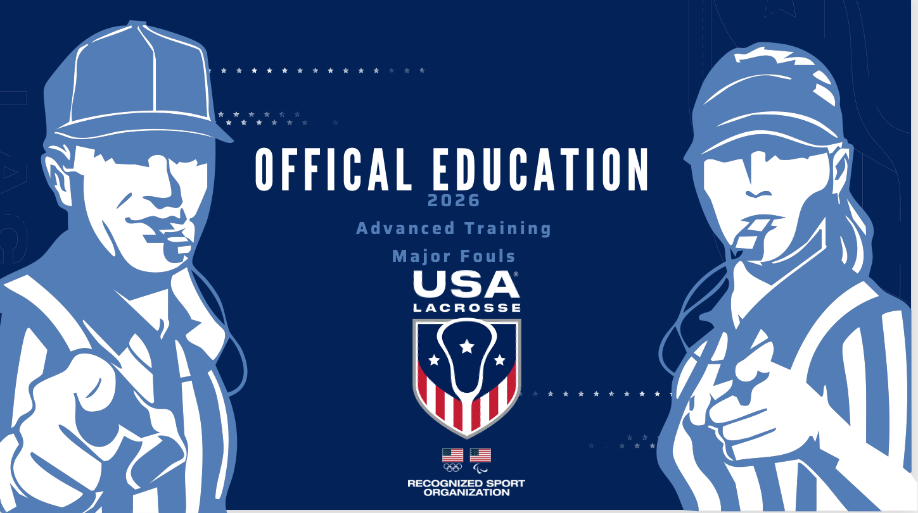

Slide 2
Major Fouls By Defense
Block
Holding
Dangerous Contact
Repeated Fouls
Misconduct/Carding
Notes:
These are more “Advanced” fouls to call – not fouls a new official may be able to identify.
Refer to pages of definitions in Rule Book (rule 6, rule 8)

Slide 3
Block
Use this link to access the
USL Women’s Officials’ Educational Development
YouTube Channel:
View the video ‘Block, Illegal Pick’
https://youtu.be/oZgSBZK0NUo
Notes:
Block the opponent by moving into the player’s path without giving them a chance to stop or change direction and contact occurs.

Slide 4
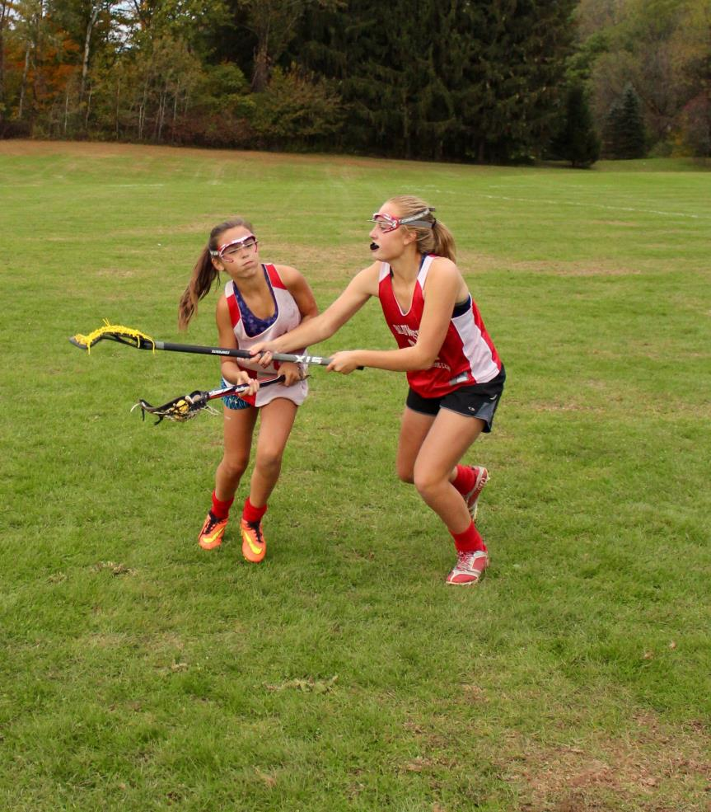
Holding
Defender uses her crosse to prevent player from
Continuing on her established path
Notes:
Used to be called “Detaining” May be a hold using the crosse (as shown)
Also includes grabbing the uniform Demonstrate a ‘hold’ with the body (or body part-leg, arm), or clothing.
Signal?

Slide 5
Dangerous Contact
Use this link to access the
USL Women’s Officials’ Educational Development
YouTube Channel:
View the video ‘Dangerous Contact’
https://youtu.be/uxWAvXp_SU4
Notes:
Any action that thrusts or shoves any player with or without the ball who is in a defenseless position.
This includes but is not limited to: head down, from out of the visual field, in the air, or out of balance, especially in the kidneys, ribs, lower back, shoulder blades or aimed at the neck or head.
Look for a defender making no attempt to play the ball!

Slide 6
Repeated Fouls
Multiple actions that are not considered fouls (Failure to move 4m away, self start beyond playing distance, etc.)
Delay of Game penalty
Multiple Minor fouls
Upgrade to Major Foul penalty administration
Multiple Major fouls
Misconduct
Notes:
Violations that are not fouls would warrant a Delay of Game call (green card)
2. Repeated Minor fouls can be penalized as a Major Foul.
Tells all players that repetitive fouls of this nature will not be tolerated.
3. Repeated major fouls are categorized as Misconduct. Yellow Card

Slide 7
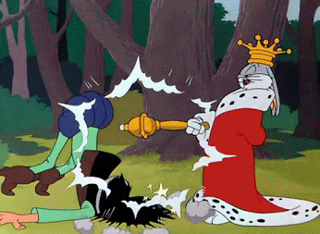
Why are Repeated Fouls Difficult to Call?
Notes:
There are a variety of circumstances to consider when repeated fouls may occur:
Repeated fouls by an individual player
Repeated fouls by a team – not one individual, but multiple players
Can be within a short period of time or extended throughout the game.
Can be intentionally committed to slow down a fast break or transition -- OR they may be entirely by accident!
Repeated fouls may or may not be dangerous or threaten a player’s safety on their own. But, when they are allowed to continue, they may escalate.
So What are we looking for when considering repeated fouls?

Slide 8
Factors to Consider
Offender
# of Fouls
Frequency
Intensity
Intent
Effect on Game
Notes:
Judging the occurrence and calling repeated fouls is more than counting fouls. It requires officials to consider a number of factors:
Who is the Offender?
How many Fouls have been committed?
How frequent is the player/team fouling?
How intense are the fouls?
Was it intentional?
And finally, how does it effect the game?

Slide 9
Repeated Fouls
Use this link to access the
USL Women’s Officials’ Educational Development
YouTube Channel:
View the video ‘Repeated Fouls Team’
https://www.youtube.com/watch?v=T0szHj7-QBw
Notes:
Discuss the multiple fouls by the same team. What was the intent of the team committing the fouls? How could officials have handled it better?

Slide 10
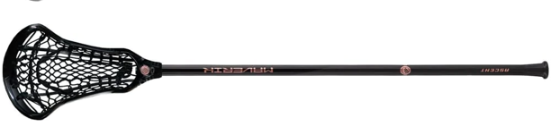
Three Seconds
No defender may remain in the 8m arc for more than three seconds unless she is marking an opponent within a stick’s length
Stick’s Length? 35 ½” to 43 ¼”
Does NOT include the arm!
Notes:
Demonstrate the idea of within a stick’s length. The player cannot extend the arm if they are trying to be within a stick’s length.

Slide 11
Three Seconds
Is the ball in the attacking end of the field?
Is the defender within a stick’s length of the opponent they are marking?
Yes?
Is the defender in the 8m arc?
Yes?
Yes?
No Call
No?
No?
No?
No Call
No Call
Is the defender marking an opponent directly behind the goal circle?
CALL!
No?
The defense is not exempt from the three-second rule by virtue of double teaming/multiple teaming a non-ball attack player in the arc.
Yes ?
No Call
Notes:
First rule of thumb – Make sure the ball is over the restraining line!
Official should check off all of these questions before making the call!
Regarding Double teams: the three-second count will continue against the original non-marking defense player within the arc, until there is again only one defender on the non-ball attacker.

Slide 12
Three Seconds
A1 D1
No defender may remain in the arc for more than 3 seconds unless she is marking an opponent within a stick’s length
Count begins when the ball crosses the restraining line into the attacking end of the field
D2
A2
Being part of a double team does NOT exempt the defender from 3 Seconds*
*Unless double team is on the ball carrier!
Notes:
Animation starts automatically
Define a stick's length. Demonstrate: butt of the stick in contact with your body and the opponent at or inside the length of that stick – IT DOES NOT INCLUDE THE EXTENSION OF ONE or both ARM(s) HOLDING THE STICK.
Where must the ball be for this call to be made? (Across the Restraining Line)
Define a ‘double team’ and why one of them may be called for 3 seconds (3 second count continues against the original non-marking defender within the arc, unless there is again only one defender on that player)
What if defender is in front of the Goal Circle and ‘marking the player behind’? (Defender is exempt from three seconds but may be in shooting space.)
Discuss why we have this rule and what might happen if we did not.

Slide 13
Exemption From Three Seconds Foul
A1
D2
D1
A2
Exempt from Three Seconds – NOT from Shooting Space!
Notes:
A defensive player, who is marking an unmarked opponent who is standing directly behind the goal circle is exempt from the three-second rule,

Slide 14
Three Seconds Foul Administration
Closest point to spot of the foul
A1
A1
Closest point to spot of the ball
A1
D1
D1
D1
D1
A1
Notes:
(Four clicks for animation)
Foul for Three Seconds ALWAYS occurs in the 8m arc.
Penalty Administration depends on spot of the ball:
(click)
Ball in the 8m Arc – FP on the nearest hash
(click)
Ball in the CSA, above GLE – FP on a spot on the 12m fan closest to the spot of the FOUL
(click)
Ball in the CSA, below GLE – FP on the nearest dot
(click)
NEW FOR 2023! Ball outside the CSA – FP on a spot on the 12m fan closest to the spot of the BALL

Slide 15
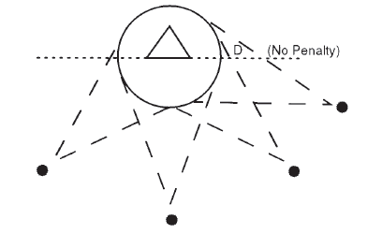
Shooting Space
While outside the goal circle, a player cannot guard the goal by obstructing the free space to goal, between the ball and the goal circle, and deny the attack the opportunity to shoot safely.
Notes:
The shooting space ”cone” is from the BALL to both sides of the goal circle.

Slide 16
Shooting Space
Is the ball carrier able to shoot safely?
Is the ball carrier in the CSA and above the Goal Line Extended?
Is the defender marking an opponent within a stick’s length?
Yes?
Yes?
Yes?
No Call
No?
No?
No?
No Call
No Call
Is the defender drawn into shooting space by following an attacker?
CALL!
No?
Defensive players who are double or multiple teaming a player without the ball and are within a stick’s length are exempt from shooting space.
Yes ?
No Call
Notes:
Able to shoot safely? Are arms free? Is she so closely marked that a shot would likely result in a dangerous follow through?

Slide 17
Shooting Space
Ball must be within the CSA and above GLE
Action must be initiated by the defender, not if they are drawn into path by attacker
Defender must not be marking within a stick’s length
A1
D1
No defender may guard the goal outside the goal circle in a way that denies the shooter the opportunity to shoot safely
D2
Notes:
No part of the body can obstruct the free space to goal.
The shooter must have the ‘opportunity’ to shoot’. The stick of player with ball has a clear ‘pathway to goal’ -- no one is in the cone (illustrated by the yellow triangle)
A closely guarded attacker (1 person, double or triple teamed) with the ball may have difficulty getting a clear ‘pathway; double or triple teams would make a safe shot much less likely.
Challenge the class to consider if ball carrier is not intending to shoot, but rather to pass - even if she has the pathway.
The defender in the Shooting Space “path” must be within a stick’s length of an opponent (“man-to-man” defense)
The defender must have initiated this position and was not drawn into this position by an attacker (running though the space while marking.)
Vinyl board scenarios:
Attack double teamed with no ‘pathway’ (opportunity) and lone Defender in front of goal (no SS)
Defender marking an opponent within a stick’s length and shooter within ‘pathway’ (no SS)
Ball outside the CSA (no SS)

Slide 18
Shooting Space?
A1
D3
D2
D1
Notes:
A1 Double teamed. No ‘pathway’ (opportunity) and lone Defender in front of goal (no SS)
Defender marking an opponent within a stick’s length and shooter within ‘pathway’ (no SS)
Ball outside the CSA (no SS)

Slide 19
Shooting Space?
A1
D2
A2
D1
Notes:
Defender marking an opponent within a stick’s length and shooter with ‘pathway’ (no SS)

Slide 20
Shooting Space?
A1
D2
A2
D1
Notes:
Ball outside the CSA (no SS)

Slide 21
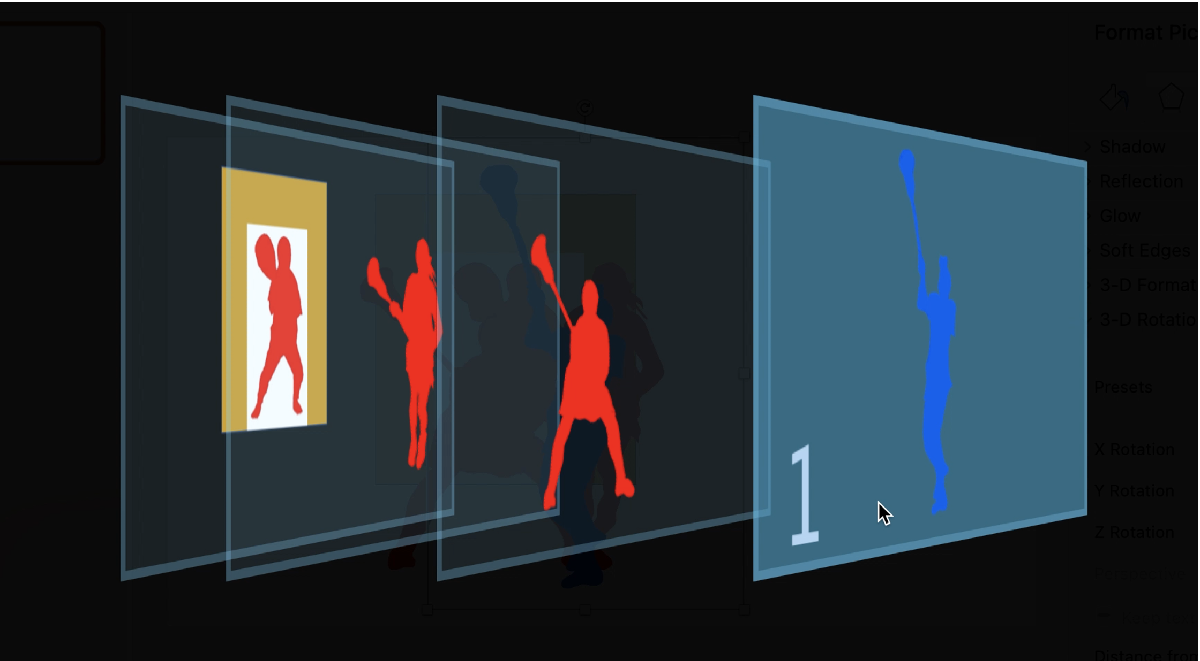
Seeing the Layers
3
2
Notes:
In making the Shooting Space call, you have to look beyond the ball carrier and her defender and see the players down low – the “layers” behind the initial defender – to have the information needed to make the call.
Blue (Layer 1) has the ball. If the closest defender (Layer 2) is within a stick’s length of 1, she is not in shooting space. However, the red defender in Layer 3 MAY be in shooting space.
Does the ball carrier have the opportunity to shoot? Is the Layer 2 defender denying that opportunity? I
f so, then the Layer 3 defender is NOT in shooting space.
But if Blue dodges Layer 2 and Layer 3 remains where she is, then she is definitely in shooting space.

Slide 22
Exemption From Shooting Space Foul
A1
D2
Defenders are Double Teaming and within a stick’s length
A2
D1
D3
Exempt from Shooting Space – NOT Three Seconds!
Notes:
Defensive players who are double or multiple teaming a player without the ball and are within a stick’s length are exempt from the obstruction of free space to goal.

Slide 23
Major Fouls in the CSA and the Goalie
If the goalie commits the foul, they must go behind. If it is a cardable foul, the new (substitute) goalie must go behind (empty net.)
If the goalie is out of the goal circle and does not commit the foul, they may go back in the goal circle before the free position is restarted.

Slide 24
Major Fouls By Offense
Dangerous Propel
Holding
Illegal Pick
Charge
Notes:
These are more “Advanced” fouls to call – not fouls a new official may be able to identify.
Dangerous Propel – does not have to be a shot and can be called if at a teammate (flick to save a ball going out of bounds)
Holding – Can be with the crosse, hand, body
Illegal Pick – Time and space are the essential elements here
Charge -- block or charge? Tough to determine (we will discuss)

Slide 25
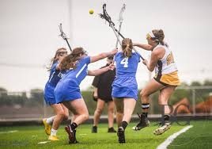
Dangerous Propel
MANDATORY CARD
Propel the ball with the crosse in a dangerous or uncontrolled manner at any time.
Notes:
A shot, throw, bat or flick of the ball without regard to the positioning of a field player is dangerous propelling
It disregards/jeopardizes player safety

Slide 26
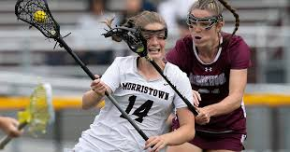
Holding
Detaining, restraining, tagging or pressing/pushing against the opponent’s body, clothing or crosse with an arm, leg, body or crosse
Notes:
Doesn’t have to be with the stick! Any action that prevents an opponent (with or without the ball) from continuing on their path
-Grabbing the jersey
-Holding them back with the stick
-Preventing them from moving through the CSA (path has to be established)
If defender is in place and opponent tries to push through to get where they want to be, could be forcing through (with crosse) or charge (with body)

Slide 27
Illegal Pick
Set a moving or stationary pick out of the visual field of an opposing player which does not allow
time or space to stop or change direction and contact occurs.
View the video ‘Block, Illegal Pick’
https://youtu.be/oZgSBZK0NUo
Notes:
NOTE: This video is the same as the ”block” video. Focus on the illegal pick here.
What is “The visual field”? (The area that can be seen when an eye is fixed straight at a point)
Was the pick in the visual field? If the player did NOT see the pick, could she have? Should she have? If the pick was in the visual field and she was not “aware”, that is NOT the same as being out of the visual field. If she could have/should have seen the pick and had time and space – it’s legal!

Slide 28
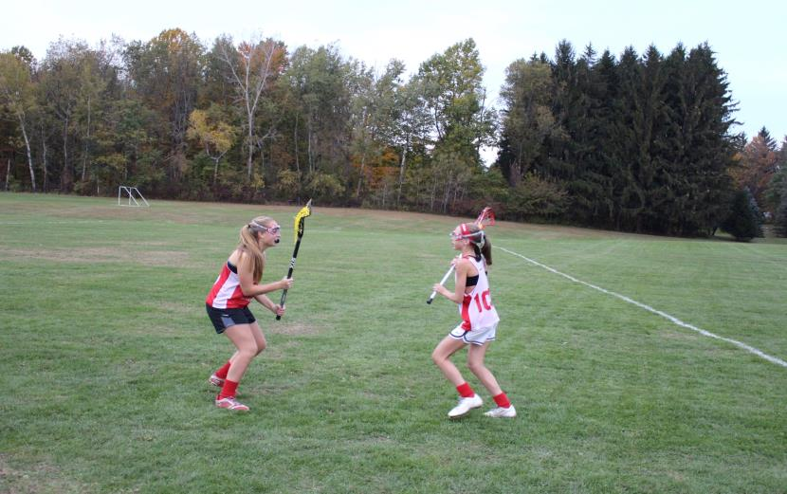
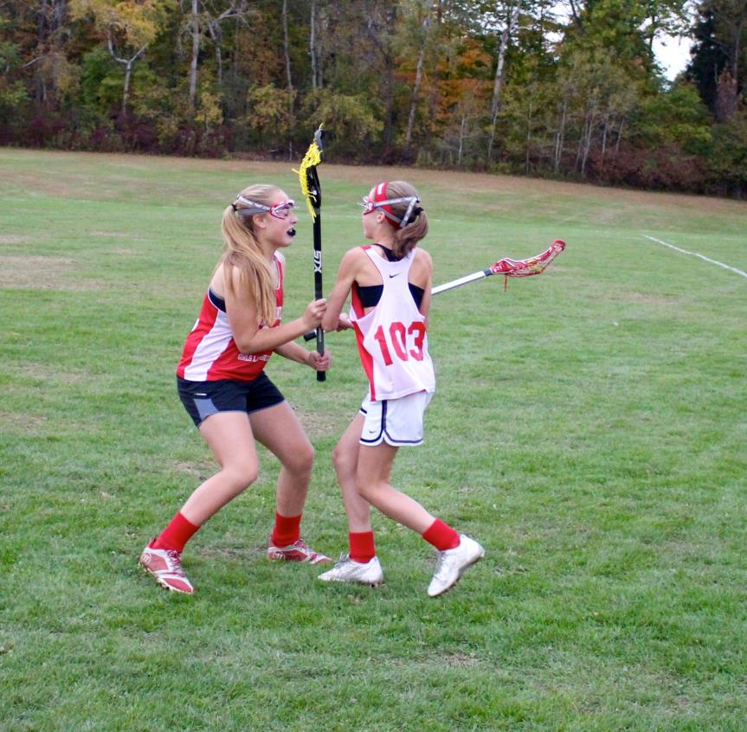
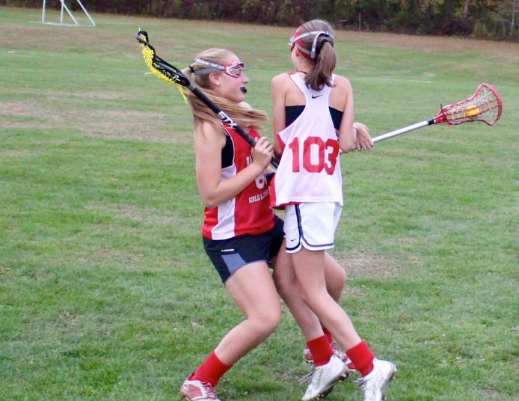
Charge
Defense established
Defender maintained space
CHARGE!
Offense has space to change direction
Offensive player went into her space
Notes:
Here is a good illustration of ‘time and distance’. The defender must give attack player the space to change direction and time to do it (slower players need more time/distance.). If attacker chooses not to change direction, and then she creates the contact, it is a charge.
With all fouls, consider “Who created the contact?”
The defender established her position and stayed there.
The offensive player moved into the defenders established space, therefore, the offensive player “created the contact”, and fouled.
Signal?

Slide 29
Charge
Use this link to access the
USL Women’s Officials’ Development YouTube Channel:
View the video ‘Charge’
https://youtu.be/-SKCiWeoy04

Slide 30
Attack Fouls in 8m Arc
A1
D1
When the attack fouls in the 8m arc, the player fouled will take the free position at the spot of the foul and may self-start.
Notes:
The defensive player is given the ball and may self-start
Officials still direct the offender “away” or “behind”… but the defender may self-start immediately.

Slide 31
Attack Fouls in CSA Below the GLE
A1
D1
When the attack fouls in the CSA but below the GLE, the player fouled will take the free position at the spot of the foul and may self-start.
Notes:
The defensive player is given the ball and may self-start
Officials still direct the offender “away” or “behind”… but the defender may self-start immediately.

Slide 32
Attack Fouls in CSA, Outside the 8m Arc
A1
D1
When the attack fouls in the CSA, between the 8m arc and 12 m fan, the player fouled will take the free position at the spot of the foul and may self-start.
Notes:
And when the attack fouls in the CSA above the GLE and not in the 8m ARC, (between the 8m and the 12m), the restart is at the spot of the foul.

Slide 33

Attack Fouls in the CSA
00:47
D1
A1
Preventative officiating during last minute of each quarter will ensure a fair restart for a defender.
Notes:
During the last minute of each quarter, ALL fouls in CSA require a whistle restart, regardless of whether offense or defense committed the foul.
The exception? If there is a 10-goal differential, the game clock will continue to run so officials will NOT call timeout for fouls in the CSA. Free positions for the attack will still require a whistle start, but defensive free positions will not.

Slide 34
Major Fouls on Scoring Play –
Held Whistle

Slide 35
Held Whistle
A held whistle is in effect when an attack player in the critical scoring area is on a scoring play and a defender commits a Major foul, but the ball carrier retains possession of the ball
and continue their effort towards goal
OR
An attack player in the critical scoring area is on a scoring play and a Major foul is committed against an attack teammate without the ball.
In both instances, the official will raise a YELLOW FLAG to acknowledge the foul but let play continue . (Rule 11 art. 1)
Notes:
What is Advantage? Where else can we use it?

Slide 36
If Criteria Met :
Pull Yellow Flag
(shows recognition of foul)
Hold up until:
Scoring play ends
Another foul occurs
Attack shoots
Ball Is In the Critical Scoring Area?
Attack On a Scoring Play?
Major Foul by Defense?
Notes:
Relate the ‘held whistle’ to the advantage arm on a midfield ‘held’ ( “I see the foul but you’re doing ok so I’m not going to call it”)
The Major foul need not be on the attacker with the ball but any major foul on any attacking player on this scoring play.
Could the flag be raised by the Trail official? (yes) In what scenarios could the Trail raise the flag? (to demonstrate a held whistle on an off-ball foul the Trail sees)
Discussion on the “scoring Play” . What is it?

Slide 37
Scoring Play
A continuous effort by the attacking team within the CSA to move the ball toward the goal and to complete a shot on goal.
Offense spread wide (don’t want to go to goal? No scoring play)
Ball passed behind the goal (setting up a play? Scoring play over. Continuing to move the ball towards goal? Possible scoring play)
Cutting and passing through the CSA (no attempt to take a shot? No scoring play)
Notes:
If the offense is on a “stall” and is spreading wide and just passing the ball, they are NOT looking to go to goal. This is NOT a scoring play.
If the ball is passed below the goal line extended and behind the goal, it MAY be the end of a scoring play. If the ball carrier stops and calls out a play/looks for an open teammate, the scoring play is likely over. If the ball carrier continues around the goal circle/quickly passes the ball back into the 8m arc, it may the continuation of a scoring play.

Slide 38
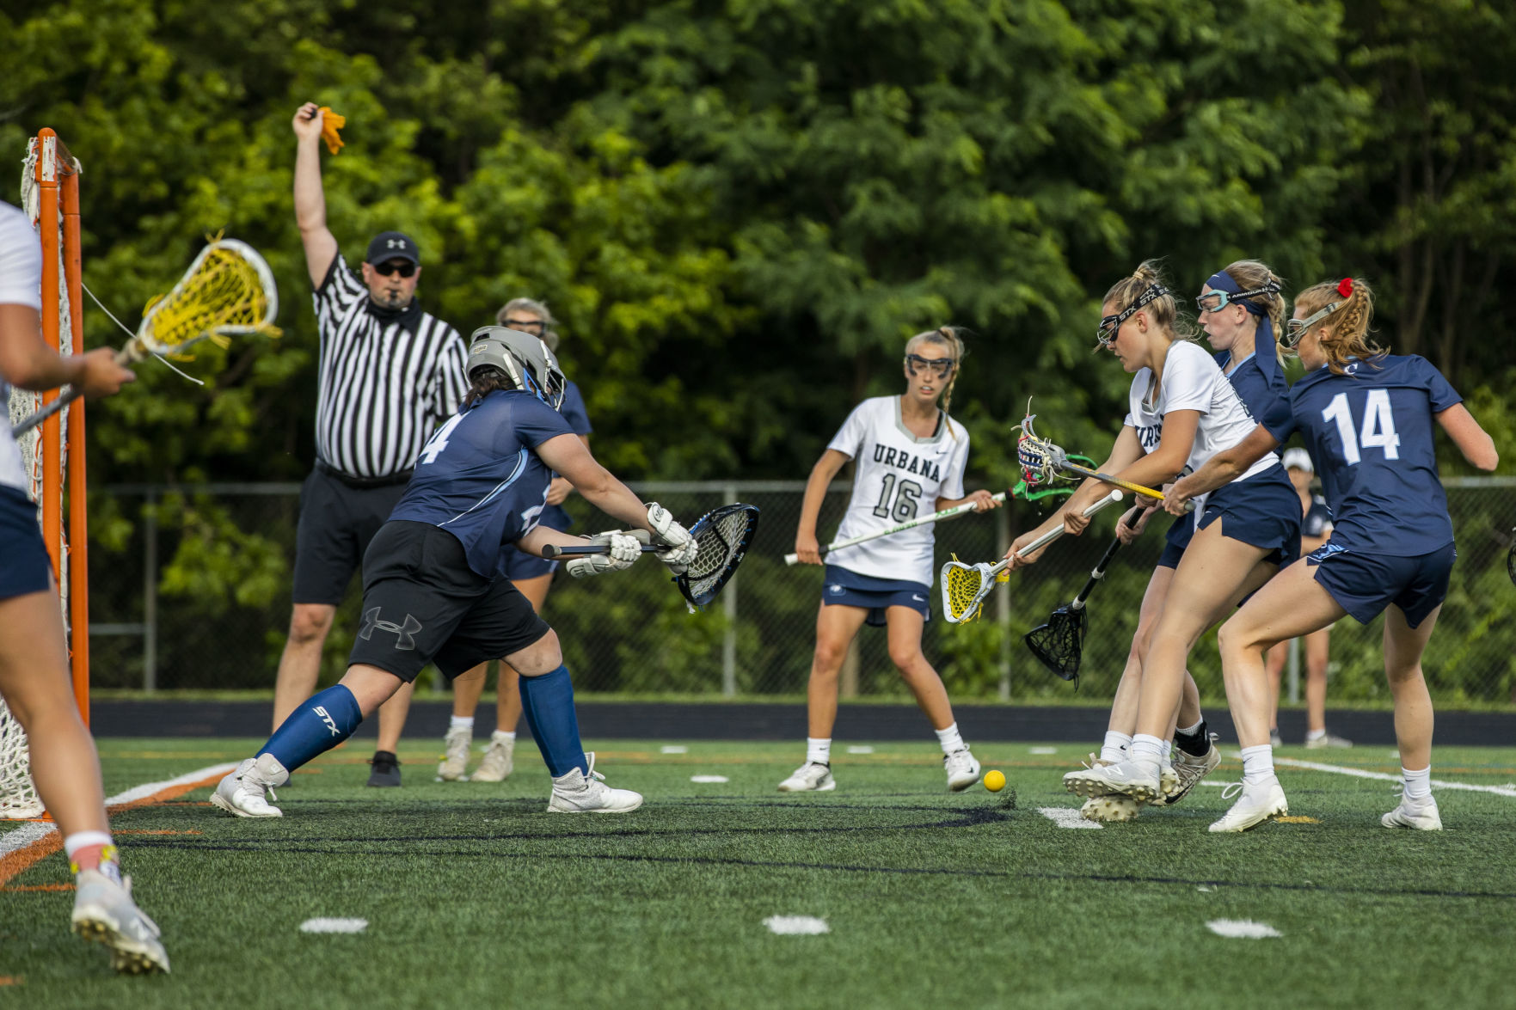
When Is A Scoring Play Over?
A shot is taken
Was it a pass or a shot?
The attacking team loses possession of the ball (A bounce pass is not considered loss of possession)
The attacking team passes or carries the ball behind the level of the goal line AND stops the continuous attempt to score
Notes:
Knowing when a scoring play is over is important! Official either puts away the flag and play continues OR a free position is set up.
If officials are unsure if the movement of the ball was a pass or a shot, call timeout and discuss!
If the ball carrier was fouled – major or minor -- during a held whistle (flag), the free position is awarded on the 8m hash closest to the spot of the most recent foul.
Going below the GLE does not ALWAYS mean a scoring play is over

Slide 39
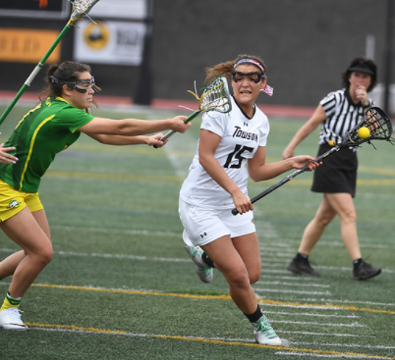
When Is A Scoring Play Over (continued)?
The attacking team stops the continuous attempt to score, or the player with the ball is forced by the defense to lose forward momentum
Did the defense block the attacker?
The attacking team fouls
ALTERNATE POSSESSION!
Notes:
If the ball carrier is prevented from continuing to move the ball by a defensive block, penalize the block and set up the free position on the 8m hash closest to where the block occurred.
If the attacking team fouls during a held whistle, it is an Alternate Possession – UNLESS the defensive foul was a cardable foul! In that case, Alternate Possession will NOT apply. The attacking team will be awarded the free position and the defensive team will be down a player.

Slide 40
Foul Affected the Shot
If shot is taken and no additional foul occurred, the “advantage” is over. Flag is put away and play continues.
If an additional foul affected the shot (ball carrier was fouled during the act of shooting), the official can award a free position for the most recent foul.
Notes:
How do you tell if the foul affected the shot? Was ball carrier displaced in the act of shooting? Did the trajectory of the ball change due to the foul? Did the foul affect the accuracy of the shot?

Slide 41
Any Questions?

