Slide 1


Slide 2
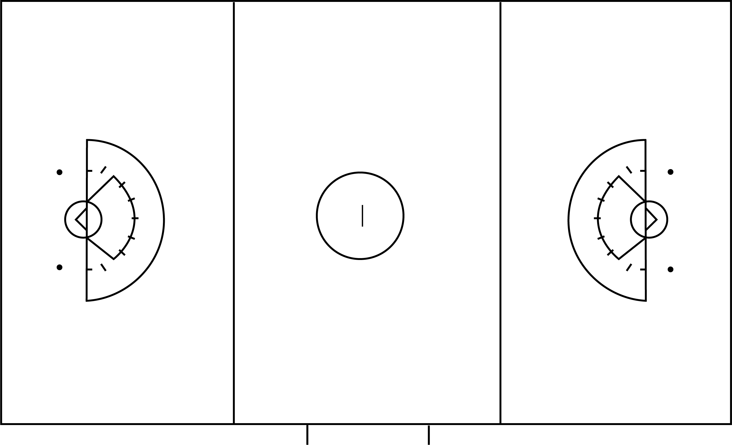

table
4m
Must be 30 yds
10-20 yds
Field Width 60-70 yds
Field Equipment, Uniforms and Field Personnel
Field Length 110-140 yds
3
Notes:
Field size: Maximum – 140 yards x 70 yards Minimum – 110 yards x 60 yards. Goals may be 90-100 yards apart. There maust be 10 to 20 yards behind each goal line.
Optimal field is 120 yards x 65 yards, with goals 100 yeards apart and 10 yards of space behind each goal line. Additional space outside the playing area is required.
4 meters of space between the sideline boundary and scorers table and 4 m between the other sideline and any other spectator area
Two dots must be 5 yds below the marks on the goal line extended
Flexible cones, pylons or flags must be used to mark the corners of the field.

Slide 3
Must be 30 yds
Restraining line
Restraining line
Field Equipment, Uniforms and Field Personnel
4
Notes:
The Restraining line is 30 yards from each goal line and extends the width of the field
Restraining lines are used both during the draw to hold players out of the area between them until possession has been gain, as well as during play limiting the number of players from both teams playing at one time in the attacking and defending ends of the fields.

Slide 4
Rule 1:The Field and Markings
Team Bench
Team Bench
Table
Penalty Area
Team Substitution Area
4m
Coach Area
Coach Area
Field Equipment, Uniforms and Field Personnel
10 yds
Restraining Line
Restraining Line
4
Notes:
Team Substitution Area is sectioned off by two hash marks, 2 to 4 meters in length
Penalty Area is directly in front of the scorer’s table. Player serving a penalty must sit or kneel in this area.
Team bench area is from the end of the substitution area to their team’s restraining line and even with the scorer’s table. Non-playing team personnel must remain in their team area.
Coaching Area extends from their side of the substitution area to their end line

Slide 5
Unified Field
Field Equipment, Uniforms and Field Personnel
5
Notes:
In some cases, the game will be played on a “unified field” that will accommodate both boys and girls’ lacrosse.

Slide 6
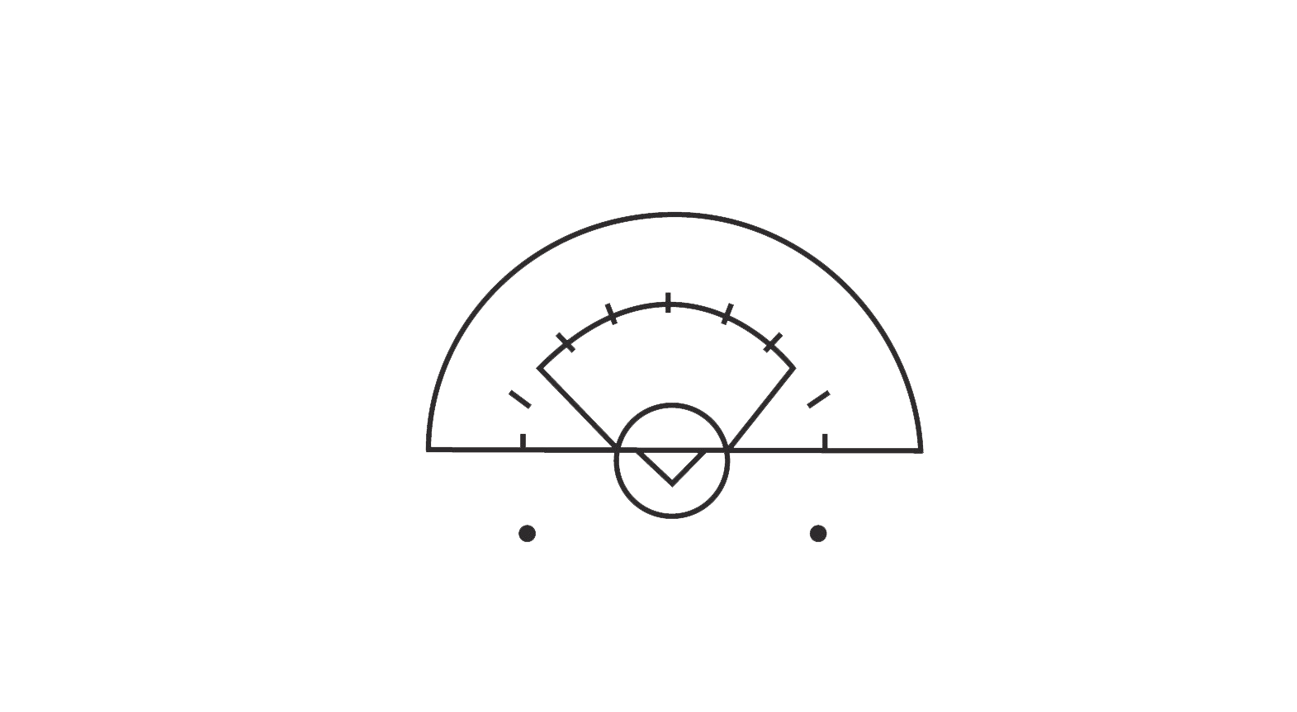
Critical Scoring Area
12m Fan
8m Arc
This area is not marked on the field but is part of the CSA
Field Equipment, Uniforms and Field Personnel
9

Slide 7
Critical Scoring Area
Center Hash
Second Inside Hash
Second Inside Hash
First Inside Hash
First Inside Hash
Outside Hash
Outside Hash
Field Equipment, Uniforms and Field Personnel
The “Dots”
10
Notes:
Click to start animation
Review the names for the markings in the CSA

Slide 8
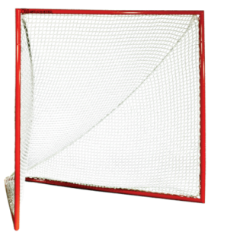
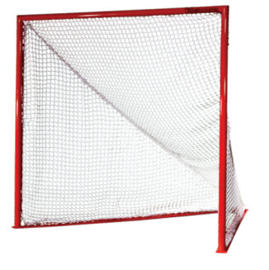
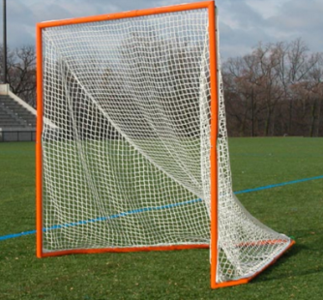
Good Goals and Bad Goals
This cage goes straight back before it angles to the point in the back.
Field Equipment, Uniforms and Field Personnel
Bad
Flat bottom –
needs NO padding
Good
No angle and rounded pipe
Good
8
Notes:
Animation starts automatically
Goals: Six feet high, six feet wide. Posts must be white, orange or silver, 1 ½ inches in diameter.
Prior to the start of any game you should inspect the goals to be sure the pipes are flat, go straight back or are padded; along with that check the netting to be sure there are not holes where the ball can go through. This will ensure that you do not miss calling a goal if the ball went through the hole and out the back.

Slide 9
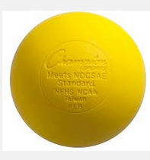
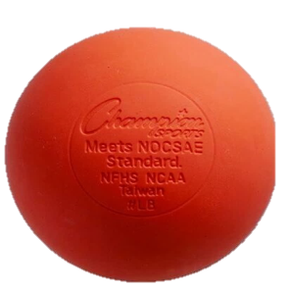
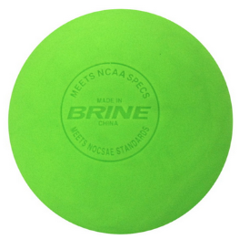
The Ball
Shall be Yellow, Bright Orange or Lime Green
Must have “Meets NOCSAE Standard” on ball
Field Equipment, Uniforms and Field Personnel
Activity: Label The Field
9
Notes:
Distribute Unified Field diagram and “Label the Field” activity sheet. Work in pairs, groups, etc. to complete the activity.
If possible, walk the field to demonstrate proper field inspection

Slide 10
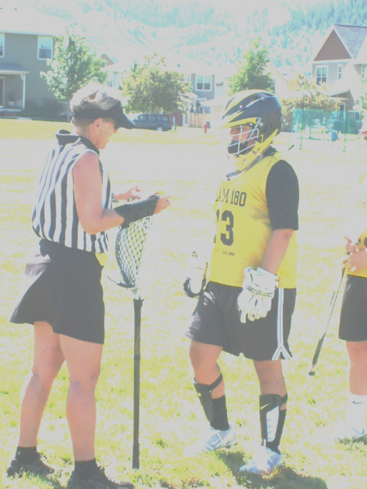
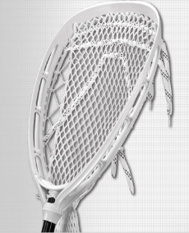
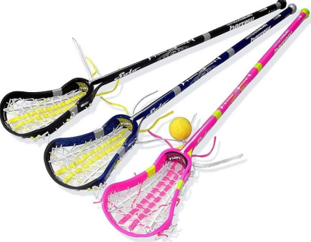
Equipment and Uniforms
Crosse
Uniforms
Personal Equipment
Protective Equipment
Field Equipment, Uniforms and Field Personnel
10
Notes:
Refer to rule 2 in the rulebook and review criteria for ball, crosse, Personal Equipment and Uniform.
Officials must check field players AND goalies for proper equipment

Slide 11
Crosse (Lacrosse Stick)
Field Player
Goalkeeper
Between 35 ½ inches and 43 ¼ inches long
Ball must move freely in pocket
Top of ball must remain above sidewall on both front and back of pocket
Between 35 ½ inches and 52 inches long
May be synthetic or mesh
Ball must move freely in pocket laterally and length
Field Equipment, Uniforms and Field Personnel
11
Notes:
Animation starts automatically
Note: Instructors should bring sticks (if available) to show the class and use in demonstrations
The players’ sticks are called crosses. A field player’s crosse may be between 35 ½ and 43 ¼ inches long.
When checking the pocket of a field player’s stick: Drop the ball into the front of the pocket of the crosse. Observe that the top of the ball remains above the sidewall of the crosse. Repeat on the back side of the pocket. The ball must also move freely in the pocket and roll out of the pocket when the shaft is tilted 90 degrees.
The goalkeeper’s crosse may be between 35 ½ and 52 inches long.
A Head coach may request a measurement on any opposing player’s crosse anytime the game clock is stopped. This includes following goals and OT.

Slide 12
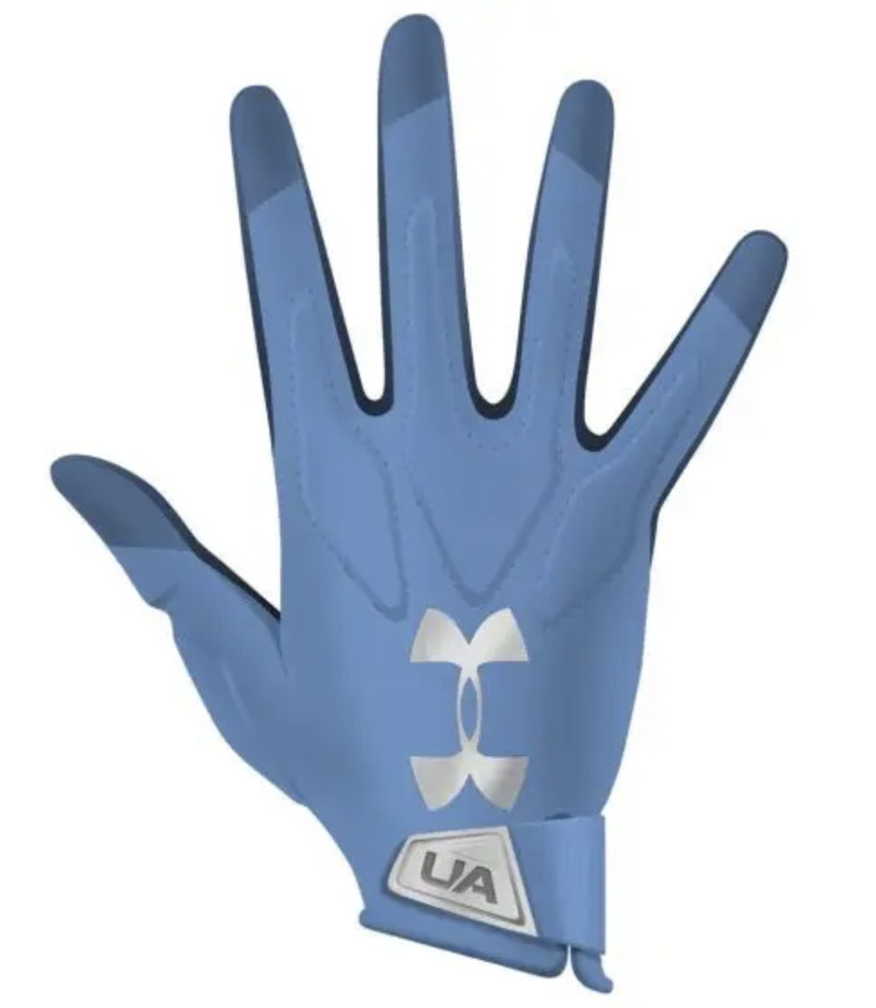
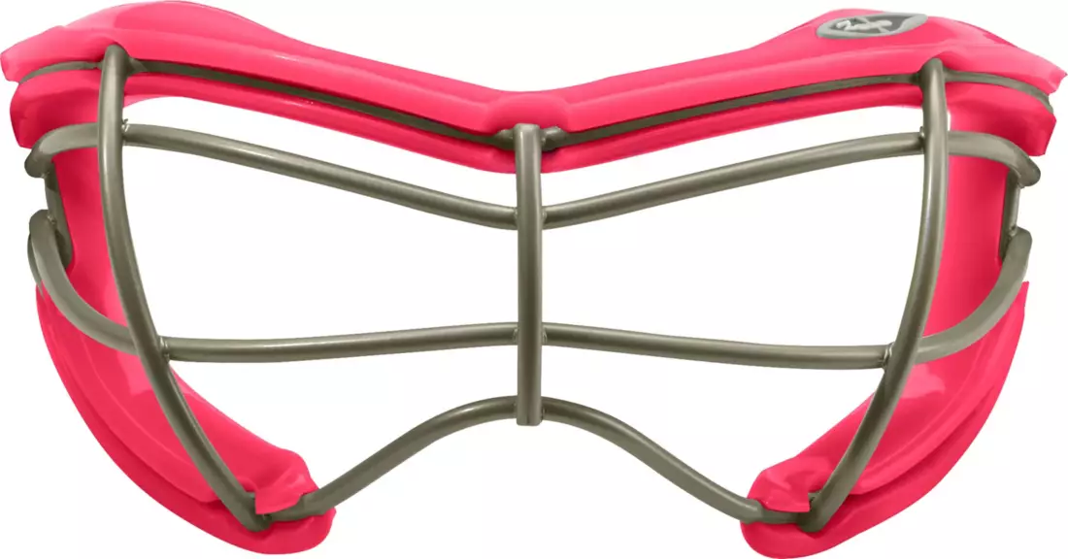
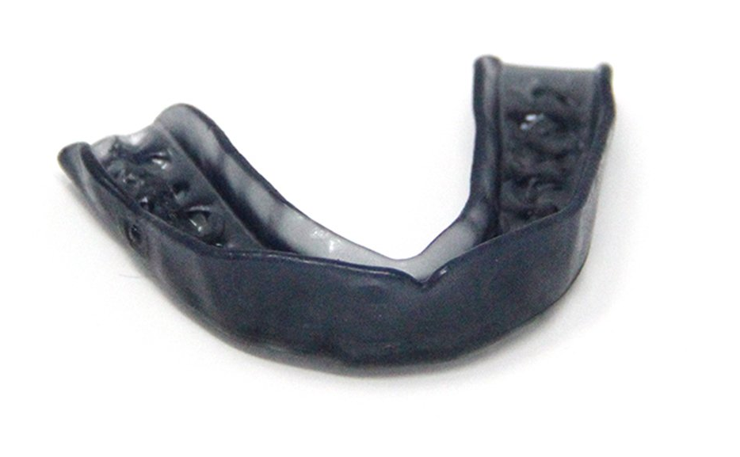
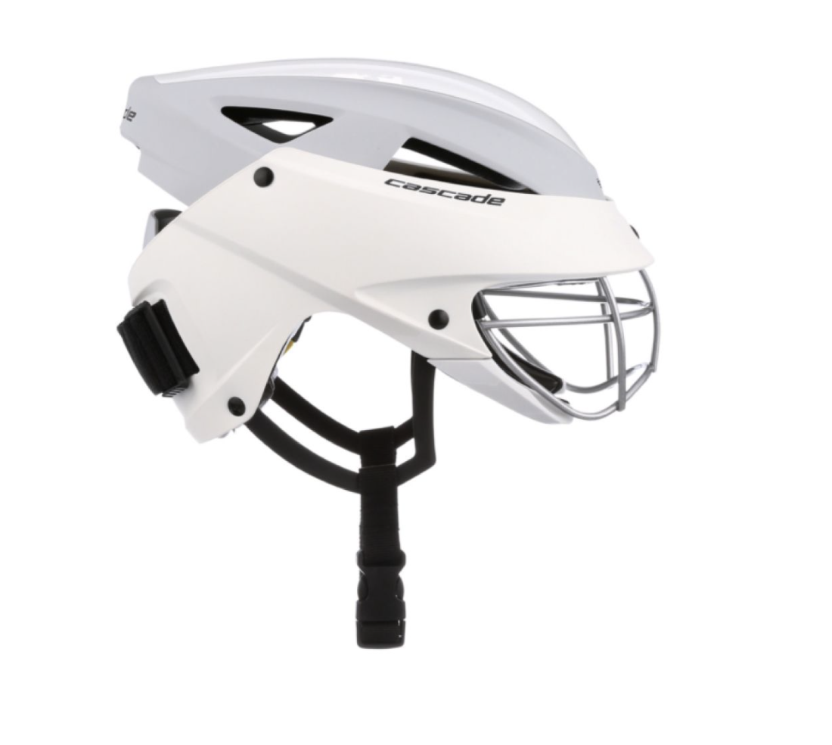
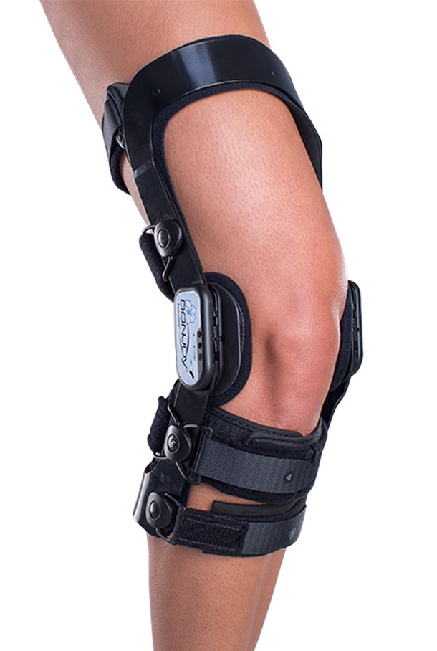
Mandatory Equipment: Field Players
Close-fitting gloves, cloth sweatbands, hair ties, etc. may be worn on the hand/arm
Eyewear
Must be ASTM 3077 approved
Mouthguard
Field Equipment, Uniforms and Field Personnel
Medical devices may be worn as long
as they do not endanger other players
Headgear
ASTM 3137 approved may be worn
12
Notes:
Refer trainees to the USL Website for approved eyewear (uslacrosse.org) . Note that some are ‘optional’. You will be checking for all this when you do the stick check at the beginning of the game.
Be sure they know all field players MUST have eyewear and mouth guard, everything else is optional.
Soft face masks are permitted. Protective molded face masks are STILL NOT permitted.

Slide 13
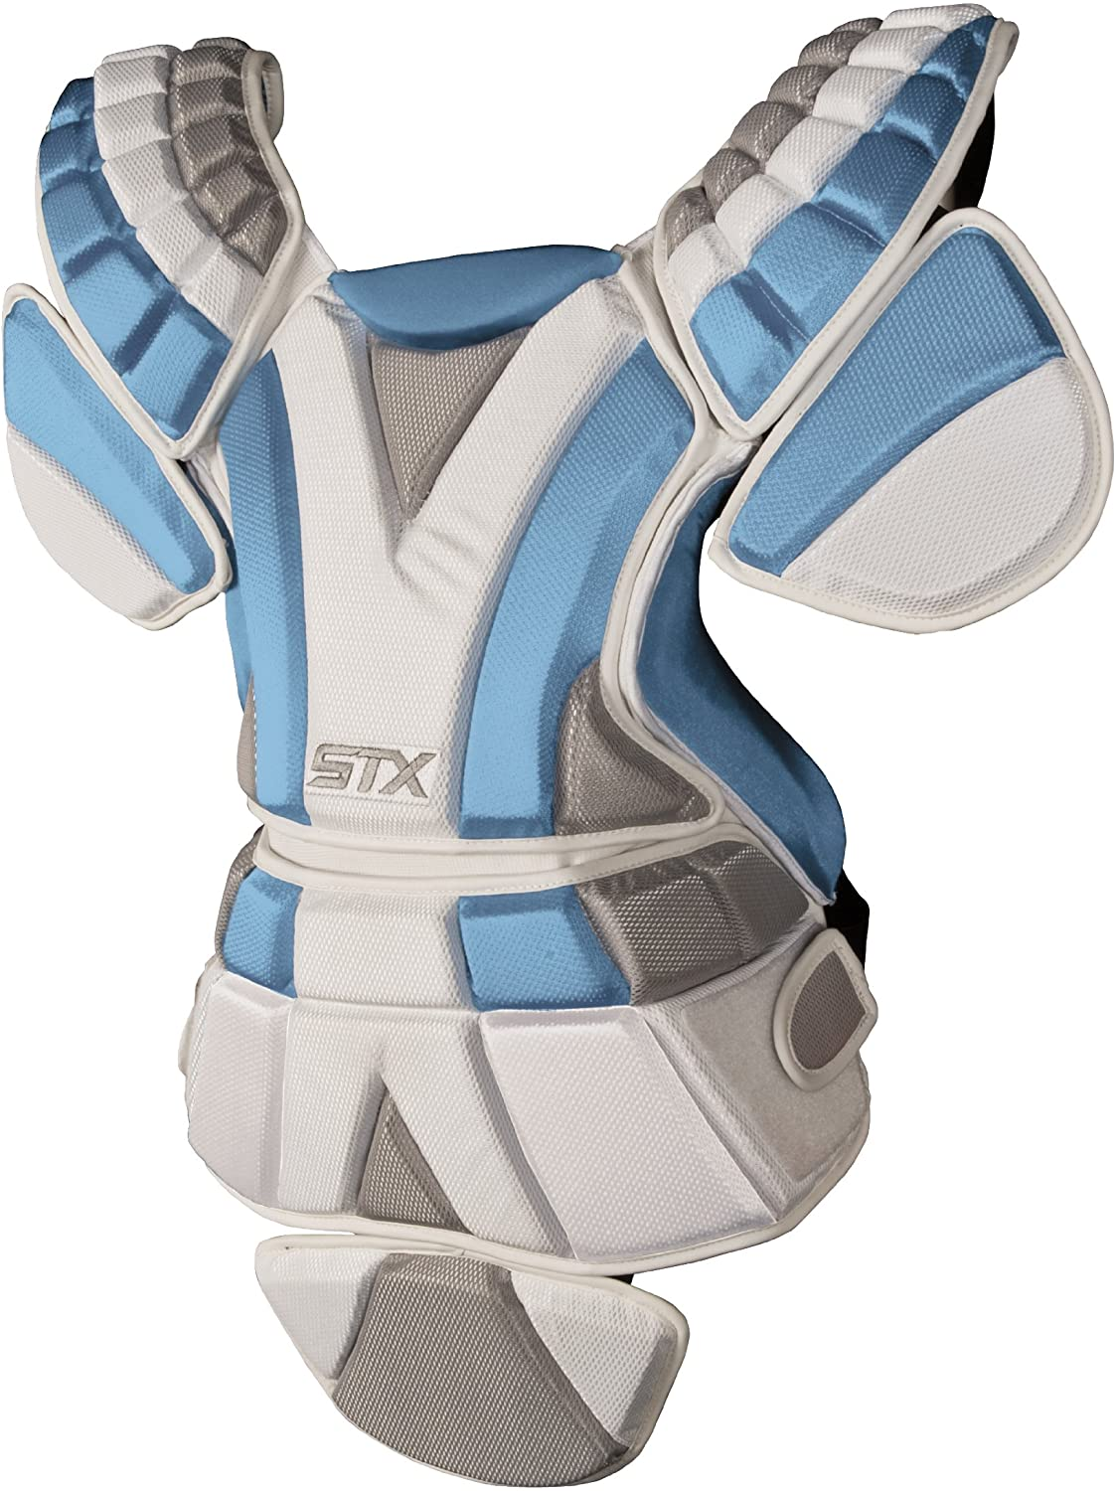
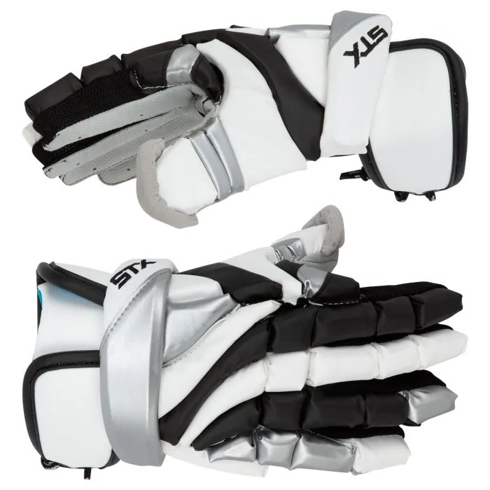
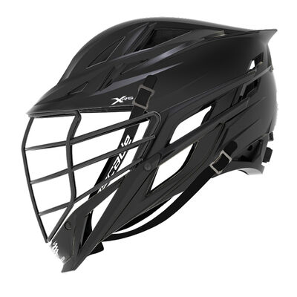
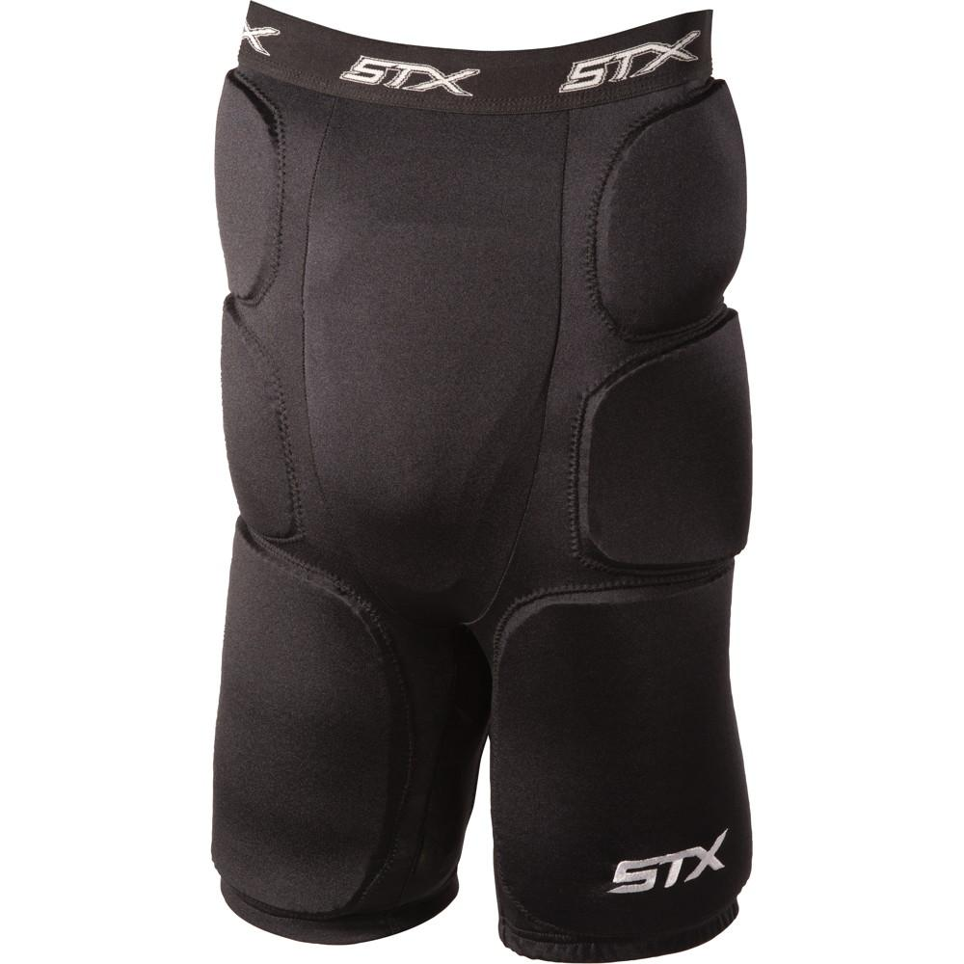
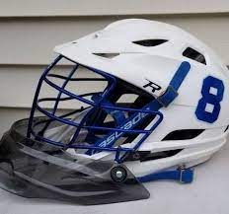
Mandatory Equipment: Goalies
Chest Protector
Designed for lacrosse
Must meet NOCSAE
standard
Padded Gloves
(Padding on arms and shoulders recommended)
Helmet
With facemask and chinstrap
Throat Protector
Separate; may be attached to helmet
Field Equipment, Uniforms and Field Personnel
Mouthguard
Protective Padding on Thighs
13
Notes:
Goalkeeper helmet must be NOCSAE-certified. Chest protector must have met the NOCSAE ND200 lacrosse standard at the time of manufacture. Coach will certify this during captain’s meeting.
The goalkeeper MUST wear all these items – no exceptions!
Shin guards are not REQUIRED
A goalkeeper may wear a clear, molded and non-rigid helmet eye shield

Slide 14
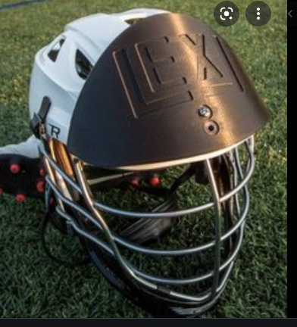
Illegal Goalkeeper Equipment
This shield is NOT allowed
Field Equipment, Uniforms and Field Personnel
14
Notes:
This may be called a “Lexi shield” and attached to the front top of the goalkeeper’s helmet. This is NOT allowed for NFHS girls lacrosse.

Slide 15
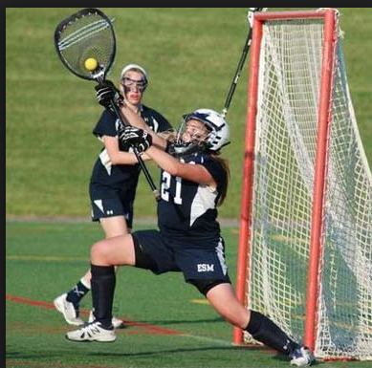
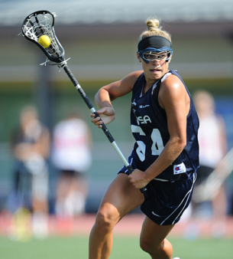
Equipment
Helmet with Facemask
Goggles
Padded Gloves
Separate Throat Protector
Mouth guard
Mouth guard
Chest Protector
Field Equipment, Uniforms and Field Personnel
Thigh Protection
Field Player
Goalkeeper
15
Notes:
Animation starts automatically
Here is an easier inventory graphic for you. You have to check all this equipment before the start of the game
Molded face masks on any player are not permitted.
Any player may wear eyeglasses, either tinted or clear, that are SEI certified.

Slide 16

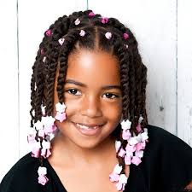
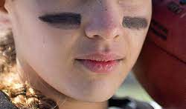
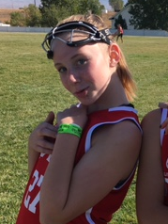
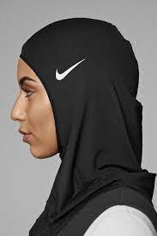
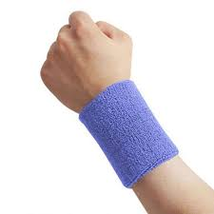
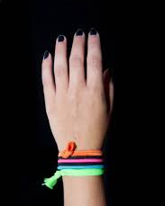
Optional Personal Equipment
All of these are LEGAL
Field Equipment, Uniforms and Field Personnel
16
Notes:
Eye Black must be one solid stroke with no logos/numbers/letters and shall not extend further than the width of the eye socket or below the cheekbone
Close-fitting cloth sweatbands, hair ties, soft bracelets may be worn on the arm
Barrettes and other hair adornments that are securely fastened are legal as long as they do not endanger other players.
Head coverings may be worn. Must be made of non-abrasive material and fit securely.

Slide 17
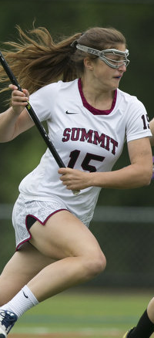
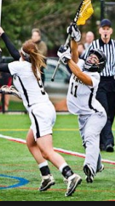
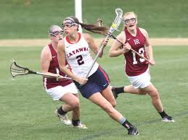

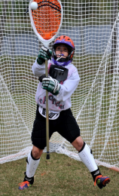
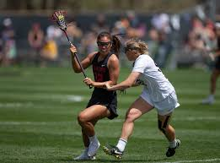
Uniforms
Field Player
Goalkeeper
Jersey: Single solid color
Jersey:
Must be same color as team
Kilts, shorts or pants:
Same dominant color do
not need to match jerseys
Pants or shorts:
Same color as team or white,
black or gray
Field Equipment, Uniforms and Field Personnel
Home Team: light jerseys
Visitors: Dark jerseys
Chest or shoulder equipment
must be worn under jersey
17
Notes:
The jersey’s do not need to be the same color as the kilts, shorts, pants.
Numbers on jerseys can be between 0- 99
Visible under garments must be one solid color by the entire team, white, grey, black, or uniform color.
Goalkeepers may wear shorts, pants or a kilt that is the same color the team is wearing; OR she may wear black, white or gray.

Slide 18

Game Personnel
Teams
Any number up to 12 players on the field at one time
One MAY be a goalkeeper
Head Coach
Must certify equipment is legal
Can request a timeout
Must submit roster to the scorer 10 minutes prior to game time
Game Administrator
Ensures game timer and scorer are on hand and field is safe for play
Handles game management issues
Field Equipment, Uniforms and Field Personnel
18
Notes:
Teams do not have to have 12 players on the field to start the game.
Head Coach certifies all equipment meets NFHS standards. This includes all goggles, headgear, and goalie equipment.
Game Administrators are not required but are strongly recommended. If unavailable, head coach of home team assumes responsibilities.

Slide 19
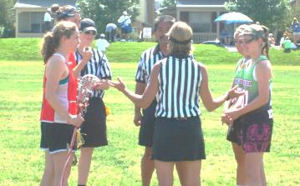
Officials
Game officiated by two officials certified for the game by the authority having jurisdiction
Inspect grounds and equipment prior to game
Ensure timers and scorers understand their responsibilities
Conduct Captains’ and Coaches’ meeting
Game Personnel
Team Captains
Meet with officials before the game
May ask for clarifications of the rules
Scorer and Timer
Must sit at the table
Records cards, timeouts, alternate possession and goals
Keeps official game time and time of card penalties
Field Equipment, Uniforms and Field Personnel
19
Notes:
Game Administrator can be the home coach if no administrator is present.

Slide 20
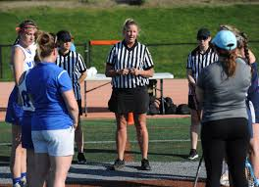
Captain’s/Coaches Meeting
Introductions
Coaches certify players are legally
dressed and equipped
3. Site Administration (ask the home coach)
4. Field marking
5. Coin toss
(Visitor calls tails)
6. Questions?
Field Equipment, Uniforms and Field Personnel
Discussion: “Pregame Responsibilities”
20
Notes:
Use the DISCUSSION; “Pregame Responsibilities” Guide to what needs to happen before each game.

Slide 21
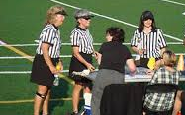
Meeting with the Table Personnel
Introductions
Scorer?
List players in book
Record goals, timeouts, cards, AP
Blow the horn for illegal substitute
Timer?
Set clock for pregame protocol
Halftime
Stop the clock on our signal
Start the clock on the whistle
Time outs
3. Questions?
Field Equipment, Uniforms and Field Personnel
21

Slide 22
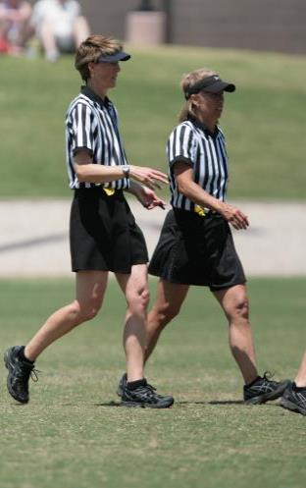






Summary of Pregame Duties
Confirm that the Scorer and Timer understand their job responsibilities
Conduct Captains’ and Coaches’ meeting
Arrive on-site 30 minutes before the game
Inspect the field and goals, and conduct pregame discussion with partner
Field Equipment, Uniforms and Field Personnel
Perform equipment, uniform, and stick checks for each team
22
Notes:
Review each one of the Officials duties.
Remind participants about being professional from the time they arrive until they depart. Part of being professional is arriving on time, inspecting the field and following the pregame duties listed here.

Slide 23
Review: Equipment and Personnel
1. A flat bottomed goal cage is legal and needs no padding (T/F)
2. The ball may be orange (T/F)
3. The winner of the coin toss may choose an end of the field to defend first (T/F)
4. A player’s stick may have a mesh pocket (T/F)
5. A player may wear eye black that covers their eyelids (T/F)
6. Goalies must wear shin guards (T/F)
PRESENTATION TITLE HERE
23
Notes:
Click for next question
Answers:
True
True
True
True
False
False

Slide 24
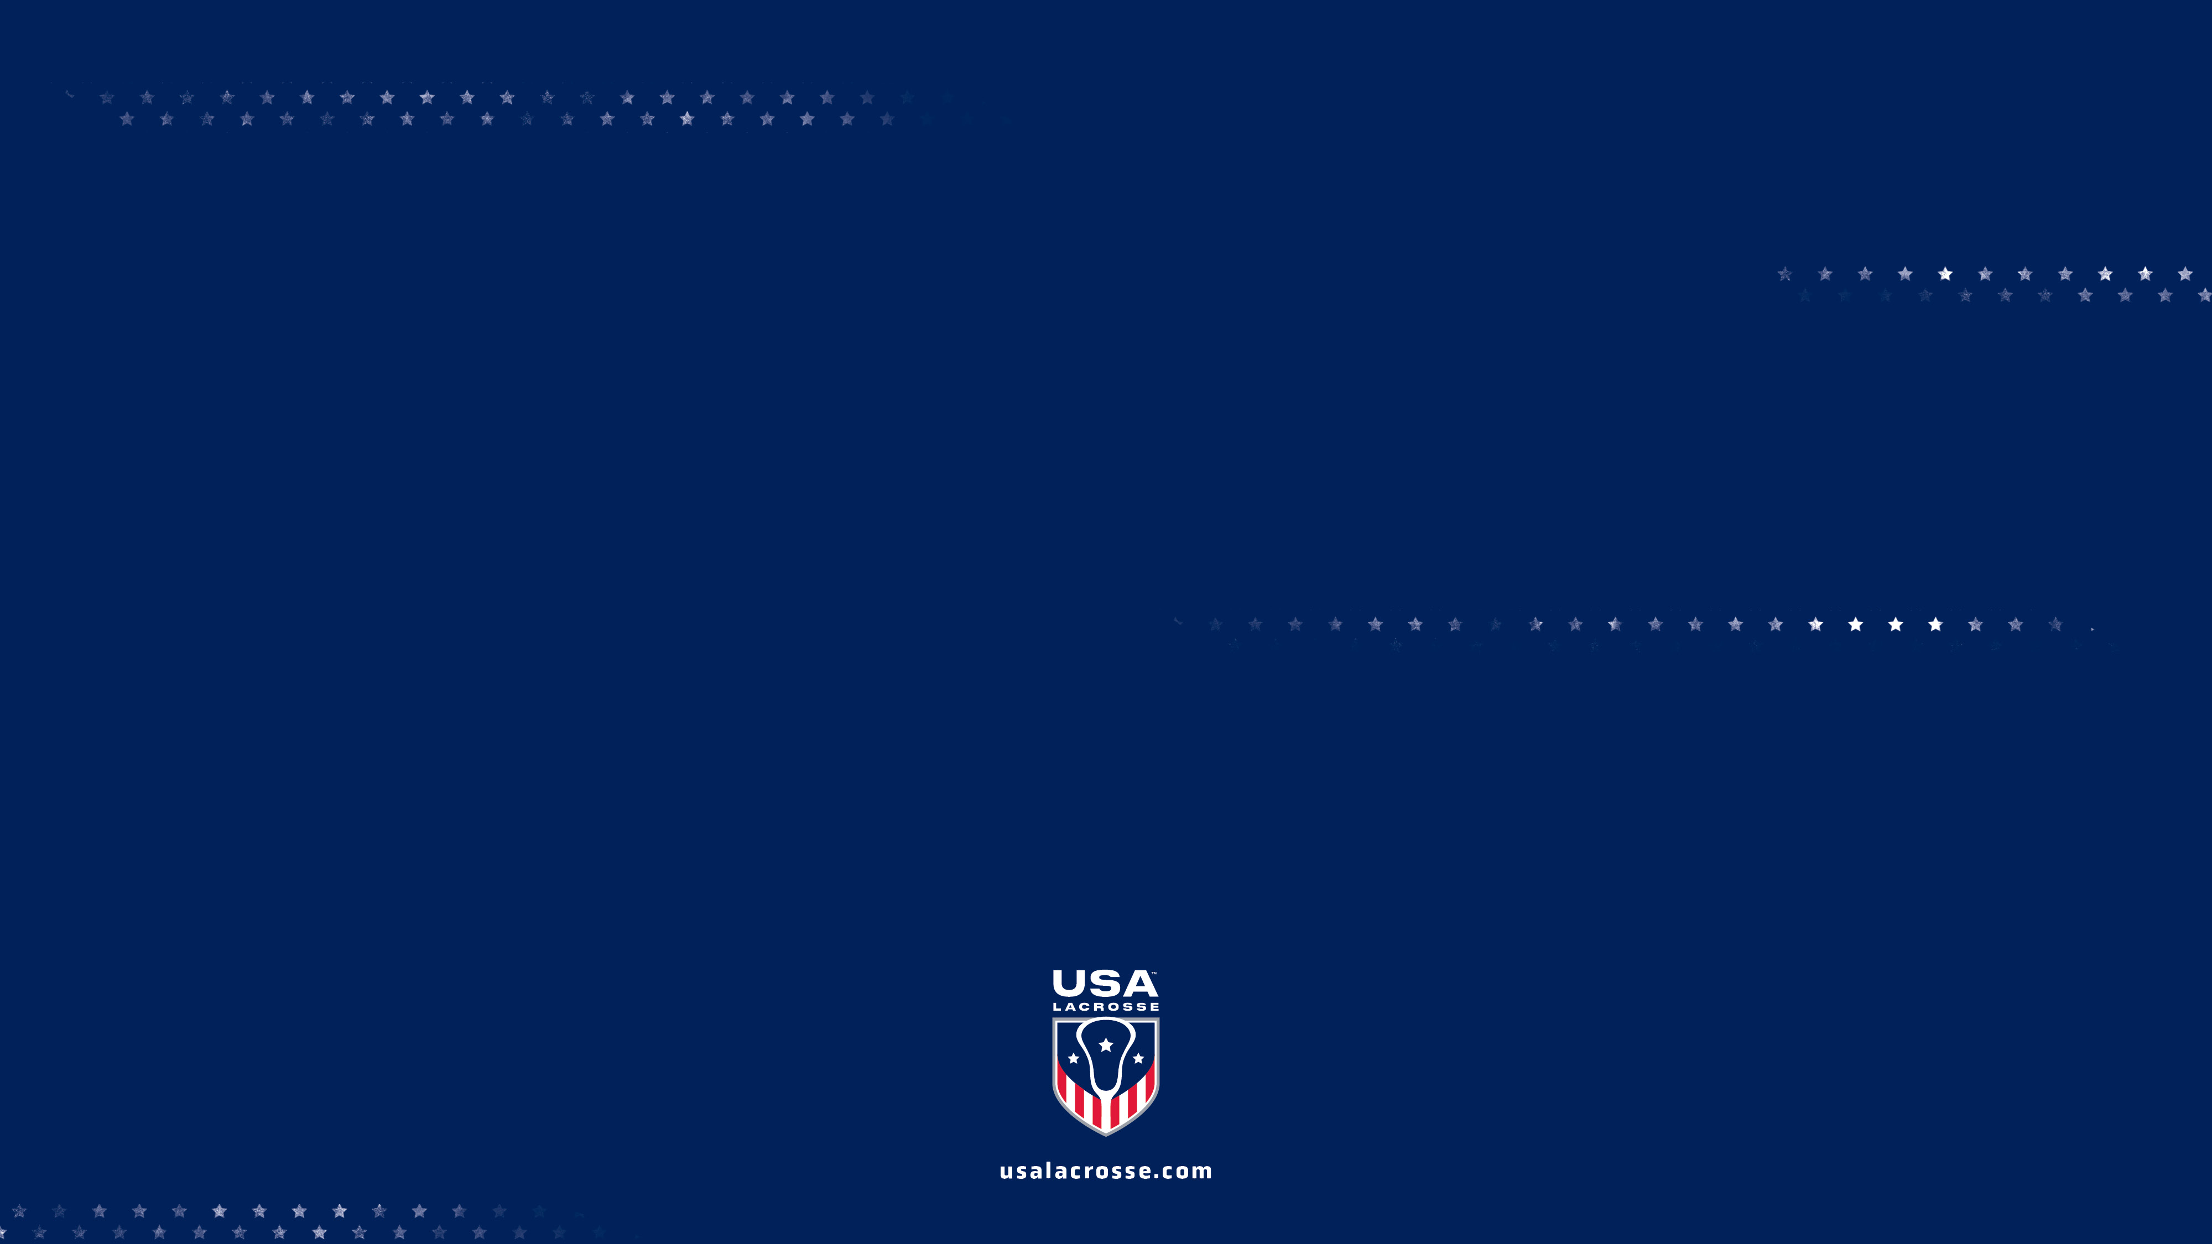
QUESTIONS?

