Slide 1
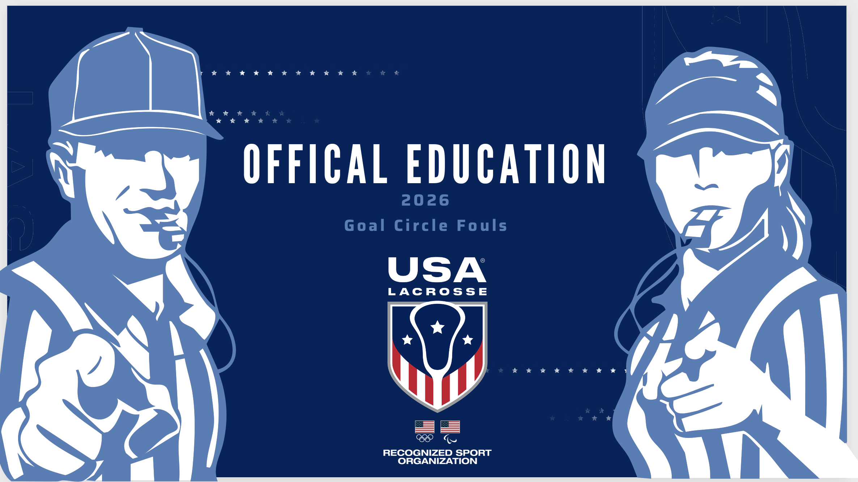
Notes:
Have the class stand up. Call out minor fouls and ask for signals. Focus on “stadium signals,” Use of directional, etc. If outdoors, practice whistle as well!

Slide 2
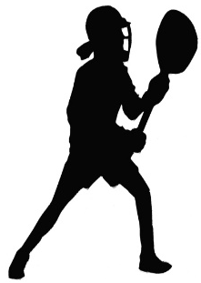
Goal Circle Fouls
The goal circle is a “cylinder.”
An attack player cannot step into the GC at any time.
Any ball resting on the goal circle line belongs solely to the goalkeeper or the deputy.
Any other player touching this ball would be committing a goal circle foul.
Notes:
The goal circle is a cylinder -- an invisible plane that creates a “wall” rising up from the goal circle line.
Opposing players may NOT reach through that wall to attempt to play a goalie working to clear the ball. Officials should be aware of this type of illegal pressure on the goalie -- It’s a goal circle violation.
The goalie is considered in the circle as long as any part of their body is touching ground in the circle or touching the goal circle line. (Click)
Any ball resting on the goal circle line belongs solely to the goalkeeper or the deputy. (Click)
Any other player touching this ball would be committing a goal circle foul.

Slide 3
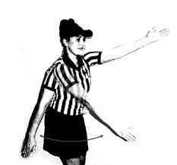
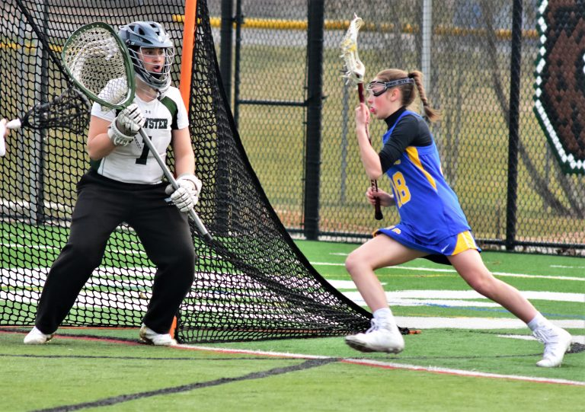
Attack Goal Circle Fouls
No attack player Can step on or over the goal circle line.
goal circle foul signal
The shooter’s crosse may follow-through into the goal circle on a shot, but their feet must not touch the line
Notes:
No field player can step on the goal line. The circle “belongs” to the goalie. (Click)
Attack players can follow through the “plane” on a shot but cannot step on the line.
Shooting motion must be initiated from outside the goal circle.

Slide 4
Defense Goal Circle Fouls
Field Player
Deputy
Can enter to prevent a rolling ball from crossing the goal line
Can only enter when team is in possession of ball
Cannot run through the Goal Circle
Defender directly marking the shooter can only reach into GC to block a shot or check shooter’s crosse
Only one player, either the goalkeeper or her deputy, is permitted in the goal circle at any time
Notes:
Field player may not break the plane of the goal circle unless they are shooting (on attack) or the player(s) directly defending the shooter (on defense) may reach into the goal circle with their stick(s) to block the shot or checkthe shooter’s stick. A defender’s feet must not touch the goal circle line.
No field player can step on the goal line. The circle “belongs” to the goalie.
Deputy may not enter the goal circle unless her team has the ball. Reminder: No Deputy at Youth level.

Slide 5
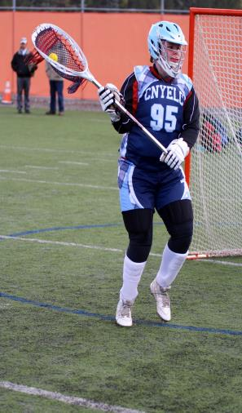
Goalie Play
If the Goalie/Deputy gains possession outside of the Goal Circle the ball may enter the Goal Circle.
If the Goalie/Deputy gains possession inside the Goal Circle the ball may reenter the Goal Circle after it has been cleared* and played**
The ball may be carried into the circle!
Notes:
Goalie can carry the ball back into the circle – she doesn’t have to throw it in and follow in after it.

Slide 6

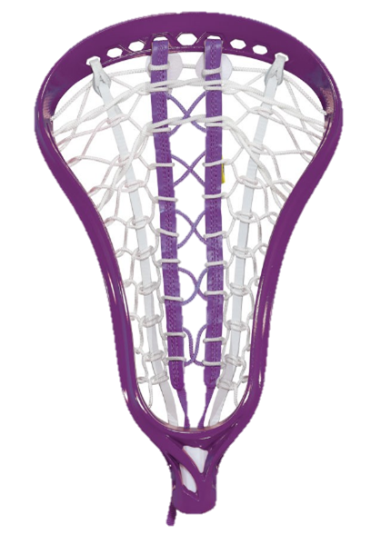


Cleared and Played
PLAYED
The ball is touched by another player’s stick, such as catching a pass or knocking down a pass
The Goalkeeper’s stick is checked: a stick to stick check
A foul is committed
CLEARED
The ball was possessed inside the Goal Circle and exits the Goal Circle
The ball may be carried out or passed out

Slide 7
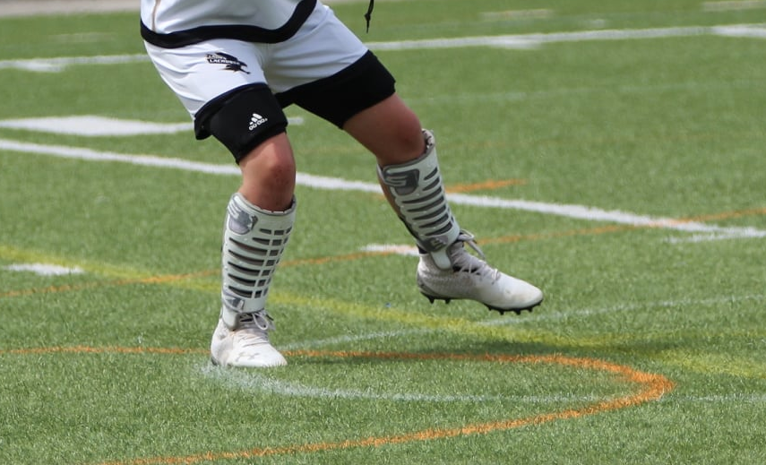
Goalie Play
Goalkeeper can reach out the crosse and bring a ball back into the goal circle provided one foot is inside the goal circle***
*** The foot is considered inside the goal circle if any portion remains inside the plane of the goal circle.
If any part of the goalie’s foot is on the goal circle line, they are considered IN the circle
Notes:
Goalie can “rake” the ball back into the circle provided that no player from the other team is within playing distance and is disadvantaged because the goalie covered the ball.
What if an opponent could’ve played the ball? Minor foul (Cover) on the goalie. If goalie was in the circle, the goalie remains in the circle. No other player is required to move within 4m of the free position.

Slide 8
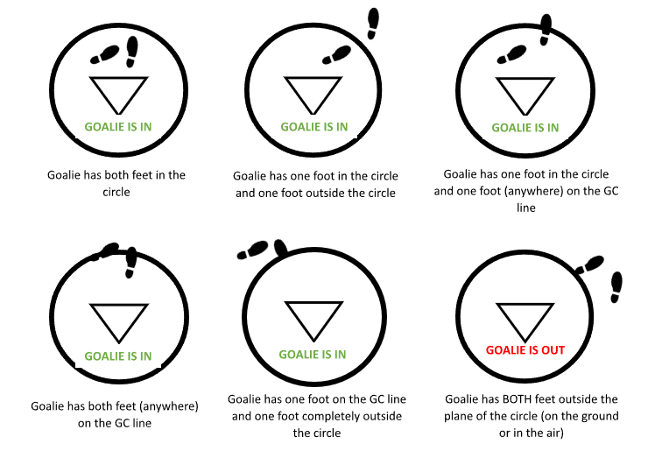
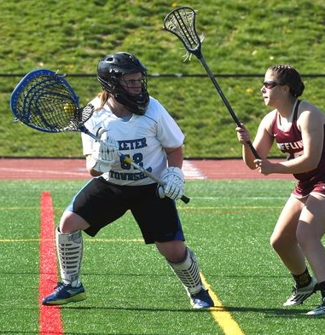
Goalie Play
Notes:
Let’s take a look at goalies positioning relative to being in or out of the goal circle.
When both feet are completely in the goal circle she is in. She is also in the goal circle when one foot is in and one is out, one is in and one is on the line, both feet are on the line, one is on the line and one foot is completely outside the goal circle.
The goalie is not considered fully out of the goal circle until both feet are wholey out of the goal circle.

Slide 9
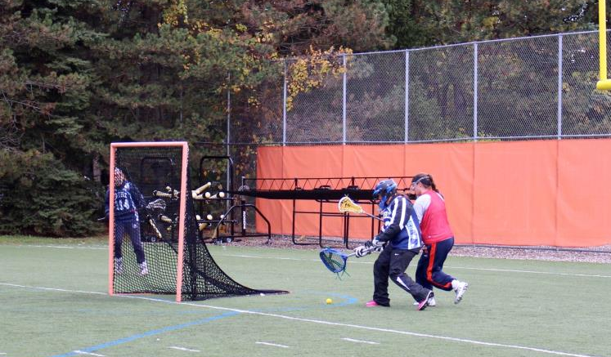
Goal Circle Play
Once goalie is out of goal circle, goalie or deputy must have at least one foot inside the goal circle to play a ball that is inside the circle.
Notes:
No one outside the goal circle can play a ball that is inside the circle. They must have one foot in the circle to play it.
If the goalie leaves the circle to allow a teammate to come in and pick up the ball, that teammate has to have one foot in before they can play a ball inside the circle.
REMINDER: On the line is considered inside the circle!

Slide 10
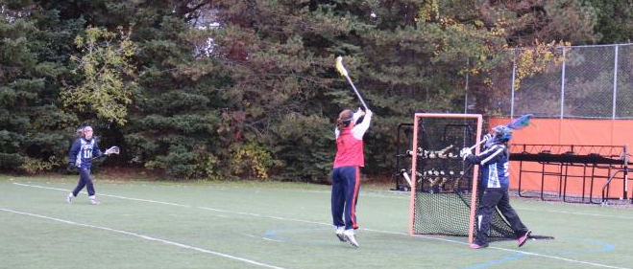
Goal Circle Foul: 10 Second Count
Goalie (or deputy) has 10 seconds to clear the ball from the goal circle.
Goalie can throw OR carry the ball out of the goal circle.
Notes:
A 10-second count is how the official lets the goalie know how much time is left before the ball must leave the circle.
The 10-second count begins when the BALL enters the goal circle (not when the goalie/deputy picks it up!)
Demonstrate proper count: arm wide and high enough to be seen by sidelines, gesture is towards with center of the field (not the endline.) Start verbal count at “five” and get LOUDER as the count gets closer to 10.
If official counts/signals with the arm “10”, it is a goal circle foul. Free position at the closest dot. Goalie stays in the circle. No other player is required to move within 4m of the free position.

Slide 11
Penalty Administration
Goal Circle Foul
by the Attack
Goal Circle Foul
by the Defense
Free position awarded to the Goalie (or her deputy) in the GC
Offender: 4m behind GC
Others: 4m away from GC
Free position awarded at the closest dot
Offender: (except the Goalie) 4m behind the free position
Others: 4m away
Illegal Deputy is penalized as a major foul. FP awarded at the 8m center hash. Goalie may NOT clear back into circle.
Notes:
Practice the penalty administration for GC fouls. On Vinyl field or white board
Illegal Deputy is penalized as a major foul. FP awarded at the 8m center hash. Goalie may NOT clear back into circle.

Slide 12
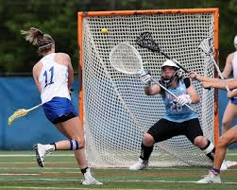
Oh that Goalie!
Quiz Time!
Notes:
Let’s review some situations we might see with a goalkeeper

Slide 13
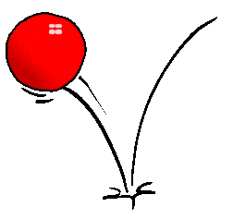
Oh that Goalie #1
The goalie has come out of her goal circle, in the 8m arc, to challenge an attacker.
A shot is taken and is bouncing past the goalie towards the goal when a defender places her stick into the goal circle to prevent the goal.
Is this a Legal Deputy or an Illegal Deputy?
.
Illegal
Notes:
A Deputy may go into the goal circle to prevent a ROLLING ball from crossing the goal line
This is an illegal deputy

Slide 14
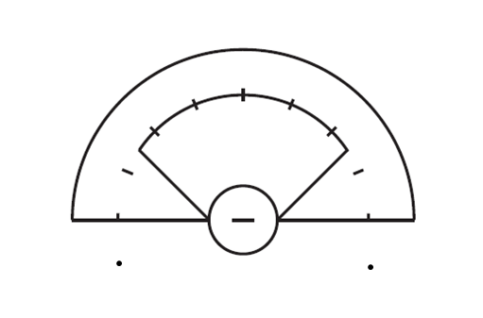
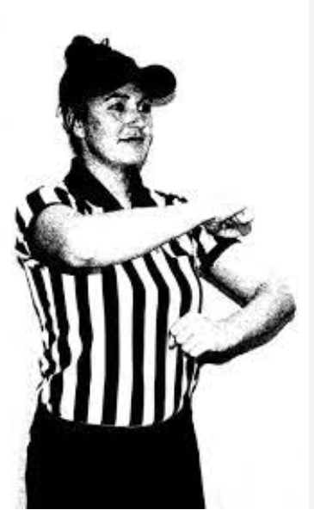
Oh that Goalie #2
O
x
G
The official blows a whistle for an “Illegal Deputy”. A Free Position is awarded to the attack at the center hash. Where does the goalie go? IN or OUT
Out
Notes:
The illegal deputy is placed 4 meters behind the attack player taking the free position. The goalkeeper is NOT permitted to move back into the circle (Click)
A yellow or red card may be issued

Slide 15
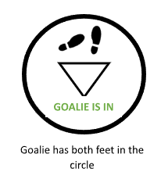
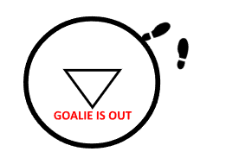

Oh that Goalie #3
A goalie gains possession of the ball in her circle and walks out of the circle.
The goalie then brings the ball back into her circle.
She has not been played.
Is this a Goal Circle violation Yes or No?
yes
Notes:
Once a team gains possession of the ball in the goal circle and the ball is cleared, the team must not intentionally
return the ball to the goal circle until another player has played the ball. The ball has been “played” if it leaves the
goalkeeper’s crosse and is touched by another player -- either a teammate or an opponent.
This is a Goal Circle Violation

Slide 16
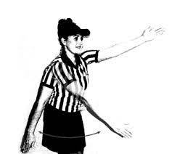
Oh that Goalie #4
The official gives the ball to the attack at the nearest dot for a defensive goal circle violation on the Goalkeeper while she has one foot in the goal circle.
Is the goalie directed to move 4m behind the Free Position or may she stay in her goal circle?
IN or OUT
In
Notes:
If the goalkeeper is in (or partially within) the goal circle when they commit the goal circle violation, they may remain in
the circle and do not have to move to within 4m of the player taking the free position. No other defender is moved directly
behind the player taking the free position.

Slide 17
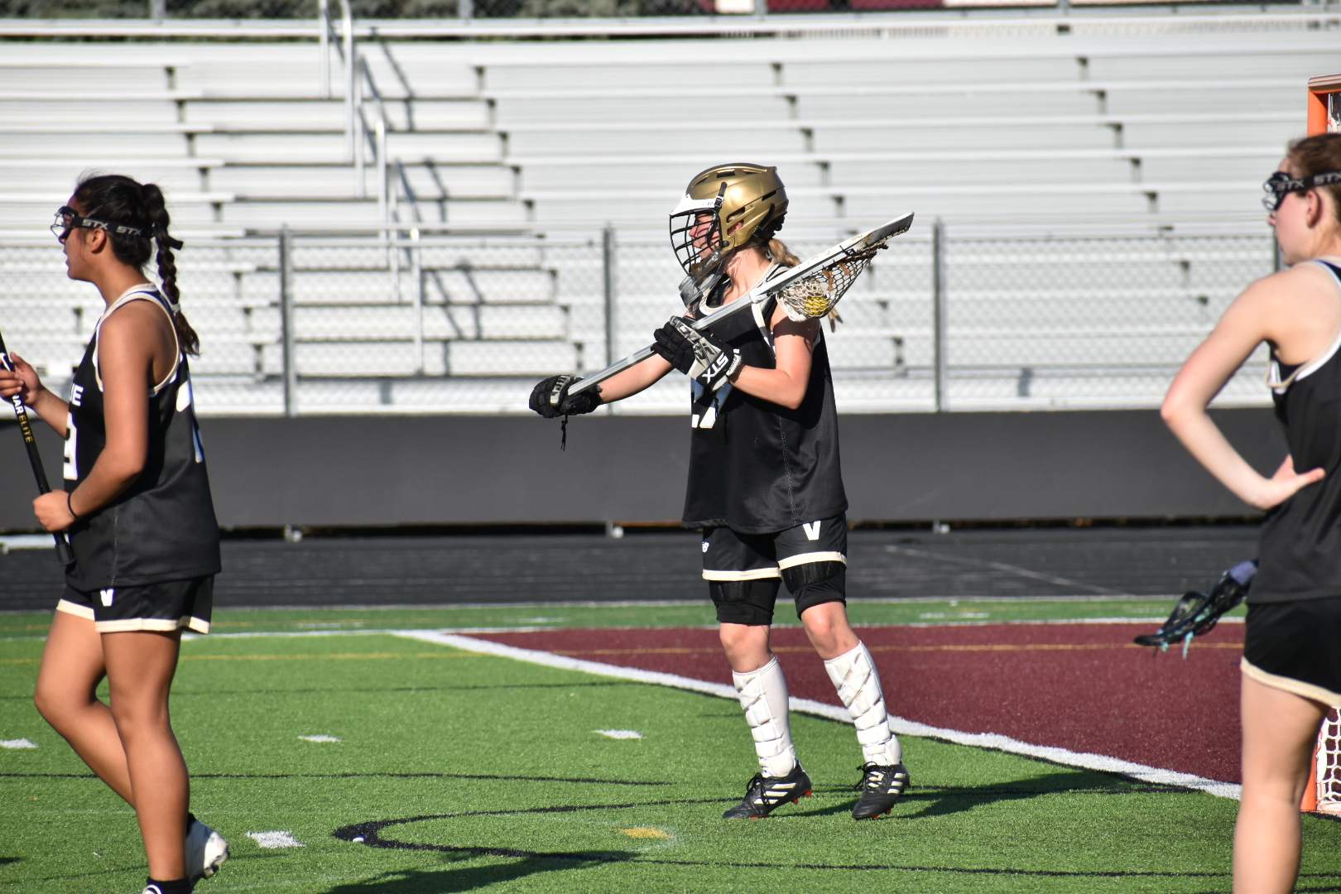
Oh that Goalie #5
The goalie fails to clear the ball from her goal circle within the 10-second time frame.
Is this a Goal Circle violation Yes or No?
Yes
Notes:
A Deputy may go into the goal circle to prevent a ROLLING ball from crossing the goal line

Slide 18
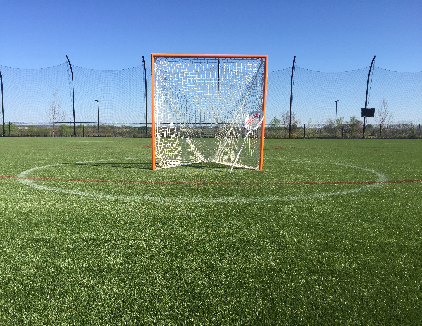
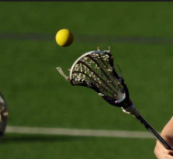
Oh that Goalie #6
A Deputy goes into the goal circle to prevent a ROLLING ball from crossing the goal line, while the Goalkeeper is completely out of the goal circle.
Is this Legal?
Yes

Slide 19
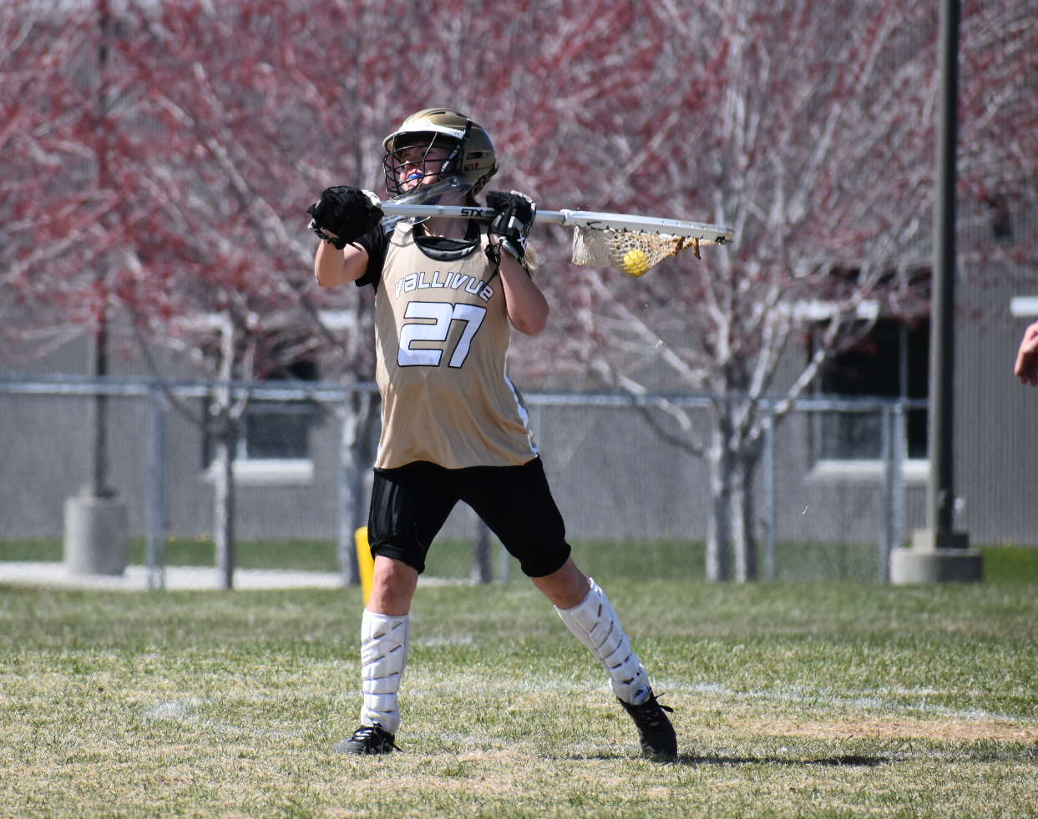
Oh that Goalie #7
The goalie carries the ball completely out of her goal circle when she hangs her crosse back into the goal circle to prevent a check by an attack player.
Is this a Goal Circle violation Yes or No?
Yes
Notes:
GOAL CIRCLE FOUL: The attack is awarded a free position on the closest dot. The goalkeeper is placed 4m away
relative to the goalkeeper’s position when the foul occurred.
Note: Any free position administered on the dot is not considered indirect. Attack may always go to goal and shoot.

Slide 20
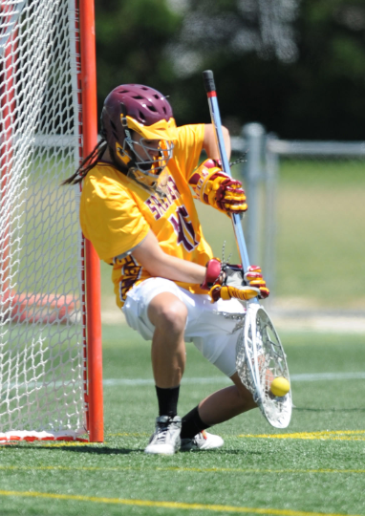
Oh that Goalie #8
The goalie has come out of her goal circle to defend the shooter and is within a stick’s length of the ball carrier.
The shooter fakes high and shoots low.
The goalie, knowing she is beat, deliberately sticks out her foot and deflects the shot away from the goal.
Is this legal Yes or No?
No
Notes:
If a field player uses their body to deliberately “impede, accelerate or change the direction of the ball”, except
when kicking the ball in a non-shooting attempt, the player will be called for a minor foul.
However, if the goalkeeper does this when fully outside of the goal circle, the official must decide whether this infraction
should be penalized as a major foul or as a minor foul.
If the goalkeeper blatantly attempts to stop a shot on goal with the body while outside the goal circle, it is a
major foul.
It is not difficult to see a blatant body ball by the goalkeeper when the shot is high, but when the
shot is low the determination becomes less obvious.
When the goalkeeper is fully outside the goal circle the official must quickly determine whether:
a. The body ball occurred because the goalkeeper did not have time to react (no call).
b. The body ball occurred because the goalkeeper misplayed the ball with her stick (no call).
c. The body ball occurred because the goalkeeper blatantly used any part of her body to defend a shot (major
foul).

Slide 21
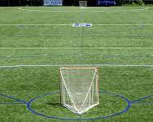
GOAL CIRCLE REVIEW
Notes:
Use the Goal Circle Review questions to confirm understanding of goal circle fouls.

