Slide 1
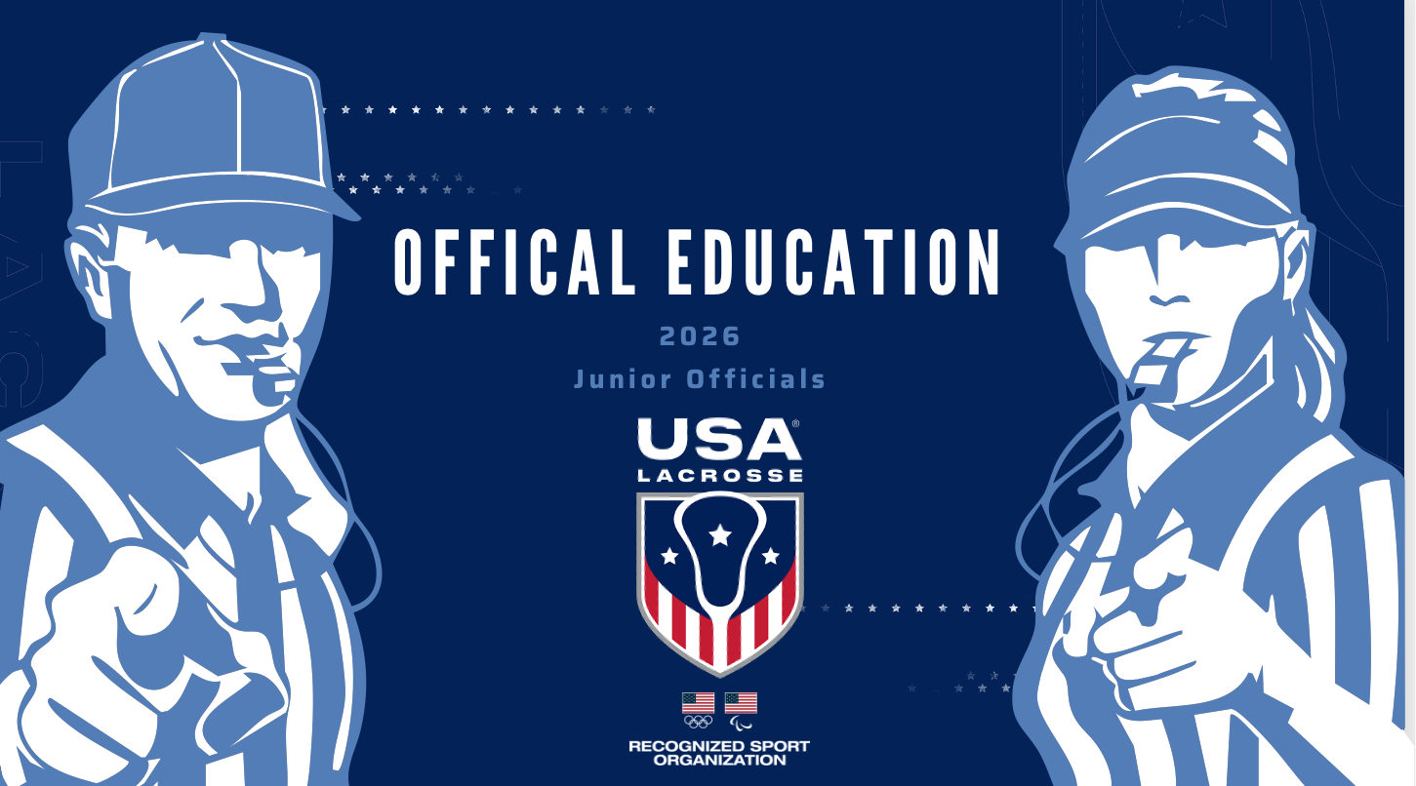

Slide 2
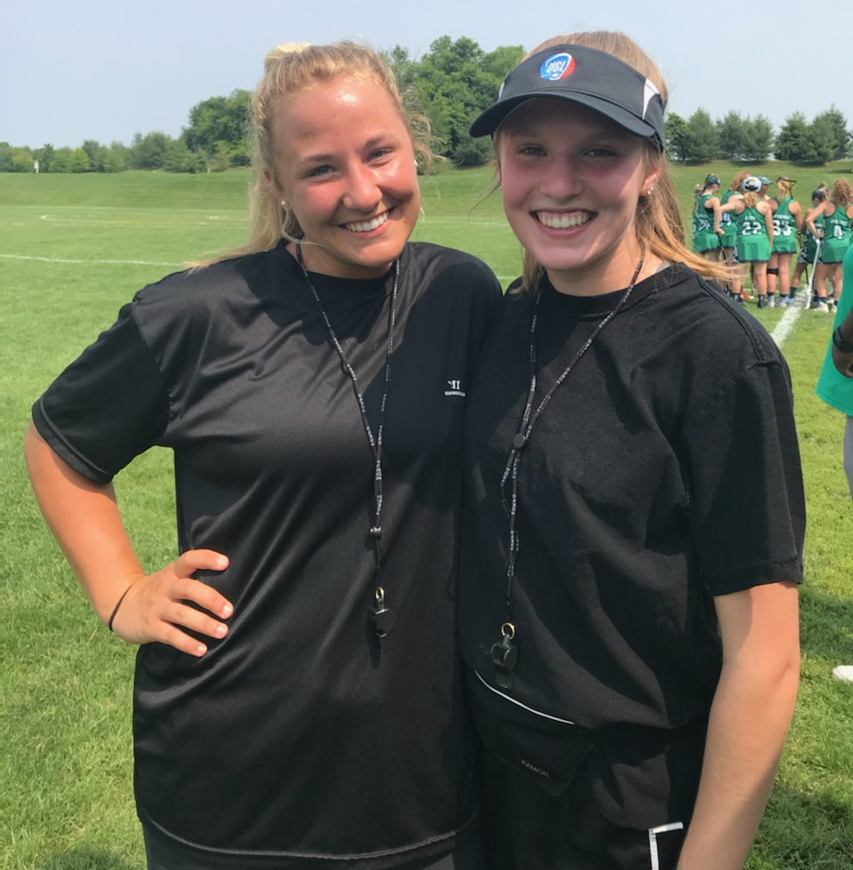
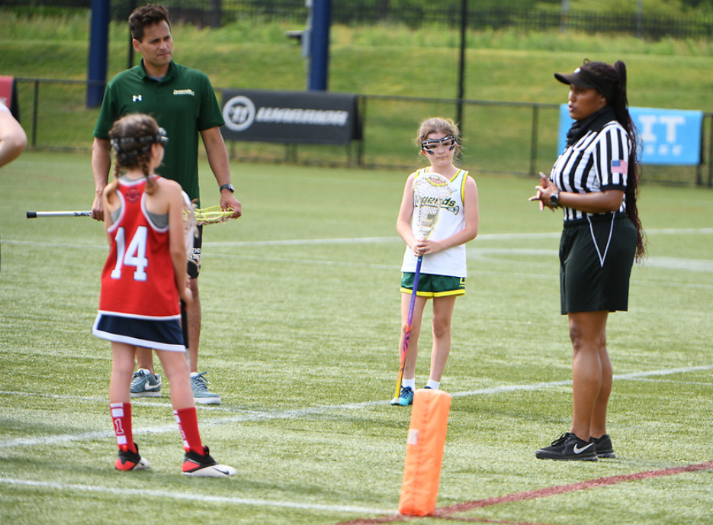
The Goal of our Training
To increase the skills set and confidence of our girl’s lacrosse officials as you learn to call the game

Slide 3
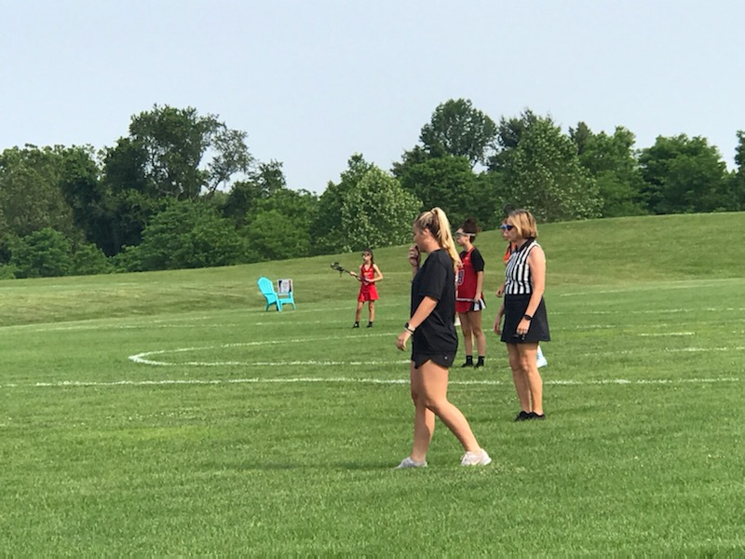
Questions You May Have as a New Official
Where should I be on the field throughout the game?
What do I once I call a foul?
How do I know which fouls have which set ups?
How do I facilitate self-starts, boundaries, draws and time-outs?
How do deal with coaches, parents and other officials (because they are older than me)?

Slide 4
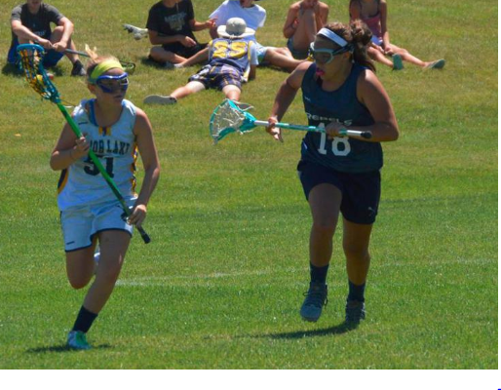
Goals of Two-Person Positioning
To put us in the best position to make the calls that allow us to keep the game safe and fair.
To work as a TEAM to cover all areas of the field efficiently and consistently.

Slide 5
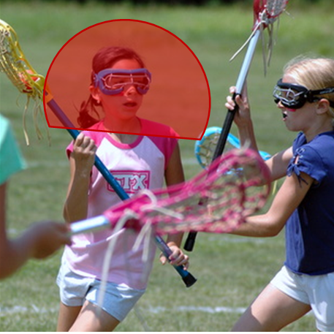
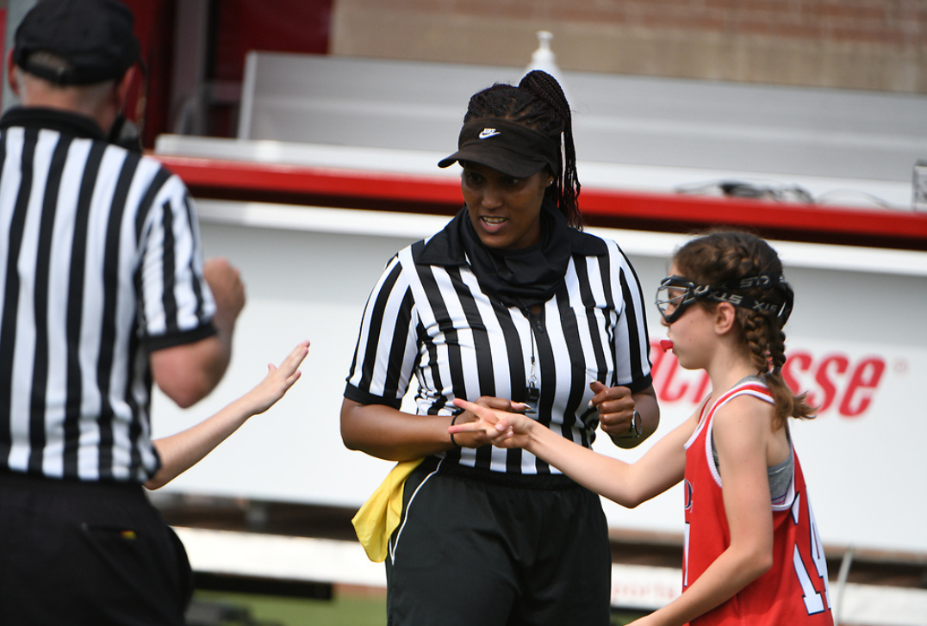
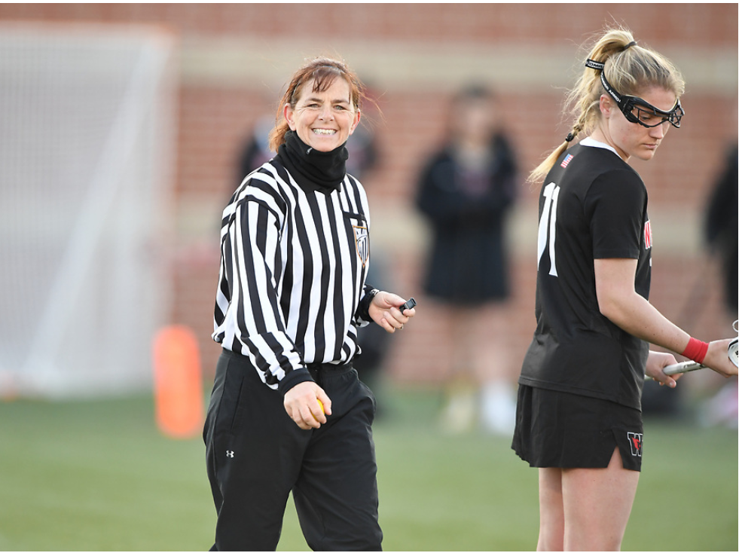
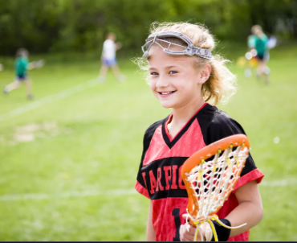
Role of the Officials
Safety
Fairness
Fun
Notes:
Safety: Maintain safety for all involved.
Fairness: Remain neutral and call the game fairly.
Fun: That’s why we (players, parents, coaches) are all there!
How do we achieve these 3 goals? What do we, as officials, do to make sure these goals are met?

Slide 6
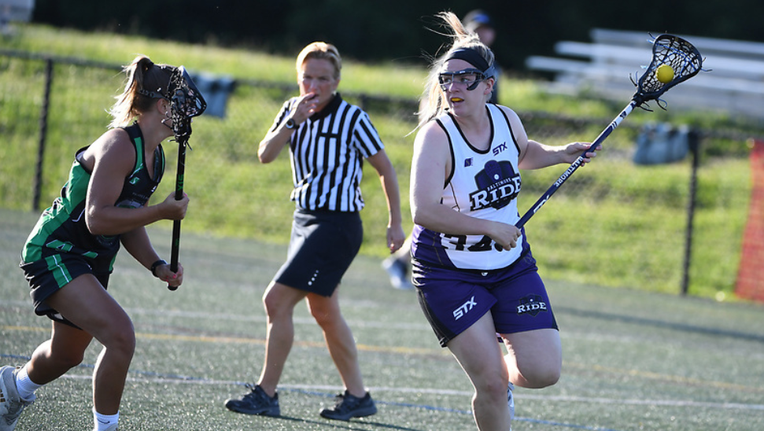
Positioning
Where to Be and Why
PRESENTATION TITLE HERE
6
Notes:
Being in the right location on the field will put you in the best position to see who caused the foul and what happened.
See the space between the players.

Slide 7
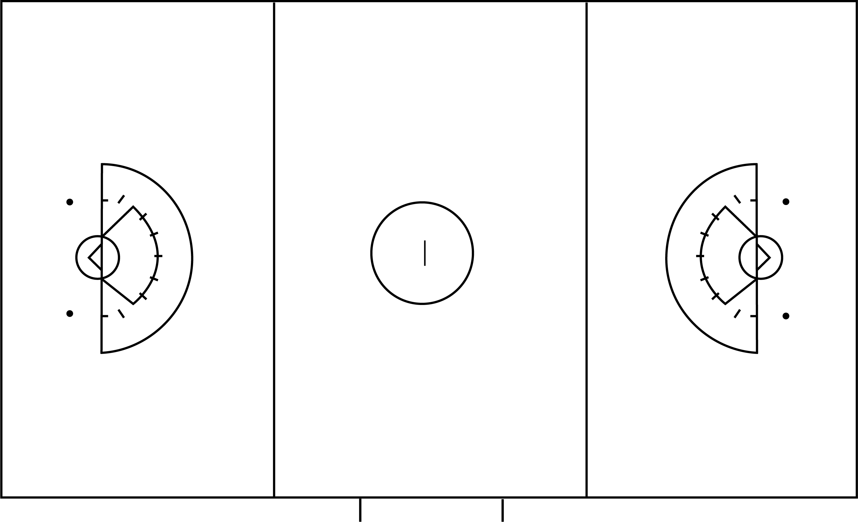
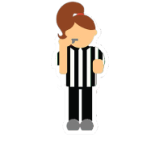
SCORER’S TABLE
Should be the more experienced of the team
Will run the Coaches’/Captains’ Meeting
Will discuss responsibilities with the Timer and Scorer
Table Side Official
May be less experienced
Will participate in all pre-game discussions and meetings
“Far Side” Official
4
Notes:
Review:
It’s important that the table-side official can most easily address questions that may arise during the game from coaches or others.

Slide 8
Areas of Responsibility
As Lead
As Trail
Shared Area
As Trail
As Lead
5
Notes:
Officials work the Lead position to their right and the Trail position to their left.
They cover their entire sideline and the end line where they are the Lead.
(click)
The official in the green oval has their sideline and end line, (click) and the official in yellow has her sideline and end line.
Officials are responsible for calls on their side of the field, but the center of the field is a “shared area” where both officials can make calls.
“Lines” are flexible! Shared area constantly changes as the ball moves up and down the field.

Slide 9


Areas of Responsibility- the Draw
Counts players from both teams
Administers opening draw
Notes:
Animation begins automatically.
Table official counts players from both teams to ensure proper number on field.
Far side official administers the opening draw. All subsequent draws will be taken by the official farthest from the goal that was scored upon.
Reminder: Teams may now have less than 12 players on the field at any time during play including the draw.

Slide 10
Areas of Responsibility – The Draw
ox
ox
ox
ox
ox
GK
ox
GK
ox
o
x
ox
ox
ox
What are the rules for player movement once “hands are on sticks?’
7
Notes:
Note to trainer: Be sure to review player movement from sub box, over RL (even when teams have less than 3 between RL), and early entry violations, or when cards expire before possession.
The official administering the draw is responsible for the observing the players taking the draw to ensure the draw is legal. In addition, they should try to keep an eye on the two other sets of players outside of the draw circle to watch for early entry.
The 2nd official is responsible for watching players on the restraining lines as well as the players around the circle. Officials should watch for players pushing or jockeying for position or an early entry – either stepping into the circle before the whistle has blown or stepping over the restraining lines before possession has been established.
If a player enters the center circle early, the official should blow the whistle immediately.
If a player steps over either restraining line early, the official should wait to see which team gains possession. If the team who did not foul gains possession on the draw, the official can signal “Advantage” and allow play to continue.

Slide 11
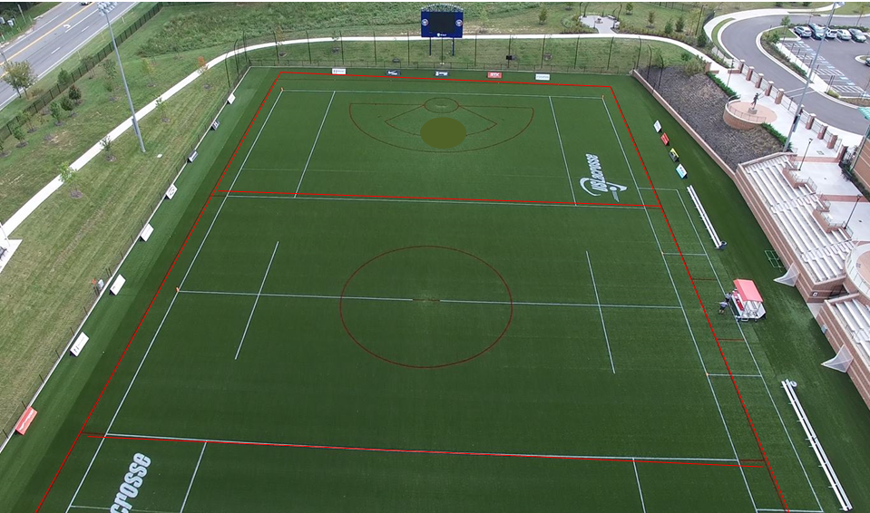
Positioning for Different Areas on the Field
In the
Critical Scoring
Area
As Lead
As Trail
In the Midfield
In Transition
Shared
Responsibilities

Slide 12
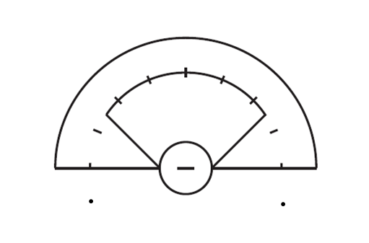
Critical Scoring Area Responsibilities
TRAIL
LEAD
Notes:
In the Critical Scoring Area, (click) the Lead official is typically on-ball and responsible for on-ball fouls.
The Trail official (click) is off-ball and responsible for fouls that occur away from the ball (3 seconds, detaining, shooting space, etc.) Trail is also responsible for restraining line violations (offside) calls.

Slide 13
CSA Responsibilities
Lead
Trail
On-Ball Fouls
Shooting Space on your side of the Arc
Goal Circle Activity
Endline and Sideline Boundaries
Off Ball Fouls on your side of the Arc
Off-Ball Fouls
Shooting Space on your side of the Arc
Restraining Line Violations
Dangerous Propelling/Dangerous Follow Through
13
Notes:
What are some On-Ball fouls the Lead would be watching for? (Checks to the body, Checks to the head, Dangerous Propel, Forcing Through, etc.)
What are some Off-Ball fouls the Trail would be watching for? (Shooting Space, 3 Seconds, Dangerous Follow Through, or any off-ball violations.)

Slide 14
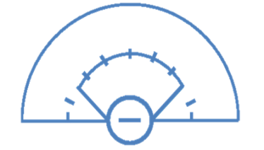
Lead Positioning
The Lead’s purpose of movement is to see the ball and space between the
ball carrier and her defenders
TANGENT
QUADRANTS
3
1
4
Use the approach that works best for you!
14
Notes:
Note to trainer: Keep this simple. Encourage seeing “space” and keeping players safe.
Use the next several slides ONLY as needed depending on your audience! Don’t get in too deep if your officials are brand new!
More detail, but don’t scare the new officials!
There are two guiding techniques that can be used to understand the positioning of the Lead around the Arc. Two ways to learn it.
To be “on tangent” is to form a right angle (90 degrees) from you to a point on the goal circle and out to the ball.
Quadrants refer to a specific area in the CSA.

Slide 15
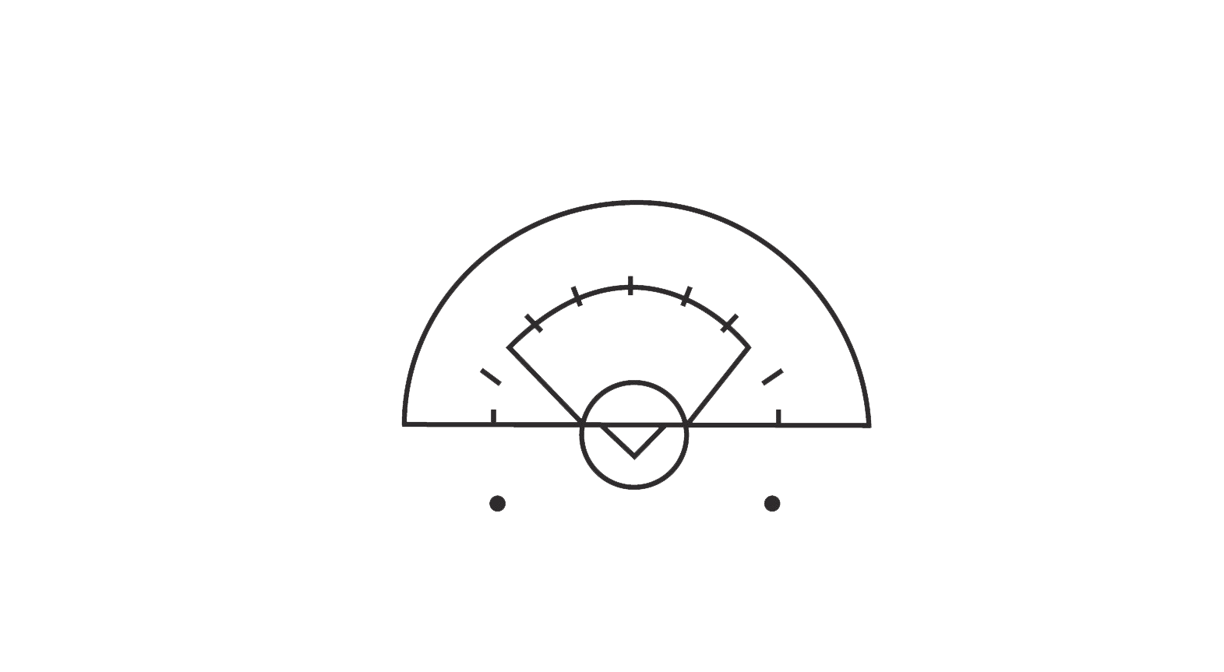
Lead Tangent Positioning
Two-Person Positioning 2021
15
Notes:
The idea of working on Tangent as Lead is to continually move to reposition yourself in relation to the ball. “See Space”!
If the ball is in the center of the CSA and at the top of the 8m arc, the Lead official will move to be parallel to the top of the goal circle. In this position, they have created a 90-degree angle to the approaching ball carrier and are now “on tangent.”

Slide 16
Lead Tangent Positioning
Two-Person Positioning 2021
16
Notes:
As the ball moves, the official moves as well. (click) If the ball goes high on the far side of the arc, the official moves to a HIGH tangent. Once again, they are creating a 90-degree angle from a spot on the goal circle to the ball. (click)
As the ball moves across the CSA, the official repositions to maintain that 90-degree angle. Now, the official is on a LOW tangent.

Slide 17
Lead Tangent Positioning
Two-Person Positioning 2021
17
Notes:
When the ball is below the GLE and is moving towards the official, (click) the official moves further below the GLE to maintain the tangent.
They are creating a 90-degree angle from a spot on the goal circle to the ball. In this scenario, the official must be ready to quickly move above the GLE to maintain the tangent if the ball is passed into the 8m.

Slide 18
Lead Quadrant Positioning
2
3
Two-Person Positioning 2021
1
4
18
Notes:
The CSA has four quadrants and each is numbered clock-wise.
Quadrant 1 is in the lower left part of the CSA.
Quadrant 2 is in the upper left part of the CSA.
Quadrant 3 is in the upper right part of the CSA
Quadrant 4 is in the lower right part of the CSA.
.
When an official’s movement is based on Quadrants, they will always be one quadrant away from the quadrant the ball is in, unless the ball is in Quadrant 1. When the ball is in Quadrant 1, the official is in quadrant 1.

Slide 19
Lead Quadrant Positioning
2
3
Two-Person Positioning 2021
1
4
19
Notes:
In this instance, the ball is in Quadrant 4. The official will be in quadrant 1, one Quadrant away from the ball.

Slide 20
Lead Quadrant Positioning
2
3
Two-Person Positioning 2021
1
4
20
Notes:
When the ball is in Quadrant 3, the official will be in quadrant 2. Note that the official is on tangent here.

Slide 21
Lead Quadrant Positioning
2
3
Two-Person Positioning 2021
1
4
21
Notes:
When the ball is in Quadrant 2, the official will be in Quadrant 1. Again, the official is on tangent by making a 90-degree angle with the ball and the goal circle.

Slide 22
Lead Quadrant Positioning
2
3
Two-Person Positioning 2021
1
4
22
Notes:
When the ball is moving from Quadrant 4 to Quadrant 2, the official will let ball “pass by” while they are in Quadrant 1. This is the only time the ball and the official will be in the same location.

Slide 23
Transition
Trail to Lead
Stay ahead of and outside the ball
Position your body to keep play and players in your vision
Maintain a “view” of the action into CSA
Lead to Trail
Count players ahead of you
Stay up with play, run through the restraining line
Anticipate where the play is going
Notes:
Note to Trainer:
Review with new officials they should work to keep all players in front of them and “inside” of play in the mid-field.
What does “outside the ball” mean?
Can you “open your arms” and gather the players? This is a helpful visual to support your efforts to be in the right position as lead.
“Running through” restraining line. Move with purpose – and urgency – to get to the right position to make AND SELL your call.

Slide 24
Responsibility in Transition
Handout: Officials In Transition
Lead to Trail
Trail
Lead
Trail to Lead
Two-Person Positioning 2021
20
Notes:
When the ball transitions from one end of the field to the other, the officials’ responsibilities shift. (click) As the ball leaves the CSA, Lead is still on-ball while Trail works to get ahead of the ball.
Midfield is a “Shared Area.” Either official may be on ball, depending upon the ball’s location. The Trail is NOT looking at the ball carrier if they are on the other side of the field. But will pay attention to the ball if it transitions down their side of the field.
As the ball moves into the CSA at the other end of the field, (click) the new Lead positions to get ahead to receive the play as it comes into the CSA. At the same time, the new Trail keeps up with play, always running through (past) the Restraining Line to help officiate at that end of the field.
The handout will review what both the Trail and the Lead might consider as they advance down the field.

Slide 25
Restart Guidelines
Officials manage restarts in their “third” of the field
Each official always manages restarts on their sideline and endline boundary
Lead Official whistles all restarts in the CSA
Know when to release monitoring restart to partner
Step up as Trail to manage restarts when your partner is transitioning to Lead
Two-Person Positioning 2021
25
Notes:
Trainer note: Officials should work to encourage a fluid game. So, IF THE OFFICIAL is directing the offender to move away or behind and the ball carrier starts play – THAT IS FINE!!
What does it mean to “manage” a restart? The official will make sure the restart is made within the guidelines of a legal self-start (within 4m of the fouls)
If the ball or player is further than 4m from spot of foul, the official should instruct them to return to the correct area.
If the player waits for a whistle start, or if a stoppage of play requires a whistle start, the official will manage the restart in that way.
Both officials will manage self-starts in their third of the field and will work together to manage the center third of the field. (This will be discussed further in the next slide.)
Sideline and endline restarts will most often be self-starts. The nearest official will manage to be sure self-start guidelines are met.
The Lead always restarts play in the CSA. Self-starts are not allowed in the CSA, so the Lead will whistle to start all play.
Trail supports the restart by helping to ensure the Penalty Zone and/or the lane is clear, and that play is ready to restart.
If in transition, the Trail may need to support/manage their partners restart as that official moves to get ahead of play.

Slide 26

Restarts
Each official monitors restarts on their side of the field
Each official restarts play (whistle) in their CSA
Notes:
Discuss restarts in coffin corner.
Look at middle “white” rectangle. Either official should make calls in this area depending on direction of play and how play develops.
Use the vinyl field or use this slide and call a few fouls in each 1/3rd . Ask who should restart.

Slide 27
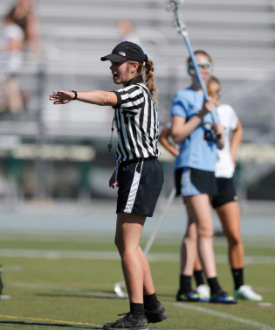
Making the Call
Types of Fouls
Major Fouls
Minor Fouls
Goal Circle Fouls
Misconduct and/or Suspension
Team Fouls
"Rule Reference” hand out
Notes:
Hand out Rule reference.
.

Slide 28
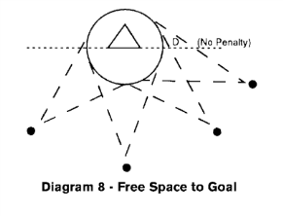
Understanding the Two “Illegal Defensive Position” Fouls
Shooting Space
What is the definition?
Three Seconds Violation
What are the parameters?
Marking “within a stick’s length”
Marking Ball Carrier & Marking Non-Ball Players
When to start and stop the count
Person-to-Person Defense
Zone Defense
FSG and the zone defense
Umpire responsibilities
Notes:
Use white board/ vinyl field to give the participants a visual of these two defensive fouls.

Slide 29
Minor Fouls
Fouls that have minimal on safety of play,
but unfairly interfere with play
Covering
Empty stick check
Warding
Playing from out
of bounds
Hand Ball
Misplays
Illegal substitution
Delay of Game
3rd request to check
a stick that is legal
Illegal Re-entry
Procedural Errors
Crosse
Mouth guard
Goggles
Uniform
Jewelry
Illegal Equipment
Notes:
Possible Activity: Call out a foul and ask officials to put them in the categories of Major or Minor. Discuss the definition of Major foul vs minor.

Slide 30
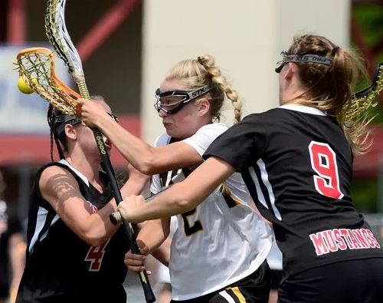
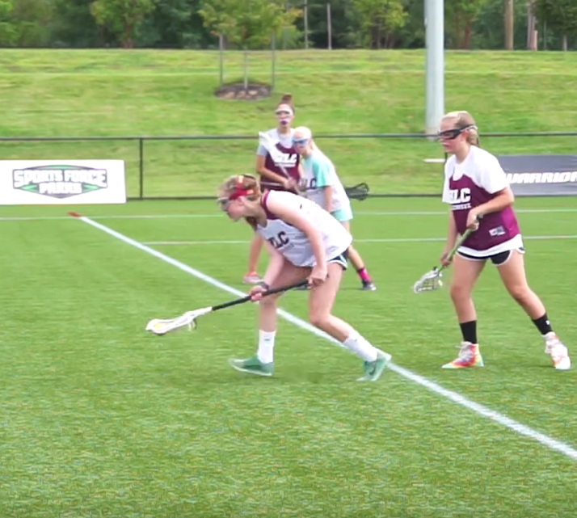
Major Fouls
Jeopardize the SAFETY of the players or
threatens the “Spirit of the Game”
Notes:
Reference the handout.

Slide 31
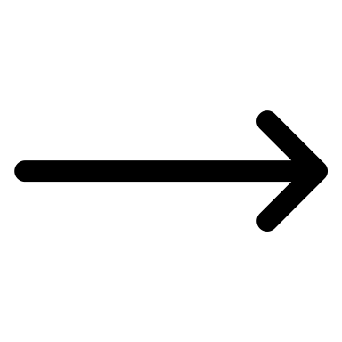


Steps to Penalty Administration
Whistle
Directional Signal
Foul Signal
Manage the Restart:
“BOO” [Ball, Offender, Others]
Confirm Restart is Correct
Work to reposition as
Lead or Trail
Notes:
Reminder to Trainer: Managing restart does not mean preventing the ball carrier from starting as quickly as she desire following her pause/settled stance.
Activity:
Have class stand and practice correct mechanics.
Practice the 7 steps. Demo the 7 steps: recite the 7 steps. Handout 7 steps card to each participant.
Discuss impact of Self-Start in understanding the 7 steps…

Slide 32
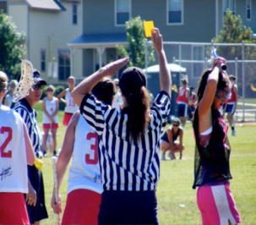
Misconduct (Cardable) Fouls
Mandatory Cards
Discretionary Cards
Check to the Head
Slash
Dangerous Propelling
Dangerous Follow-Through
Dangerous Contact
Dangerous Play
Repeated Major Fouls
Unsportsmanlike Behavior
-Verbal
-Physical
Notes:
Mandatory vs Discretionary. Discuss ‘repeated majors’. Discuss Dangerous Contact
Note: Review what repeated fouls are, but also let new officials know that we just expect them to keep the game safe.
Repetitive foul cards are a tool we can use, but also is an elevated call.
Hopefully new officials will have an experienced partner that would address repetitive fouls.

Slide 33
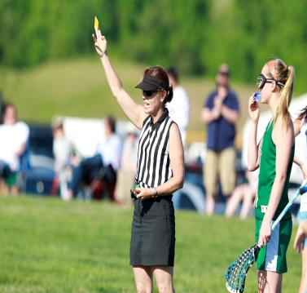
Procedure for Carding
Wait for player to be in Penalty Area and table to have information before restarting play
Face table, hold card up, show foul signal
Beckon player to you, meet them halfway
Call TIME OUT (whistle blast and ‘X’ overhead signal)
Notes:
Demonstrate carding. Walk through the steps.
Activity – ask for a couple of volunteers to mirror the mechanic
Note: officials will do a much better job if your tools are handy.
Where does your yellow card, green and red cards, flag belong?

Slide 34
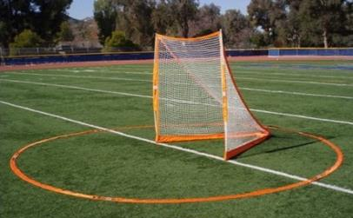
Goal Circle Fouls
By the Defense
Stepping on or in the GC
Not “clearing” the ball within 10 seconds
Returning the ball to the GC a second time before it has been “played”
Exception – defense may “break” the goal circle with their stick if defending the shooting action of the attack player they are covering.
By the Attack
Stepping on or in the Goal Circle
Reaching in the Goal Circle - except during the follow-through of a shot
Notes:
Discuss or have students look up definition of “clearing” and “played” in the rule book.

Slide 35
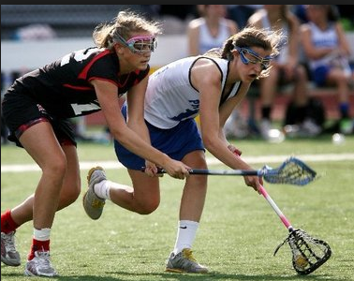
Determine What Type of Foul and Where
What kind of Foul occurred?
MAJOR Foul- Player is directed 4 meters BEHIND
MINOR Foul- Player is directed 4 meters AWAY
  Where on the Field is the Foul?
  Midfield
  In the Critical Scoring Area
  In the 8m Arc
Notes:
Check back of “Rule Reference” handout for Penalty Administration review.
Discuss when you stop to MANAGE reset because an offender isn’t moving as they should, and when you “let it go” or hold your whistle for ball carrier advantage

Slide 36
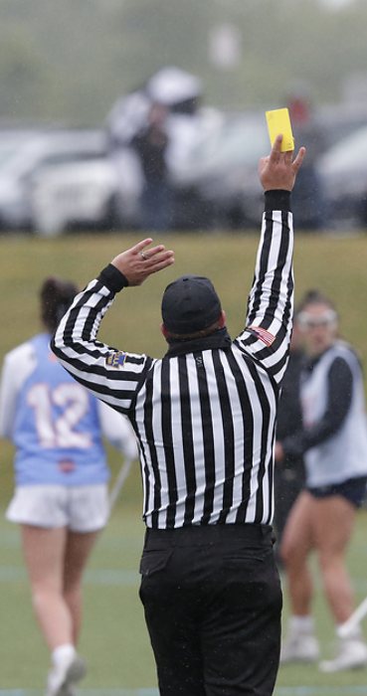
MECHANICS
Our form of communication with Players, Coaches, Partners and Fans
Consistent, Clear and Concise
Directional Signal followed by Foul Signal
Bigger is Better!
Use the signals we have, refrain from creativity
Sell Your Call

Slide 37
Criteria for Self-Start
Foul occurs outside the CSA
Game clock is running
Ball is within 4m
from where foul occurred
Notes:
Boundary ball inside the CSA is the only time a self-start is allowed in the CSA!

Slide 38
Self-Start Options
Restart immediately, no hesitation needed
Settle & wait for offender to move 4m as directed
Settle & wait for the official’s whistle
Notes:
Settled = “momentary pause”!!!

Slide 39
When is Self-Start NOT an Option
When the game clock is stopped
  Cards
  Injury and team time-outs
  Restraining Line violation : “Offside”
  Offensive Fouls in the Critical Scoring Area*
  Alternate Possession
  Inadvertent Whistle
  A goal is scored
* Offensive AND Defensive restarts in the CSA during the last two minutes of the half and the game (except with running clock)
Repeatedly self-starting when not allowed may result in a warning
and/or Delay of Game penalty
Notes:
So, when can a player NOT self-start?
-Whenever the game clock is stopped (a team time out, a card is issued, an injury, or redraw)
-When offsides is called (officials need to move additional players to correct offsides)
-All fouls in the critical scoring area (Penalty Zone needs to be cleared, multiple players moving, etc.)
-Alternate Possession and Inadvertent Whistle
-And after a goal is scored. (In the event opposing team gets ball at center to restart play)
Use commands PRIOR to the start/restart of play to prevent a player from making a false start.
Examples:
- Clock stopped to issue a yellow card. Before you give the ball to the opposing team, you state “On my whistle,” loudly and clearly so the players know they have to wait for a whistle to restart.
- Administering fouls in the 8m, state “center hash and it is on my whistle” to the fouled player.

Slide 40
Ball Beyond Playing Distance?
Return
Retrieve
Teammate may retrieve the ball and pass it to her fouled teammate within 4m of the site of the foul
Player may pick up the ball and return to within 4m to the site of the foul
Self
Start
Allowed
Notes:
Remind everyone that free movement is still in place
Any stoppage of the clock – she can’t self-start

Slide 41
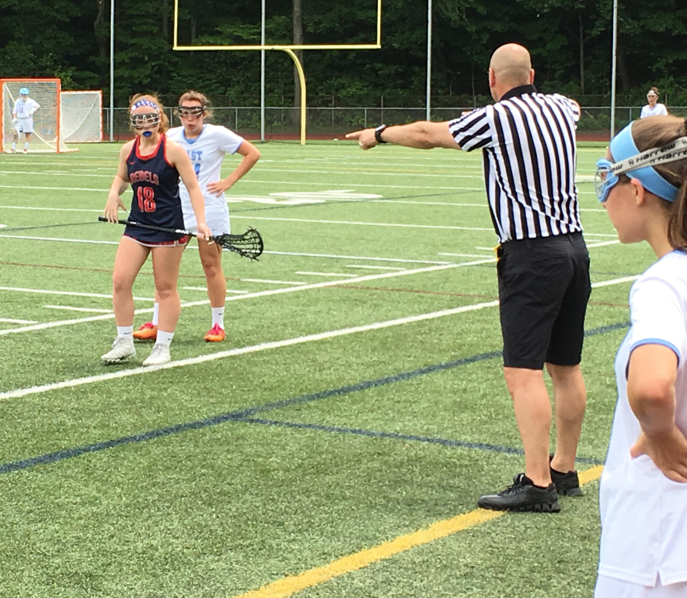
The Offending Player
The OFFENDING player shall be directed to move 4m from the player taking the free position
  The player should respond to the officials’ direction. Should the ball carrier restart play prior to her offender reaching a 4m distance, the offender may immediately defend.
All other players must move 4m from the player taking the free position
Player with the ball may not be engaged until self-start is initiated
Notes:
The fouled player is allowed to immediately initiate play after coming to a settled stance, and the offender may then attempt to engage.

Slide 42
After a foul is called, play restarts when…
The player with the ball steps out of her settled stance
The player with the ball passes to a teammate
Notes:
Note to trainer: AS SOON as the ball carrier restarts play, players (attack and defense) may be within a 4m distance of the ball carrier. Defenders can play the ball.
Immediate play of the ball is always legal as soon as the ball carrier restarts play.

Slide 43
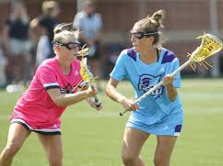
Play DOES NOT restart with…
A rocking motion of the player with the ball
A cradling of the ball by the player with the ball
A pumping action of the crosse

Slide 44
Boundary Self-Starts
2m
O
O
X
Any player on the team that was awarded possession may retrieve the ball and self-start from a position relative to where the ball went out of bounds
X
Play may not start with a pass from out of bounds!
Notes:
(animation starts automatically)
Boundary Balls and Self-Starts
Passes/misplays out of bounds go to opposite team, shots go to team closest to where the ball exited the field.
X passes to teammate, teammate misses ball and it goes out of bounds.
Any player on the opposing team may retrieve the ball and restart play at a position relative to where the ball went out of bounds.
Play may not commence with a pass from out of bounds! IF player did “pass” the ball in from out of bounds to start play, it is a foul and a turnover. Self-start for the opposing team 4m in from the sideline. All other players 4m away.
Boundary restarts at or near the Restraining Line:
If player is above RL and awarding her the ball would put her offside, the official should take the next closest player (from below the RL.)

Slide 45

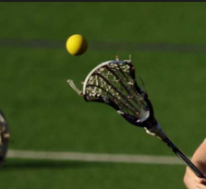
Boundary Self-Starts
Self-starts are always allowed on boundary balls - including when the ball crosses the end line in the CSA
X
X
O
Play may not start with a pass from out of bounds!
Notes:
(animation starts automatically)
Boundary Self-Starts in the CSA:
Consistent with boundary ball restarts on the side-lines -- self-starts are allowed when the ball crosses the end line in the CSA.
NOTE: f, on a shot, the closest player’s team will gain possession, any player on that team can retrieve the ball and self-start from a position on the field relative to where the ball went out of bounds.
On all four sides of the field, self-starts are legal on boundary balls.

Slide 46
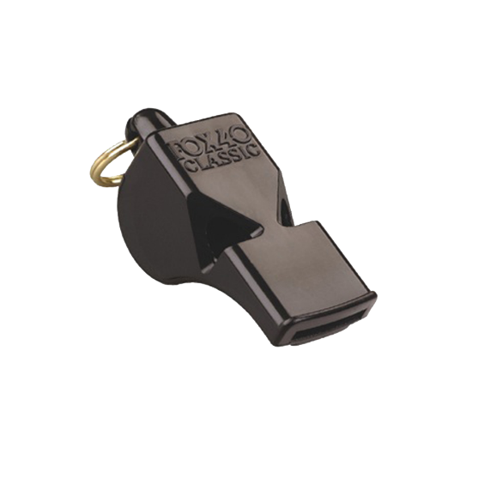
All Fouls Committed by Defense in the Critical Scoring Area
Whistle Start*
* During last minute of each quarter of game both offensive and defensive restarts require a whistle.
Notes:
PREVENTIVE OFFICIATING IS CRITICAL!
Help the players – remind them by saying “whistle start!” or “on my whistle!” – so offense does not self start on a foul in the CSA
Help both defense and offense the last two minutes of each half to avoid false starts!

Slide 47
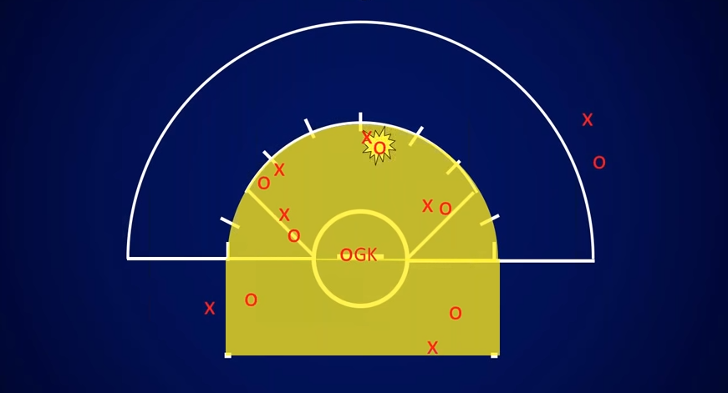
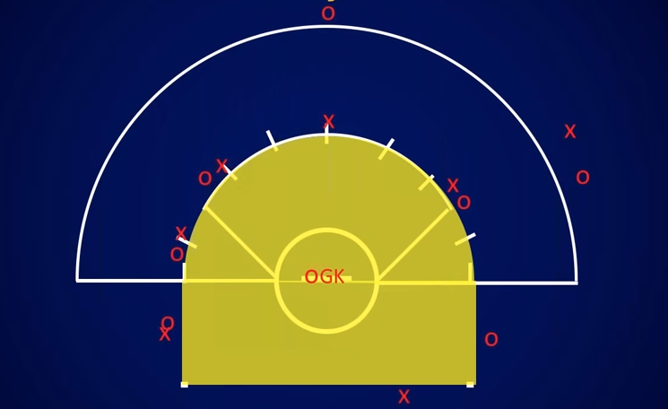
Restarts and the Penalty Zone
For fouls anywhere above the GLE and within 8m of goal
Fouled player is instructed to move to the nearest hash mark
Offender is moved 4m behind
Defense is entitled to the 2 adjacent hash marks if they choose to go there
All others clear “The Zone” – Free Movement!
Notes:
As long as the players are out of the Penalty Zone and at least 4m from the free position, they can go anywhere!

Slide 48
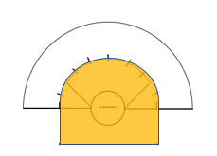
Review: The Penalty Zone and Free Movement
Only the player fouled and her offender are directed to a position in the CSA
Any defender may take either hash adjacent to the 8m Free Position
Players can take any route out of the Penalty Zone
After FP is set, Lead backs out of the 8m arc, raises an arm, and whistles to restart play.
Any player entering the PZ or coming within 4m of the FP after the Lead backs out will be assessed a foul for a False Start
CSA fouls below the GLE are set up on the dot. Offender 4m behind or away.
Notes:
(Animation starts automatically)

Slide 49
3 Seconds Penalty Administration
O
Foul ALWAYS occurs in the CSA
(Even if ball is outside)
X
O
X
O
The offender ALWAYS goes behind the ball carrier
O
X
Always a whistle start
Restarts are ALWAYS in the CSA: either on the 8, 12 or dot
Notes:
This particular penalty administration takes a little extra time to set up -- the offender goes behind the ball and she might have quite a walk!
(click)
Ball stays with ball carrier, offender goes 4m behind ball carrier, regardless of location of ball.
(click)

Slide 50
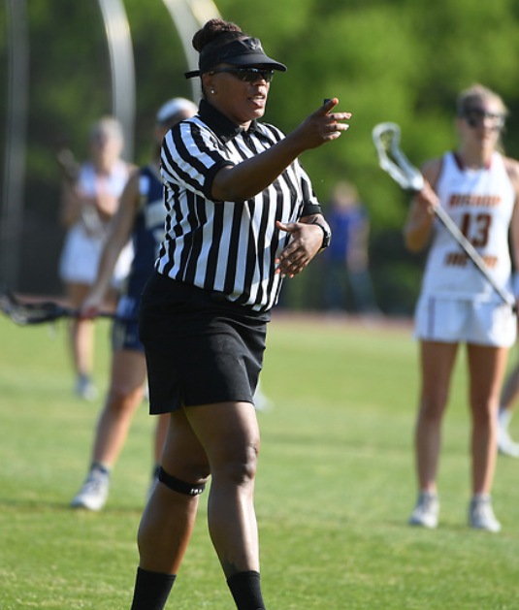
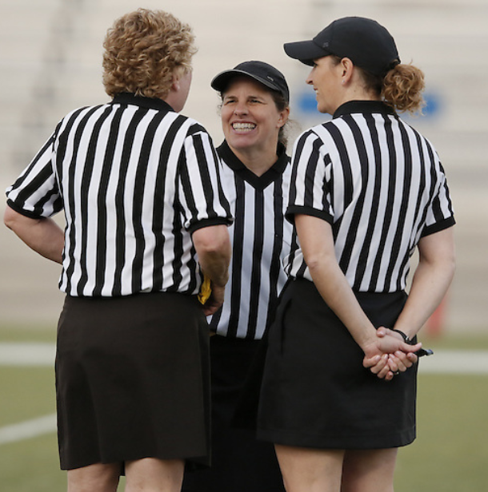
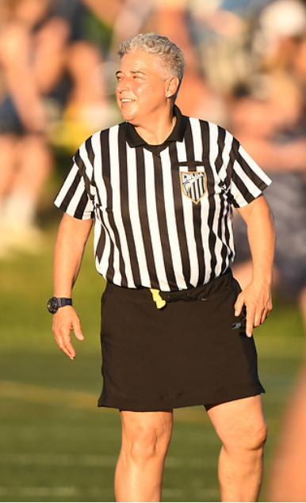
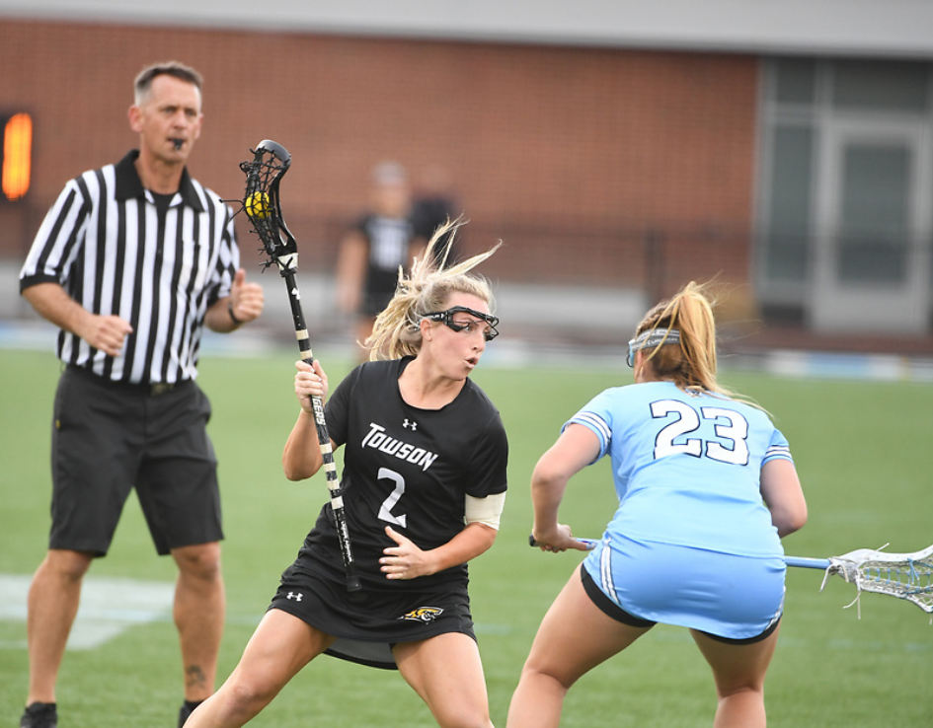
WHAT IS PROFESSIONALISM?

Slide 51
KEYS TO BEING A TRUE PROFESSIONAL
Character
Attitude
Excellence
Competency
Conduct

Slide 52
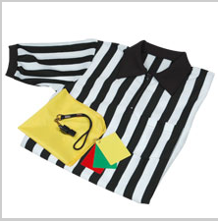

EQUIPMENT CHECK
Whistle
Yellow flag
Cards (red, yellow, green)
Rule book
Measuring tape
Pencil
Coin
Sportsmanship card (if applicable)
Notes:
Be sure to have these with you at every game. Most officials have a small black bag they take with them on the field that contains these items. Next step – whistle training!

Slide 53
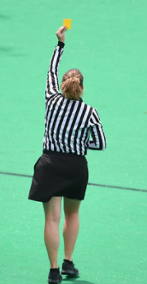
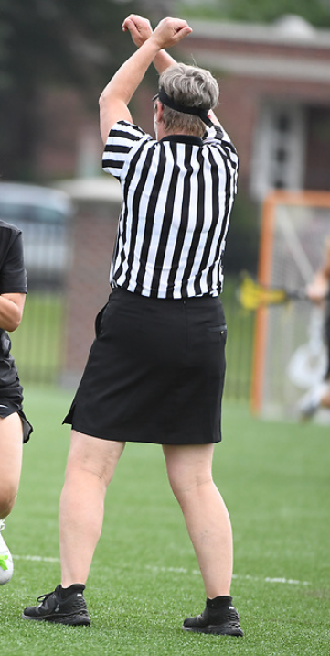
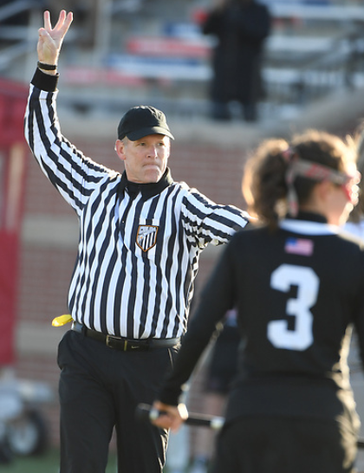
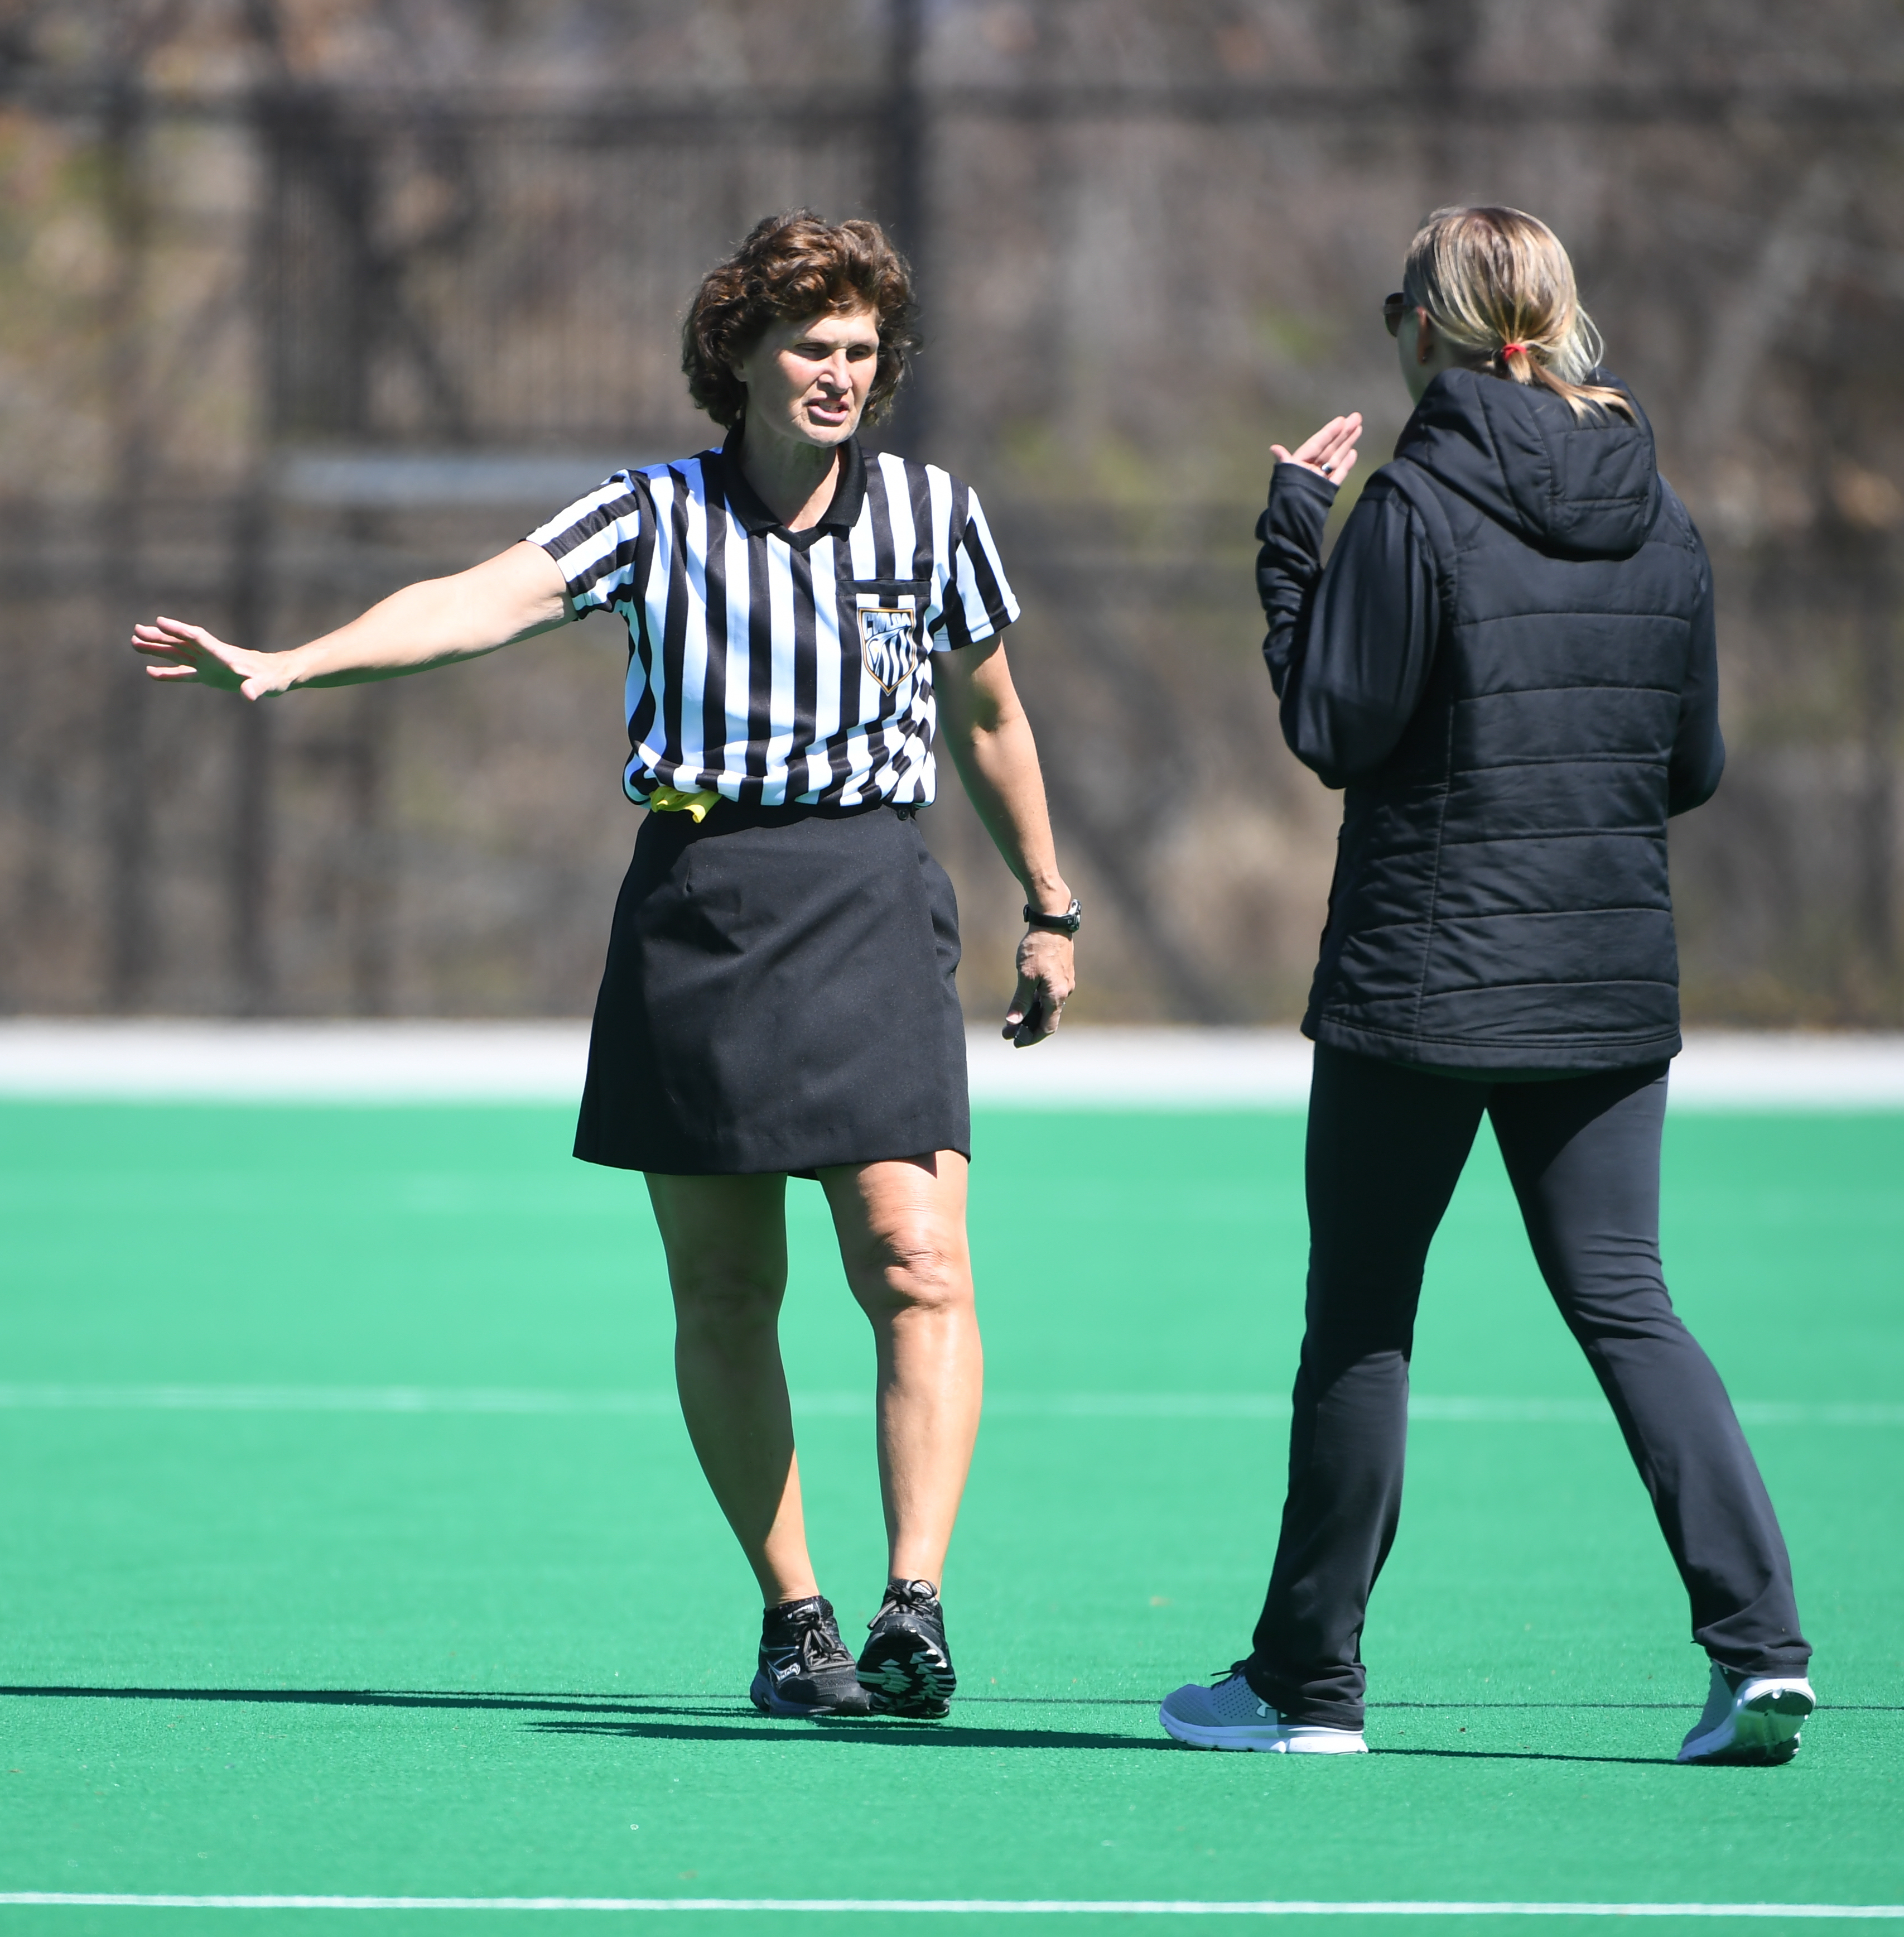
WHAT IS GAME MANAGEMENT?

Slide 54
WHAT IS GAME MANAGEMENT?
Managing the clock
Recognizing and handling fouls
Setting the tone of the game
Handling Unsportsmanlike Behavior
Responding appropriately to players, coaches and spectators
Management is a skill that can be learned

Slide 55
THE TONE OF THE GAME
Be prepared for anything as soon as the game starts
Allow the game to dictate how you call it
Make the calls in the midfield rather than hold for advantage
Address the coaches’ questions
Notes:
Assess the tone of the game early. Is it a very physical game? Maybe the officiating team needs to discuss tightening up calls. Is it a lopsided contest? The officials should make sure they are calling fouls to keep the less-skilled players safe.
Making calls in the midfield cleans up many games. If you hold for advantage, you are telling players you will allow a certain level of play. Is that what you are intending? Discuss with your partner to make sure you are on the same page.
Addressing the coaches’ questions may mean that you tell them you will answer later, not immediately.
Have the ability to end the conversation in a respectful way,"Coach, we can further discuss this at a time out, halftime or after the game?"

Slide 56
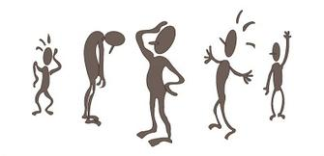
COMMUNICATION
VERBAL VS. NON-VERBAL
NON –VERBAL COMMUNICATION
SPEAKS LOUDLY
Body language SPEAKS volumes!
Notes:
What are you saying without actually saying it?
Have class take turns “saying” things non-verbally
Show some subtle ones like looking at the ground, putting hands on hips, etc.

Slide 57

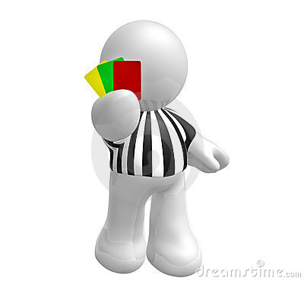

NON-VERBAL COMMUNICATION
WHISTLE TALK
Loud and bold for BIG fouls
Short and sweet for restarts, boundaries
CARDS
Use them!
BIG whistle to stop clock
efficient mechanics
SIGNALS
Show signal/direction every time
“Stadium signals”

Slide 58
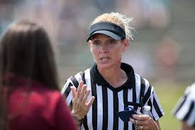
COMMUNICATION WITH COACHES
Listen
Keep interaction professional and concise
Read and know the rulebook
Use the language of the rules to answer questions
Activity : Coach Interaction
Notes:
(animation starts automatically)
Practice and know the “language” of the rules (Give an example of things you have heard that do not speak the language of the rules -- moving pick, etc)
Look up and read slash and empty stick check.
Make sure what you say is what you are calling. A dangerous shot is a major foul while a dangerous propel is a major foul that also has to be a yellow card.
Checking towards the head is different than check to the head. (major foul vs. cardable major foul)

Slide 59
COMMUNICATION WITH PLAYERS
Do
Answer questions
Don’t
Yell at players
Coach players
Diffuse volatile situations
Escalate negative emotions
Respect players
Emphasize safety
Be clear and concise
Threaten with cards
Notes:
On the field, keep your verbal communication to a minimum.
Give foul called, what color & number will get the ball, what color & number needs to move for the penalty and what direction everybody else should be moving away.
Tone of voice - ask your partner what you sound like when giving directions. Does it sound like you are yelling? Barking at the players? Are you too quiet? Are you too “wordy”?
Don’t respond to spectators during a game - resist that urge!

Slide 60
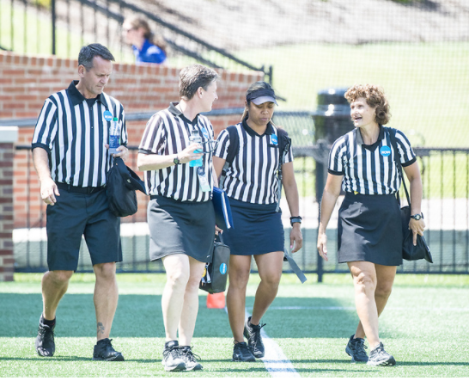
TEAMWORK
Have a good pregame discussion
Check in with your partners throughout the game
Have a thorough postgame discussion
Welcome to Team Zebra!

