Slide 1
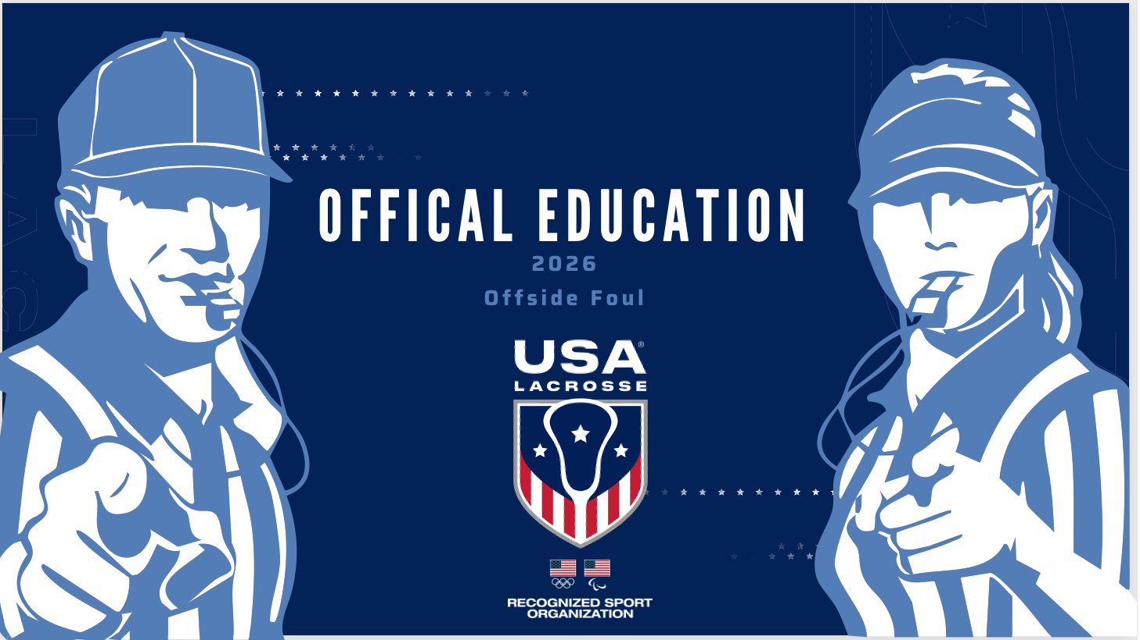

Slide 2
RESTRAINING LINE
The Restraining Line is 30 yards from the goal line.
The attack must have no more than 7 players below the Restraining Line in their attacking end of the field.
The defense must have no more than 8 players below the Restraining Line in their defensive end of the field.
30 yds.
Notes:
“Below the Restraining Line” refers to the area between the end line and the restraining line, as soon as the ball crosses into that area.
When the ball is in either end, the players remaining “Above” (sometimes called “behind”) the restraining line (whether defense or attack) MAY NOT touch or step over the line with their feet/body, but MAY reach over with their sticks and even touch the ground to pick up a ball.
8 Players in Defensive end = maximum limit (usually comprised of 7 plus the goalie); or fewer, depending on number of players serving a card, if any.
7 Players in the Offensive end = maximum limit; or fewer, depending on number of players serving a card, if any.
Note: If a team has elected to play with fewer than 12 players, they may have fewer players *behind* the
restraining line (meaning in the end of the field without the ball).

Slide 3
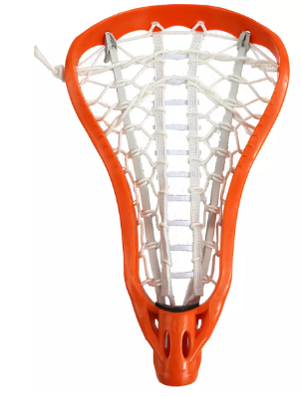
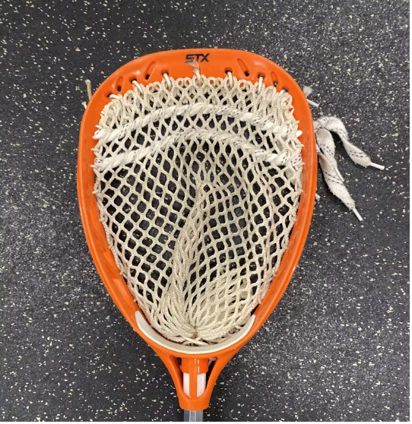
RESTRAINING LINE: Ball in Offensive End
If orange goalie is here
Orange has 7 players in their offensive end
And orange has 5 players (1 goalie and 4 field) in their defensive end
Notes:
If orange goalie is here (Click)
This is Orange’s offensive restraining line (Click)
Orange has 7 players in their offensive end (Click)
And orange has 5 players (1 goalie and 4 field players) in their defensive end

Slide 4
RESTRAINING LINE: Ball in Defensive End
If orange goalie is still here
Orange has 8 players in their defensive end
And orange has 4 players in their offensive end
Notes:
Orange goalie is still here (Click)
This is orange’s defensive restraining line, Orange has 8 players in their defensive end (Click)
orange has 4 players in their offensive end

Slide 5
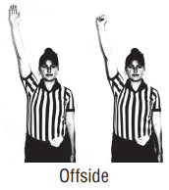
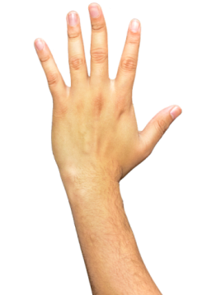
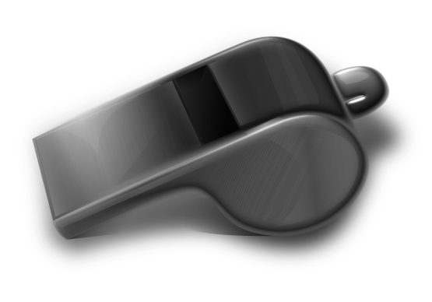
WHEN TO CALL OFFSIDE FOUL
Attack
If an attack player goes offside, the official will make the call immediately.
Defense
If a defender goes offside, the official may hold the whistle if player is not impacting play.
Notes:
Any part of the foot on or over the line or touching the ground beyond the line is considered a violation.
Players may reach over with their stick (which may be touching the ground) to play the ball if no part of the foot is on or over the line.
Violation of the restraining line rule is considered a major foul. Officials indicate a violation by raising the arm straight up
over the head with the palm open.
When the whistle is sounded to make the call, the open palm should be closed into a fist.
Players may exchange places on either side of the restraining line during play, but a player *switching places* must have both feet above the restraining line before a teammate can go below it.

Slide 6
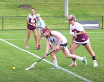
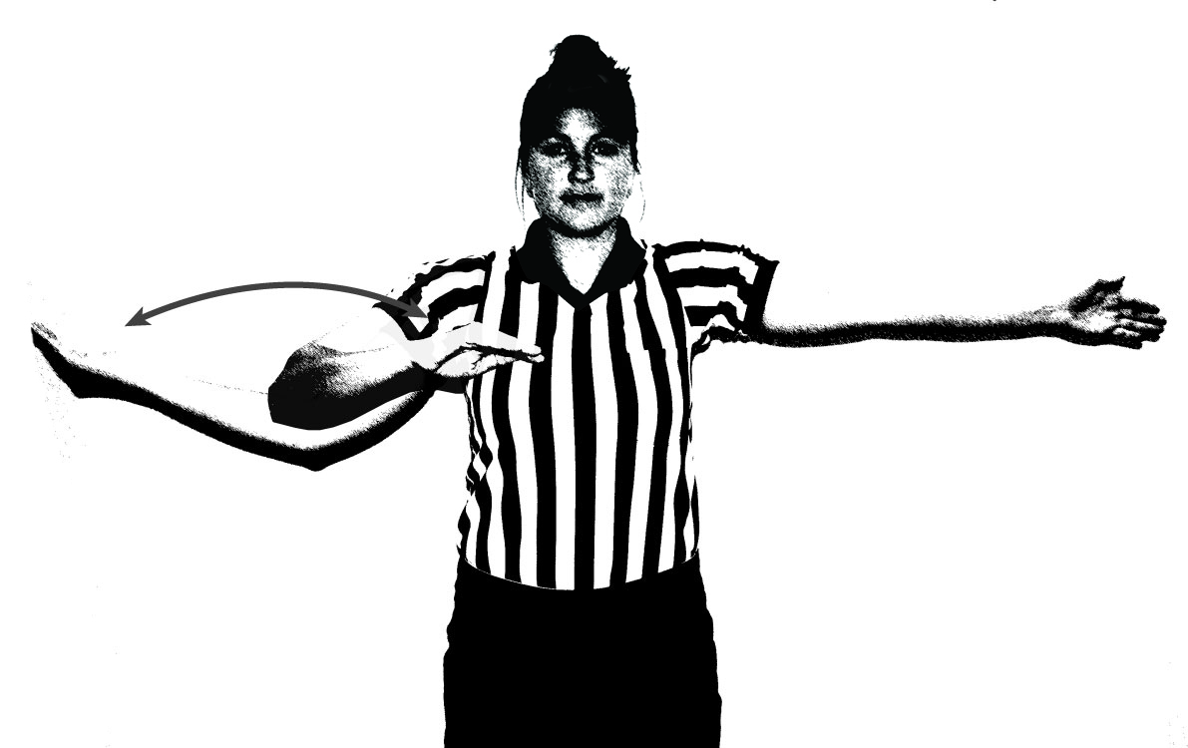
OFFSIDE FOUL vs EARLY ENTRY
Offside is the result of too many players below/above the restraining line during play.
Offside requires a time out, unless there is a 10 goal differential.
Offside always requires a whistle to restart play.
Early Entry foul occurs only on the draw and is a Minor foul.
Notes:
Different signal. Different foul. Different administration!

Slide 7
OFFSIDE PENALTY ADMINISTRATION: DEFENSE
Offsides called
x
INSIDE THE CSA, ABOVE THE GLE
Correct the offside
Attack awarded free position
Closest opponent 4m behind
Clear penalty lane
Whistle start
o
x
x
o
x
o
o
x
o
x
G
o
x
x
o
x
o
Reminder: Call Time Out to administer the penalty*
Notes:
Hand up in the air for suspected Offside – blow whistle when you see it.
Call time out (*unless 10 goal differential). (The asterisk in the slide reminds us that if a 10 goal differential exists, the 2024 rule says do not call a TO - - like for AP & Official TO’s, Offside is always a whistle start. No self start).
Correct the offside first (nearest player to the RL goes back) (Click)
Attack awarded free position at the center of the 12m fan (Click)
Closest opponent 4m behind (Click)
Clear penalty lane (Click)

Slide 8
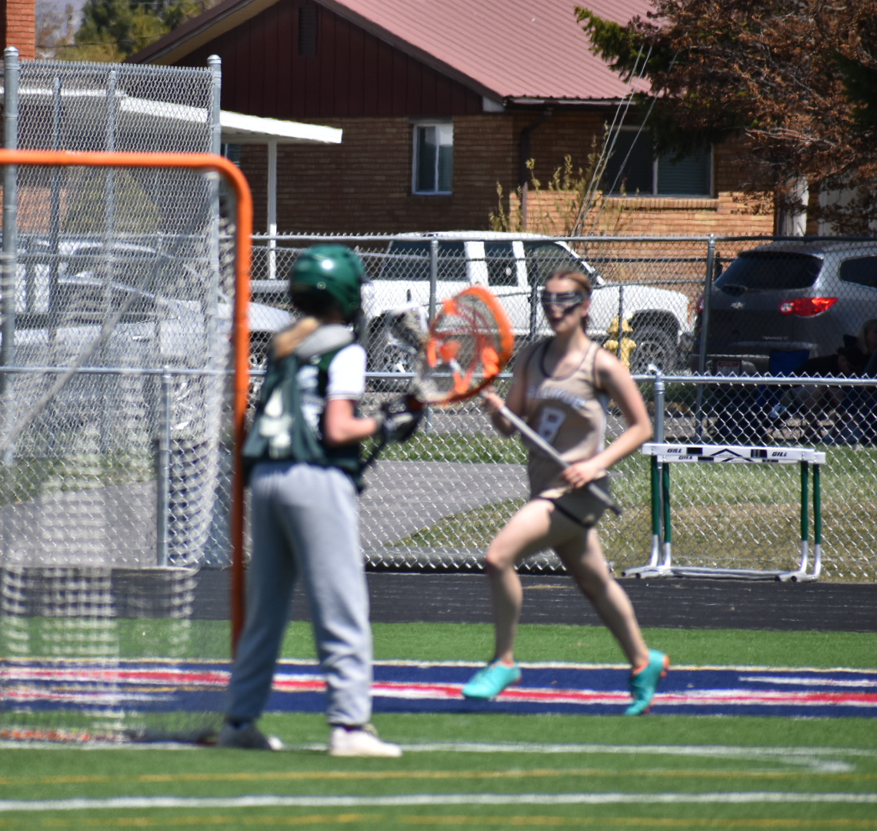
OFFSIDE PENALTY ADMINISTRATION: DEFENSE
INSIDE THE CSA, BELOW THE GLE
Correct the offside
Attack awarded free position at the nearest dot
Closest opponent 4m behind
Whistle start
Reminder: Call Time Out to administer the penalty*
Notes:
Call time out.
Correct the offside first (nearest player to the RL goes back)
Below GLE – set up on nearest dot
*The asterisk reminds us that if there is a 10 goal differential, we do not call Time Out. (The rule book clearly states it still must be a whistle start; no self starts from Offside, AP or Official TO)

Slide 9
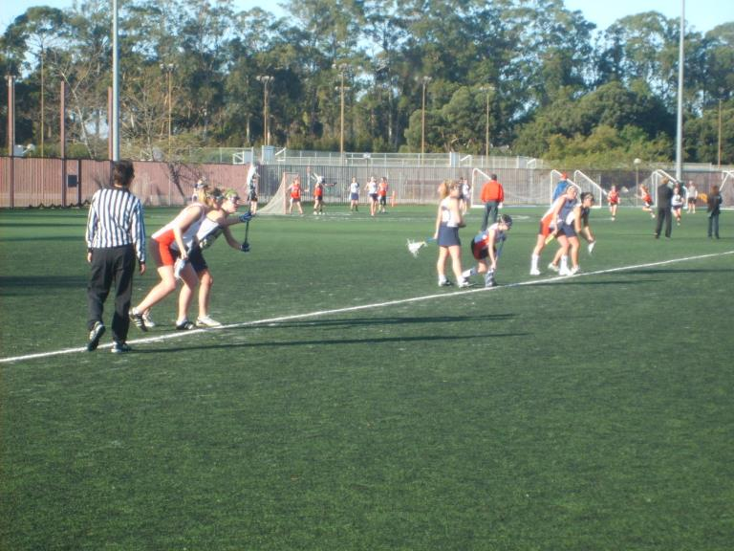
OFFSIDE PENALTY ADMINISTRATION: OFFENSE AND DEFENSE
OUTSIDE THE CSA
Correct the offside
Non offending team awarded free position at the spot of the ball
Closest opponent 4m behind
Whistle start
Reminder: Call Time Out to administer the penalty*
Notes:
Call time out.
Correct the offside first (nearest player to the RL goes back)
Outside the CSA – still requires a time out!
*Unless there is a 10 goal differential…

Slide 10
OFFSIDE PENALTY ADMINISTRATION: OFFENSE
Offsides called
x
INSIDE THE CSA, ABOVE THE GLE
Correct the offside
Defense awarded free position at spot of the ball (no closer than 8m to the goal circle)
Closest opponent 4m behind
Whistle start
o
x
x
o
x
o
o
o
x
G
x
o
x
o
x
x
o
Reminder: Call Time Out to administer the penalty unless there is a 10 goal differential
Notes:
Call time out (unless 10 Goal Diff.)
Correct the offside first (nearest player to the RL goes back) (click)
Above GLE – spot of the foul, but no closer than 8m to the GC (click)
Closest opponent 4m behind (click)

Slide 11
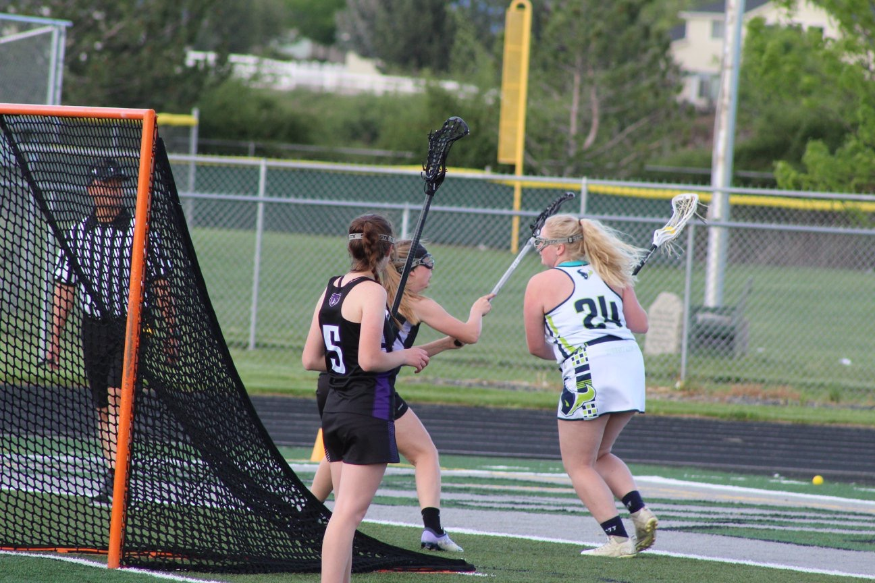
OFFSIDE PENALTY ADMINISTRATION: OFFENSE
INSIDE THE CSA, BELOW THE GLE
Correct the offside
Defense awarded free position at the nearest dot
Closest opponent 4m behind
Whistle start
Reminder: Call Time Out to administer the penalty (unless there is a 10 goal differential)
Notes:
Call time out (unless 10 Goal Differential).
Correct the offside first (nearest player to the RL goes back)
Below GLE – set up on nearest dot
Whistle Start

Slide 12
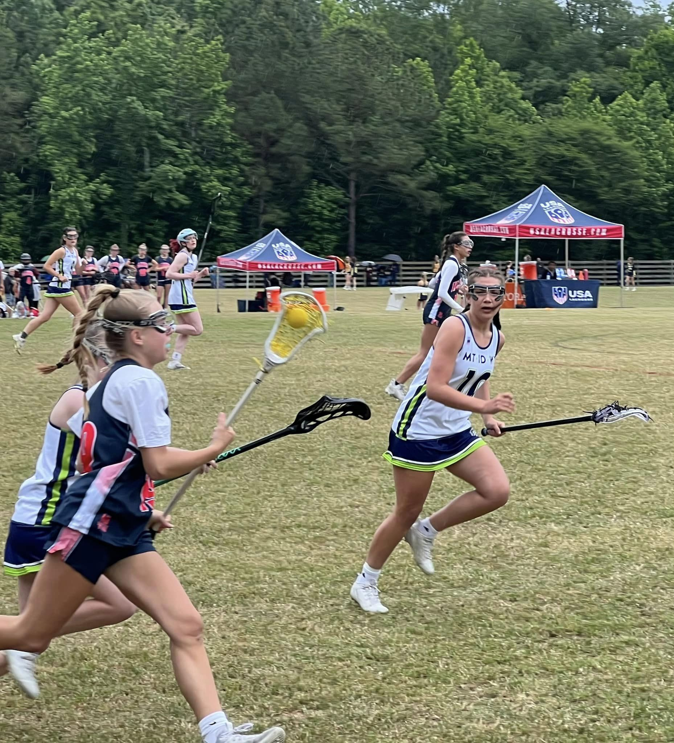
OFFSETTING OFFSIDE FOULS
If players from both teams are offside,
it is an offsetting foul situation. Players nearest to the restraining line from both teams will be moved back onside.
INADVERTENT WHISTLE
If a whistle is blown for offsides, but no one is in fact offside, it is considered an
inadvertent whistle.
The player who was in possession of, or nearest to the ball at the time play was stopped, will be awarded the ball. Whistle Start.
Notes:
If two players are equidistant from the ball, AP will be used to determine which team receives possession.
An offsetting foul situation can also arise if, for instance, the defense has a player offside and, while you are holding the
whistle, the attack commits some other foul. The spot of the ball at the time play was stopped will determine where
alternate possession will be awarded.
Time out will be called for Alternate Possessions (except for a 10 goal differential). Play will always be restarted with the official’s whistle. Self-starts are not permitted (even with a 10 GD).
If a whistle has been blown for an offside foul, and it is discovered that no one is in fact offside, it is considered an inadvertent
whistle and time out is called (unless there is a 10 GD).
The player who was in possession of, or nearest to, the ball at the time play was stopped will be awarded the ball. Play is
restarted at the spot of the ball when the ball is outside the CSA. If the ball is inside the CSA, play will resume at the dot. In
both instances, all other players are no closer than 4m to the ball carrier. If two players are equidistant from the ball, the
alternate possession procedure (AP) will be used to determine which team receives possession.
Play will be restarted with the official’s whistle. Self-starts are not permitted following an Inadvertent whistle.

Slide 13
PLAYING ”SHORT”
When a team is serving a penalty for a card, they will play short in both their attacking and defensive ends.
They may only have 6 players in their offensive end.
They may only have 7 players in their defensive end (including the goalie.)
o
x
x
x
o
x
o
o
o
o
o
x
x
o
x
o
o
x
x
o
x
x
o
Carded players in the penalty area
Notes:
Click to start animation
IN ATTACKING END: Attack team “playing down” (one) will only be allowed six field players
IN DEFENDING END: Defense team “playing down” (one) will only be allowed seven players (usually goalie plus six)
On the other side of the field… there are usually (in the non-ball end of the field):
4 field players from defending team
4 field players and their goalie from team on attack
But this number could be lower if the teams agreed to play with fewer players.

Slide 14
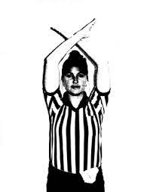
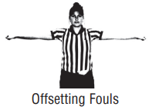
Held Whistle on Defense with Additional Fouls
Defense
Whistle to stop play, signal Time Out*
Determine if foul was major or minor.
Attack
Whistle to stop play, signal Time Out*
Use the Alternate Possession procedure to determine which team will gain possession
of the ball for the restart of play
Time Out
Determine if ball was outside CSA, outside 8M arc, but inside the 12M fan or inside 8M arc
*unless 10 goal differential
Notes:
If you are holding the whistle on an offside foul by the defense and another foul is called on either team, you must step in
and indicate the offside foul and correct the offside situation.
If the defense has committed the additional foul, determine if the foul is major or minor, and position of ball
You will always correct the Offsides if still necessary, but the Penalty depends on what kind (location and/or severity) of additional Defensive foul it is… (see next slide)

Slide 15
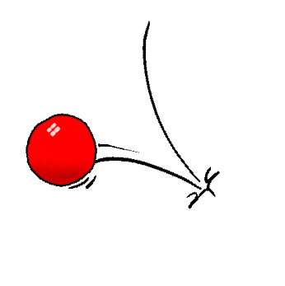
HELD WHISTLE ON DEFENSE WITH ADDITIONAL DEFENSE FOUL
Where is ball? | Minor Foul | Major Foul
Outside CSA | Correct Offsides Closest defense player goes 4M behind the free position. | Correct Offsides Closest defense player goes 4M behind the free position.
Outside 8M arc, but inside the 12M fan | Correct Offsides Free position for closest attack player at the top of the 12m fan. Closest defense player 4m behind. Clear the lane. | Correct Offsides Free position for closest attack player at the top of the 12m fan. Closest defense player 4m behind. Clear the lane.
Inside 8M arc | Correct Offsides Free position for closest attack player at the top of the 12m fan. Closest defense player 4m behind. Clear the lane. | Correct the offsides. Free position for closest attack player at the 8m hash closest to the spot of the foul. Closest defense player 4m behind.
Notes:
a. Ball is outside the CSA
1. If additional defense foul was a major foul: whistle to stop play. Correct the offsides, closest defense player goes
4m behind the free position.
2. If additional defense foul was a minor foul: whistle to stop play. Correct the offsides, closest defense player goes
4m away from the free position.
b. Ball is outside the 8m arc, but inside the 12m fan
If additional foul is a major foul or a minor foul: whistle to stop play. Correct the offsides. Free position for closest attack
player at the top of the 12m fan. Closest defense player 4m behind. Clear the lane.
c. Ball is inside the 8m arc
1. If additional defense foul was a major foul: whistle to stop play. Correct the offsides. Free position for closest
attack player at the 8m hash closest to the spot of the foul. Closest defense player 4m behind.
2. If defense foul was a minor foul: whistle to stop play. Correct the offsides. Free position for closest attack player
at the top of the 12m fan. Closest defense player 4m behind. Clear the lane.
Note: When an official blows the whistle for a foul by the defense, and another defender is found to be offside, the official
must first determine if the defensive foul is a major or a minor. If the foul is minor, penalize the major offside foul. If the foul
is major, penalize according to Rule 10, Penalties.

Slide 16
OFFSIDE FOUL REVIEW
1. If we see 3 attackers “above/behind” the Restraining Line – would we call offside immediately?
2. If a defender is offside but coming back over the Restraining Line – should we call offside?
3. If, after a goal, we discover offside by the Attack – do we allow the goal?
Notes:
Three clicks to bring up questions
First check to be sure of player counts. If no cards and no players down on either team and both teams do not have illegal number of players Below the restraining line (i.e. in the end where the ball is) do not make this call.
Officials’ Discretion – not required to call if they are not influencing play at all.
No. If the next draw has been taken, then a goal stands: it’s considered too late to “not count” or take it back. But if the Attack Offside is discovered before that draw occurs, then the goal is disallowed. **Someone’s going to ask about the Penalty set up here: just penalize the Att Offside by correcting Att players, then giving ball to Defense (location determined by location of ball closest to time of discovery (in goal or 12M?) at the 8m or 12m and nearest Att 4 m behind.

Slide 17
QUESTIONS?

