Slide 1


Slide 2
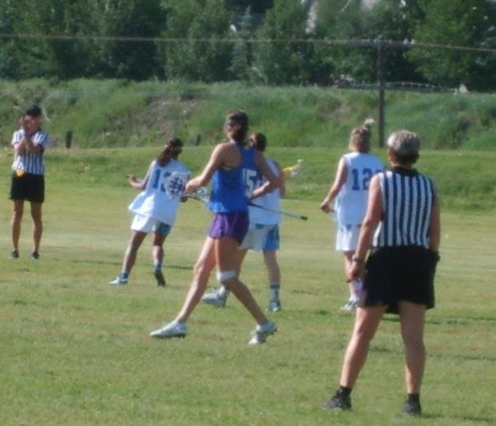
Goals of Two Person Positioning
To put us in the best position to make the calls that allow us to keep the game safe and fair.
To work as a TEAM to cover all areas of the field efficiently and consistently.​
2
Notes:
There are two main goals in executing two-person positioning properly:
1. To ensure both officials are in the best position to call the game safely and fairly, and
2. To work as a two-person team to cover the field and make the calls, both efficiently and consistently.

Slide 3
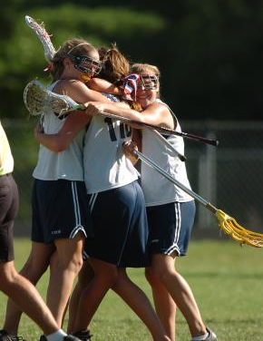
Role of Officials
Ensure the game is…
Safe
Fair
Fun
Fluid!
3
Notes:
Safety: Maintain safety for all involved.
Fairness: Remain neutral and call the game consistently.
Fun: That’s why we (players, parents, coaches) are all there!
Fluid: With self-starts and free movement, the game will become more fluid. Our role as officials is to help it do that while maintaining the first three goals

Slide 4
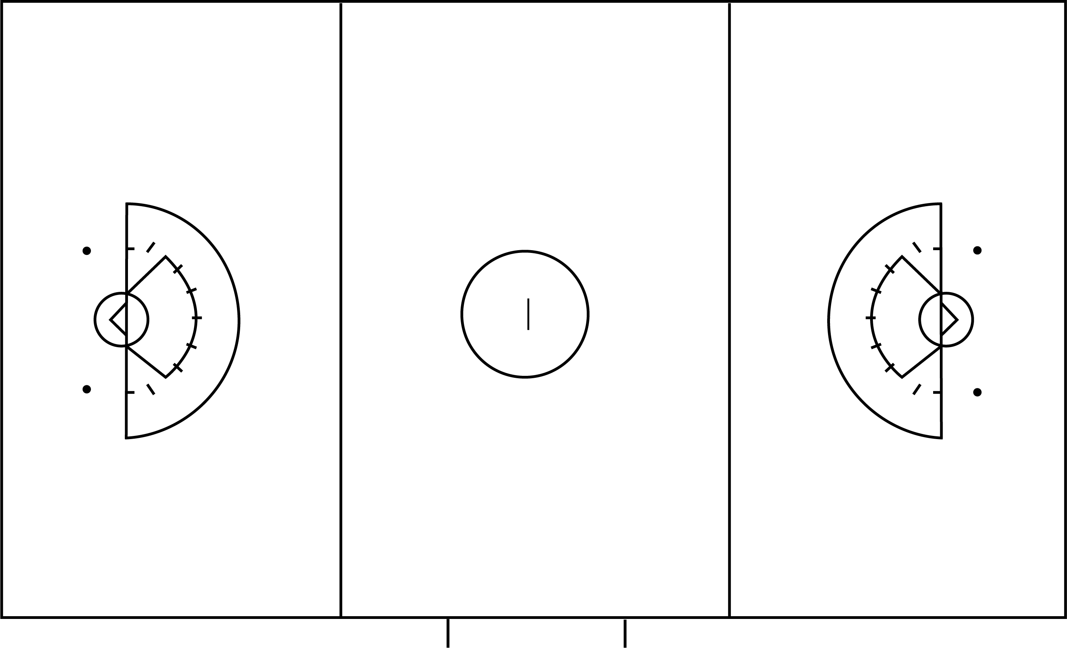
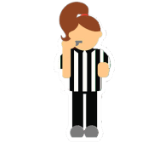
SCORER’S TABLE
Should be the more experienced of the team
Will run the Coaches’/Captains’ Meeting
Will discuss responsibilities with the Timer and Scorer
Table Side Official
May be less experienced
Will participate in all pre-game discussions and meetings
“Far Side” Official
4
Notes:
Note: Officials may rotate sides after every 2 or 3 goals. If working with a very inexperienced official, rotating may be too challenging at first, so this is not a mandatory procedure. Discuss this with your partner
USL has no formal policy regarding rotating sides. Follow your board’s guidelines or discuss in your pregame.

Slide 5
Areas of Responsibility
As Lead
As Trail
Shared Area
As Trail
As Lead
5
Notes:
Officials work the Lead position to their right and the Trail position to their left.
They cover their entire sideline and the end line where they are the Lead. So, (click) the official in the green oval has her sideline and endline, (click) and the official in yellow has her sideline and endline. Officials are responsible for calls on their side of the field, but the center of the field is a “shared area” where both officials can make calls.
“Lines” are flexible! Shared area constantly changes as the ball moves up and down the field.

Slide 6

Areas of Responsibility – The Draw
Counts players from both teams
Shared Area
Administers opening draw
6
Notes:
(Animation begins automatically)
Table official: counts players from both teams; no more than 3 players from each team between the RLs when the draw is administered.
Far side official: administers the opening draw. All subsequent draws will be taken by the official farthest from the goal that was scored upon.

Slide 7
Areas of Responsibility – The Draw
ox
ox
ox
ox
ox
GK
ox
GK
ox
o
x
ox
ox
ox
7
Notes:
The official administering the draw is responsible for the observing the players taking the draw to ensure the draw is legal. In addition, they should try to keep an eye on the two other sets of players outside of the draw circle to watch for early entry.
The 2nd official is responsible for watching players on the restraining lines as well as the players around the circle. Officials should watch for players pushing or jockeying for position or an early entry – either stepping into the circle before the whistle has blown or stepping over the restraining lines before possession has been established.
If a player enters the center circle early, the official should blow the whistle immediately.
If a player steps over either restraining line and into the middle third of the field BEFORE possession is gained , the official should wait to see which team gains possession. If the team who did not foul gains possession on the draw, the official can signal “Advantage” and allow play to continue.
Once the official's hands are on the sticks to set the draw, no players can cross from below the restraining line. Players can go from the center third of the field to below the restraining line, but not the reverse. Also, players cannot enter the field of play from the substitution area/penalty box until possession has been gained.

Slide 8
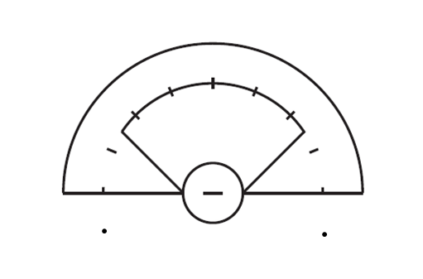
CSA Responsibilities
Trail
Lead
Notes:
In the Critical Scoring Area, the Lead official is typically on-ball and responsible for on-ball fouls. (click)
The Trail official (click) is off-ball and responsible for fouls that occur away from the ball (3 Seconds, Detaining, Shooting Space, etc.) Trail is also responsible for restraining line violations (offside) calls.
If the ball is near the 12m fan and right in front of the Trail official, Trail may have a better view of potential fouls.
Calls made in the “coffin corner” can be shared with the Trail official (may have a better angle for those calls)

Slide 9
CSA Responsibilities
Lead
Trail
On-Ball Fouls
Shooting Space on your side of the Arc
Goal Circle Activity
Endline and Sideline Boundaries
Off Ball Fouls on your side of the Arc
Off-Ball Fouls
Shooting Space on your side of the Arc
Restraining Line Violations
Dangerous Propelling/Dangerous Follow Through
9
Notes:
What are some On-Ball fouls the Lead would be watching for? (Checks to the body, Checks to the head, Dangerous Follow Through, Forcing Through, etc.)
What are some Off-Ball fouls the Trail would be watching for? (Illegal Picks, 3 Seconds, false starts, Dangerous Follow Through, etc.)

Slide 10
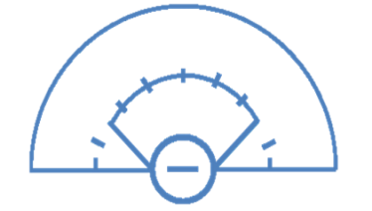
Lead Positioning
The Lead’s purpose of movement is to see the ball and space between the
ball carrier and her defenders
TANGENT
QUADRANTS
3
1
4
Use the approach that works best for you!
10
Notes:
These are two guiding techniques that can be used to understand the positioning of the Lead around the ARC. Two ways to learn it.
To be “on tangent” is to form a right angle (90 degrees) from you to a point on the goal circle and out to the ball.
Quadrants refer to a specific area in the CSA.

Slide 11
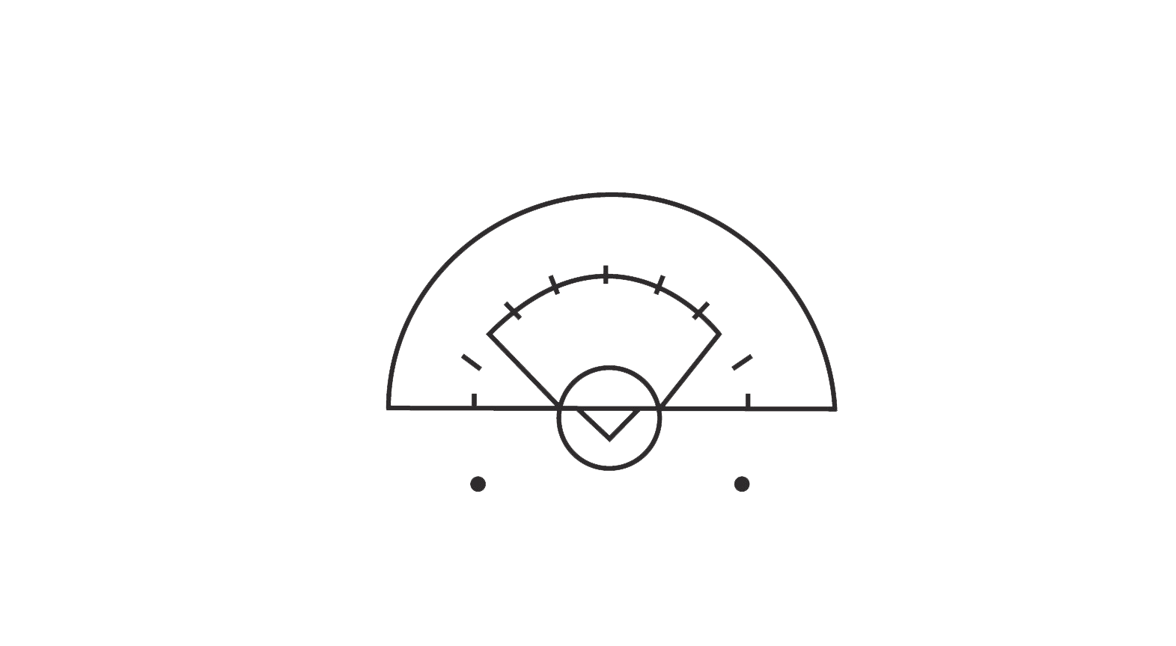
Lead Tangent Positioning
Two-Person Positioning 2021
11
Notes:
The idea of working on Tangent as Lead is to continually move to reposition yourself in relation to the ball.
If the ball is in the center of the CSA and at the top of the 8m arc, the Lead official will move to be parallel to the top of the goal circle. In this position, they have created a 90-degree angle to the approaching ball carrier and are now “on tangent.”

Slide 12
Lead Tangent Positioning
Two-Person Positioning 2021
12
Notes:
As the ball moves, the official moves as well. (click) If the ball goes high on the far side of the arc, the official moves to a HIGH tangent. Once again, they are creating a 90-degree angle from a spot on the goal circle to the ball. (click)
As the ball moves across the CSA, the official repositions to maintain that 90-degree angle. Now, the official is on a LOW tangent.

Slide 13
Lead Tangent Positioning
Two-Person Positioning 2021
13
Notes:
When the ball is below the GLE and is moving towards the official, (click) the official moves further below the GLE to maintain the tangent.
They are creating a 90-degree angle from a spot on the goal circle to the ball. In this scenario, the official must be ready to quickly move above the GLE to maintain the tangent if the ball is passed into the 8m.

Slide 14
Lead Quadrant Positioning
2
3
Two-Person Positioning 2021
1
4
14
Notes:
The CSA has four quadrants and each is numbered clock-wise.
Quadrant 1 is in the lower left part of the CSA.
Quadrant 2 is in the upper left part of the CSA.
Quadrant 3 is in the upper right part of the CSA
Quadrant 4 is in the lower right part of the CSA.
.
When an official’s movement is based on Quadrants, they will always be one quadrant away from the quadrant the ball is in, unless the ball is in Quadrant 1. When the ball is in Quadrant 1, the official is in quadrant 1.

Slide 15
Lead Quadrant Positioning
2
3
Two-Person Positioning 2021
1
4
15
Notes:
In this instance, the ball is in Quadrant 4. The official will be in quadrant 1, one Quadrant away from the ball.

Slide 16
Lead Quadrant Positioning
2
3
Two-Person Positioning 2021
1
4
16
Notes:
When the ball is in Quadrant 3, the official will be in quadrant 2. Note that the official is on tangent here.

Slide 17
Lead Quadrant Positioning
2
3
Two-Person Positioning 2021
1
4
17
Notes:
When the ball is in Quadrant 2, the official will be in Quadrant 1. Again, the official is on tangent by making a 90-degree angle with the ball and the goal circle.

Slide 18
Lead Quadrant Positioning
2
3
Two-Person Positioning 2021
1
4
18
Notes:
When the ball is moving from Quadrant 4 to Quadrant 2, the official will let ball “pass by” while they are in Quadrant 1. This is the only time the ball and the official will be in the same location.

Slide 19
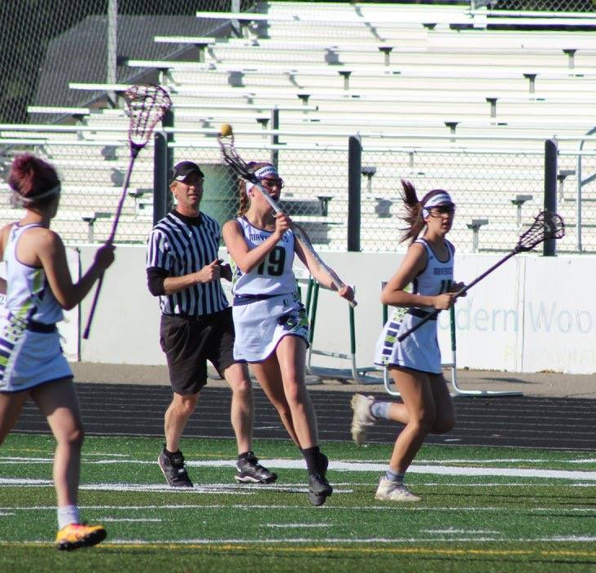
Transition
Trail to
Lead
Stay ahead of and outside the ball
Position your body to keep play and players in your vision
Maintain a “view” of the action into CSA
Lead to
Trail
Count players ahead of you
Stay up with play, run through restraining line
Anticipate where the play is going
Two-Person Positioning 2021
ACTIVITY:
Officials in Transition
19
Notes:
What does “outside the ball” mean? (Official is closer to the sideline, keeping the ball and player “inside” the field of play and their field of vision)
Handout: “Official’s in Transition” available to support next few slides

Slide 20
Responsibility in Transition
Handout: Officials In Transition
Lead to Trail
Trail
Lead
Trail to Lead
Two-Person Positioning 2021
20
Notes:
When the ball transitions from one end of the field to the other, the officials’ responsibilities shift. (click) As the ball leaves the CSA, Lead is still on-ball while Trail works to get ahead of the ball.
Midfield is a “Shared Area.” Either official may be on ball, depending upon the ball’s location. The Trail is NOT looking at the ball carrier if they are on the other side of the field. But will pay attention to the ball if it transitions down their side of the field.
As the ball moves into the CSA at the other end of the field, (click) the new Lead positions to get ahead to receive the play as it comes into the CSA. At the same time, the new Trail keeps up with play, always running through (past) the Restraining Line to help officiate at that end of the field.
The handout will review what both the Trail and the Lead might consider as they advance down the field.

Slide 21
Restart Guidelines
Officials manage restarts in their “third” of the field
Each official always manages restarts on their sideline and endline boundary
Lead Official whistles all restarts in the CSA
Know when to release monitoring restart to partner
Step up as Trail to manage restarts when your partner is transitioning to Lead
Two-Person Positioning 2021
21
Notes:
What does it mean to “manage” a restart? The official will make sure the restart is made within the guidelines of a legal self-start (within playing distance, all other players 4m away, etc.) If the player waits for a whistle start, or if a stoppage of play requires a whistle start, the official will manage the restart in that way.
Both officials will manage self-starts in their third of the field and will work together to manage the center third of the field. (This will be discussed further in the next slide.)
Sideline and endline restarts will most often be self-starts. The nearest official will manage to be sure self-start guidelines are met.
The Lead always restarts play in the CSA. Self-starts are not allowed in the CSA, so the Lead will whistle to start all play.
Trail supports the restart by helping to ensure the Penalty Zone and/or the lane is clear, and that play is ready to restart.
If in transition, the Trail may need to support/manage their partners restart as that official moves to get ahead of play.

Slide 22

Restart Guidelines
Shared Area
Two-Person Positioning 2021
22
Notes:
(Animation starts automatically) Discuss concept of swim lanes.
Officials make calls/manage restarts in their own lane, rarely in their partner’s lane.
(click) Middle “lane” is shared area.

Slide 23
Restart Guidelines
Two-Person Positioning 2021
Lead restarts play (whistle) in their CSA
22
Notes:
The Lead always restarts play in the CSA. Self-starts are not allowed in the CSA, so the Lead will whistle to start all play.
Trail supports the restart by helping to assure the Penalty Zone and/or the lane is clear, and that play is ready to restart. . (click)
If in transition, the Trail may need to support/manage their partners restart as that official moves to get ahead of play.
What does it mean to “release to partner?” How do we do that? (calling a foul but allowing partner to manage the restart so official can get ahead of play and receive it as it comes down the field)
Discuss restarts in coffin corner.
Use the vinyl field or use this slide and call a few fouls in each 1/3rd . Ask who should restart.

Slide 24
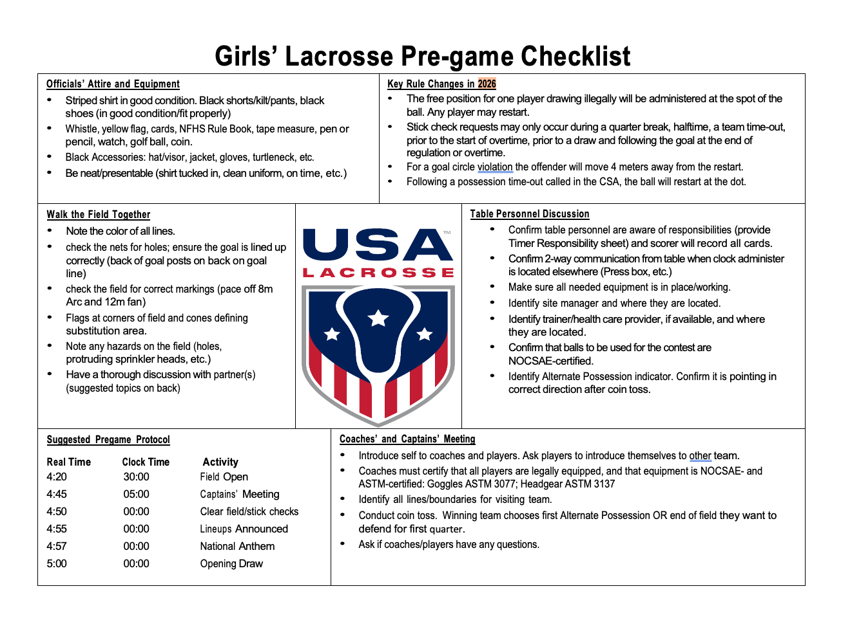
Teamwork and Communication
Establishes:
Common understanding
Efficient transitions
Professional Presence
Partner Support
PRESENTATION TITLE HERE
HAND OUT:
Two Person Pregame Checklist
24
Notes:
Discuss content of a pre-game discussion
Review Two-Person Pregame Checklist
Practice a sample pre-game
SCRIPT:
A thorough pregame discussion between officials is essential. It gets officials working as a team,. The discussion can include anything from the uniform they wear and the way they plan to check the field to the communication they will have with the coaches and captains, and their plan to manage fouls consistently.
Please refer to the “Pregame Checklist” in the US Lacrosse Resource Library for a list of topics to be covered in a two-person pregame discussion.

Slide 25
